Slide 1
Simple Linear Regression: A Model for the Mean
Notation
Least Squares principle

Slide 2
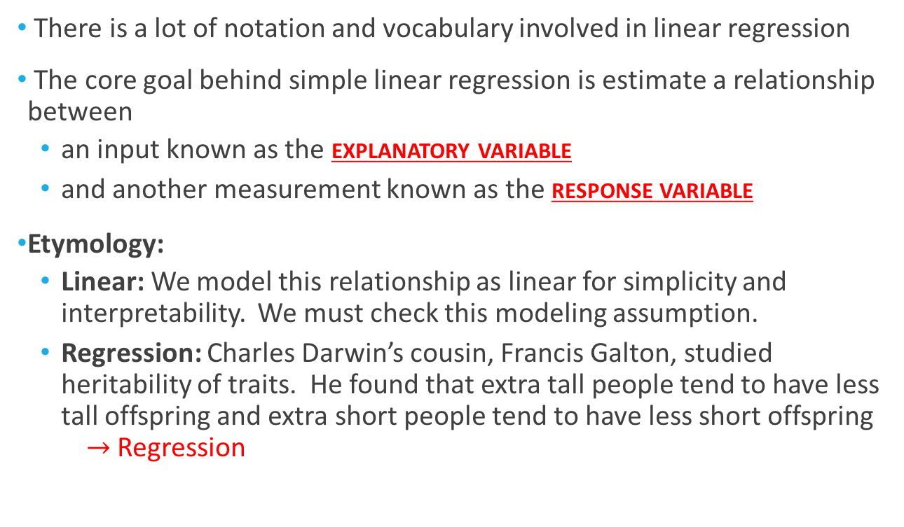
Terminology & Goals
There is a lot of notation and vocabulary involved in linear regression
The core goal behind simple linear regression is estimate a relationship between
an input known as the explanatory variable
and another measurement known as the response variable
Etymology:
Linear: We model this relationship as linear for simplicity and interpretability. We must check this modeling assumption.
Regression: Charles Darwin’s cousin, Francis Galton, studied heritability of traits. He found that extra tall people tend to have less tall offspring and extra short people tend to have less short offspring $→$ Regression

Slide 3
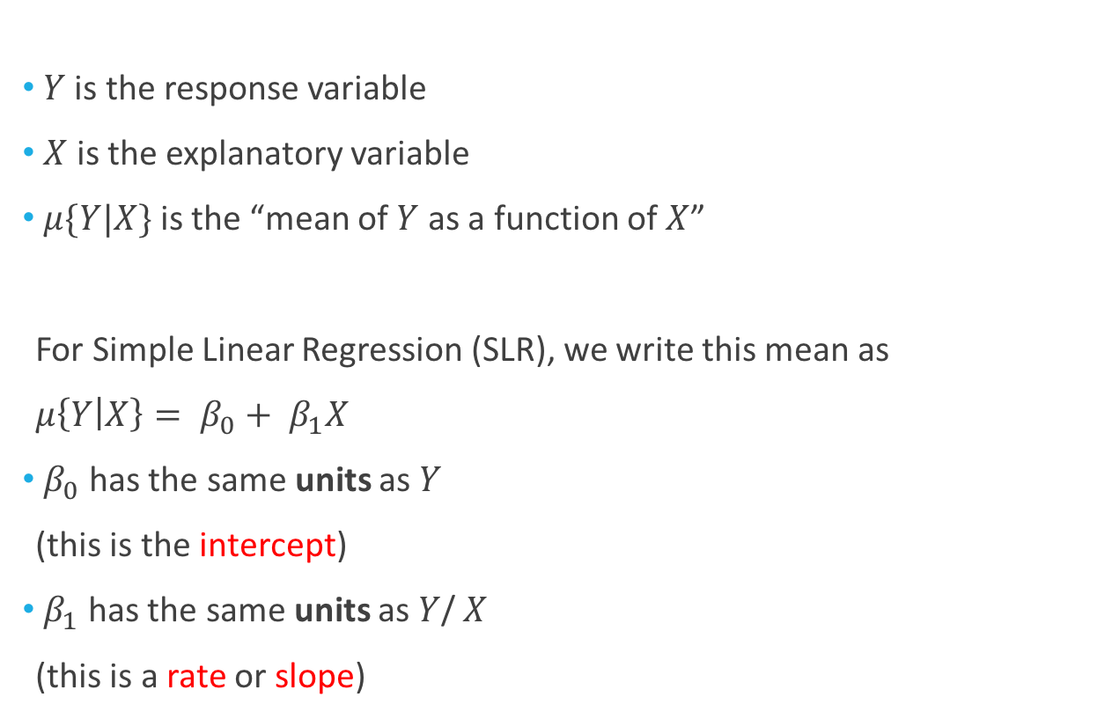

Notation for the Mean
$Y$ is the response variable
$X$ is the explanatory variable
$μ\{Y|X\}$ is the “mean of $Y$ as a function of $X$”
For Simple Linear Regression (SLR), we write this mean as
$μ\left\{Y | X\right\}= β_{0}+ β_{1}X$
$β_{0}$ has the same units as $Y$
(this is the intercept)
$β_{1}$ has the same units as $Y$/ $X$
(this is a rate or slope)
Example: $Y$ (deaths per million) is mortality from skin cancer in a state & $X$ is state latitude (in degrees)
$β_{0}$ is in deaths per million
$β_{1}$ is in (deaths per million)/degrees

Slide 4
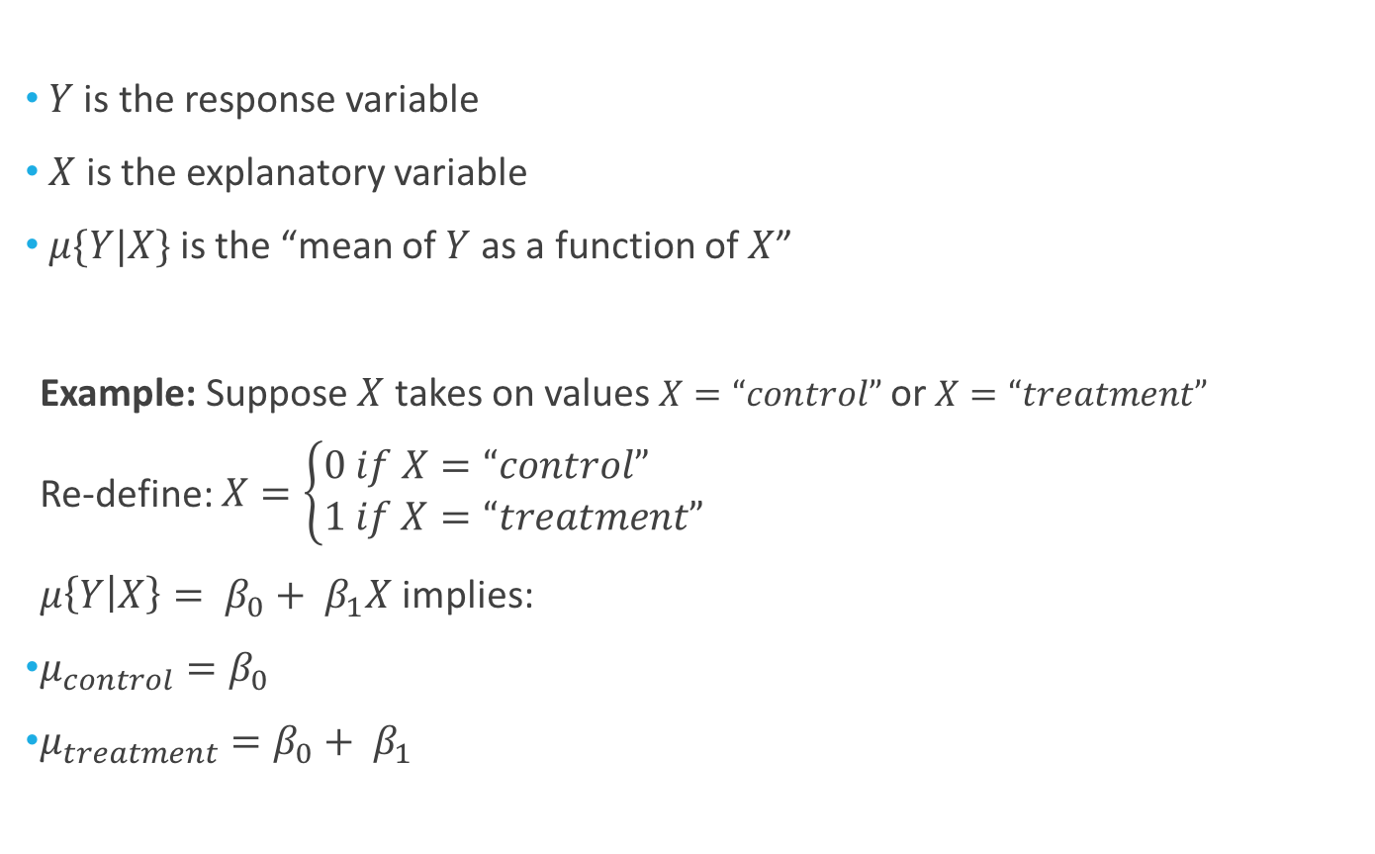
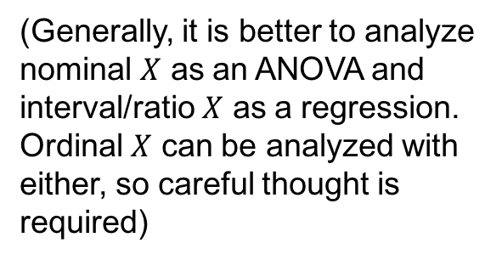
Notation for the Mean
$Y$ is the response variable
$X$ is the explanatory variable
$μ\{Y|X\}$ is the “mean of $Y$ as a function of $X$”
Example: Suppose $X$ takes on values $X=“control”$ or $X=“treatment”$
Re-define: $X=\left\{\begin{aligned}0 if X=“control” \\ 1 if X=“treatment” \end{aligned}\right.$
$μ\left\{Y | X\right\}= β_{0}+ β_{1}X$ implies:
$μ_{control}=β_{0}$
$μ_{treatment}=β_{0}+ β_{1}$
(Generally, it is better to analyze nominal $X$ as an ANOVA and interval/ratio $X$ as a regression.
Ordinal $X$ can be analyzed with either, so careful thought is required)

Slide 5
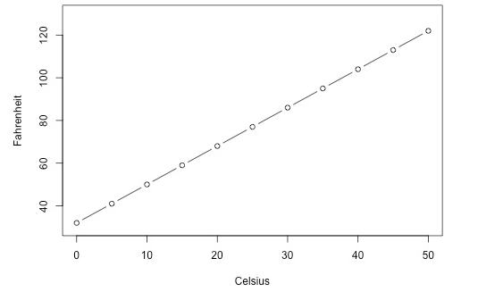

Example: Temperature
In North America, we have two standards for measuring temperature:
Fahrenheit ($F$)
Celsius ($C$)
They are related via
the linear relationship
$F=32+9/5C$
This relationship is exact,
so no statistics is necessary
18 F
10 C

Slide 6
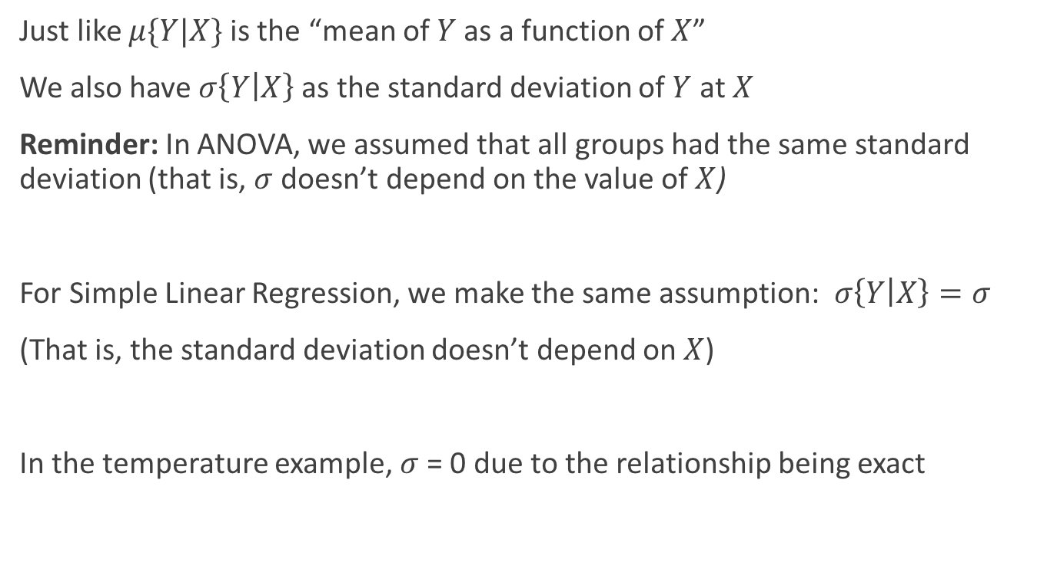
Notation for the Standard Deviation
Just like $μ\{Y|X\}$ is the “mean of $Y$ as a function of $X$”
We also have $σ\left\{Y | X\right\}$ as the standard deviation of $Y$ at $X$
Reminder: In ANOVA, we assumed that all groups had the same standard deviation (that is, $σ$ doesn’t depend on the value of $X$)
For Simple Linear Regression, we make the same assumption: $σ\left\{Y | X\right\}=σ$
(That is, the standard deviation doesn’t depend on $X$)
In the temperature example, $σ$ = 0 due to the relationship being exact

Slide 7
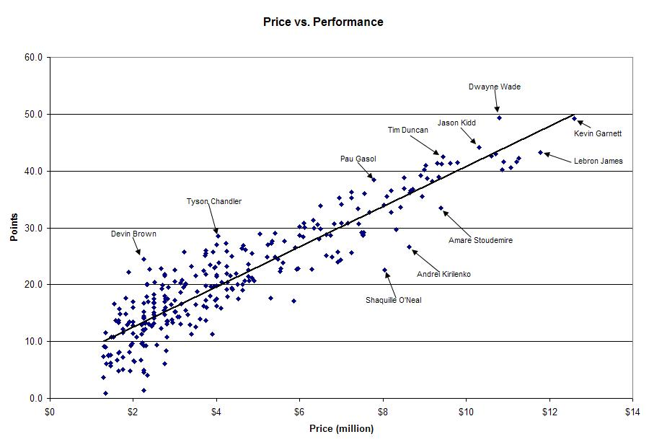

Slide 8
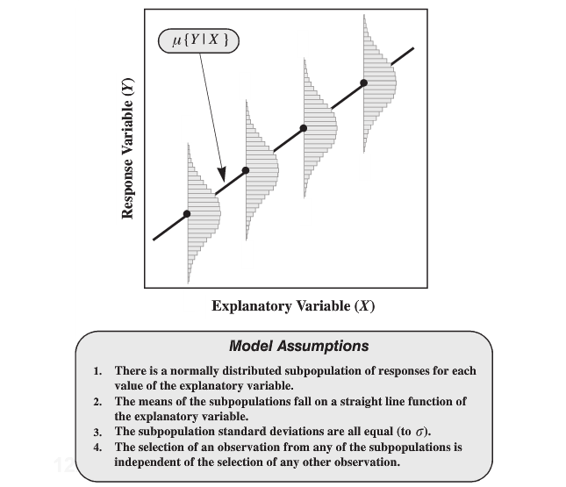
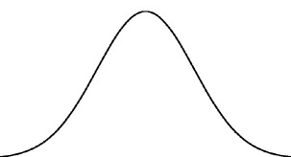
Assumptions
There is an NBA salary cap &
only so many points can be scored in a game…

Slide 9
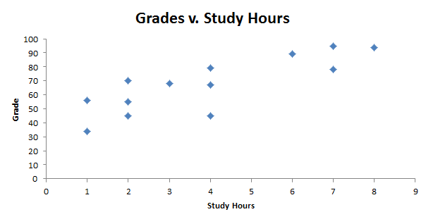
How Do We Estimate the Mean?
A
B

Slide 10
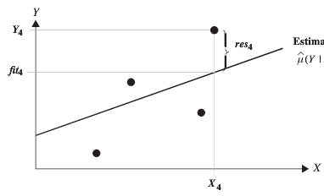
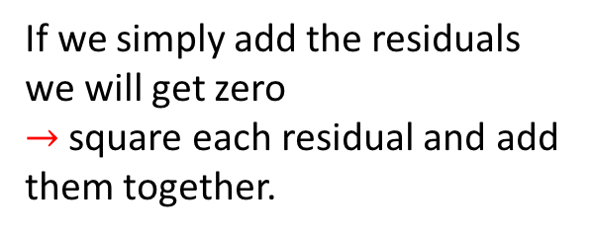
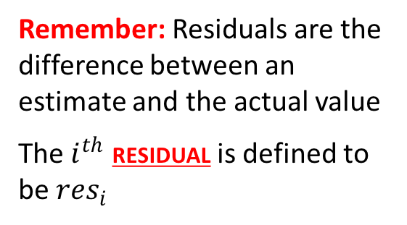
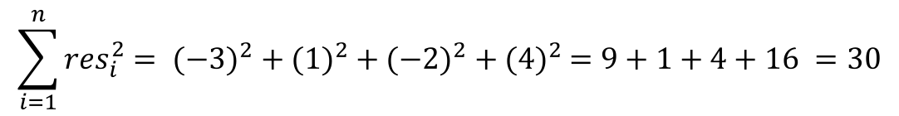
How Do We Estimate the Mean?
Remember: Residuals are the difference between an estimate and the actual value
The $i^{th}$ residual is defined to be ${res}_{i}$
res₄ = 4
res₂ = 1
res₃ = -2
res₁ = -3
If we simply add the residuals we will get zero
$→$ square each residual and add them together.
Sum of Squared Residuals = SSR =
$$\sum_{i=1}^{n}{{res}_{i}^{2}}= {(−3)}^{2} + {(1)}^{2} + {(−2)}^{2} + {(4)}^{2} =9+1+4+16 =30$$

Slide 11
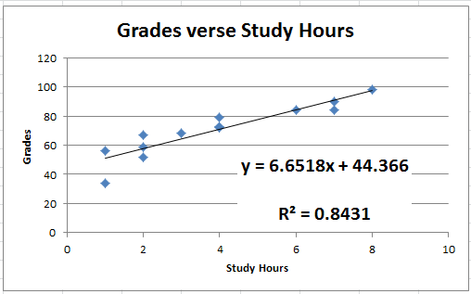
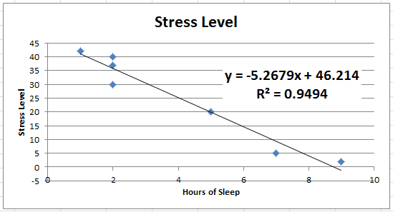
How Do We Estimate the Mean?
res₁₀ = 7
res₆ = 5
res₁₁ = 30
res₁ = -10
res₇ = 20
res₅ = 60
Observation: The sum of squared green residuals is greater than the sum of squared red residuals

Slide 12
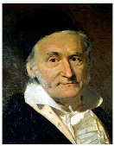
How Do We Estimate the Mean? The Least Squares Principle
The “Least Squares Line minimizes the sum of squared residuals!”

Slide 13
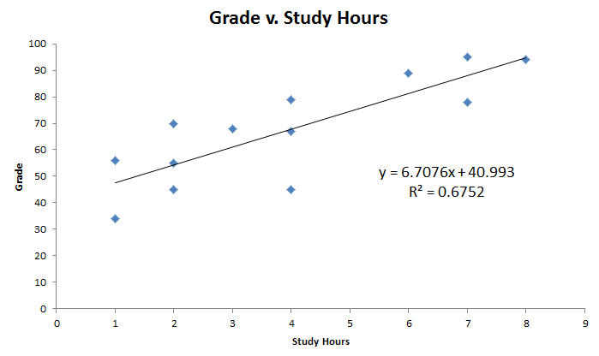
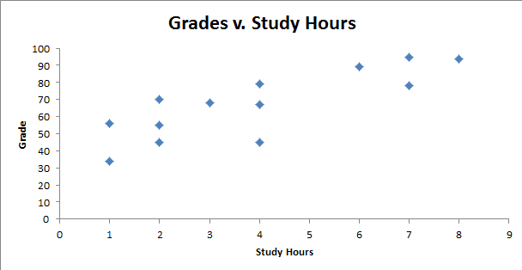
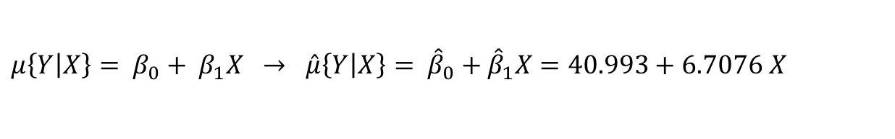
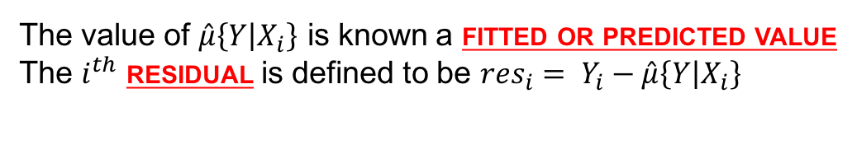
Example: Grades vs. Study Hours
$μ\left\{Y | X\right\}= β_{0}+ β_{1}X → \hat{μ}\left\{Y | X\right\}= {\hat{β}}_{0}+{\hat{β}}_{1}X=40.993+6.7076 X$
The value of $\hat{μ}\left\{Y | X_{i}\right\}$ is known a fitted or predicted value
The $i^{th}$ residual is defined to be ${res}_{i}= Y_{i}−\hat{μ}\left\{Y | X_{i}\right\}$

Slide 14
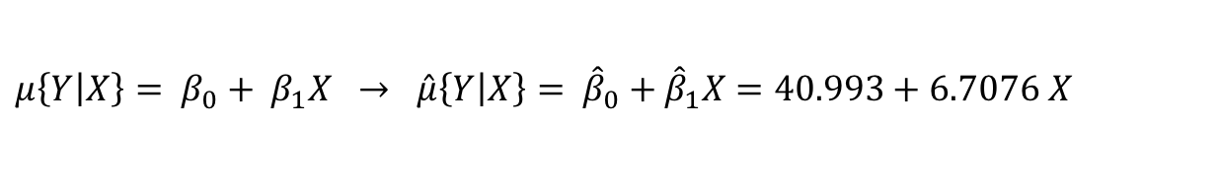
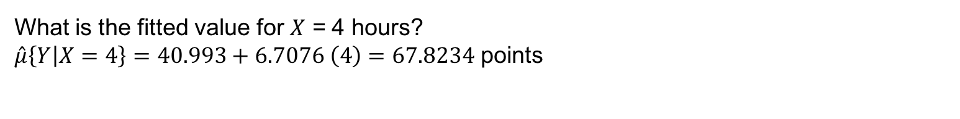
Example: Grades vs. Study Hours
$μ\left\{Y | X\right\}= β_{0}+ β_{1}X → \hat{μ}\left\{Y | X\right\}= {\hat{β}}_{0}+{\hat{β}}_{1}X=40.993+6.7076 X$
What is the fitted value for $X$ = 4 hours?
$\hat{μ}\left\{Y | X=4\right\}=40.993+6.7076 \left(4\right)=67.8234$ points
“We estimate the mean score after studying for 4 hours to be 67.8234 points”

Slide 15
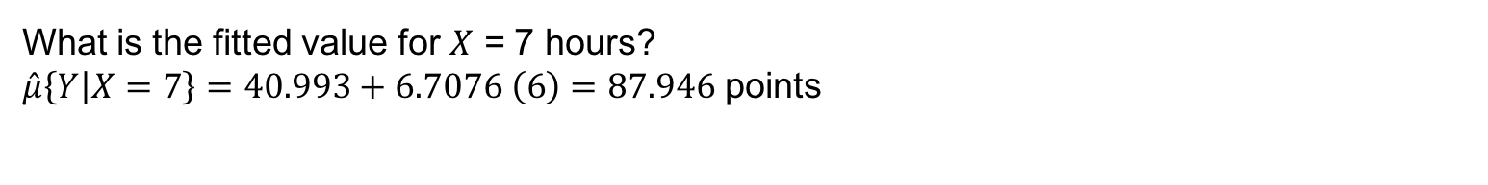
Example: Grades vs. Study Hours
$μ\left\{Y | X\right\}= β_{0}+ β_{1}X → \hat{μ}\left\{Y | X\right\}= {\hat{β}}_{0}+{\hat{β}}_{1}X=40.993+6.7076 X$
What is the fitted value for $X$ = 7 hours?
$\hat{μ}\left\{Y | X=7\right\}=40.993+6.7076 \left(6\right)=87.946$ points
“We estimate the mean score after studying for 7 hours to be 87.946 points”

Slide 16

Extrapolation
Predictions are only valid for values of X in the range of $X_{1},X_{1}, …,X_{n}$
This least squares fit is only valid for study hours between 1 and 8 hours
Any prediction outside this range is known as an extrapolation

Slide 17
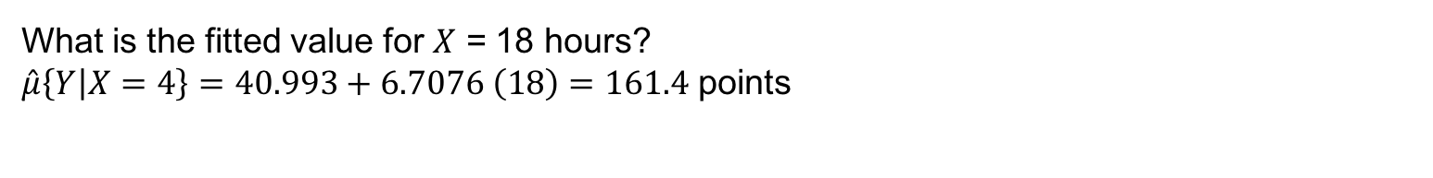
Extrapolation
$μ\left\{Y | X\right\}= β_{0}+ β_{1}X → \hat{μ}\left\{Y | X\right\}= {\hat{β}}_{0}+{\hat{β}}_{1}X=40.993+6.7076 X$
What is the fitted value for $X$ = 18 hours?
$\hat{μ}\left\{Y | X=4\right\}=40.993+6.7076 \left(18\right)=161.4$ points

Slide 18

Interpretation
(Note that this is often an extrapolation)
Interpreting ${\hat{β}}_{0}$ and ${\hat{β}}_{1}$ is an important part of simple linear regression
As $\hat{μ}\left\{Y | X=0\right\}= {\hat{β}}_{0}+{\hat{β}}_{1}\left(0\right)= {\hat{β}}_{0}→$the intercept is predicted value at $X=0$
Also, $\hat{μ}\left\{Y | X=4\right\} −\hat{μ}\left\{Y | X=3\right\}= {\hat{β}}_{0}+{\hat{β}}_{1}\left(4\right)−{\hat{β}}_{0}−{\hat{β}}_{1}\left(3\right)={\hat{β}}_{1}$
$→$ the slope is the change in the prediction for a 1 unit change in $X$

Slide 19
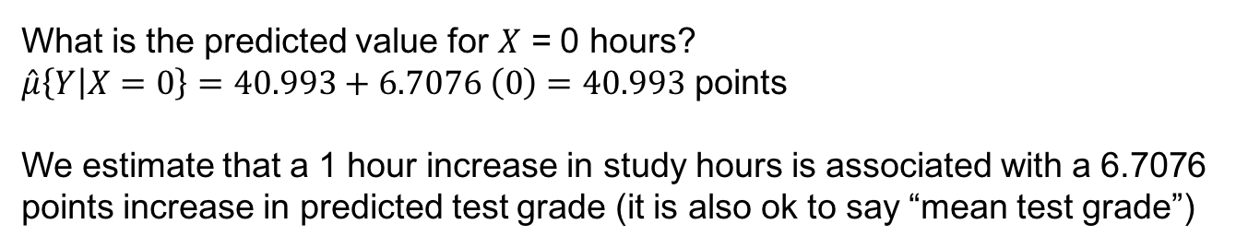
Interpretation
What is the predicted value for $X$ = 0 hours?
$\hat{μ}\left\{Y | X=0\right\}=40.993+6.7076 \left(0\right)=40.993$ points
We estimate that a 1 hour increase in study hours is associated with a 6.7076 points increase in predicted test grade (it is also ok to say “mean test grade”)

Slide 20
Bad Interpretations
We estimate that a 1 hour increase in study hours is associated with a 6.7076 points increase in test grade
A 1 hour increase in study hours leads to a 6.7076 points increase in test grade
Increasing study hours causes test grade to increase

