Slide 1
Simple Linear Regression: A Model for the Mean
Hypothesis tests
Confidence intervals
(Ignore: “Calibration Intervals” and “Planning an Experiment: Replication”)

Slide 2
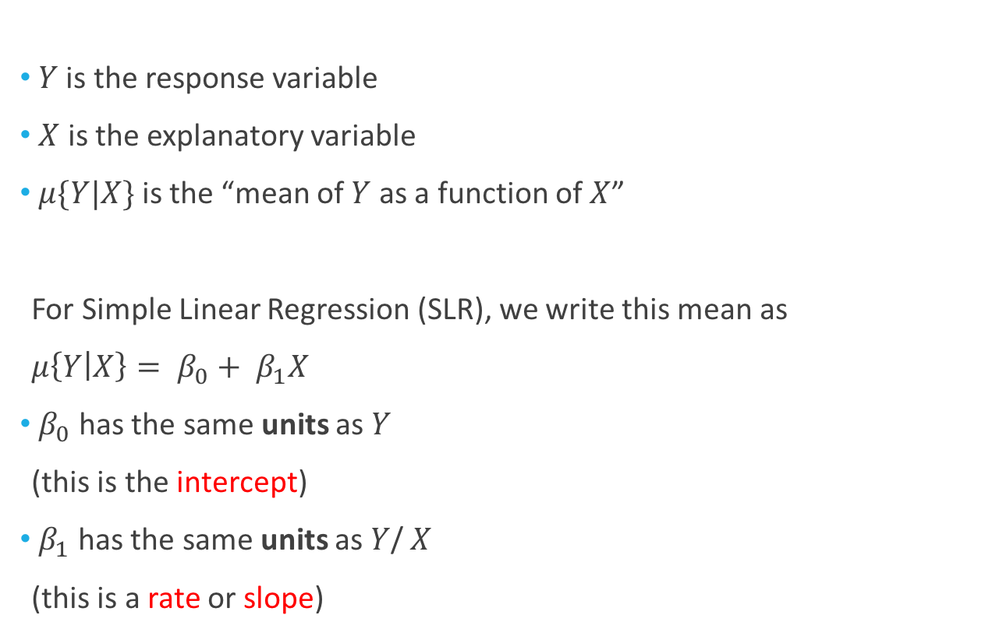

Notation for the Mean
$Y$ is the response variable
$X$ is the explanatory variable
$μ\{Y|X\}$ is the “mean of $Y$ as a function of $X$”
For Simple Linear Regression (SLR), we write this mean as
$μ\left\{Y | X\right\}= β_{0}+ β_{1}X$
$β_{0}$ has the same units as $Y$
(this is the intercept)
$β_{1}$ has the same units as $Y$/ $X$
(this is a rate or slope)
Example: $Y$ (deaths per million) is mortality from skin cancer in a state & $X$ is state latitude (in degrees)
$β_{0}$ is in deaths per million
$β_{1}$ is in (deaths per million)/degrees

Slide 3

Confidence Intervals and Hypothesis Tests
The current chapter focusses on 4 major confidence intervals/tests:
For $β_{0}$
For $β_{1}$
For the mean value of Y at $X_{0}$, $μ\left\{Y | X_{0}\right\}= β_{0}+ β_{1}X_{0}$
For a prediction of Y at $X_{0}$, $Pred\left\{Y | X_{0}\right\}$
We will cover these first

Slide 4
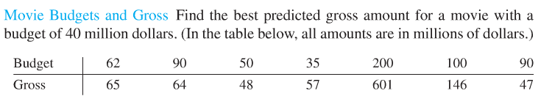
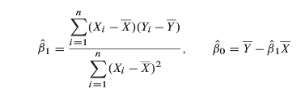
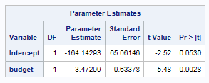


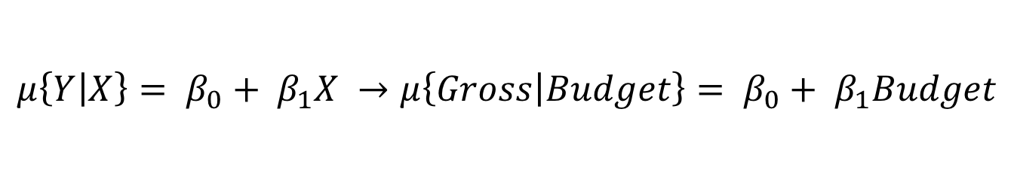
The Estimators
$$\overline{X}=89.57$$
$$\overline{Y}=146.86$$
$$μ\left\{Y | X\right\}= β_{0}+ β_{1}X →μ\left\{Gross | Budget\right\}= β_{0}+ β_{1}Budget$$

Slide 5
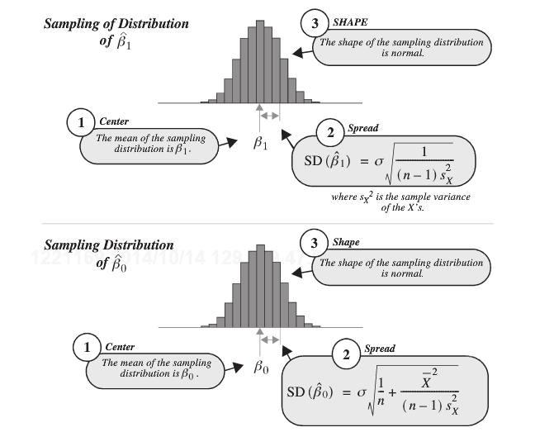
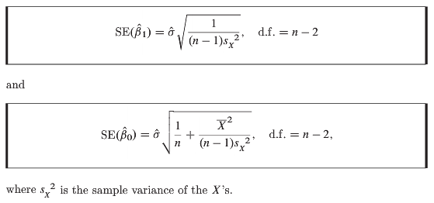

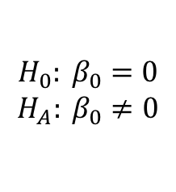
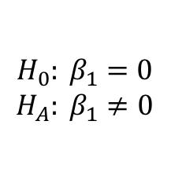
Sampling Distributions & Hypothesis Test
Two Hypothesis Tests:
$$H_{0}: β_{0}=0$$
$$H_{A}: β_{0}≠0$$
$$H_{0}: β_{1}=0$$
$$H_{A}: β_{1}≠0$$

Slide 6
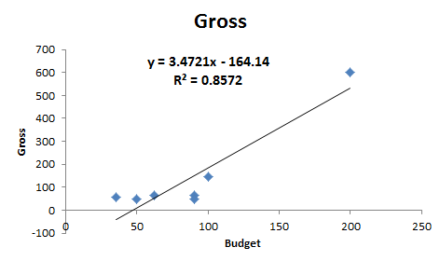
The Estimators
Estimate ± t_{α/2,df}*SE
(df = n-2)
Estimate ± t_{α/2,df}*SE
Intercept ± t_{.025,5}*SE
Budget_slope ± t_{.025,5}*SE
-164.143 ± 2.571*65.06
3.472 ± 2.571*.6338
(-331.39,3.103)
(1.84, 5.10)
We estimate that budget of $0 is associated with a gross between $0 and $3.103M (95% CI)
We estimate that an increase in budget of $1 million is associated with an increase in gross between $1.84M and $5.10M

Slide 7
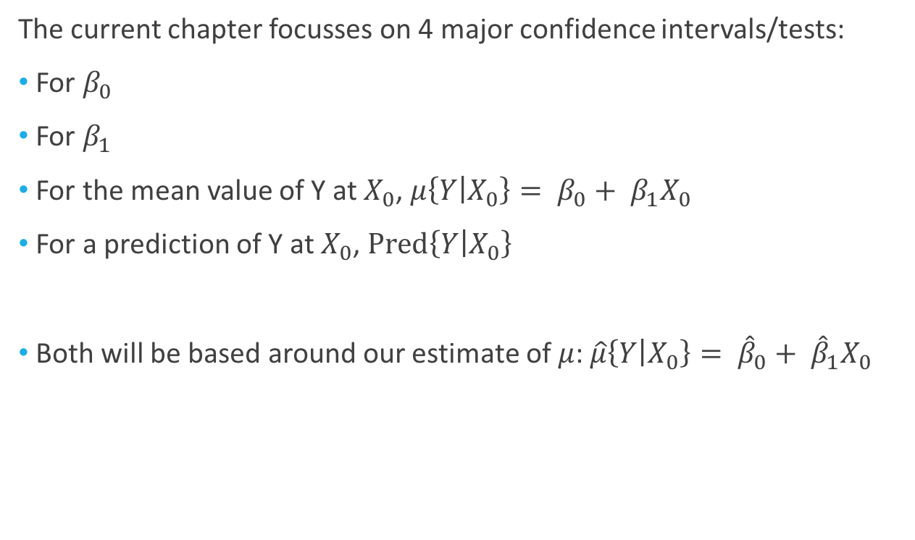
Confidence Intervals and Hypothesis Tests
The current chapter focusses on 4 major confidence intervals/tests:
For $β_{0}$
For $β_{1}$
For the mean value of Y at $X_{0}$, $μ\left\{Y | X_{0}\right\}= β_{0}+ β_{1}X_{0}$
For a prediction of Y at $X_{0}$, $Pred\left\{Y | X_{0}\right\}$
Both will be based around our estimate of $μ$: $\hat{μ}\left\{Y | X_{0}\right\}= {\hat{β}}_{0}+ {\hat{β}}_{1}X_{0}$
Now these
(Confidence Intervals)
(Prediction Intervals)

Slide 8




Confidence Intervals & Prediction Intervals
(Confidence Interval)
(Prediction intervals will always be wider and won’t go to zero as $n→∞)$

Slide 9
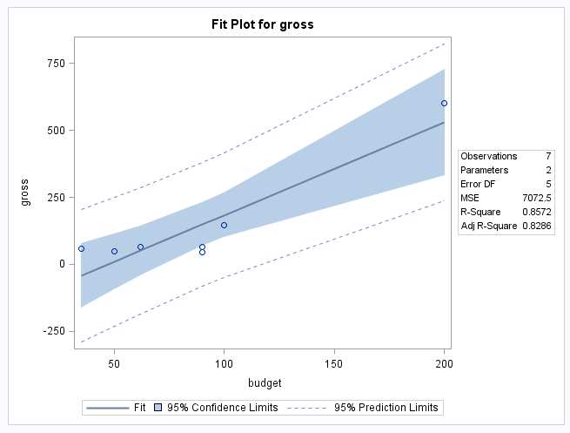
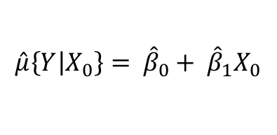


Confidence Intervals & Prediction Intervals
$$\hat{μ}\left\{Y | X_{0}\right\}= {\hat{β}}_{0}+ {\hat{β}}_{1}X_{0}$$
$X_{0}$ = 160
CI: $\hat{μ}\left\{Y | X_{0}\right\}$ ± t_{.025,n-2}*SE

Slide 10
A Few Additional Topics

Slide 11
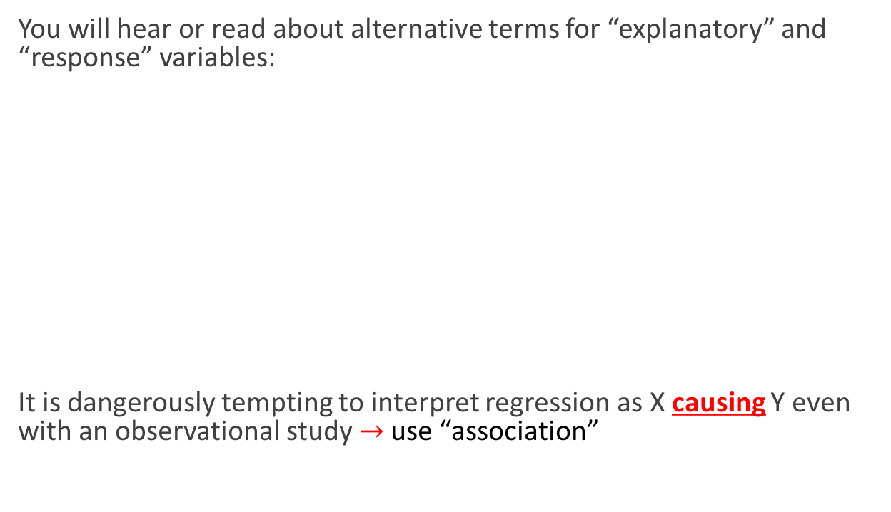
Differing Terminology & Causation
You will hear or read about alternative terms for “explanatory” and “response” variables:
It is dangerously tempting to interpret regression as X causing Y even with an observational study$→$ use “association”
Explanatory:
Independent variable
Exogenous variable
Predictor variable
Covariate
Feature
Input
Response:
Dependent variable
Endogenous variable
Supervisor
Output

Slide 12
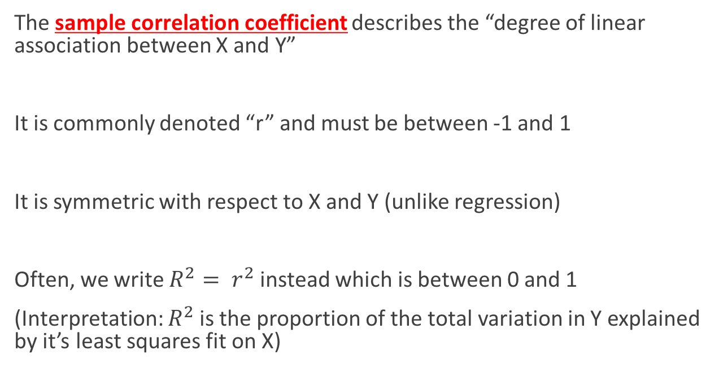
Correlation
The sample correlation coefficient describes the “degree of linear association between X and Y”
It is commonly denoted “r” and must be between -1 and 1
It is symmetric with respect to X and Y (unlike regression)
Often, we write $R^{2}= r^{2}$ instead which is between 0 and 1
(Interpretation: $R^{2}$ is the proportion of the total variation in Y explained by it’s least squares fit on X)

Slide 13
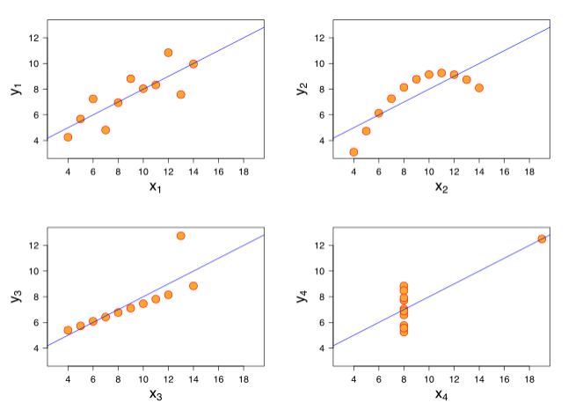
Correlation
Note the correlation will be part of a broader model checking procedure
It is important to not read too much into it as a single indicator of model fit
(from wikipedia entry)

