Slide 1
Simple Linear Regression: A Closer Look at Assumptions
Checking Assumptions

Slide 2
Review

Slide 3
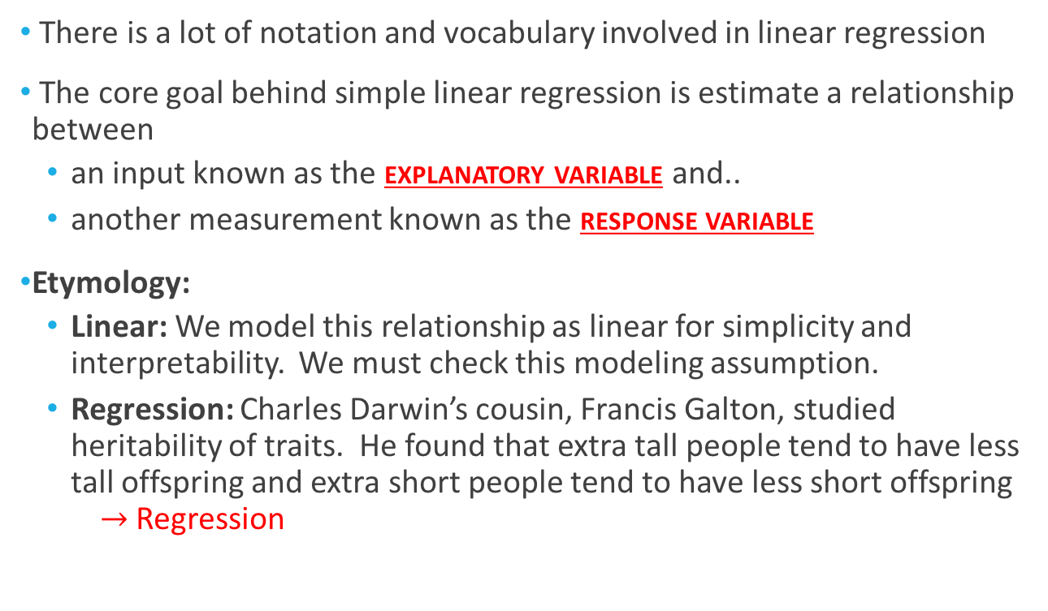
Terminology & Goals
There is a lot of notation and vocabulary involved in linear regression
The core goal behind simple linear regression is estimate a relationship between
an input known as the explanatory variable and..
another measurement known as the response variable
Etymology:
Linear: We model this relationship as linear for simplicity and interpretability. We must check this modeling assumption.
Regression: Charles Darwin’s cousin, Francis Galton, studied heritability of traits. He found that extra tall people tend to have less tall offspring and extra short people tend to have less short offspring $→$ Regression

Slide 4
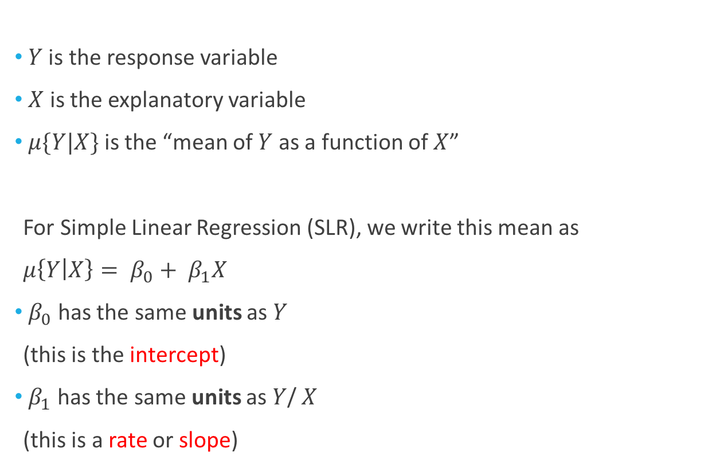

Notation for the Mean
$Y$ is the response variable
$X$ is the explanatory variable
$μ\{Y|X\}$ is the “mean of $Y$ as a function of $X$”
For Simple Linear Regression (SLR), we write this mean as
$μ\left\{Y | X\right\}= β_{0}+ β_{1}X$
$β_{0}$ has the same units as $Y$
(this is the intercept)
$β_{1}$ has the same units as $Y$/ $X$
(this is a rate or slope)
Example: $Y$ (deaths per million) is mortality from skin cancer in a state & $X$ is state latitude (in degrees)
$β_{0}$ is in deaths per million
$β_{1}$ is in (deaths per million)/degrees

Slide 5
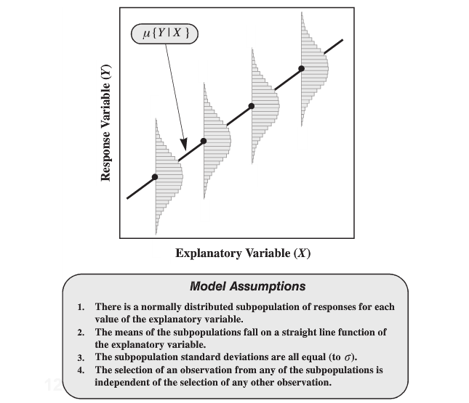
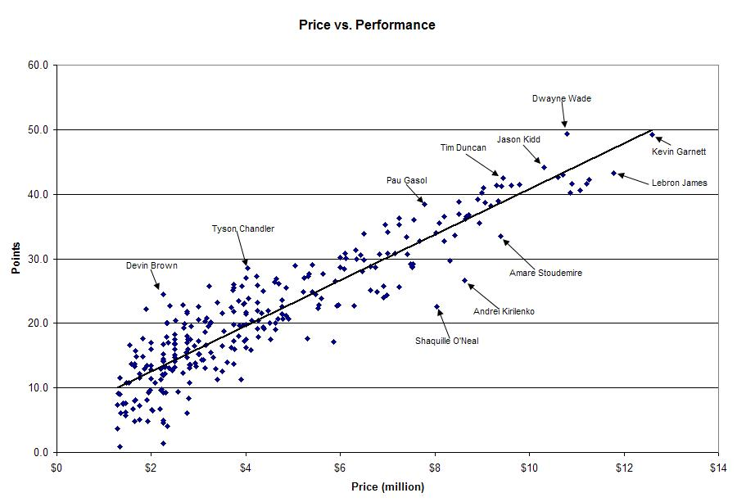
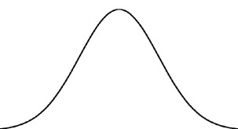
Assumptions
There is an NBA salary cap &
only so many points can be scored in a game…

Slide 6
Assumption Checking

Slide 7
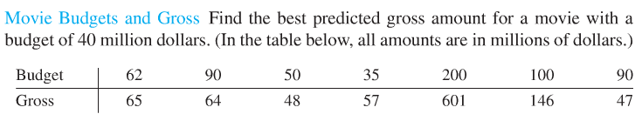
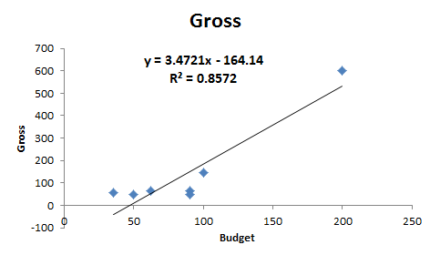

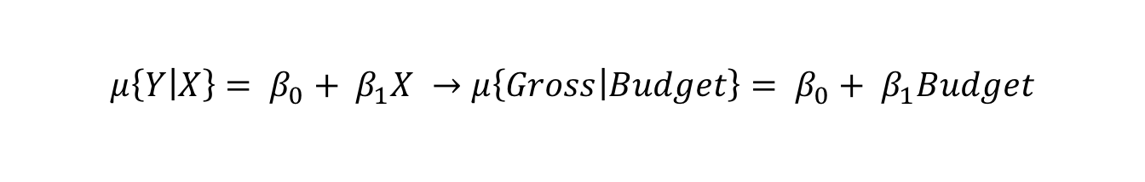
Linearity
$$μ\left\{Y | X\right\}= β_{0}+ β_{1}X →μ\left\{Gross | Budget\right\}= β_{0}+ β_{1}Budget$$
Two types of potential violations:
A (straight) line is inadequate for the data
There exists some outliers (extreme points)
$→$ Misleading answers from SLR

Slide 8
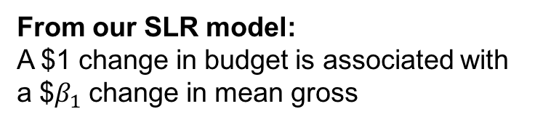

Linearity: Line is Inadequate
Simple linear regression model:
$$μ\left\{Gross | Budget\right\}= β_{0}+ β_{1}Budget$$
Suppose the true model is instead:
$$μ\left\{Gross | Budget\right\}= β_{0}+ β_{1}{(Budget −55) }^{2}$$
From our SLR model:
A $1 change in budget is associated with a $$β_{1}$ change in mean gross
From the true (but unknown) model:
For budgets less than $55 m., increasing the budget is associated with a decrease in gross.
Budgets greater than $55 m. is associated with an increase in gross.

Slide 9
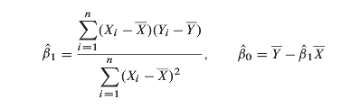
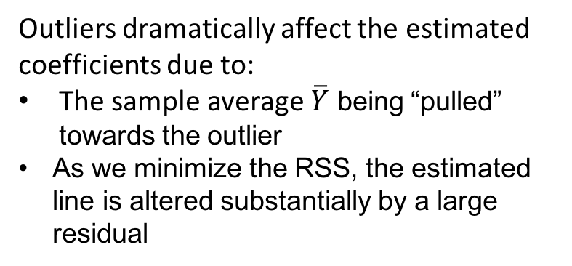
Linearity: Outliers
Outliers dramatically affect the estimated coefficients due to:
The sample average $\overline{Y}$ being “pulled” towards the outlier
As we minimize the RSS, the estimated line is altered substantially by a large residual

Slide 10
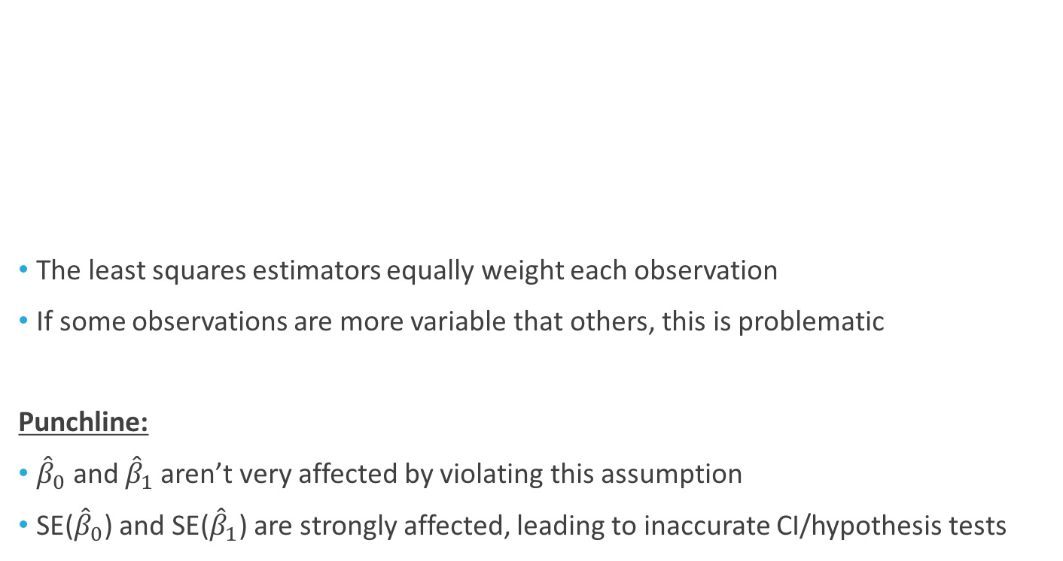
Equal Standard Deviations
The least squares estimators equally weight each observation
If some observations are more variable that others, this is problematic
Punchline:
${\hat{β}}_{0}$ and ${\hat{β}}_{1}$aren’t very affected by violating this assumption
SE(${\hat{β}}_{0}$) and SE(${\hat{β}}_{1}$) are strongly affected, leading to inaccurate CI/hypothesis tests

Slide 11

Normality
For the estimators ${\hat{β}}_{0}$ and ${\hat{β}}_{1}$ and for confidence intervals of $μ\left\{Y | X_{0}\right\}$, the central limit theorem guards against lack of normality in larger sample sizes
However, for small samples or for a prediction interval for $Pred\left\{Y | X_{0}\right\}$, normality is a crucial assumption

Slide 12
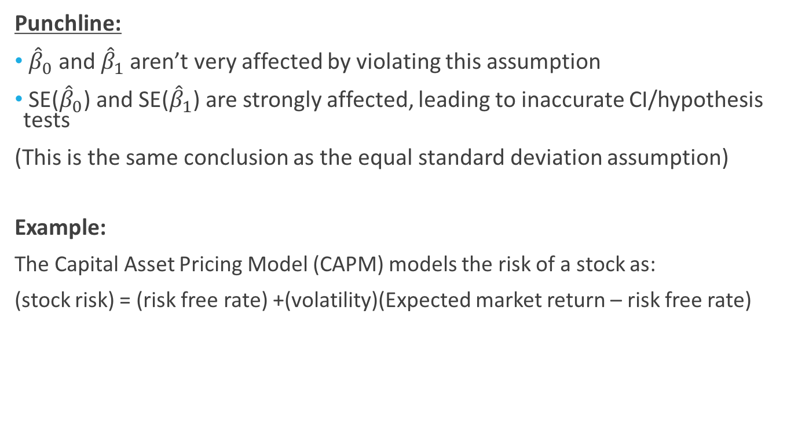
Independence
Punchline:
${\hat{β}}_{0}$ and ${\hat{β}}_{1}$aren’t very affected by violating this assumption
SE(${\hat{β}}_{0}$) and SE(${\hat{β}}_{1}$) are strongly affected, leading to inaccurate CI/hypothesis tests
(This is the same conclusion as the equal standard deviation assumption)
Example:
The Capital Asset Pricing Model (CAPM) models the risk of a stock as:
(stock risk) = (risk free rate) +(volatility)(Expected market return – risk free rate)

Slide 13
Independence
Example:
The Capital Asset Pricing Model (CAPM) models the risk of a stock as
(stock risk) = (risk free rate) + (volatility)(market return – risk free rate)
The volatility is estimated by a simple linear regression of the daily returns of a stock versus an index such as the S&P 500
The procedure:
Get the daily % changes for the stock under consideration
Get the daily % changes for the index
Run a SLR of the % changes for the stock onto the % changes for the index

Slide 14
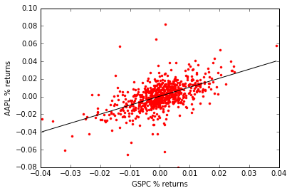
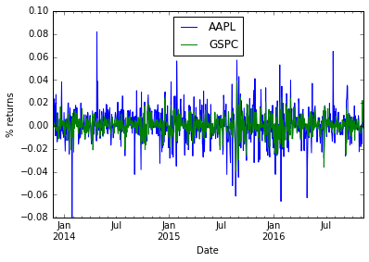
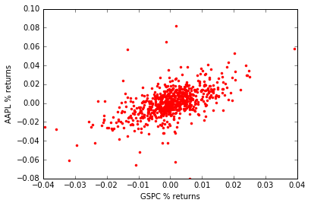
Independence
The procedure:
Get the daily % changes for the stock under consideration
Get the daily % changes for the index
Run a SLR of the % change for the stock onto the % change for the index

Slide 15
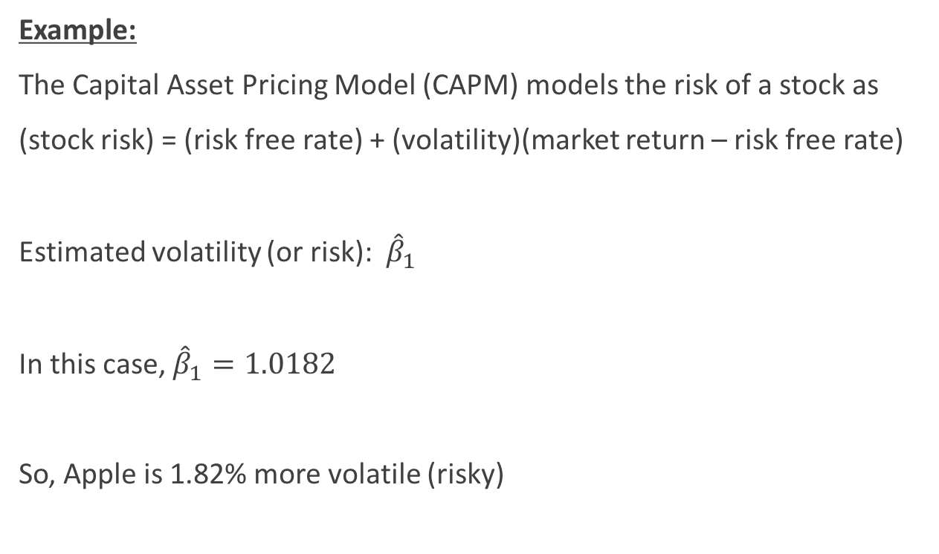
Independence
Example:
The Capital Asset Pricing Model (CAPM) models the risk of a stock as
(stock risk) = (risk free rate) + (volatility)(market return – risk free rate)
Estimated volatility (or risk): ${\hat{β}}_{1}$
In this case, ${\hat{β}}_{1}=1.0182$
So, Apple is 1.82% more volatile (risky)

Slide 16
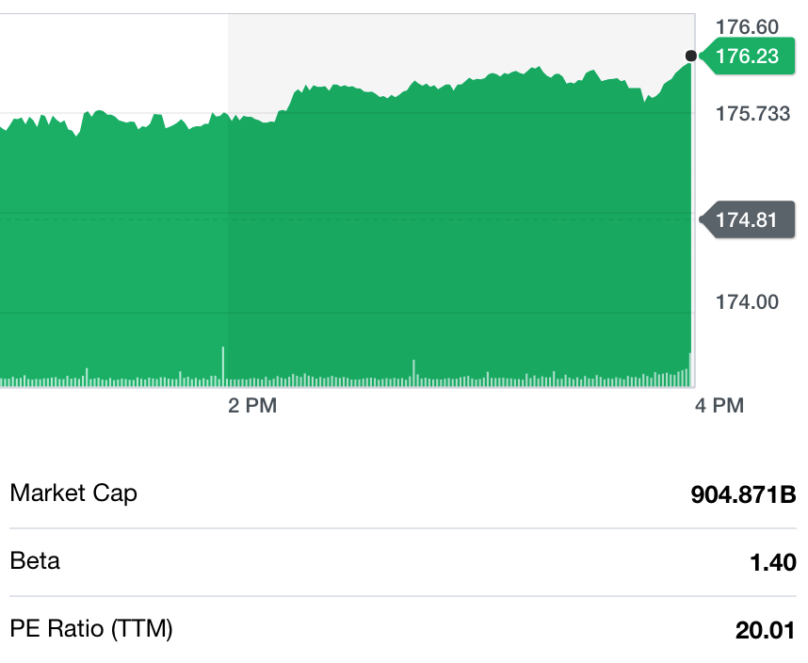

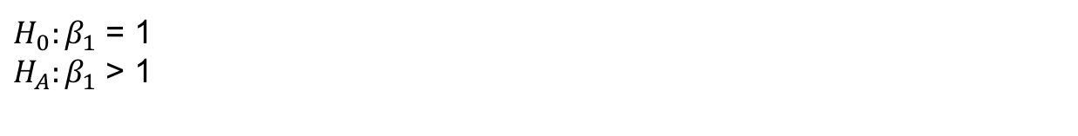
Independence
Up until this point, there isn’t any problem
Suppose I want to know if the volatility is significantly greater than 1
(this corresponds to being riskier than the underlying index)
 | Coefficient | Std. Error
Intercept | 0.0004 | 0.0004
Slope | 1.0182 | 0.0531
$H_{0}:β_{1}$ = 1
$H_{A}:β_{1}$ > 1
T = $\frac{{\hat{β}}_{1} −1}{0.0531}$ = 0.342
The Std. Error is bogus due to lack of independence!
What did we do wrong?

Slide 17
Model Assessment

Slide 18
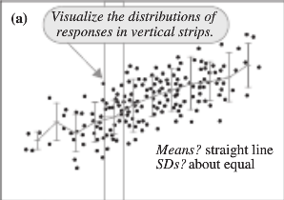
Model Assessment (Graphical)

Slide 19
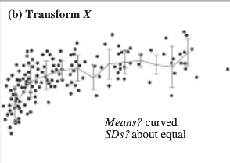
Model Assessment (Graphical)

Slide 20
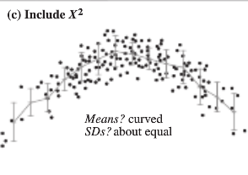
Model Assessment (Graphical)

Slide 21
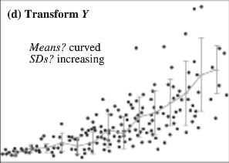
Model Assessment (Graphical)

Slide 22
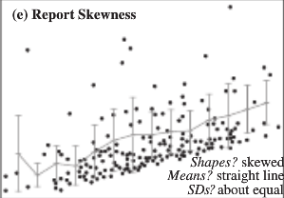
Model Assessment (Graphical)

Slide 23
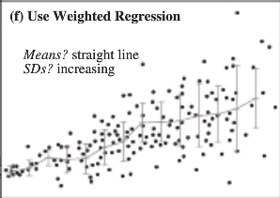
Model Assessment (Graphical)

Slide 24
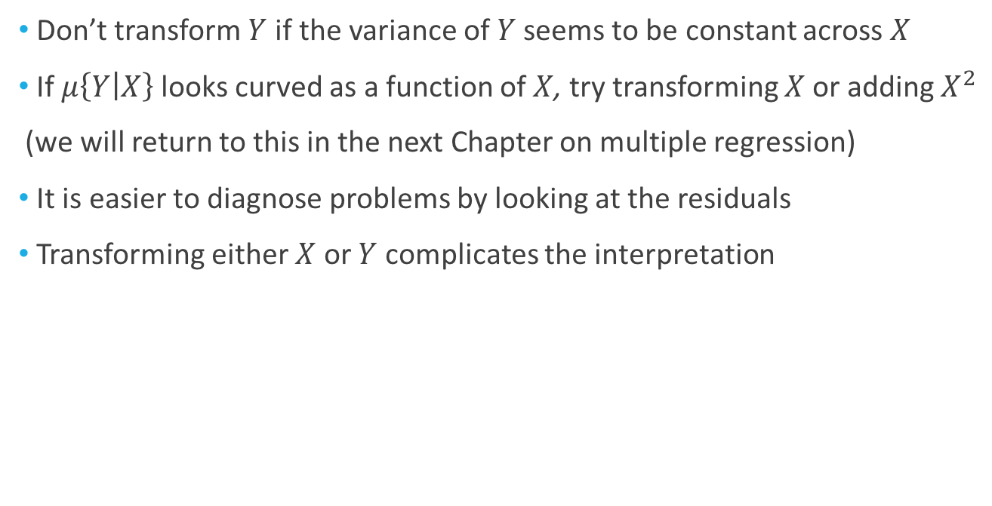
General Rules
Don’t transform $Y$ if the variance of $Y$ seems to be constant across $X$
If $μ\left\{Y | X\right\}$ looks curved as a function of $X$, try transforming $X$ or adding $X^{2}$
(we will return to this in the next Chapter on multiple regression)
It is easier to diagnose problems by looking at the residuals
Transforming either $X$ or $Y$ complicates the interpretation

