Slide 1
Simple Linear Regression: A Closer Look at Assumptions
Transformations
Goodness of fit and Lack of fit tests

Slide 2
Example: 2000 Presidential Election
On November 7, 2000, the election between G.W. Bush and Al Gore came down to electoral votes from Florida
Gore was projected the winner.
Then Bush was projected the winner.
Gore conceded.
Bush’s lead was cut to only 1,738 votes.
Gore retracts concession.
Automatic recount invoked.
Bush lead by less than 400 votes!
A strange phenomenon is discovered ….

Slide 3
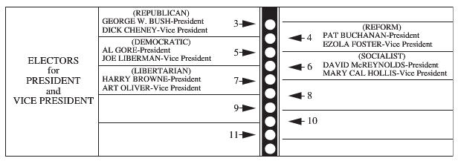
Example: 2000 Presidential Election
In Palm Beach, Buchanan had a large number of votes
Also, there were a large number of ballots that where thrown out because two “chads” were punched out
How many of the votes for Buchanan were meant for Gore?

Slide 4
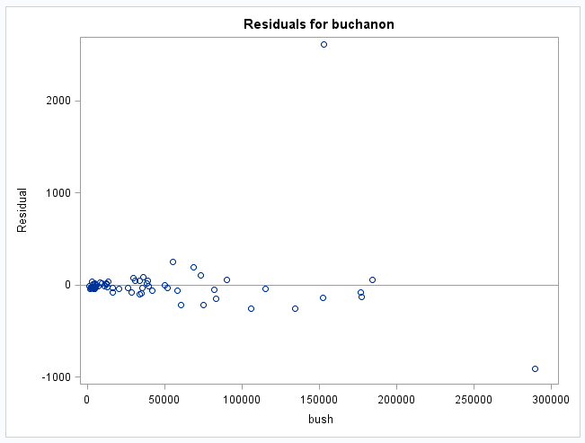
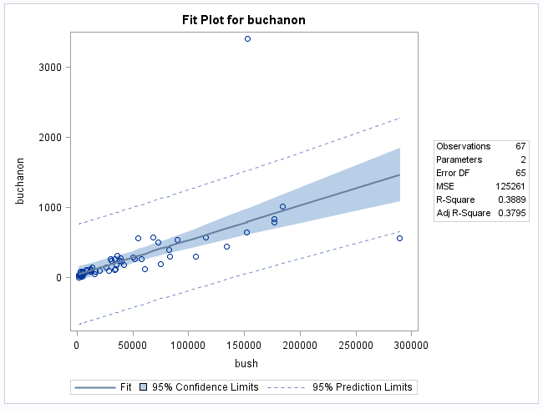
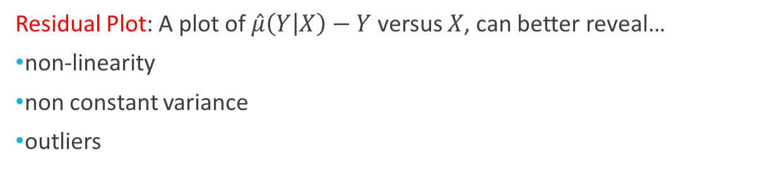
Residuals Plot
Residual Plot: A plot of $\hat{μ}\left(Y | X\right)−Y$ versus $X$, can better reveal…
non-linearity
non constant variance
outliers

Slide 5
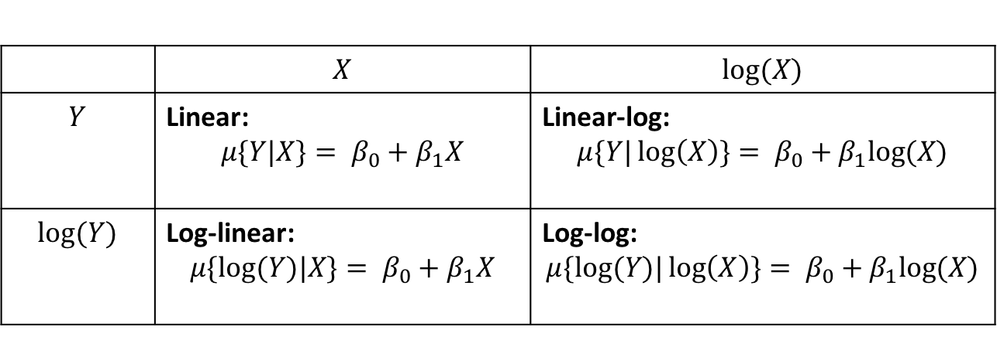
Log Transforms
 | $$X$$ | $$log⁡(X)$$
$$Y$$ | Linear: $$μ\{Y|X\}= β_{0}+β_{1}X$$ | Linear-log: $$μ\{Y|\log\left(X\right)\}= β_{0}+β_{1}log⁡(X)$$
$$log⁡(Y)$$ | Log-linear: $$μ\{log⁡(Y)|X\}= β_{0}+β_{1}X$$ | Log-log: $$μ\{log⁡(Y)|\log\left(X\right)\}= β_{0}+β_{1}log⁡(X)$$

Slide 6
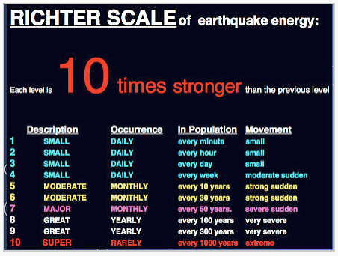
Log Transforms: Example
The Richter magnitude scale (also Richter scale) assigns a magnitude number to quantify the size of an earthquake
It is a “base-10” logarithmic scale
It computes the ratio of the maximum amplitude of the seismic wave to a baseline level

Slide 7
Comment on Transformations
Transformations are like medications, you should only be using them if you really need them and there are always side-effects

Slide 8
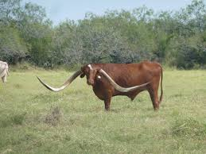
Example: Meat Processing and Acidity
A certain kind of meat processing may begin once the pH in postmortem muscle of a steer carcass decreases to 6.0
The pH at time of slaughter is around 7.0 to 7.2.
It is not practical to monitor the pH decline for each animal so an estimate is needed of the time after slaughter at which the pH reaches 6.0
To estimate this time, 10 steer carcasses were assigned to be measured for pH at one of five times after slaughter

Slide 9
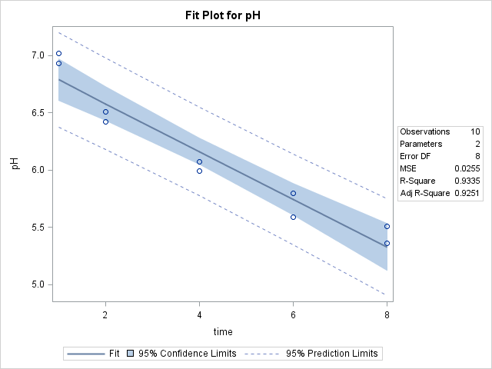
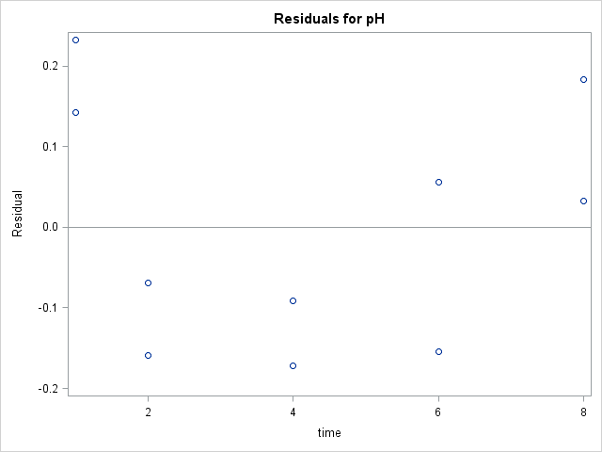
Linear-Linear
Means seem slightly curved: Try log transform of X

Slide 10
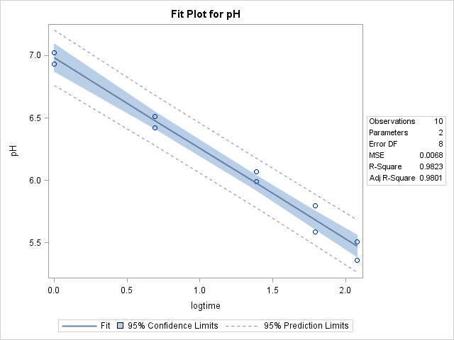
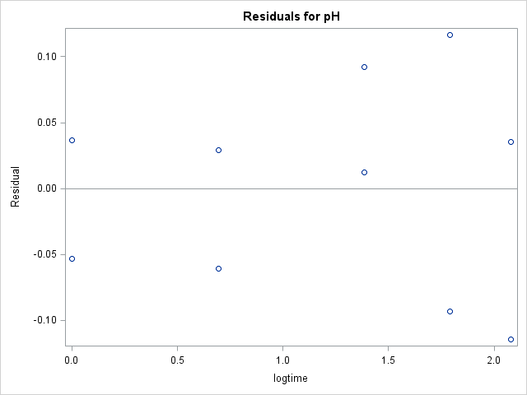
Linear-Log

Slide 11
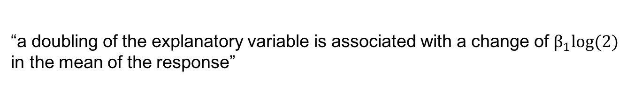
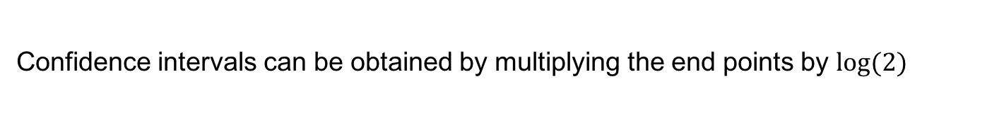
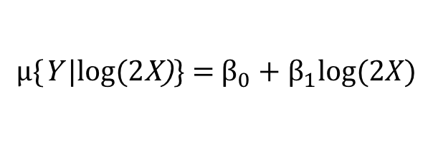
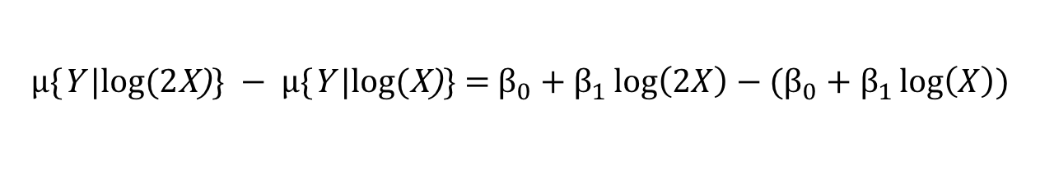

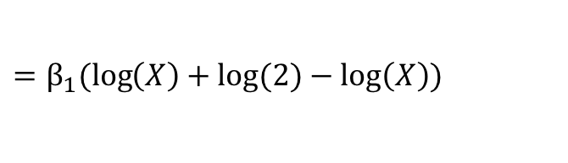
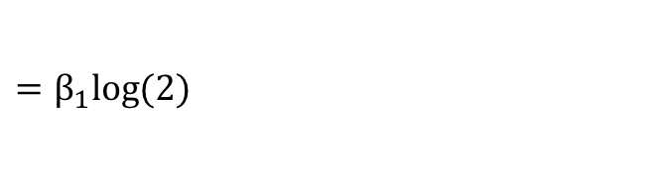
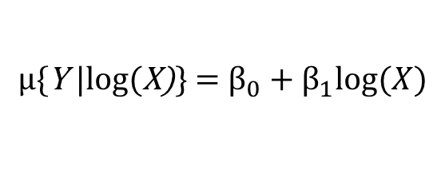
Log Transforms: Linear-Log
$$μ\text{\{}\text{Y} \text{|}\text{log}\text{(}\text{X}\text{)}\text{\}} \text{=} β_{0}+β_{1}log⁡(X)$$
$$μ\text{\{}\text{Y} \text{|}\text{log}\text{(2}\text{X}\text{)}\text{\}} \text{=} β_{0}+β_{1}log⁡(2X)$$
$$μ\text{\{}\text{Y} \text{|}\text{log}\text{(2}\text{X}\text{)}\text{\}} − μ\text{\{}\text{Y}\text{ |}\text{log}\text{(}\text{X}\text{)}\text{\} = }β_{0}+β_{1}\log\left(2X\right)−(β_{0}+β_{1}\log\left(X\right))$$
$$=β_{1}(\log\left(2X\right)−\log\left(X\right))$$
$$=β_{1}(\log\left(X\right)+log⁡(2)−\log\left(X\right))$$
$$=β_{1}log⁡(2)$$
“a doubling of the explanatory variable is associated with a change of $β_{1}log⁡(2)$
in the mean of the response”
Confidence intervals can be obtained by multiplying the end points by $log⁡(2)$

Slide 12
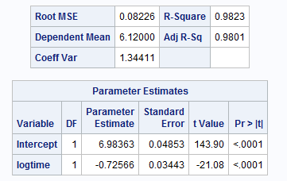
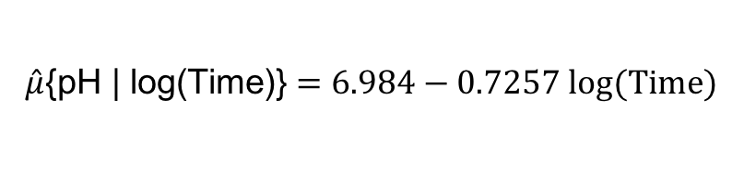
Interpretation: Linear - Log
$$\hat{μ}\text{\{}\text{pH}\text{ | }\text{log}\text{(}\text{Time}\text{)\}}=6.984−0.7257 log(Time)$$
There is evidence that each doubling of time is associated with a mean pH decrease of (-0.72556)log(2) = -0.503
A 95% confidence interval is from
((-0.726 - 2.31*0.034)log(2), (-0.726 + 2.31*0.034)log(2)) = (-0.558, -0.448)

Slide 13
Example: 2000 Presidential Election
Fit a SLR of Buchanan votes on Bush votes
Build a prediction interval at the observed number of Bush votes
With this, we can predict how many votes Buchanan should receive given the explanatory variable Bush votes
How many of the votes for Buchanan were meant for Gore?

Slide 14
Example: 2000 Presidential Election

Slide 15

Example: 2000 Presidential Election
Residual Plot: A plot of $\hat{μ}\left(Y | X\right)−Y$ versus $X$, can better reveal
non-linearity
non constant variance
outliers

Slide 16
Example: 2000 Presidential Election

Slide 17
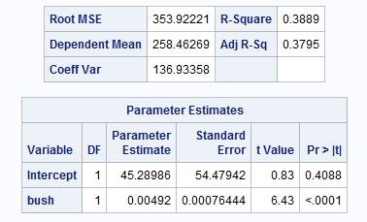
Scatterplot: Buchanan vs. Bush

Slide 18
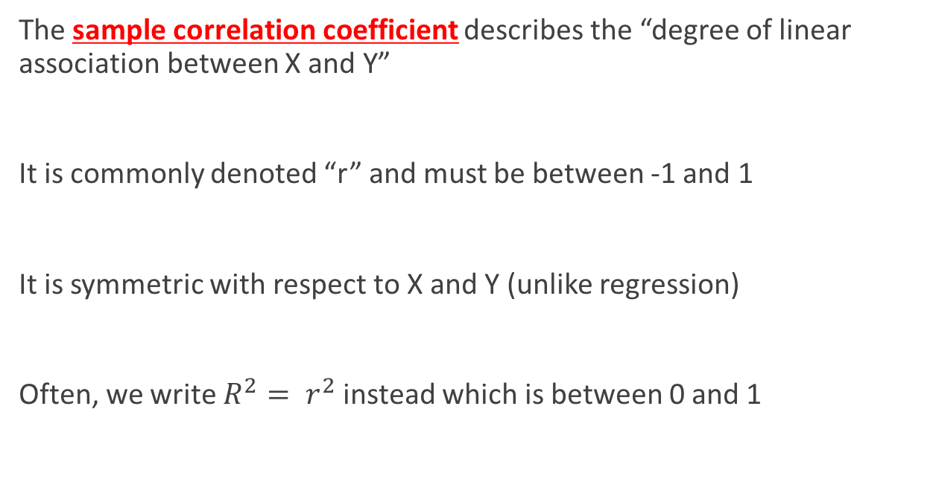
Reminder: Correlation
The sample correlation coefficient describes the “degree of linear association between X and Y”
It is commonly denoted “r” and must be between -1 and 1
It is symmetric with respect to X and Y (unlike regression)
Often, we write $R^{2}= r^{2}$ instead which is between 0 and 1

Slide 19
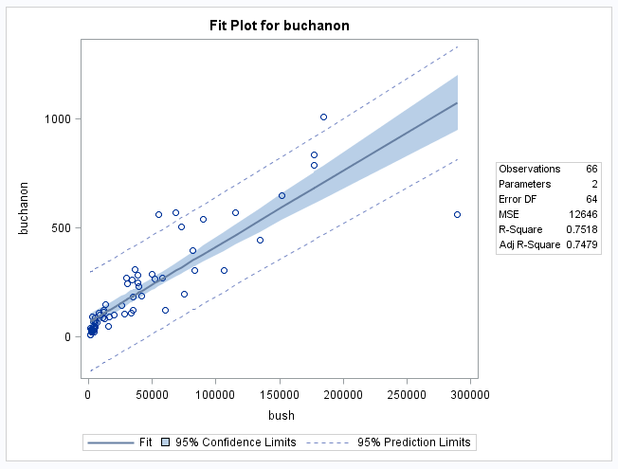
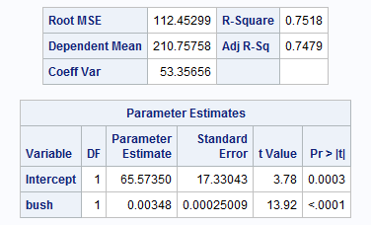
Example: 2000 Presidential Election

Slide 20
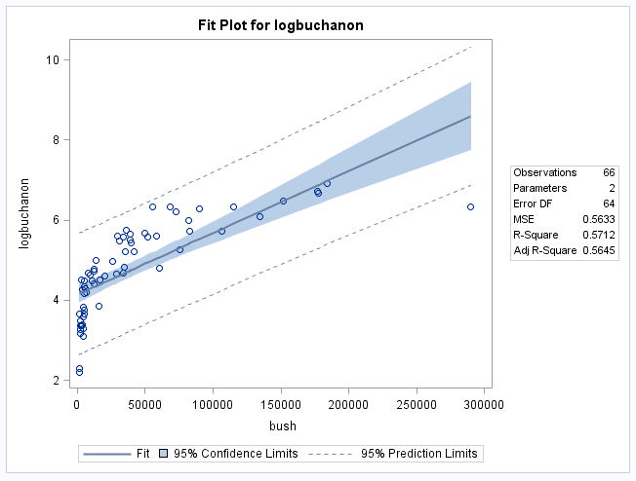
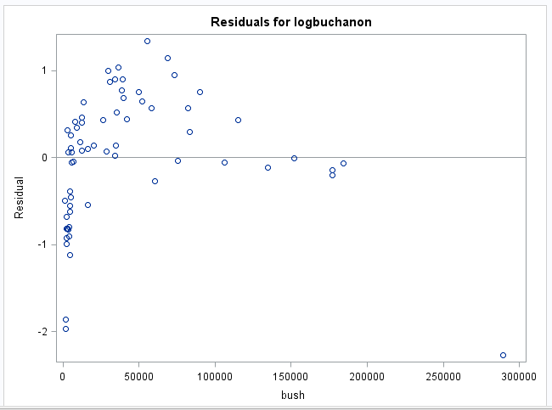
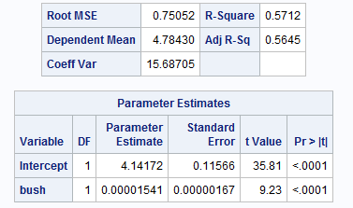
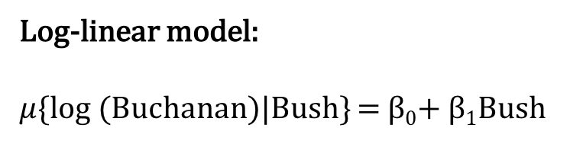
Example: 2000 Presidential Election
Log-linear model:
$μ\{$log (Buchanan)|Bush} = β₀+ β₁Bush

Slide 21
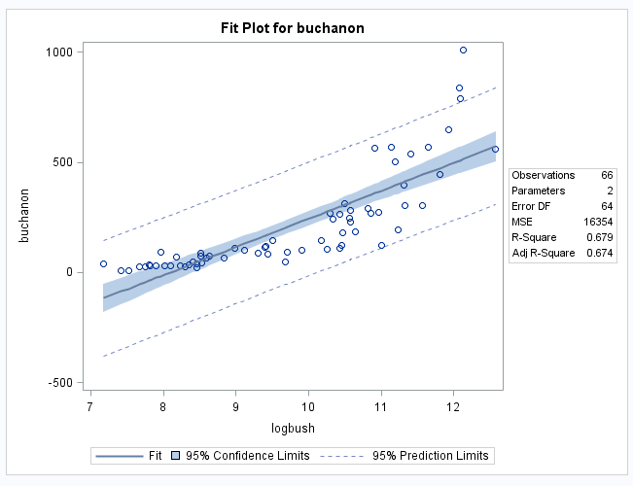
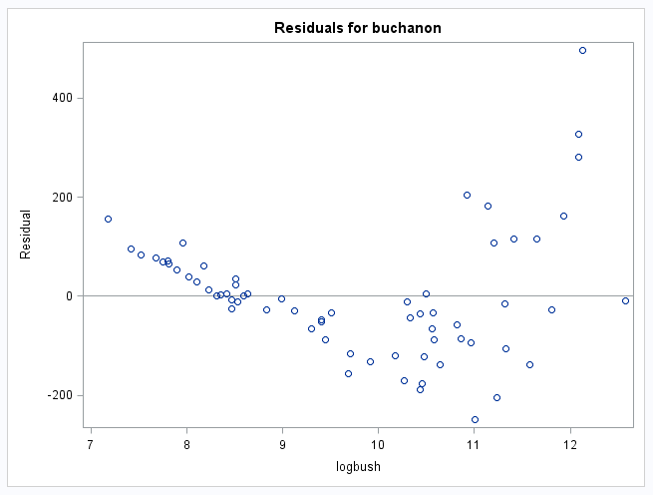
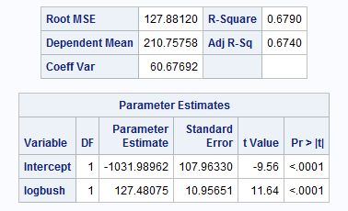
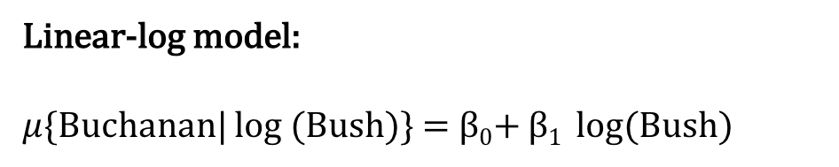
Example: 2000 Presidential Election
Linear-log model:
$μ\{$Buchanan| log (Bush)} = β₀+ β₁ log(Bush)

Slide 22
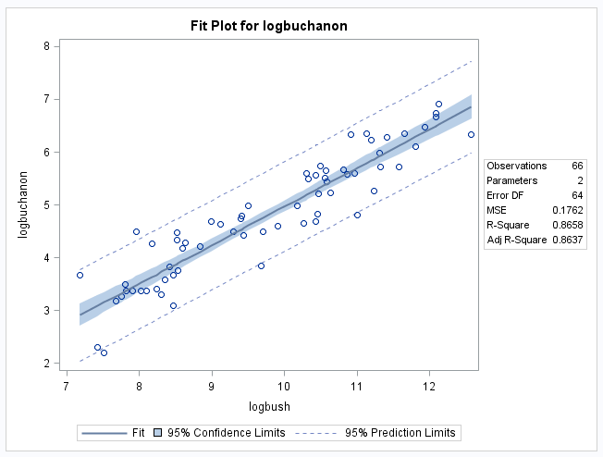
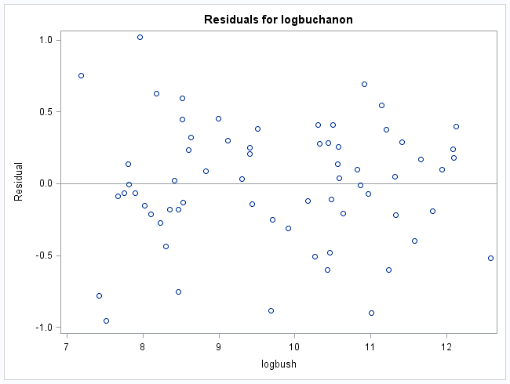
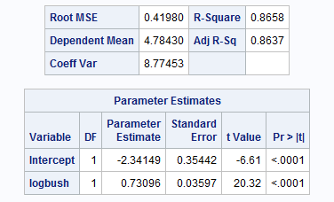
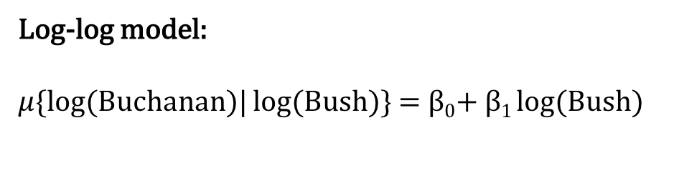
Example: 2000 Presidential Election
Log-log model:
$μ\{log⁡($Buchanan)| log(Bush)} = β₀+ β₁ log(Bush)

Slide 23

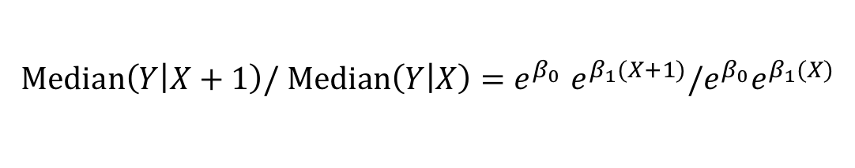

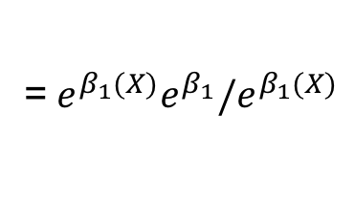

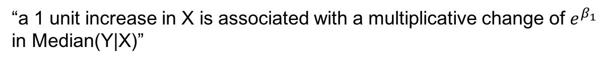
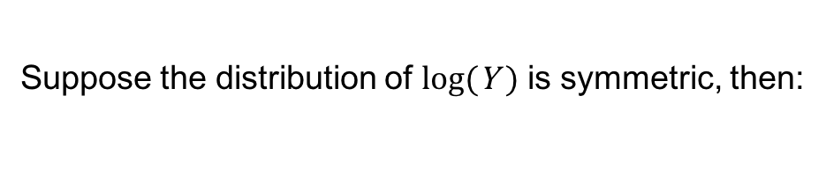
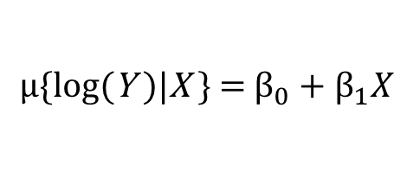
Log Transforms: Log-Linear
$$μ\text{\{}\text{log}\text{(}\text{Y} \text{)|}\text{X} \text{\}} \text{=} β_{0}+β_{1}X$$
Suppose the distribution of $\text{log}\text{(}\text{Y}\text{ )}$ is symmetric, then:
$$Median\left(Y | X\right)=e^{β_{0}}e^{β_{1}X}$$
$$Median\left(Y | X+1\right)/ Median\left(Y | X\right){=e}^{β_{0}}e^{β_{1}(X+1)}/e^{β_{0}}e^{β_{1}(X)}$$
$${=e}^{β_{1}(X+1)}/e^{β_{1}(X)}$$
=${ e}^{β_{1}(X)}e^{β_{1}}/e^{β_{1}(X)}$
$${=e}^{β_{1}}$$
“a 1 unit increase in X is associated with a multiplicative change of $e^{β_{1}}$ in Median(Y|X)”
Confidence intervals can be obtained by exponentiating the end points

Slide 24
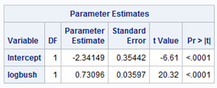

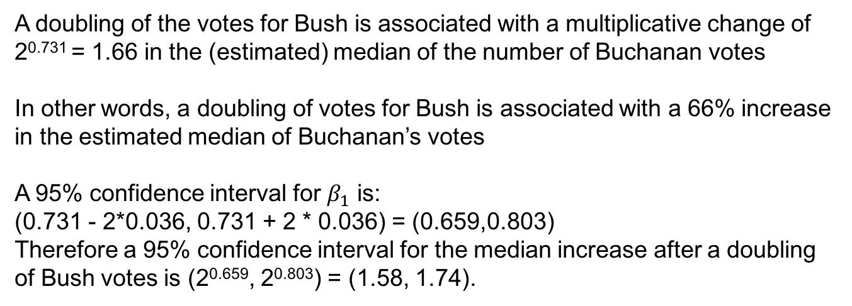
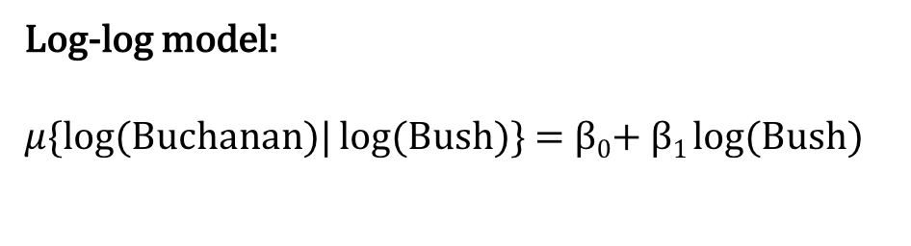
Example: 2000 Presidential Election
Log-log model:
$μ\{log⁡($Buchanan)| log(Bush)} = β₀+ β₁ log(Bush)
$$Median\left(Buchanan | Bush\right)={e^{\text{β}\text{0}}Bush}^{\text{β}\text{1}}$$
A doubling of the votes for Bush is associated with a multiplicative change of 2^{0.731} = 1.66 in the (estimated) median of the number of Buchanan votes
In other words, a doubling of votes for Bush is associated with a 66% increase in the estimated median of Buchanan’s votes
A 95% confidence interval for $β_{1}$ is:
(0.731 - 2*0.036, 0.731 + 2 * 0.036) = (0.659,0.803)
Therefore a 95% confidence interval for the median increase after a doubling of Bush votes is (2^{0.659}, 2^{0.803}) = (1.58, 1.74).

Slide 25
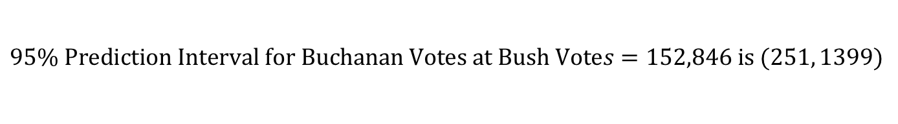
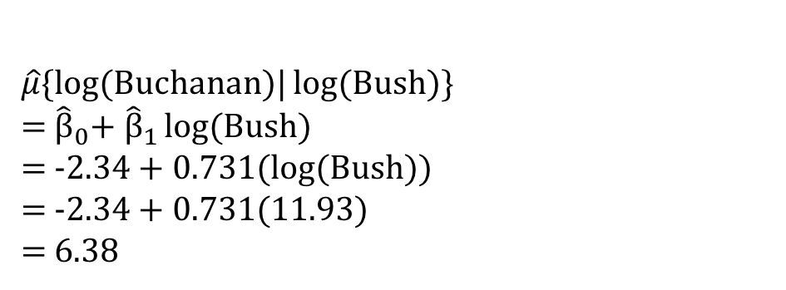
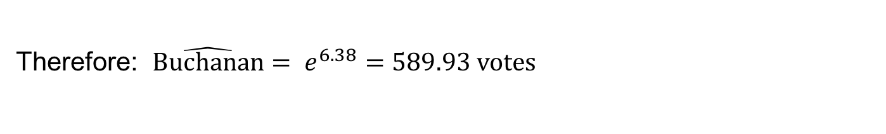
Example: 2000 Presidential Election
$\hat{μ}\{log⁡($Buchanan)| log(Bush)}
= ${\hat{\text{β}}}_{0}$+ ${\hat{\text{β}}}_{1}$ log(Bush)
= -2.34 + 0.731(log(Bush))
= -2.34 + 0.731(11.93)
= 6.38
(log(152846) = 11.93)
Therefore: $\hat{\text{Buchanan}}= e^{6.38}=589.93$ votes
$$95\% Prediction Interval for Buchanan Votes at Bush Votes=152,846 is (251, 1399)$$
The actual vote count for Buchanan: 3407 votes
Prediction: at least (3407 – 1399 = 2008) votes were not meant for Buchanan
If at least 400 would have been cast for Gore, the world could be very different

Slide 26

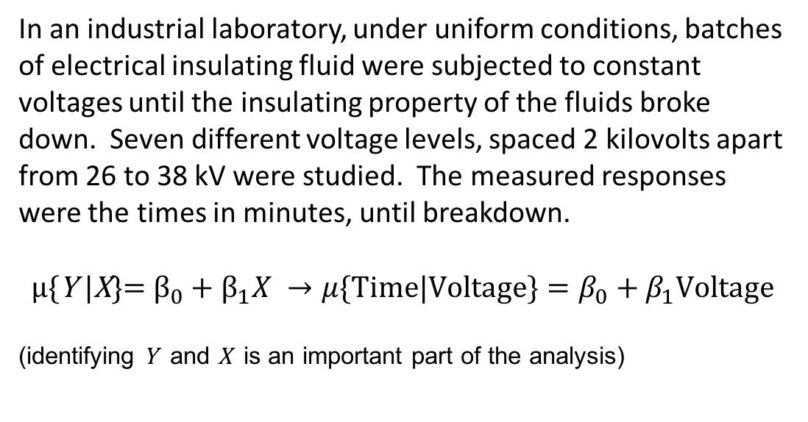
Insulation and Voltage Data
Time | Voltage
5.79 | 26
1579.52 | 26
2323.7 | 26
68.85 | 28
108.29 | 28
110.29 | 28
426.07 | 28
1067.6 | 28
7.74 | 30
17.05 | 30
20.46 | 30
21.02 | 30
22.66 | 30
43.4 | 30
47.3 | 30
139.07 | 30
144.12 | 30
175.88 | 30
194.9 | 30
In an industrial laboratory, under uniform conditions, batches of electrical insulating fluid were subjected to constant voltages until the insulating property of the fluids broke down. Seven different voltage levels, spaced 2 kilovolts apart from 26 to 38 kV were studied. The measured responses were the times in minutes, until breakdown.
$$μ\text{\{}\text{Y}\text{ |}\text{X}\text{\}}\text{= }β_{0}+β_{1}X →μ{\{Time|Voltage\}}=β_{0}+β_{1}Voltage$$
(identifying $\text{Y}$ and $\text{X}$ is an important part of the analysis)
n = 76

Slide 27
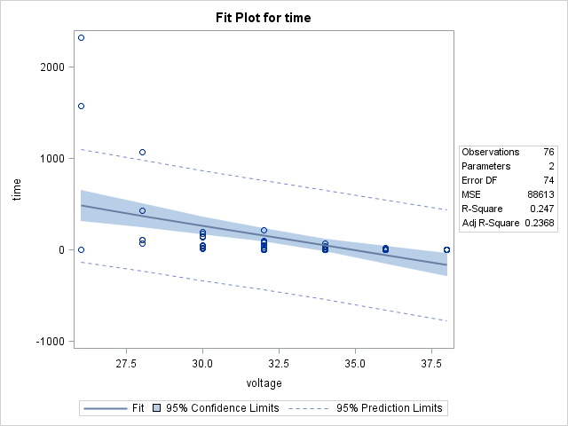
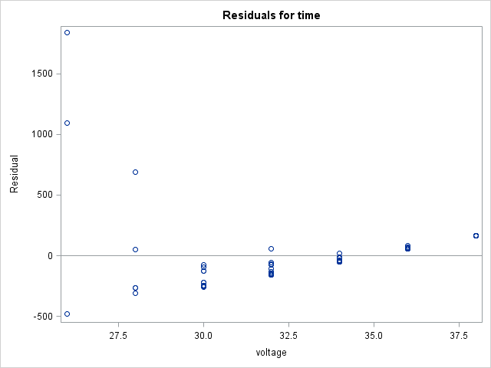
A Linear-Linear Model

Slide 28




A Log-Linear Model
$$μ{\{log⁡(Time)|Voltage\}}=β_{0}+β_{1}Voltage$$

Slide 29

Interpretation: Log – Linear
“We estimate that a 1 kV increase in voltage leads to a multiplicative change in median time to insulation breakdown of e^{-0.507 =} 0.602”
(That is, a 40% decrease. The causal language is due to randomization)
A 95% confidence interval for $β_{1}$is (-0.621, -0.393). Therefore a 95% confidence interval for $e^{β_{1}}$ is (0.537, 0.675)

Slide 30

Regression ANOVA table
(separate means model)
(simple linear regression, SLR)
(equal means model)
We can consider three different models for the mean relationship between $\text{X}$ and $\text{Y}$
$μ\text{\{}\text{Y}\text{ |}\text{X}\text{\} =} μ_{X}$
$μ\text{\{}\text{Y}\text{ |}\text{X}\text{\} = }β_{0}+β_{1}X$
$μ\text{\{}\text{Y}\text{ |}\text{X}\text{\} =}μ$
Reminder: We can construct a classic ANOVA table comparing
ESS = RSS(reduced) – RSS(full) = RSS(equal means) – RSS(separate means)
Also, we can construct an ANOVA table for SLR by comparing:
ESS = RSS(reduced) – RSS(full) = RSS(equal means) – RSS(SLR)
(Treats voltage as nominal)

Slide 31








Regression ANOVA table
(Variance Estimate: ${\hat{σ}}_{SM}^{2})$
(Display 8.8 in book)
(Equal means model vs. separate means)
(Treats voltage as nominal)
(Treats voltage as interval)
(Variance Estimate:${\hat{σ}}^{2})$
(Equal means model vs. SLR model)

Slide 32

Checking the SLR Assumption Using Replication
(separate means model)
(simple linear regression, SLR)
(equal means model)
We can consider three different models for the mean relationship between $\text{X}$ and $\text{Y}$ (note: in the voltage example, we have $Y= log⁡(Time))$
$μ\text{\{}\text{Y}\text{ |}\text{X}\text{\} =} μ_{X}$
$μ\text{\{}\text{Y}\text{ |}\text{X}\text{\} = }β_{0}+β_{1}X$
$μ\text{\{}\text{Y}\text{ |}\text{X}\text{\} =}μ$
We can construct an ANOVA table comparing
ESS = RSS(reduced) – RSS(full) = RSS(equal means) – RSS(separate means)
We can construct an ANOVA table out of SLR by comparing:
ESS = RSS(reduced) – RSS(full) = RSS(equal means) – RSS(SLR)
ESS = RSS(reduced) – RSS(full) = RSS(SLR) – RSS(separate means)

Slide 33



Checking the SLR Assumption Using Replication
(Variance Estimate: ${\hat{σ}}_{SM}^{2})$
Test: is SLR “almost” as good as separate means?
$F_{lof }=\frac{{({SSR}_{SLR}−{SSR}_{SM})}/{({df}_{SLR}−{df}_{SM})}}{{\hat{σ}}_{SM}^{2}}$
$F_{lof }=\frac{{(180.07−173.75)}/{(74−69)}}{2.52}$
$F_{lof }=0.502$
$H_{0}:$The SLR model is adequate
$H_{A}:$The SLR model is inadequate
(always use variance estimate from full model)
(Equal means model vs. separate means)
(Under $H_{0}$, $F_{lof }$ has
a F-distribution w/
_ & _ deg. of freedom)
(Equal means model vs. SLR model)

Slide 34


Checking the SLR Assumption Using Replication: Goodness of Fit
Test: is SLR “almost” as good as separate means?
$F_{lof }=\frac{{({SSR}_{SLR}−{SSR}_{SM})}/{({df}_{SLR}−{df}_{SM})}}{{\hat{σ}}_{SM}^{2}}$
$F_{lof }=\frac{{(180.07−173.75)}/{(74−69)}}{2.52}$
$F_{lof }=0.502$
$H_{0}:$The SLR model is adequate
$H_{A}:$The SLR model is inadequate
(Under $H_{0}$, $F_{lof }$ has
a F-distribution w/
_ & _ deg. of freedom)
“There is no evidence that the simple linear regression model of log(time) onto voltage is inadequate for this data”
Caveat: We need multiple Response values to occur at each explanatory variable value for this to be meaningful

Slide 35



$R^{2}$: Proportion of Variation Explained
The $R^{2}$ is the percentage of total variation in the response explained by the model
For the voltage example, this
would be interpreted as
“51% of the variation in (log)
breakdown time is explained by
the SLR on voltage”

Slide 36





Getting Confidence and Prediction Intervals: SAS
“We predict the median time to breakdown at 33 kV is between 6.39 and 13.05 sec.”

