Slide 1
Multiple Regression
Overview of a more general regression model

Slide 2
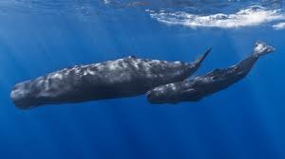
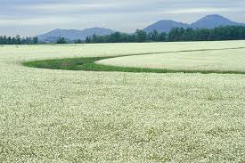
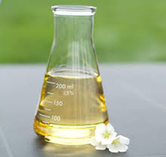
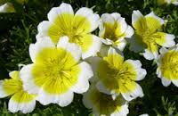
Meadowfoam Flowering

Slide 3
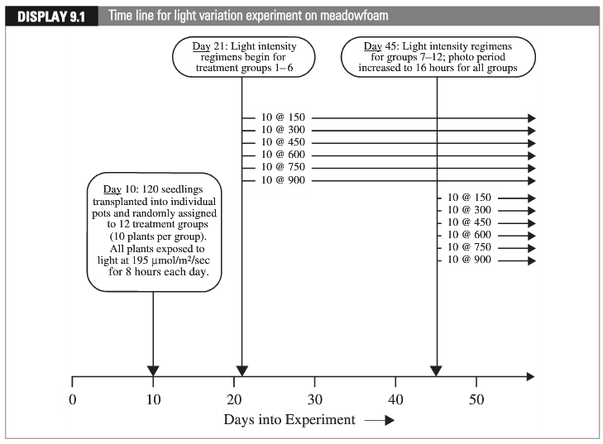
Meadowfoam Flowering
Early
Late

Slide 4
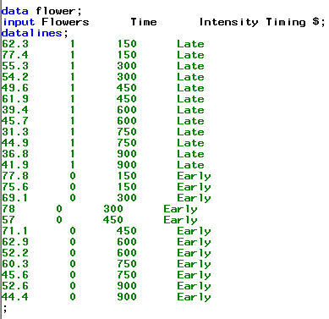
Meadowfoam Flowering
If we thought of this question like a one-group problem, there would be 12 treatments:
Intensity = 150, Timing = Late
….
Intensity = 900, Timing = Early
(there are two codings of same timing variable)
But, it is more helpful to think of there being all combinations of two grouping variables
6 light intensities
2 timing levels

Slide 5

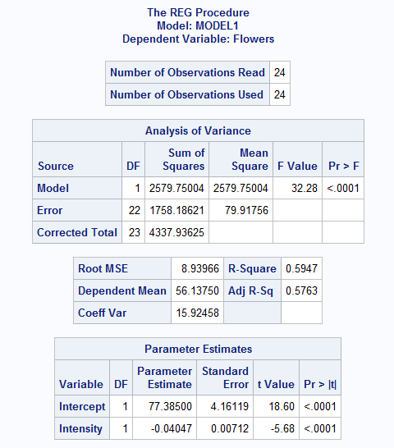
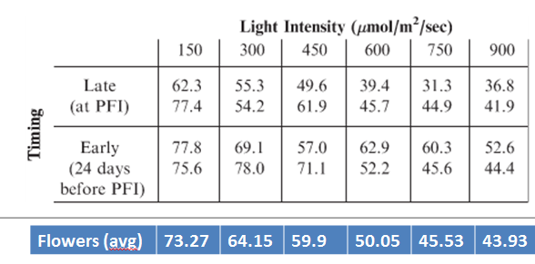
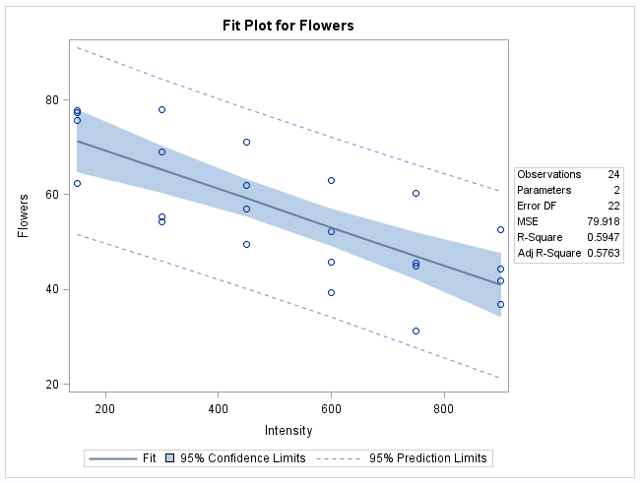

Meadowfoam Flowering Flowers vs. Intensity
$$μ\text{\{}\text{flowers}\text{|}\text{intensity}\text{\} = }β_{0}+β_{1}intensity$$

Slide 6
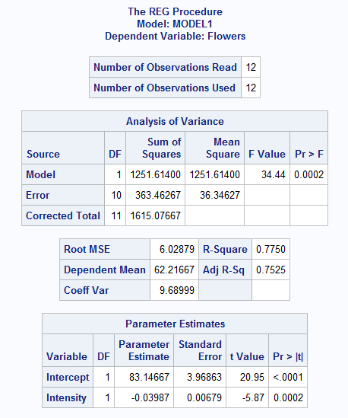
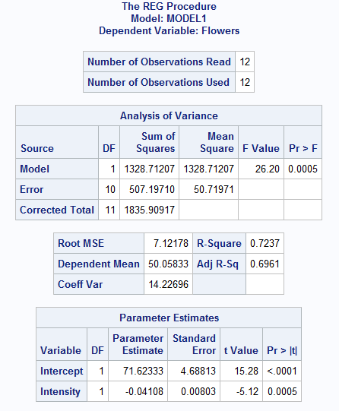
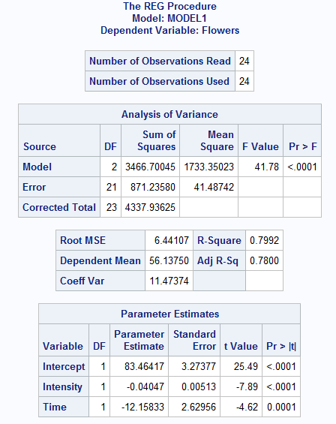



Meadowfoam Flowering Flowers vs. Intensity & Time
Notes:
ANOVA: ESS = RSS(reduce) – RSS(full) <-> Model = Total – Error

Slide 7
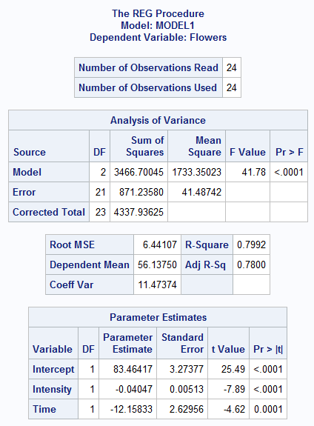
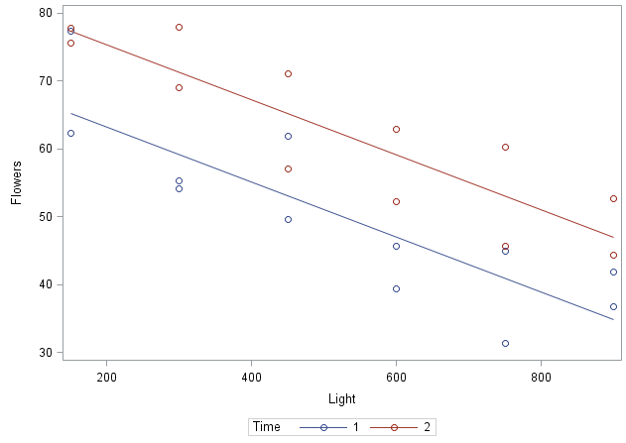
Meadowfoam Flowering Flowers vs. Intensity & Time
$$μ\text{\{}\text{flowers}\text{|}\text{intensity}\text{,}\text{time}\text{\} = }β_{0}+β_{1}intensity+β_{2}time$$
Intercept = 83.45417 -12.15833
= 71.3
Slopes = -.04047
Intensity
Intercept = 83.46
(Note that X = 0 is off the left end of the chart)

Slide 8

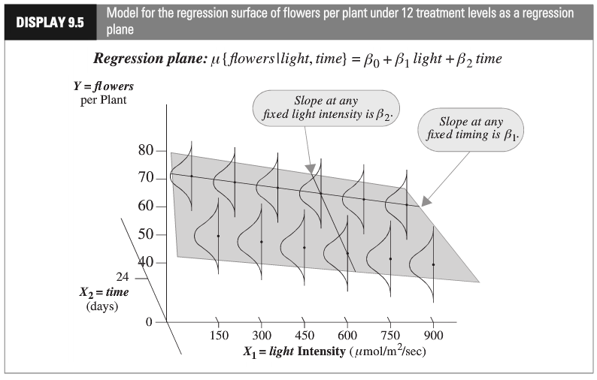
Multiple Regression
“Constant Variance Assumption”
This assumption is needed for the inferential tools developed in the next Chapter (intervals, tests, etc.)

Slide 9
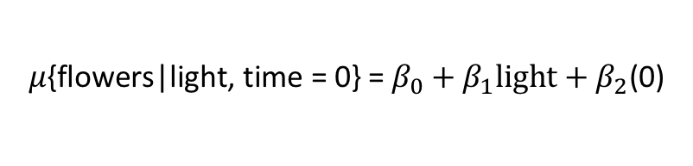

Categorical Explanatory Variable
Explanatory Variable Values:
Time: {0: “24 days before PFI”, 1: “After PFI”}
Light: {150, 300, 450, 600, 750, 900}
$$μ\text{\{}\text{flowers}\text{|}\text{light}\text{, }\text{time}\text{ = 0\} =}{ β}_{0}+β_{1}light+β_{2}\text{(0)}$$
$$μ\text{\{}\text{flowers}\text{|}\text{light}\text{, }\text{time}\text{ = 0\} = }{(β}_{0})+β_{1}light$$
$$μ\text{\{}\text{flowers}\text{|}\text{light}\text{, }\text{time}\text{ = 1\} = }β_{0}+β_{1}light+β_{2}(1)$$
$$μ\text{\{}\text{flowers}\text{|}\text{light}\text{, }\text{time}\text{ = 1\} = }{(β}_{0}+β_{2})+β_{1}light$$
$β_{2}$ is the adjustment in the expected (mean) number of flowers in the “after PFI” group relative to the ”24 days before PFI’ group

Slide 10
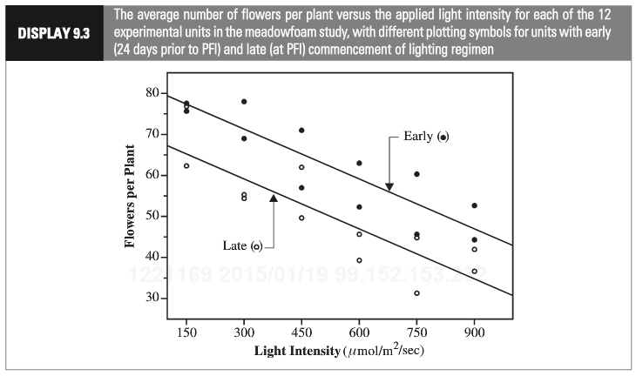



Meadowfoam: Categorical Explanatory Variable
$$μ\text{\{}\text{flowers}\text{|}\text{light}\text{, }\text{time}\text{ = 0\} =}β_{0}+β_{1}light$$
$$μ\text{\{}\text{flowers}\text{|}\text{light}\text{, }\text{time}\text{ = 1\} = }{(β}_{0}+β_{2})+β_{1}light$$
$${(β}_{0})$$
$${(β}_{0}+β_{2})$$

Slide 11
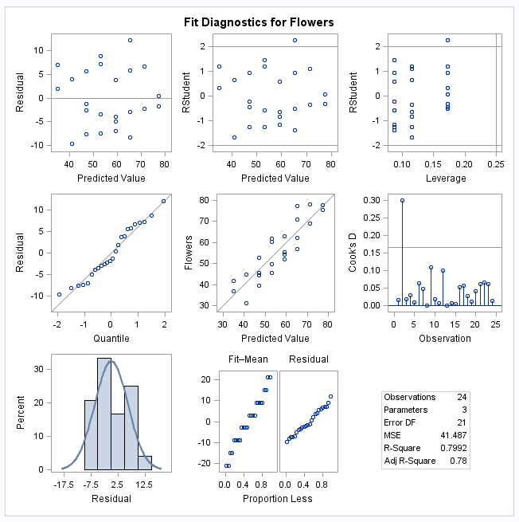
Meadowfoam: Checking Assumptions
$$μ\text{\{}\text{flowers}\text{|}\text{light}\text{\} = }β_{0}+β_{1}light+β_{2}time$$
Residuals: No evidence of changing variance nor model misfit
(what does “Predicted Value” mean?)
Influence: No evidence of extreme or influential points
(High leverage + large residual)
Normality: No evidence of any issue
Notes:
Cook’s D: Change in estimate after deleting each observations

Slide 12
Meadowfoam: Conclusion
We estimate that Increasing “Light Intensity” decreases the mean number of flowers per plant by 4.0 flowers per plant per 100 nano mol / m2 / sec. (95% confidence interval from 3.0 to 5.1)
Beginning the light treatment 24 days before PFI (time = 0) increased the mean number of flowers per plant by an estimated 12.2 flowers (95% confidence interval from 6.7 to 17.6)
We can draw the above causal relationship since the seeds were randomly assigned to each treatment group.

