Slide 1
Multiple Regression
Analyzing the housing data

Slide 2
Zillow Data
Many companies are currently trying to make online businesses for providing information to prospective buyers/sellers of houses
(zillow.com, trulia.com, redfin.com, realtor.com,…)
One of the core parts of the business is to analyze/predict the sale price of houses based on factors such as square footage, number of bedrooms/bathrooms, location, school district, ...
We will look at data from zillow to build a sale price model using multiple regression

Slide 3
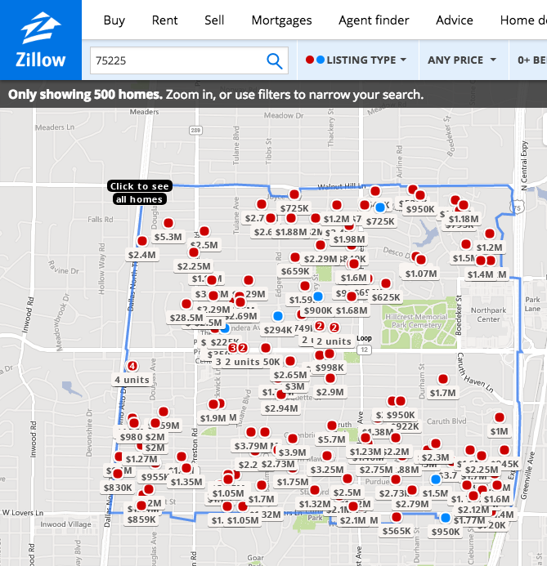
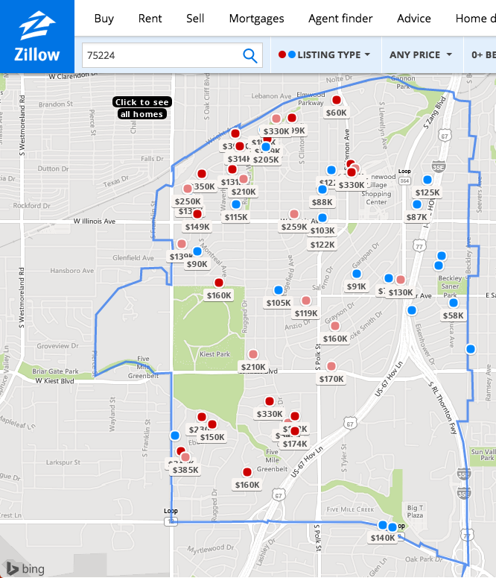
Involving Zipcode

Slide 4
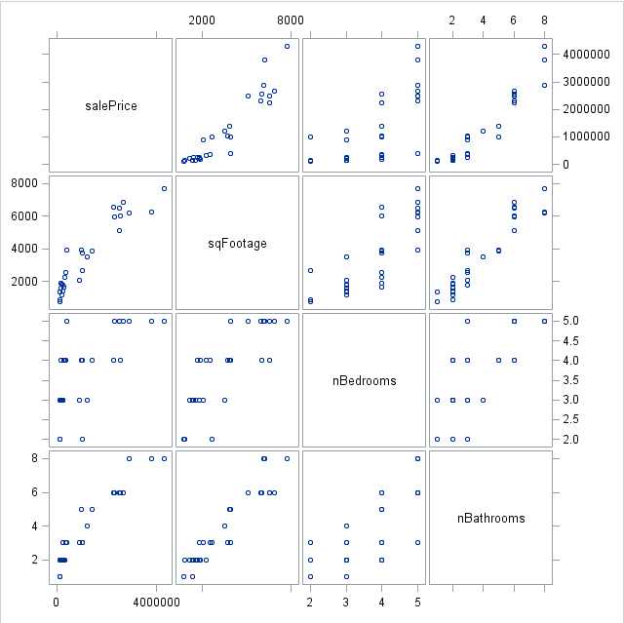

Scatterplot Matrix
“Scatterplot matrix”
Or
“Draftsmen plot”
Or
“Pairs plot”

Slide 5
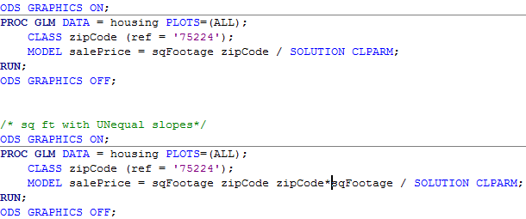
Involving Zipcode and Using “PROC GLM”
This class statement is crucial (why?)
$$μ\left\{salePrice | {ft}^{2}, zipcode\right\}=β_{0}+{β_{1}ft}^{2}+β_{2}zipcode$$
$$μ\left\{salePrice | {ft}^{2}, zipcode\right\}=β_{0}+{β_{1}ft}^{2}+β_{2}zipcode+{β_{3}ft}^{2}∗zipcode$$
These are known as main effects
This is known as an interaction term

Slide 6
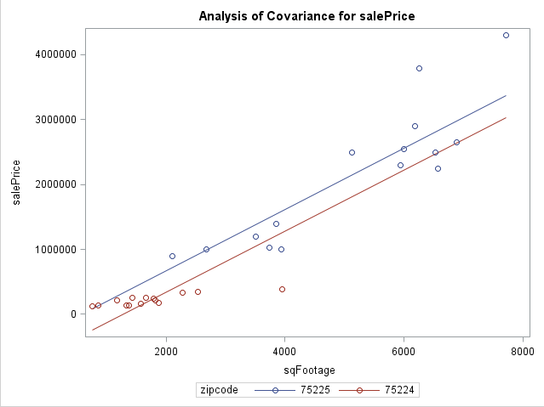
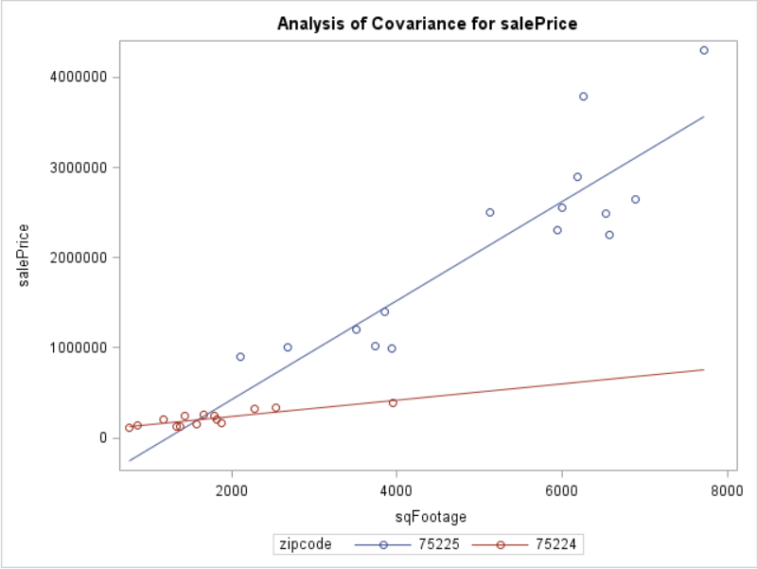
Involving Zip Code
$$\hat{μ}\left\{salePrice | {ft}^{2}, zipcode\right\}=\hat{β_{0}}+{\hat{β_{1}}ft}^{2}+\hat{β_{2}}zipcode$$
$$\hat{μ}\left\{salePrice | {ft}^{2}, zipcode\right\}=\hat{β_{0}}+{\hat{β_{1}}ft}^{2}+\hat{β_{2}}zipcode+{\hat{β_{3}}ft}^{2}∗zipcode$$

Slide 7
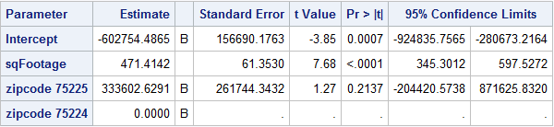
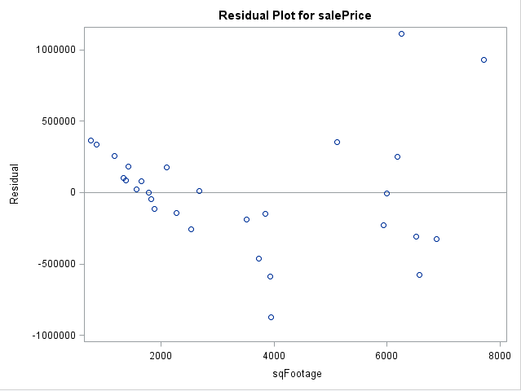
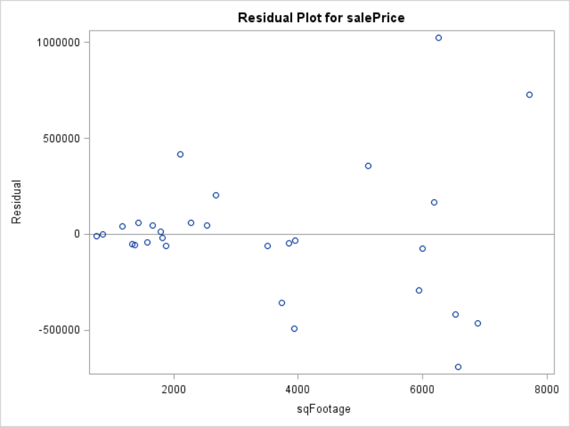
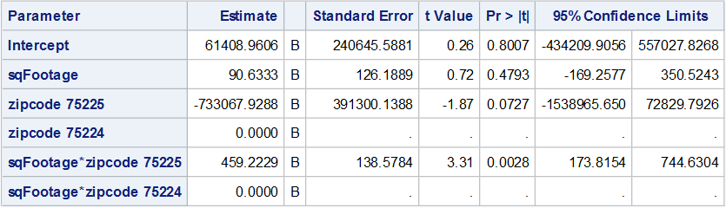

Involving Zip Code: Model Fit and Residuals
(Ignore these)
$$μ\left\{salePrice | {ft}^{2}, zipcode\right\}=β_{0}+{β_{1}ft}^{2}+β_{2}zipcode$$
$$μ\left\{salePrice | {ft}^{2}, zipcode\right\}=$$
$$β_{0}+{β_{1}ft}^{2}+β_{2}zipcode+{β_{3}ft}^{2}∗zipcode$$

Slide 8
Involving Zip Code: Interpretation
If the p-value for the interaction term is significant, interpret it even if the p-values for the main effects are not significant
There is evidence that sqFootage depends on zip code (two-sided p-value 0.0028 for the interaction). We estimate every 1 sq. ft. increase is associated with an $90.6 increase for zip=75224 or 90.6+459.2 = $549.8 increase for zip=75225 in mean sale price.
(To get confidence intervals
for this effect we can use a
contrasts)
$$μ\left\{salePrice | {ft}^{2}, zipcode\right\}=$$
$$β_{0}+{β_{1}ft}^{2}+β_{2}zipcode+{β_{3}ft}^{2}∗zipcode$$

Slide 9
Multiple Regression: Additional variables
We saw that the residuals show evidence of an assumption violation
Hence, our results/interpretation are highly suspect
We can try and add additional explanatory variables to improve the linearity assumption
$$μ\left\{salePrice | {ft}^{2}, zipcode, nBaths,nBeds\right\}=β_{0}+{β_{1}ft}^{2}+β_{2}zipcode+{β_{3}ft}^{2}∗zipcode+β_{4}nBaths+β_{5}nBeds$$

Slide 10
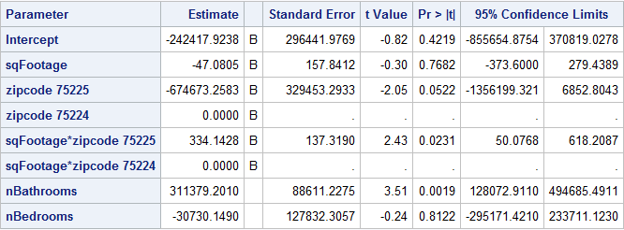
Multiple Regression: Model Statement
$$μ\left\{salePrice | {ft}^{2}, zipcode, nBaths,nBeds\right\}=β_{0}+{β_{1}ft}^{2}+β_{2}zipcode+{β_{3}ft}^{2}∗zipcode+β_{4}nBaths+β_{5}nBeds$$

Slide 11
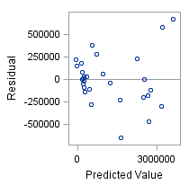
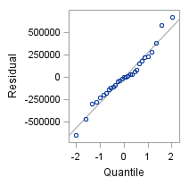
Multiple Regression: Residuals
No strong evidence of assumption violations

Slide 12
Multiple Regression: Interpretation
Evidence that nBedrooms isn’t an important explanatory variable given the other explanatory variables are in the model
Let’s refit/recheck the model without nBedrooms

Slide 13
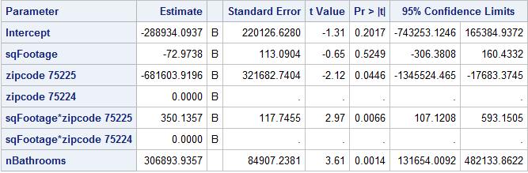
Multiple Regression: Without nBedrooms
$$μ\left\{salePrice | {ft}^{2}, zipcode, nBaths\right\}=β_{0}+{β_{1}ft}^{2}+β_{2}zipcode+{β_{3}ft}^{2}∗zipcode+β_{4}nBaths$$

Slide 14
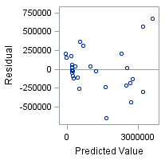
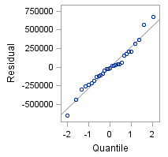
Multiple Regression: Residuals
These look pretty good, no strong evidence of assumption violations

Slide 15
Multiple Regression: Interpretation
$$μ\left\{salePrice | {ft}^{2}, zipcode, nBaths\right\}=β_{0}+{β_{1}ft}^{2}+β_{2}zipcode+{β_{3}ft}^{2}∗zipcode+β_{4}nBaths$$
sqFootage: There is evidence to suggest that sqFootage is associated with mean sale price and that this association depends on zip code (p-value 0.0066). We estimate every 1 sq. ft. increase is associated with a -$73 increase for zip=75224 or a -73+350 = $277 increase for zip=75225 in mean sale price, given the other explanatory variables in the model

Slide 16
Multiple Regression: Interpretation
$$μ\left\{salePrice | {ft}^{2}, zipcode, nBaths\right\}=β_{0}+{β_{1}ft}^{2}+β_{2}zipcode+{β_{3}ft}^{2}∗zipcode+β_{4}nBaths$$
nBathrooms: There is evidence to suggest that nBathrooms is associated with mean sale price (p-value 0.0014). We estimate every additional bathroom is associated with a $306,893 increase in mean sale price, given the other explanatory variables in the model (95% confidence interval of [$131654,$482133]).

Slide 17
Multiple Regression: Interpretation
Suppose I’m a homeowner in one of these two zip codes
I read this report and decide that by converting a portion of my existing house to add an additional bathroom I will increase my house’s sale price.
I read this report and decide if I add on to my house to add an additional bathroom, I will cause my house’s sale price to increase between [$131654,$482133]
What interpretation errors am I making in each case?
$$μ\left\{salePrice | {ft}^{2}, zipcode, nBaths\right\}=β_{0}+{β_{1}ft}^{2}+β_{2}zipcode+{β_{3}ft}^{2}∗zipcode+β_{4}nBaths$$
nBathrooms: There is evidence to suggest that nBathrooms is associated with mean sale price (p-value 0.0014). We estimate every additional bathroom is associated with a $306,893 increase in mean sale price, given the other explanatory variables in the model (95% confidence interval of [$131654,$482133]).

