Slide 1
Confounding
Alternative association between the treatment and outcome

Slide 2
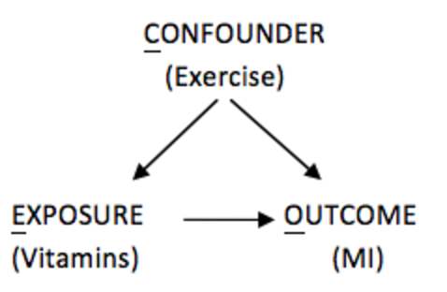
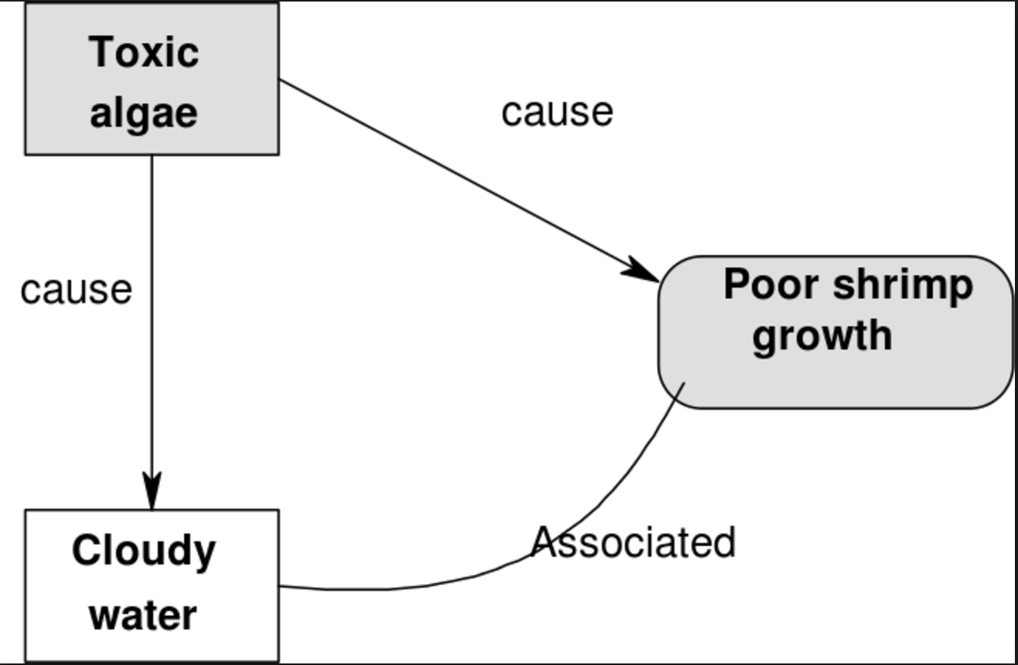
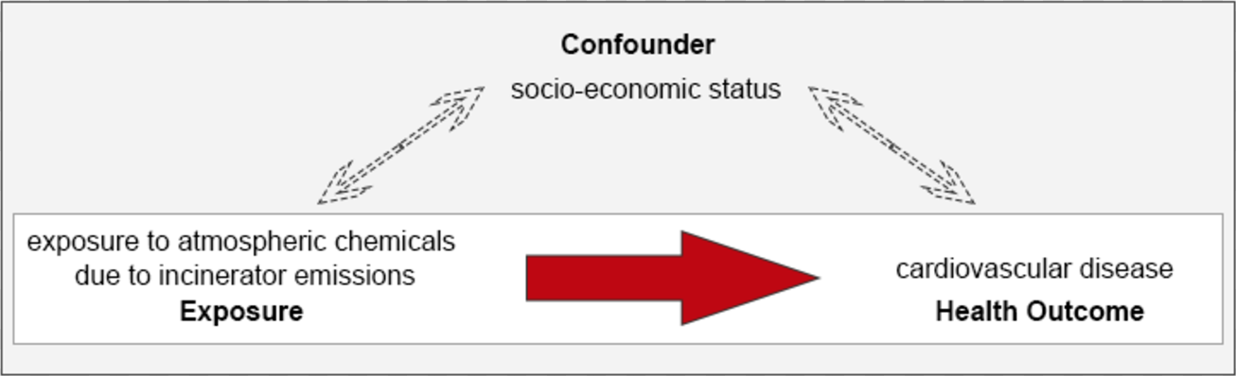
Confounding
A confounder is an unaccounted for variable associate with both the treatment and response

Slide 3
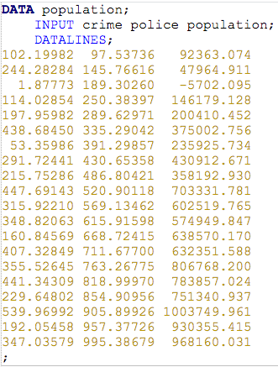
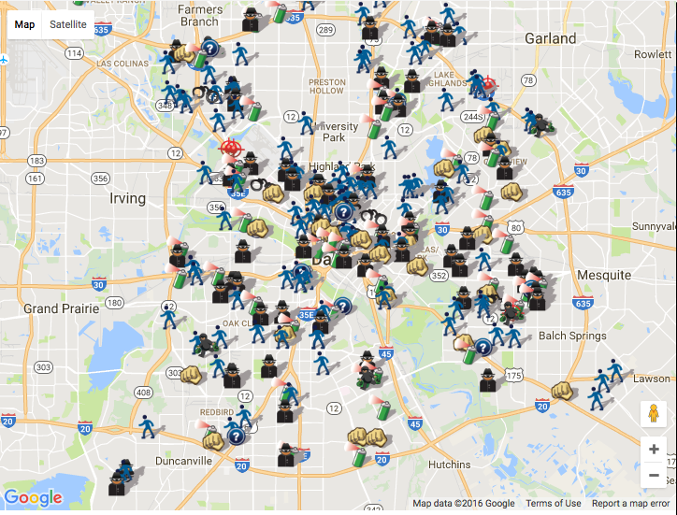
Sociology Study: Effect of Policing on Crime

Slide 4
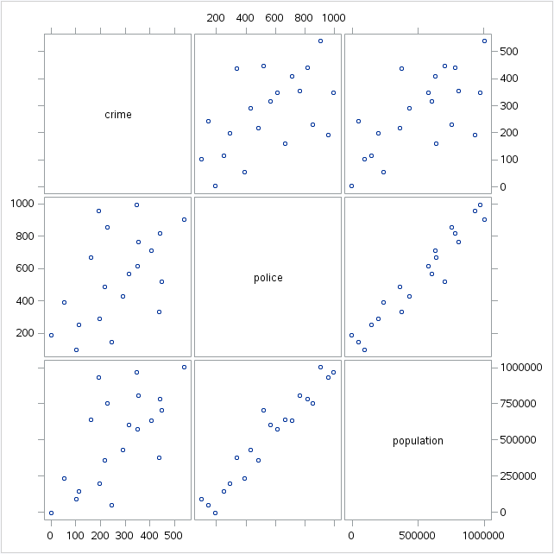

Slide 5


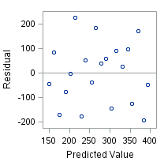
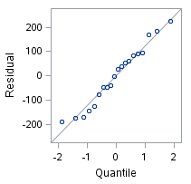
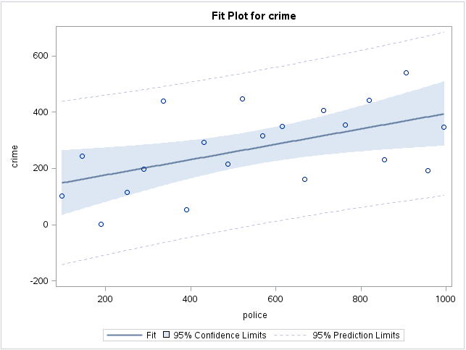
Simple Linear Regression: Crime and Policing

Slide 6


Multiple Linear Regression: Crime and Policing/Population

Slide 7
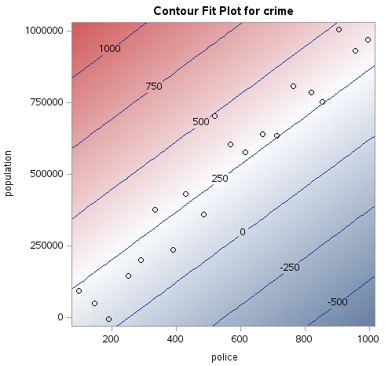
Contour Plot

Slide 8
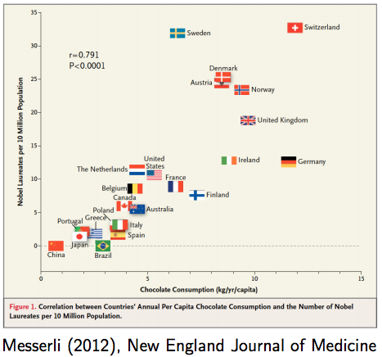
Chocolate Study
Important:
- We can say that chocolate consumption is predictive of Nobel prizes
- We cannot say that changing chocolate consumption will change the number of Nobel prizes

Slide 9
Chocolate Study
Important:
Prediction: Predict Y after observing X
Causation: Predict Y after setting X
(note that randomization breaks any confounding relationships and hence allows for causal inference)

Slide 10
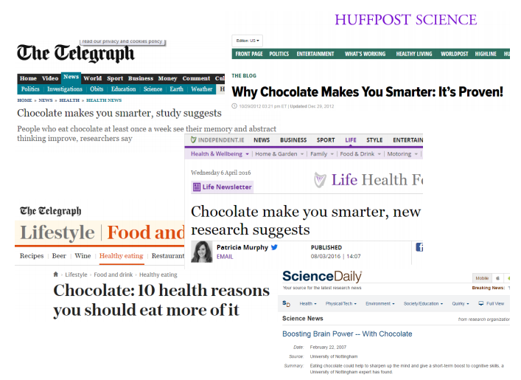

Slide 11

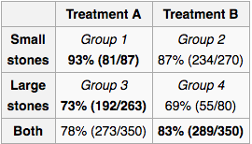
There are Many Examples of Confounding
Batting averages in Major League Baseball
Kidney stone treatments
(This is why blinding is crucial in clinical trials)

Slide 12
Berkeley Admissions
Gender | Admitted | Denied | %
Male | 1198 | 1493 | 44.52%
Female | 557 | 1278 | 30.35%
Is there evidence of discrimination?

Slide 13
Berkeley Admissions
Selectivity | Gender | Admitted | Total
High | Male | Yes | 333 (25.5%)
High | Male | No | 973
High | Female | Yes | 451 (26.5%)
High | Female | No | 1251
Moderate | Male | Yes | 865 (62.5%)
Moderate | Male | No | 520
Moderate | Female | Yes | 106 (79.7%)
Moderate | Female | No | 27

