Slide 1
Multiple Regression: A Model for the Mean
Leverage
Studentized residuals
Cooks-D

Slide 2
Influential Observations

Slide 3
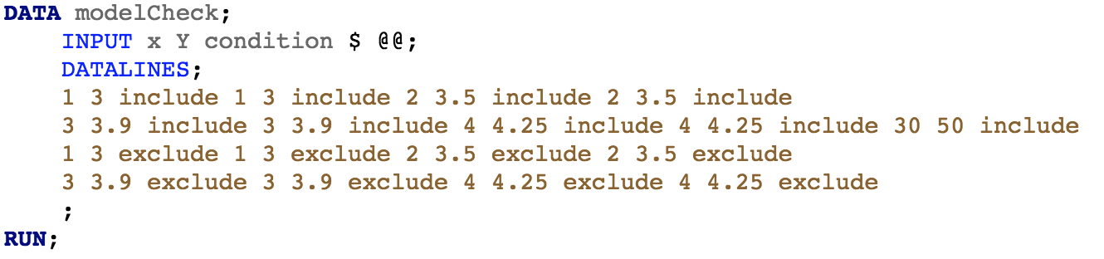
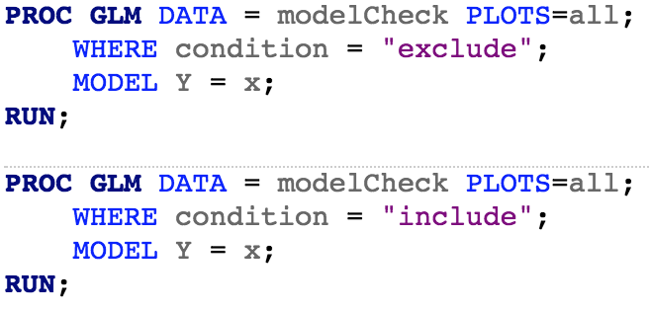
An Example Dataset

Slide 4
Influential Observations
An influential observation is an observation that has a disproportionate affect on the estimated regression model
Addressing influential observations is related to, but distinct from, assumption checking
As the estimated regression model is based on average squared deviations, it is very sensitive to observations that are extreme in some direction
The general idea is similar to the “outlier strategy” in Chapter 3.3.1
However, the details are a little different due to there being outliers in X or in Y

Slide 5
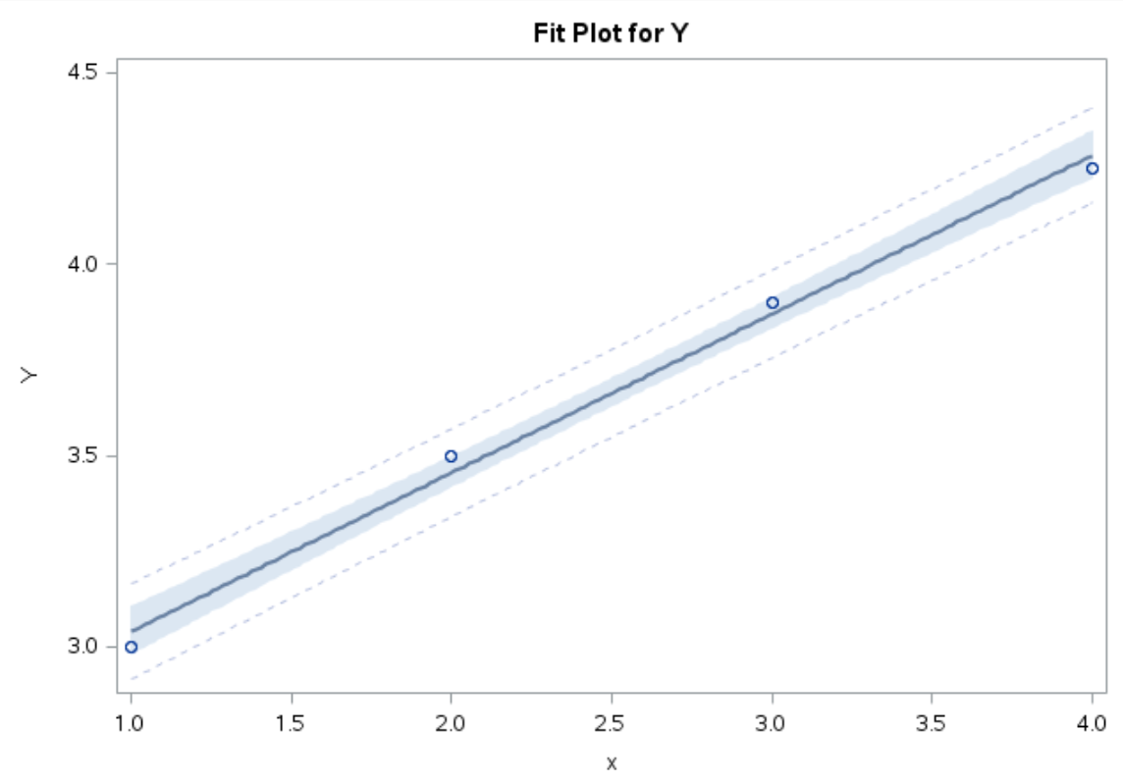
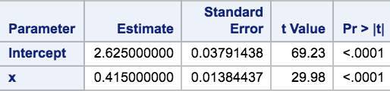
Influential Observations: Included

Slide 6
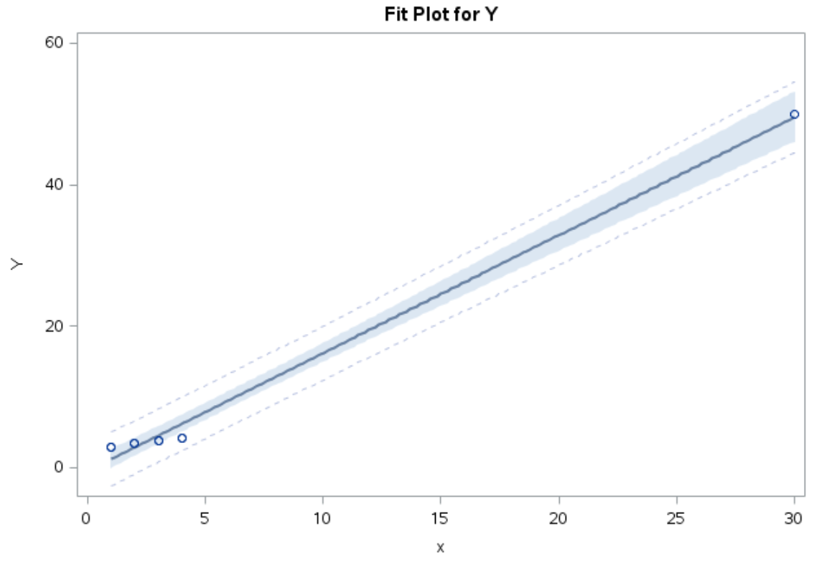
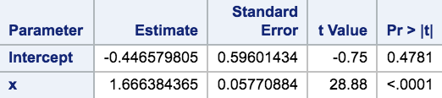
Influential Observations: Excluded

Slide 7
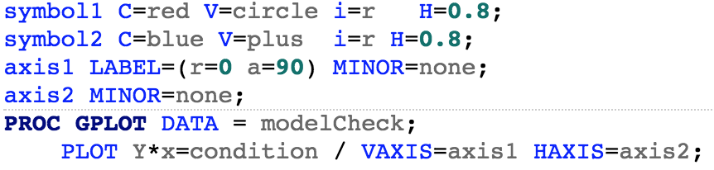
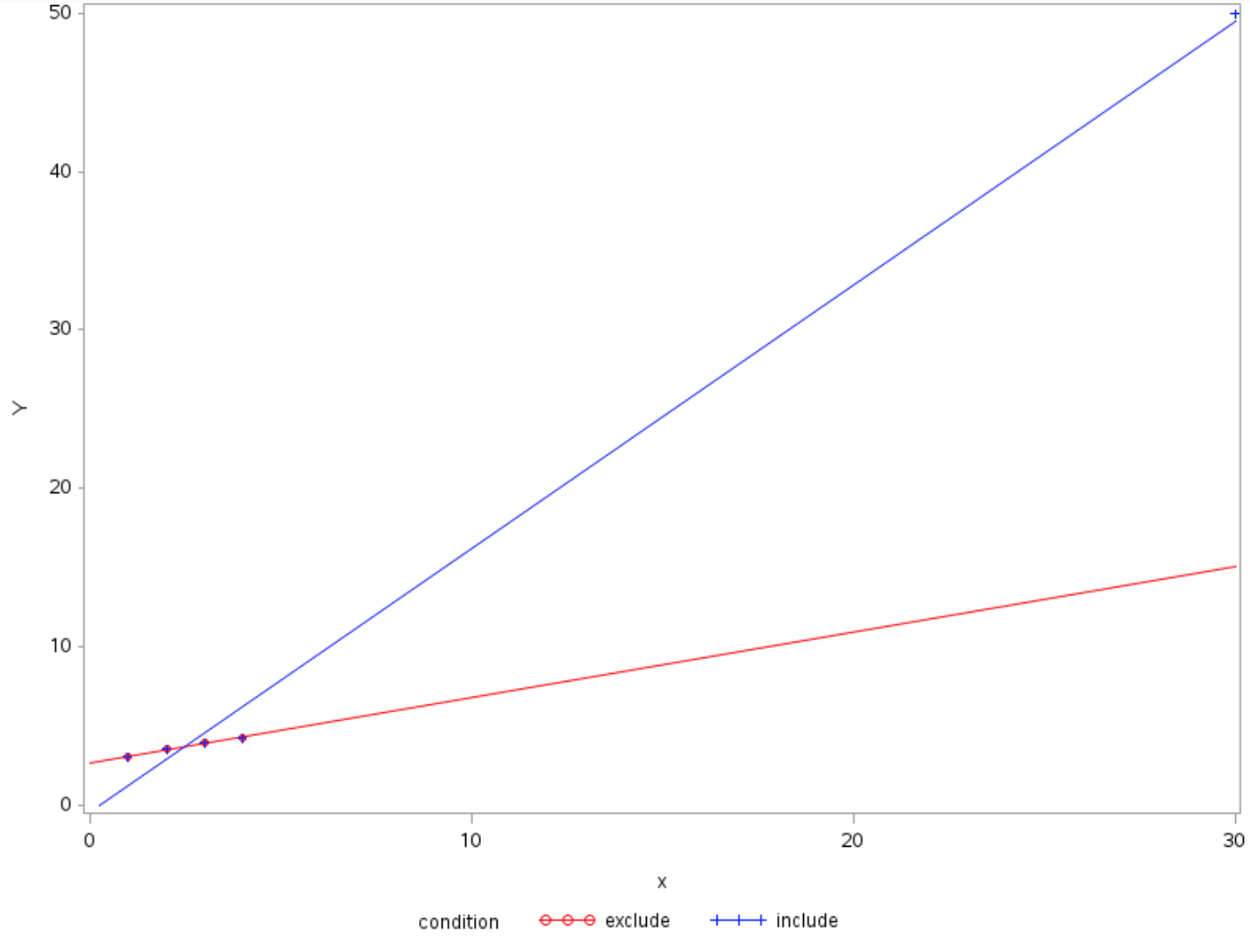
Influential Observations: Included and Excluded

Slide 8





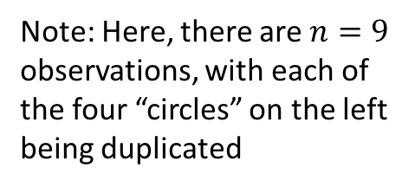
The Idea of Leverage
Note: Here, there are $n=9$ observations, with each of the four “circles” on the left being duplicated
$$X_{1}$$
$$\overline{X}$$
$$X_{9}$$
$${(X}_{1}−\overline{X})$$
$${(X}_{9}−\overline{X})$$

Slide 9
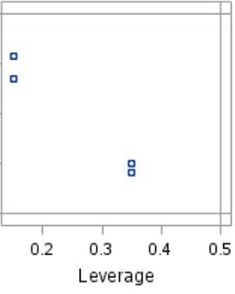
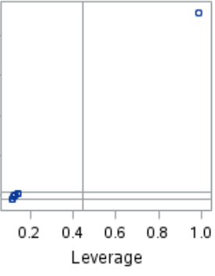

Definition of Leverage for Simple Linear Regression
The leverage of the $i^{th}$ observation is defined to be $h_{i}$ where:
$$h_{i}=\frac{1}{n−1}{\left(\frac{X_{i}−\overline{X}}{s_{X}}\right)}^{2}+\frac{1}{n}=\frac{{\left(X_{i}−\overline{X}\right)}^{2}}{\sum{{\left(X_{i}−\overline{X}\right)}^{2}}}+\frac{1}{n}$$
In words, this can be expressed equivalently as:
The squared distance of $X_{i}$ from the mean in units of standard deviation of $X$
Or the proportion of total sum of squares of $X$ contributed by $X_{i}$

Slide 10
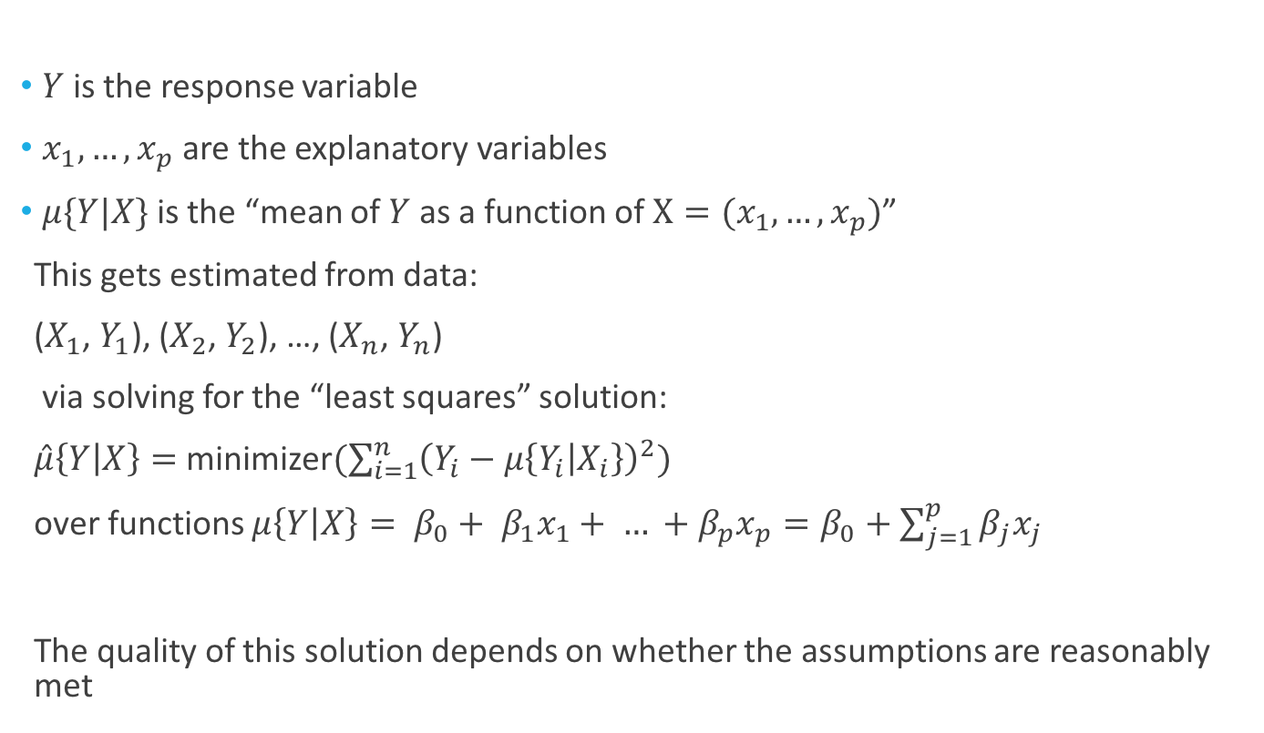
Notation for the Mean
$Y$ is the response variable
$x_{1},…,x_{p}$ are the explanatory variables
$μ\{Y|X\}$ is the “mean of $Y$ as a function of $X=(x_{1},…,x_{p})$”
This gets estimated from data:
($X_{1}$, $Y_{1}$), ($X_{2}$, $Y_{2}$), …, ($X_{n}$, $Y_{n}$)
via solving for the “least squares” solution:
$\hat{μ}\left\{Y | X\right\}=$ minimizer$(\sum_{i=1}^{n}{{\left(Y_{i}−μ\left\{Y_{i} | X_{i}\right\}\right)}^{2}})$
over functions $μ\left\{Y | X\right\}= β_{0}+ β_{1}x_{1}+ … +β_{p}x_{p}=β_{0}+\sum_{j=1}^{p}{β_{j}x_{j}}$
The quality of this solution depends on whether the assumptions are reasonably met

Slide 11


Definition of Leverage for Multiple Linear Regression
$𝕏=\left[1,x_{1},x_{2}, …,x_{p}\right]= \left[\begin{matrix}1, { X_{1}}^{T} \\ ⋮ \\ 1, {X_{n}}^{T}\end{matrix}\right]=\left[\begin{matrix}1, X_{11} & ⋯ & X_{1p} \\ ⋮ & ⋱ & ⋮ \\ 1, X_{n1} & ⋯ & X_{np}\end{matrix}\right]$, $𝕐= \left[\begin{matrix}Y_{1} \\ ⋮ \\ Y_{n}\end{matrix}\right]$
Data: ($X_{1}$, $Y_{1}$), ($X_{2}$, $Y_{2}$), …, ($X_{n}$, $Y_{n}$)
Estimate model via:
$\hat{μ}\left\{Y | X\right\}=$ minimizer$(\sum_{i=1}^{n}{{\left(Y_{i}−μ\left\{Y_{i} | X_{i}\right\}\right)}^{2}})$
over functions $μ\left\{Y | X\right\}= β_{0}+ β_{1}x_{1}+ … +β_{p}x_{p}=β_{0}+\sum_{j=1}^{p}{β_{j}x_{j}}$
This corresponds to $\hat{μ}\left\{Y | X\right\}=X^{T}\hat{β}$, where
$$\hat{β}={(𝕏^{T}𝕏)}^{−1}𝕏^{T}𝕐$$
Note that we can write the vector of fitted values as:
$$\hat{𝕐}=𝕏\hat{β}=ℍ𝕐$$
This “$ℍ$” is an important object..

Slide 12
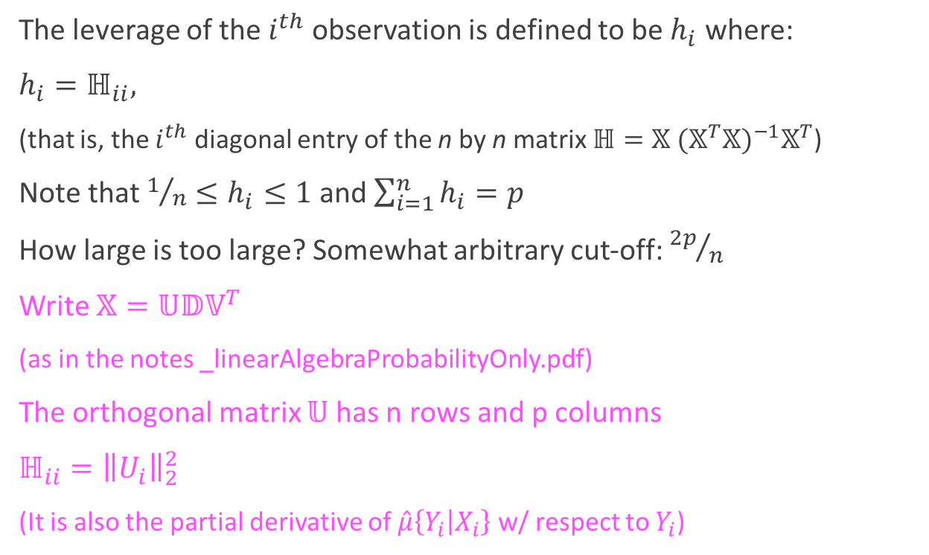
Definition of Leverage for Multiple Linear Regression
The leverage of the $i^{th}$ observation is defined to be $h_{i}$ where:
$h_{i}=ℍ_{ii},$
(that is, the $i^{th}$ diagonal entry of the n by n matrix $ℍ=𝕏 {(𝕏^{T}𝕏)}^{−1}𝕏^{T}$)
Note that $1/n≤h_{i}≤1$ and $\sum_{i=1}^{n}{h_{i}}=p$
How large is too large? Somewhat arbitrary cut-off: ${2p}/n$
Write $𝕏=𝕌𝔻𝕍^{T}$
(as in the notes _linearAlgebraProbabilityOnly.pdf)
The orthogonal matrix $𝕌$ has n rows and p columns
$ℍ_{ii}={\left\|U_{i}\right\|}_{2}^{2}$
(It is also the partial derivative of $\hat{μ}\left\{Y_{i} | X_{i}\right\}$ w/ respect to $Y_{i}$)

Slide 13
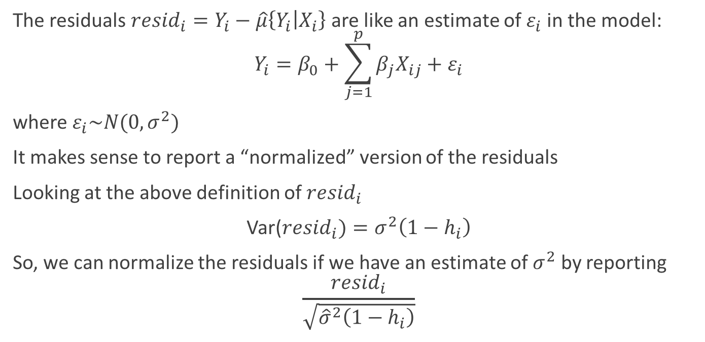
Normalized Residuals
The residuals ${resid}_{i}=Y_{i}−\hat{μ}\left\{Y_{i} | X_{i}\right\}$ are like an estimate of $ε_{i}$ in the model:
$$Y_{i}=β_{0}+\sum_{j=1}^{p}{β_{j}X_{ij}}+ε_{i}$$
where $ε_{i}\sim N(0,σ^{2})$
It makes sense to report a “normalized” version of the residuals
Looking at the above definition of ${resid}_{i}$
Var(${resid}_{i})=σ^{2}\left(1−h_{i}\right)$
So, we can normalize the residuals if we have an estimate of $σ^{2}$ by reporting
$$\frac{{resid}_{i}}{\sqrt{{\hat{σ}}^{2}\left(1−h_{i}\right)}}$$

Slide 14
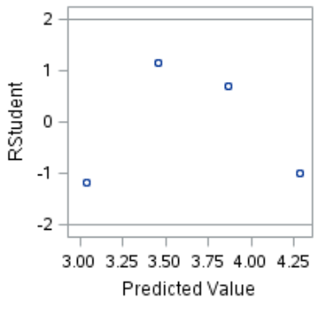
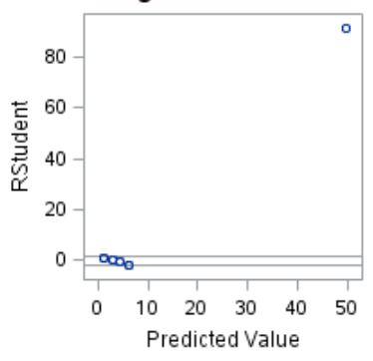

Normalized Residuals
A common convention: use the word “studentized” instead of normalized
This leads to the definition of studentized residual:
$stud{res}_{i}=\frac{{resid}_{i}}{\sqrt{{\hat{σ}}^{2}\left(1−h_{i}\right)}}$
Observation $i$is considered extreme if $\left|stud{res}_{i}\right|>2$
(Important: We would expect 5% of observations to exceed this threshold)

Slide 15
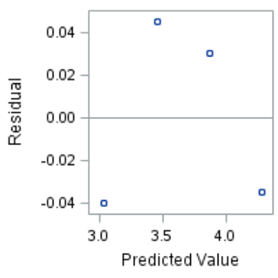
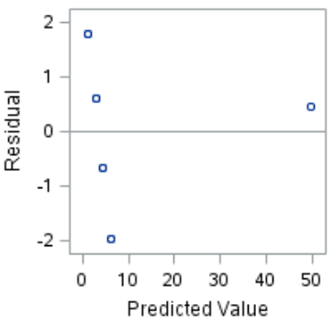
Raw Residuals vs. Studentized Residuals

Slide 16
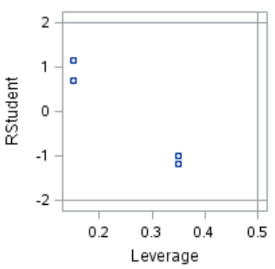
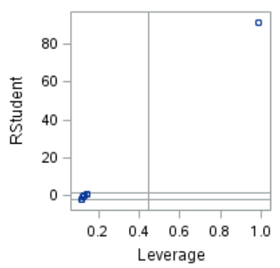
Putting Leverage and Studentized Residuals Together

Slide 17
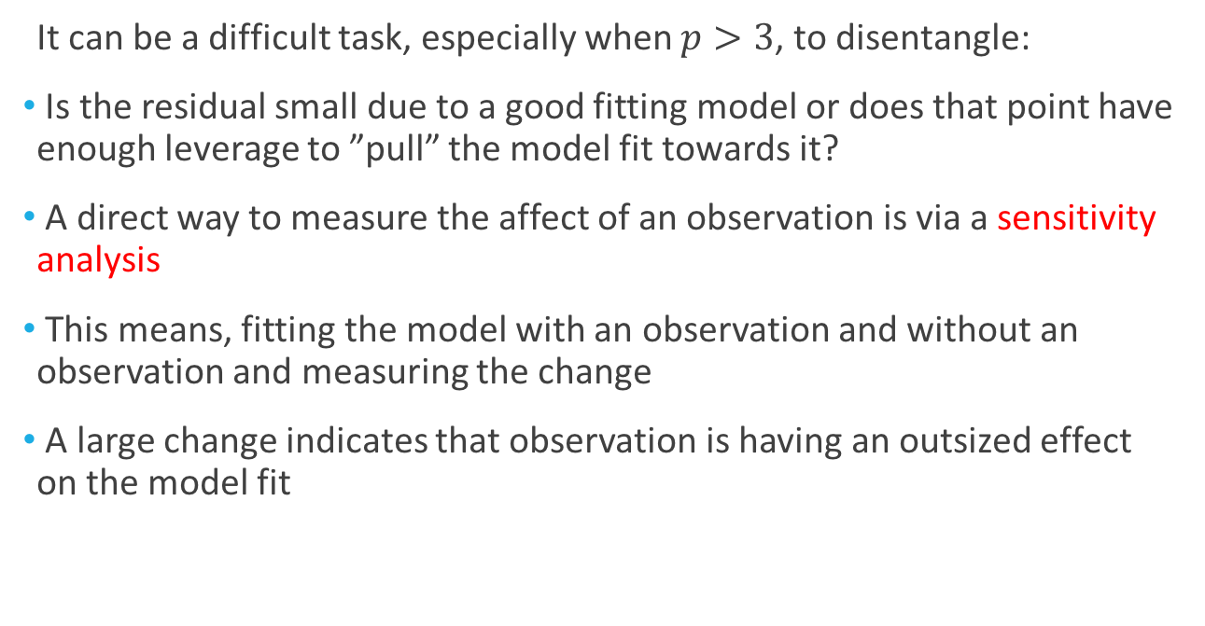
Cook’s D(istance): The Key Idea
It can be a difficult task, especially when $p>3$, to disentangle:
Is the residual small due to a good fitting model or does that point have enough leverage to ”pull” the model fit towards it?
A direct way to measure the affect of an observation is via a sensitivity analysis
This means, fitting the model with an observation and without an observation and measuring the change
A large change indicates that observation is having an outsized effect on the model fit

Slide 18
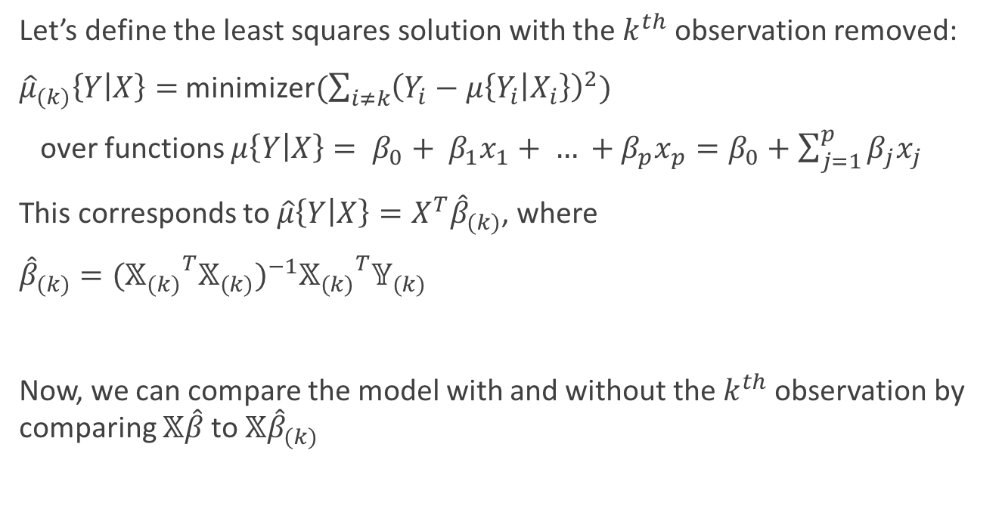
Cook’s D(istance): The Key Idea
Let’s define the least squares solution with the $k^{th}$ observation removed:
${\hat{μ}}_{(k)}\left\{Y | X\right\}=$ minimizer$(\sum_{i≠k}{{\left(Y_{i}−μ\left\{Y_{i} | X_{i}\right\}\right)}^{2}})$
over functions $μ\left\{Y | X\right\}= β_{0}+ β_{1}x_{1}+ … +β_{p}x_{p}=β_{0}+\sum_{j=1}^{p}{β_{j}x_{j}}$
This corresponds to $\hat{μ}\left\{Y | X\right\}=X^{T}{\hat{β}}_{(k)}$, where
${\hat{β}}_{(k)}={({𝕏_{(k)}}^{T}𝕏_{(k)})}^{−1}{𝕏_{(k)}}^{T}𝕐_{(k)}$
Now, we can compare the model with and without the $k^{th}$ observation by comparing $𝕏\hat{β}$ to $𝕏{\hat{β}}_{(k)}$

Slide 19
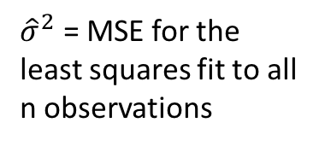

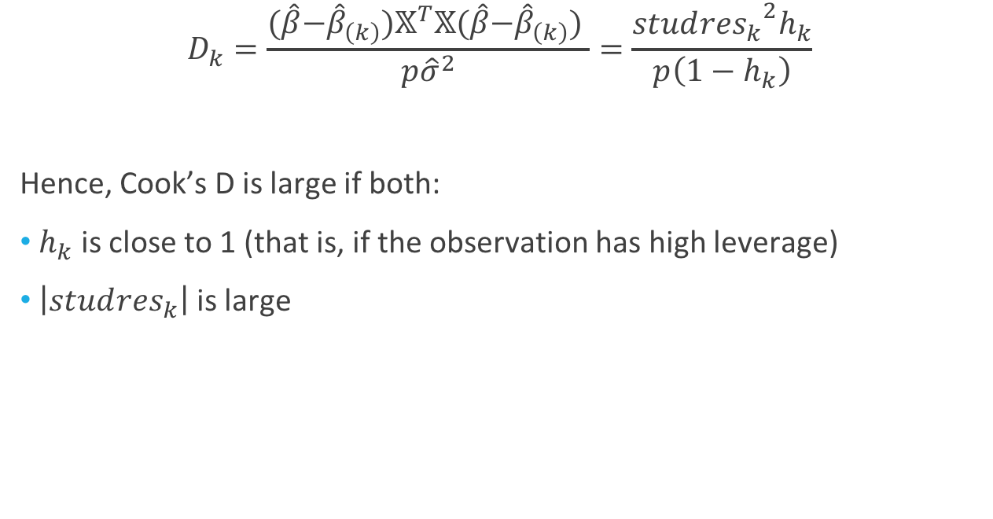
Cook’s D(istance)
${\hat{σ}}^{2}$ = MSE for the least squares fit to all n observations
$$D_{k}=\frac{(\hat{β}\text{−}{\hat{β}}_{\left(k\right)})𝕏^{T}𝕏(\hat{β}\text{−}{\hat{β}}_{\left(k\right)}) }{p{\hat{σ}}^{2}}=\frac{{stud{res}_{k}}^{2}h_{k}}{p\left(1−h_{k}\right)}$$
Hence, Cook’s D is large if both:
$h_{k}$ is close to 1 (that is, if the observation has high leverage)
$\left|stud{res}_{k}\right|$ is large
$$(\hat{β}\text{−}{\hat{β}}_{\left(k\right)})𝕏^{T}𝕏(\hat{β}\text{−}{\hat{β}}_{\left(k\right)})$$
Large leverage

Slide 20
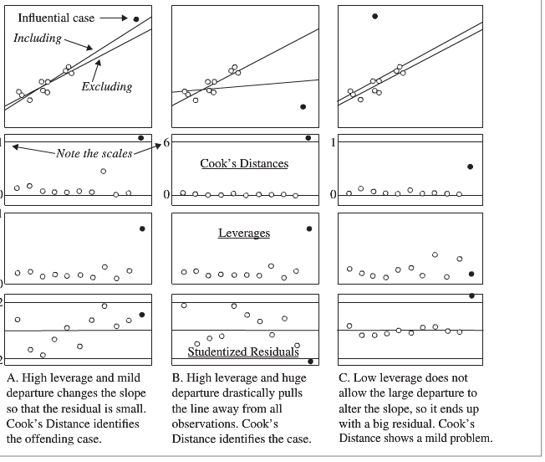

Slide 21
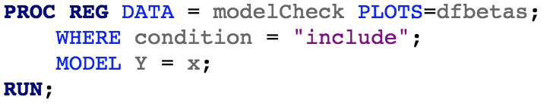
Applying Sensitivity Analysis to the Coefficients
Cook’s D is in terms of the fitted values
We can extend this idea to the coefficients as well
This can be helpful because a high leverage observation might not affect the coefficient estimate of an explanatory variable of interest
We need to use PROC REG to get the necessary output:
See the following website for details on computation:
(https://support.sas.com/documentation/cdl/en/statug/63347/HTML/default/viewer.htm#statug_reg_sect040.htm)

Slide 22
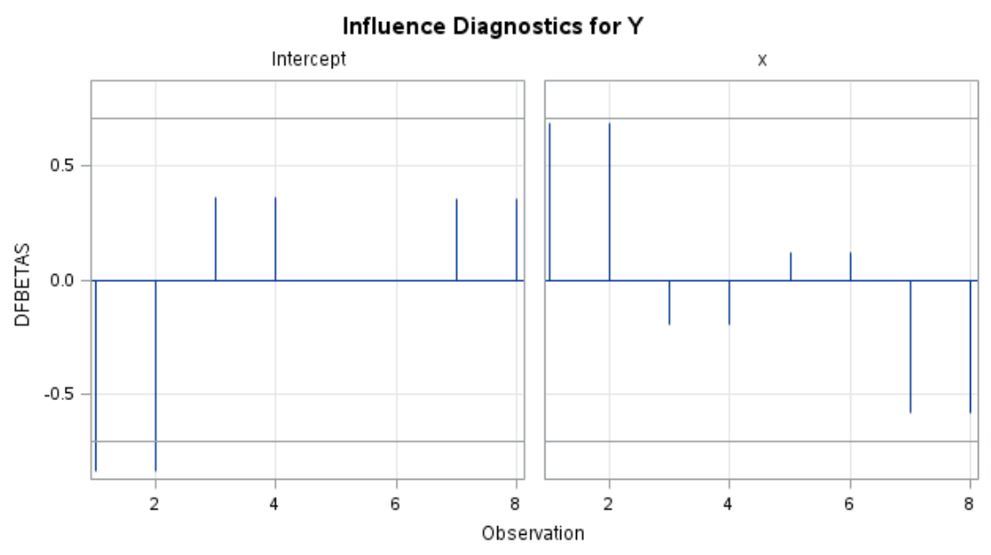
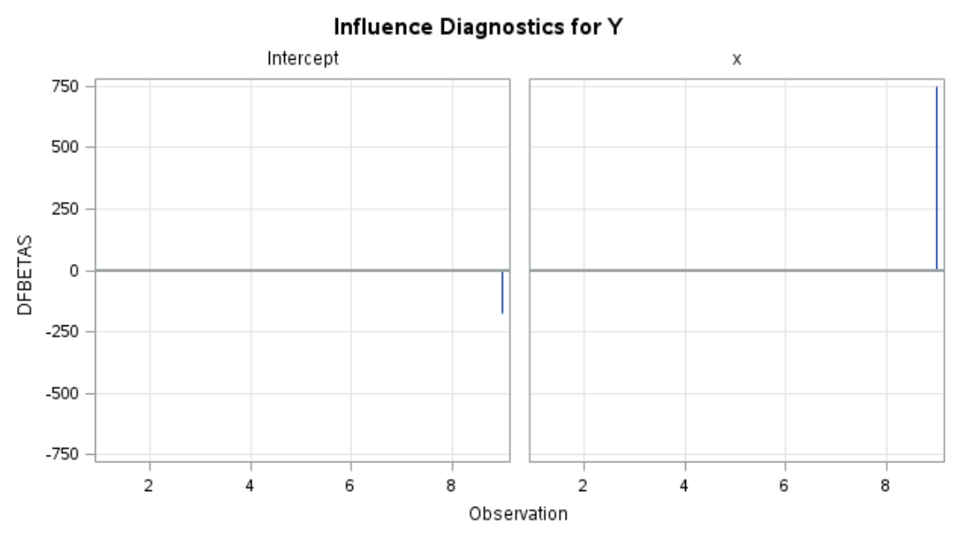

Applying Sensitivity Analysis to the Coefficients: dfbetas
There are $p+1$ explanatory variables, so there will be $p+1$ plots
There are $n$ observations, so there will be $n$ values for each plot
“Exclude”
“Include”

