Slide 1
Multifactor Studies w/o Replication
Variance Estimation
Why would designs have no replication
What hypotheses can still be tested
Random effects

Slide 2
Background

Slide 3
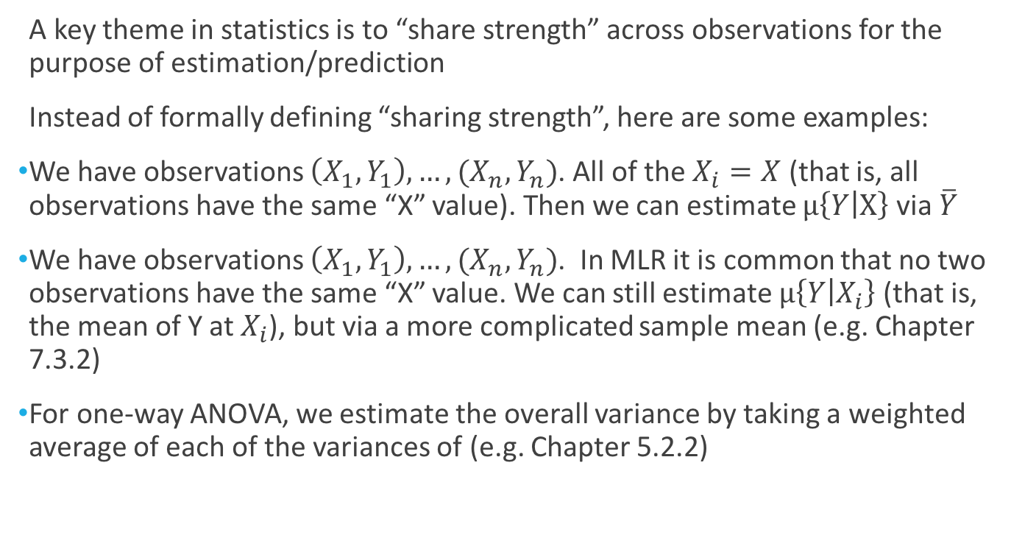
Replication is Key to Statistics: Sharing Strength
A key theme in statistics is to “share strength” across observations for the purpose of estimation/prediction
Instead of formally defining “sharing strength”, here are some examples:
We have observations $\left(X_{1},Y_{1}\right),…,(X_{n},Y_{n})$. All of the $X_{i}=X$ (that is, all observations have the same “X” value). Then we can estimate $μ\left\{Y | X\right\}$ via $\overline{Y}$
We have observations $\left(X_{1},Y_{1}\right),…,(X_{n},Y_{n})$. In MLR it is common that no two observations have the same “X” value. We can still estimate $μ\left\{Y | X_{i}\right\}$ (that is, the mean of Y at $X_{i}$), but via a more complicated sample mean (e.g. Chapter 7.3.2)
For one-way ANOVA, we estimate the overall variance by taking a weighted average of each of the variances of (e.g. Chapter 5.2.2)

Slide 4
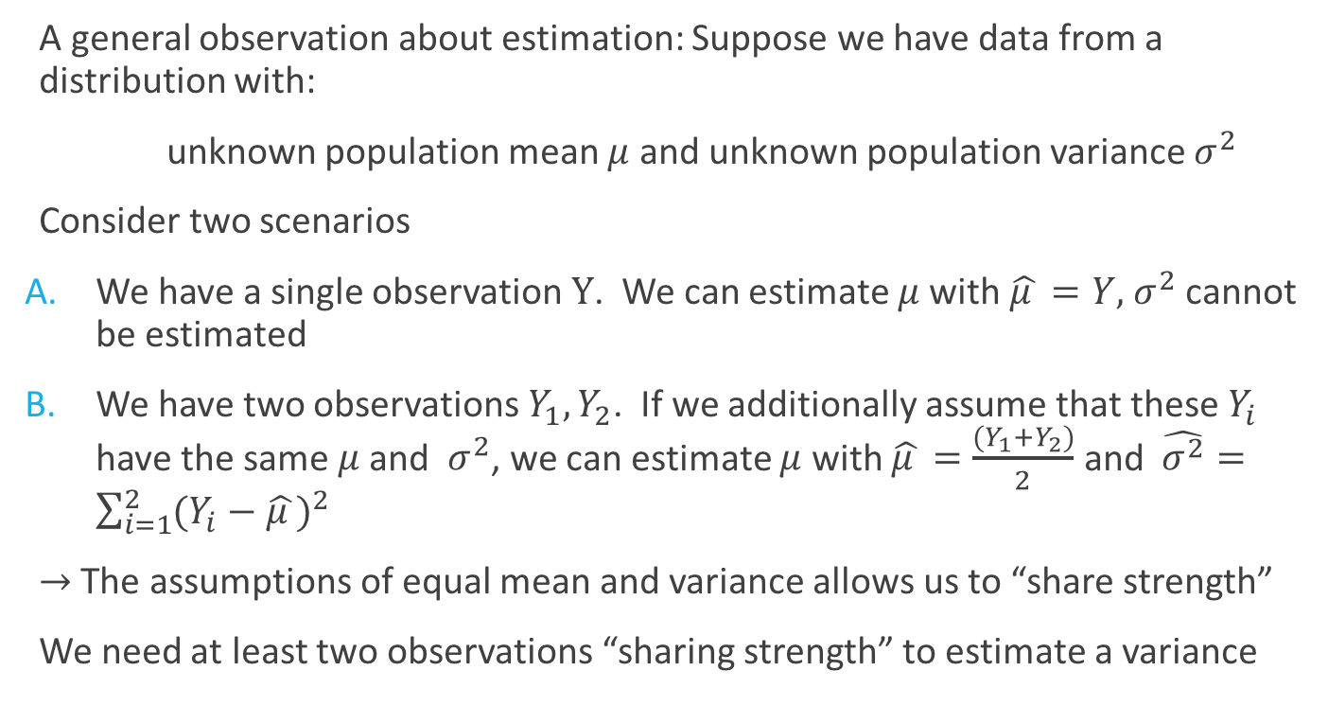
Replication is Key to Statistics: A Basic Example
A general observation about estimation: Suppose we have data from a distribution with:
unknown population mean $μ$ and unknown population variance $σ^{2}$
Consider two scenarios
We have a single observation $Y$. We can estimate $μ$ with $\hat{μ }=Y,{ σ}^{2}$ cannot be estimated
We have two observations $Y_{1},Y_{2}$. If we additionally assume that these $Y_{i}$ have the same $μ$ and $σ^{2}$, we can estimate $μ$ with $\hat{μ }=\frac{(Y_{1}+Y_{2})}{2}$ and $\hat{σ^{2}}=\sum_{i=1}^{2}{{(Y_{i}−\hat{μ })}^{2}}$
$→$ The assumptions of equal mean and variance allows us to “share strength”
We need at least two observations “sharing strength” to estimate a variance

Slide 5
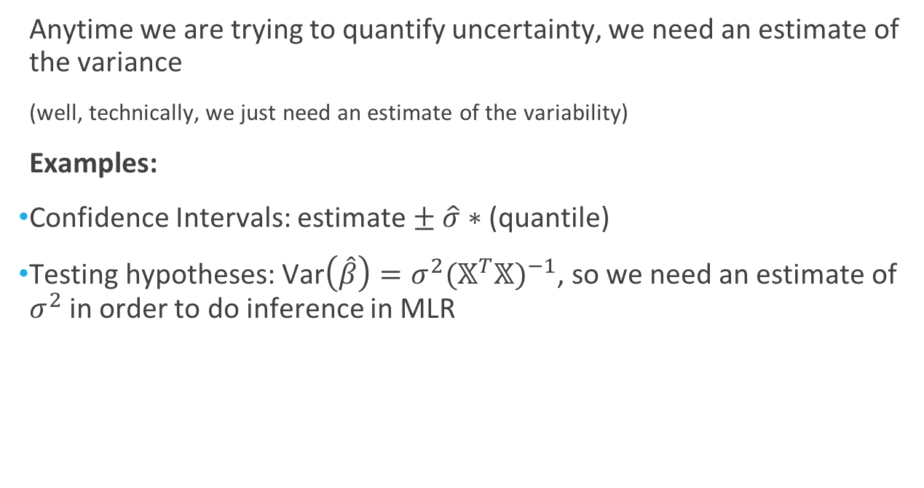
Why Do We Need to Estimate the Variance?
Anytime we are trying to quantify uncertainty, we need an estimate of the variance
(well, technically, we just need an estimate of the variability)
Examples:
Confidence Intervals: estimate $± \hat{σ}∗$ (quantile)
Testing hypotheses: Var$\left(\hat{β}\right)=σ^{2}{(𝕏^{T}𝕏)}^{−1}$, so we need an estimate of $σ^{2}$ in order to do inference in MLR

Slide 6
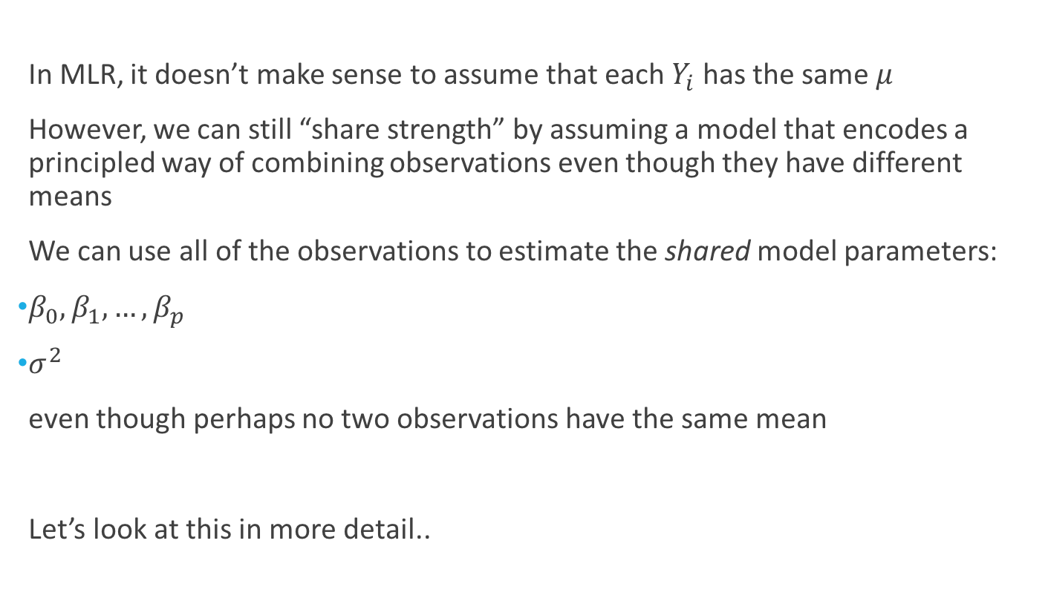
Estimating the Variance in MLR w/o Replication
In MLR, it doesn’t make sense to assume that each $Y_{i}$ has the same $μ$
However, we can still “share strength” by assuming a model that encodes a principled way of combining observations even though they have different means
We can use all of the observations to estimate the shared model parameters:
$β_{0},β_{1}, …,β_{p}$
$σ^{2}$
even though perhaps no two observations have the same mean
Let’s look at this in more detail..

Slide 7
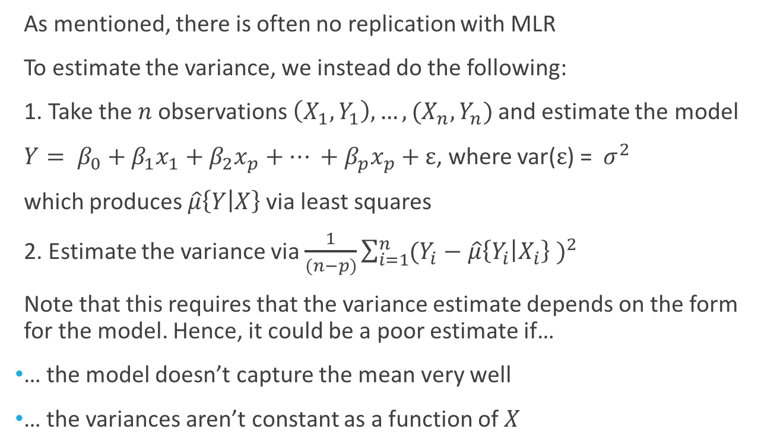
Estimating the Variance in MLR w/o Replication
As mentioned, there is often no replication with MLR
To estimate the variance, we instead do the following:
1. Take the $n$observations$\left(X_{1},Y_{1}\right),…,(X_{n},Y_{n})$ and estimate the model
$Y= β_{0}+β_{1}x_{1}+β_{2}x_{p}+… +β_{p}x_{p}+ε$, where var($ε$) = ${ σ}^{2}$
which produces $\hat{μ}\left\{Y | X\right\}$ via least squares
2. Estimate the variance via $\frac{1}{(n−p)}\sum_{i=1}^{n}{{(Y_{i}−\hat{μ}\left\{Y_{i} | X_{i}\right\} )}^{2}}$
Note that this requires that the variance estimate depends on the form for the model. Hence, it could be a poor estimate if…
… the model doesn’t capture the mean very well
… the variances aren’t constant as a function of $X$

Slide 8
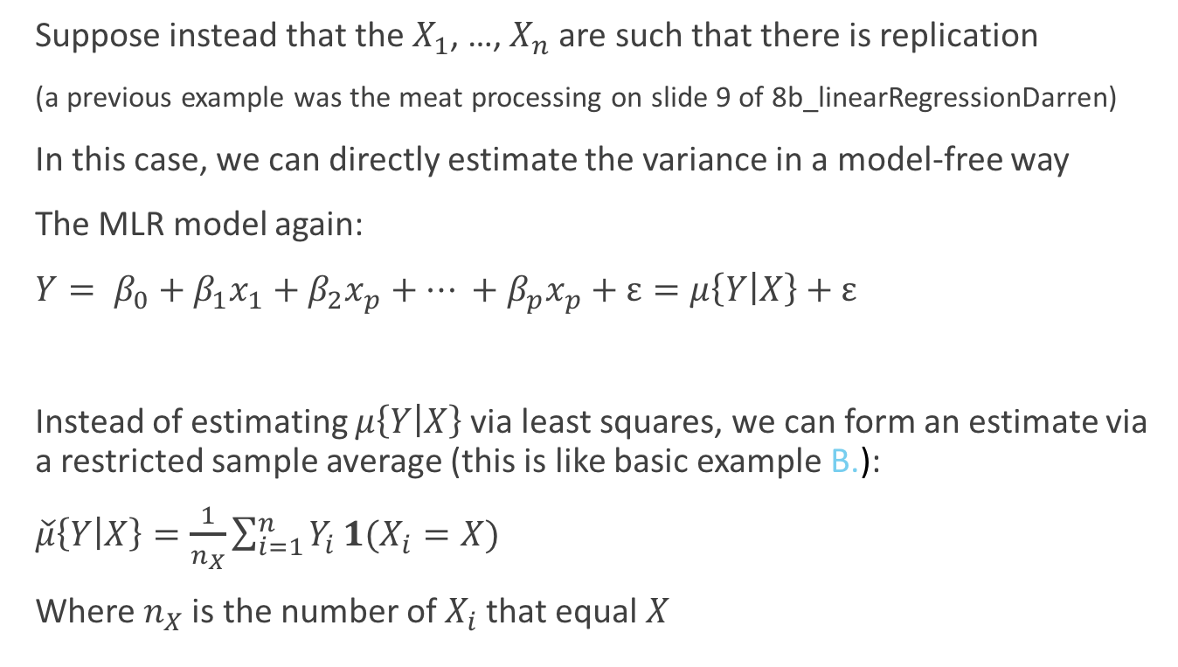
Estimating the Variance in MLR w/ Replication
Suppose instead that the $X_{1}$, …, $X_{n}$ are such that there is replication
(a previous example was the meat processing on slide 9 of 8b_linearRegressionDarren)
In this case, we can directly estimate the variance in a model-free way
The MLR model again:
$Y= β_{0}+β_{1}x_{1}+β_{2}x_{p}+… +β_{p}x_{p}+ε=μ\left\{Y | X\right\}+ε$
Instead of estimating $μ\left\{Y | X\right\}$ via least squares, we can form an estimate via a restricted sample average (this is like basic example B.):
$\check{μ}\left\{Y | X\right\}=\frac{1}{n_{X}}\sum_{i=1}^{n}{Y_{i}}1(X_{i}=X)$
Where $n_{X}$ is the number of $X_{i}$ that equal $X$

Slide 9
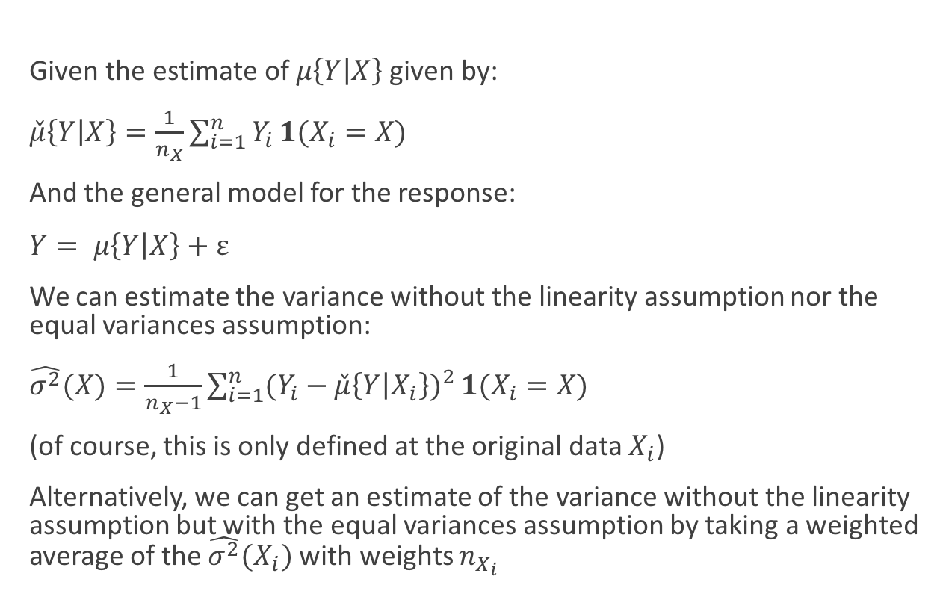
Estimating the Variance in MLR w/ Replication
$\text{Given} \text{the} \text{estimate} \text{of} μ\left\{Y | X\right\} \text{given} \text{by}\text{:}$
$\check{μ}\left\{Y | X\right\}=\frac{1}{n_{X}}\sum_{i=1}^{n}{Y_{i}}1(X_{i}=X)$
And the general model for the response:
$Y= μ\left\{Y | X\right\}+ε$
We can estimate the variance without the linearity assumption nor the equal variances assumption:
$\hat{σ^{2}}(X)=\frac{1}{n_{X}−1}\sum_{i=1}^{n}{{(Y_{i}−\check{μ}\left\{Y | X_{i}\right\})}^{2}}1(X_{i}=X)$
(of course, this is only defined at the original data $X_{i}$)
Alternatively, we can get an estimate of the variance without the linearity assumption but with the equal variances assumption by taking a weighted average of the $\hat{σ^{2}}(X_{i})$ with weights $n_{X_{i}}$

Slide 10
Multifactor Studies w/o Replication

Slide 11
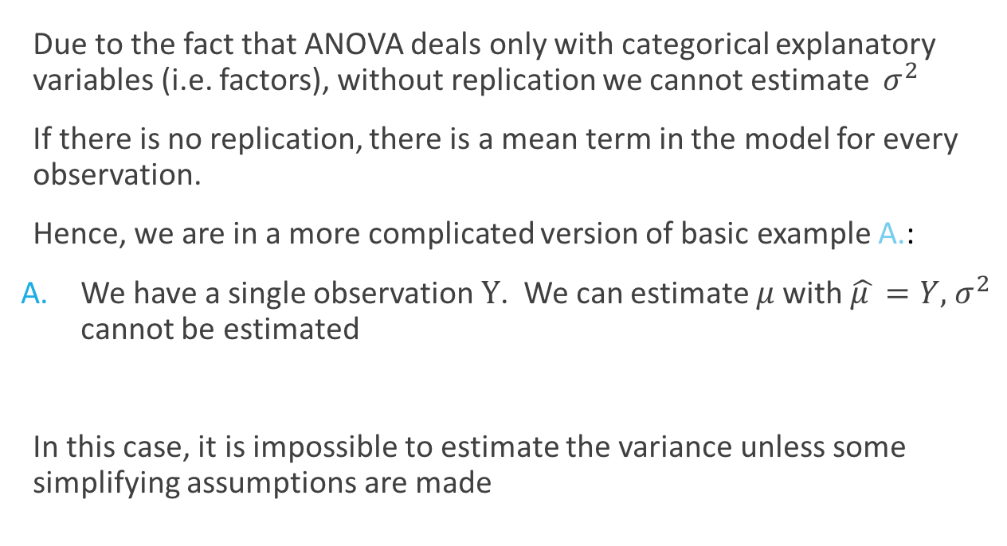
Estimating the Variance in ANOVA w/o Replication
Due to the fact that ANOVA deals only with categorical explanatory variables (i.e. factors), without replication we cannot estimate ${ σ}^{2}$
If there is no replication, there is a mean term in the model for every observation.
Hence, we are in a more complicated version of basic example A.:
We have a single observation $Y$. We can estimate $μ$ with $\hat{μ }=Y,{ σ}^{2}$ cannot be estimated
In this case, it is impossible to estimate the variance unless some simplifying assumptions are made

Slide 12
Why Would a Design Lack Replication?
Suppose we want to develop a new rocket engine for space craft
We want an engine that, for a fixed weight of fuel or metals, can fly the highest
We have narrowed down the options to
Using one of two types of rocket fuels (F1,F2)
Using one of two types of metal alloys for the shielding (A1, A2)
Our engineers cannot agree which of these factor levels will be best nor even if there might be an interaction between these factors
The only way to decide will be to make production-scale tests
However, production-scale tests for rockets are incredibly expensive

Slide 13
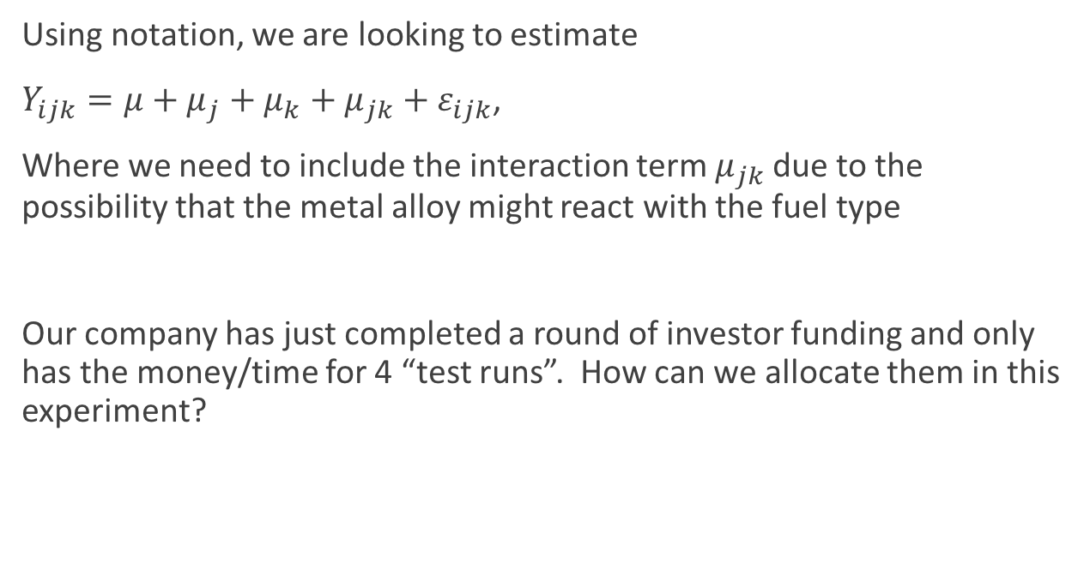
Why Would a Design Lack Replication?
Using notation, we are looking to estimate
$Y_{ijk}=μ+μ_{j}+μ_{k}+μ_{jk}+ε_{ijk}$,
Where we need to include the interaction term $μ_{jk}$ due to the possibility that the metal alloy might react with the fuel type
Our company has just completed a round of investor funding and only has the money/time for 4 “test runs”. How can we allocate them in this experiment?

Slide 14
Why Would a Design Lack Replication?
The four test runs could be allocated as:
1. Measure A1,F1 four times.
This would put us in the “one-sample” case from last semester. We could get a variance estimate, but we have no information about:
A2
nor F2
nor the interaction between alloy and fuel
2. We could allocate 2 runs to A1,F1, and 2 runs to A2,F2
This would put us in the “two-sample” case from last semester.
We can test for differences between these two configurations, but have no information about A1,F2 nor A2,F1

Slide 15
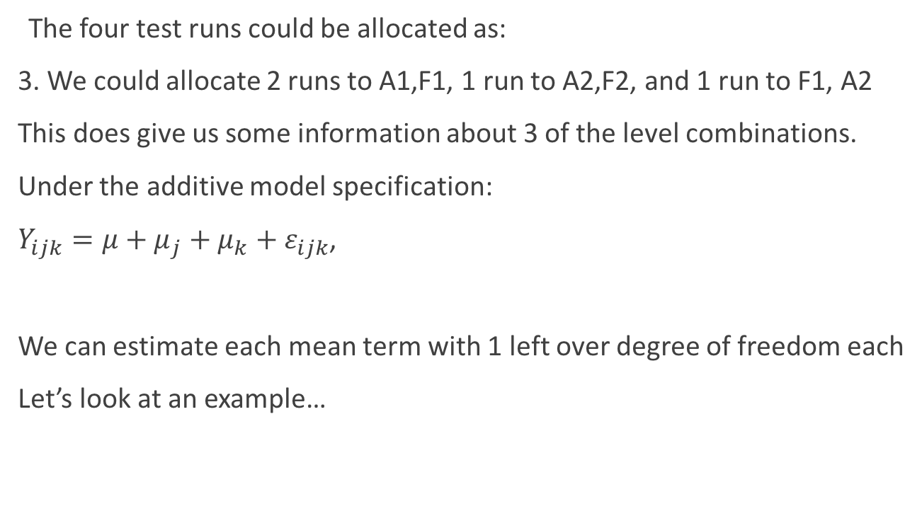
Why Would a Design Lack Replication?
The four test runs could be allocated as:
3. We could allocate 2 runs to A1,F1, 1 run to A2,F2, and 1 run to F1, A2
This does give us some information about 3 of the level combinations.
Under the additive model specification:
$Y_{ijk}=μ+μ_{j}+μ_{k}+ε_{ijk}$,
We can estimate each mean term with 1 left over degree of freedom each
Let’s look at an example…

Slide 16
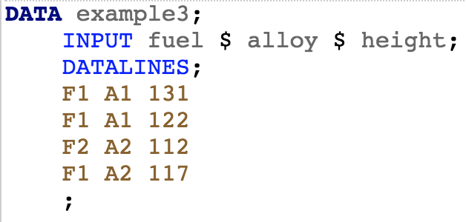
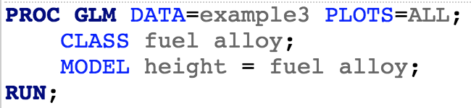
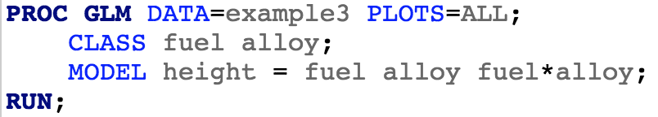
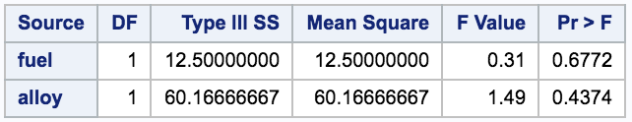
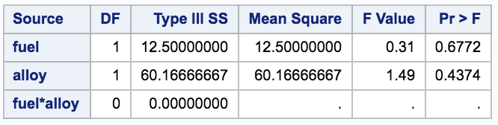


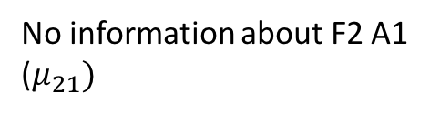
Example
No information about F2 A1
($μ_{21})$
$Y_{ijk}=μ+μ_{j}+μ_{k}+ε_{ijk}$,
$Y_{ijk}=μ+μ_{j}+μ_{k}+μ_{jk}+ε_{ijk}$,

Slide 17
Why Would a Design Lack Replication?
The four test runs could be allocated as:
4. We could allocate 1 run to each combination
This does give us some information about all 4 of the level combinations.
Let’s look at an example…

Slide 18
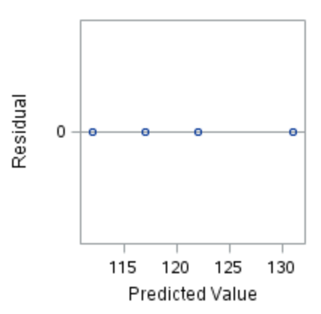
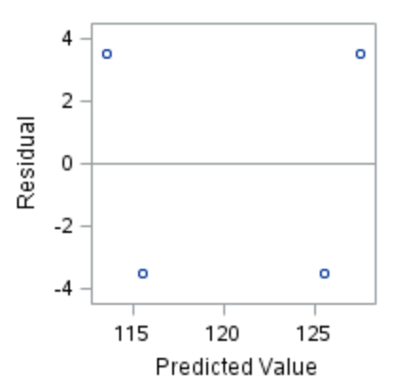
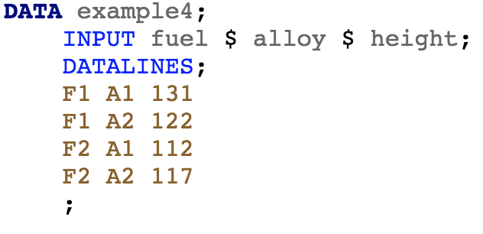
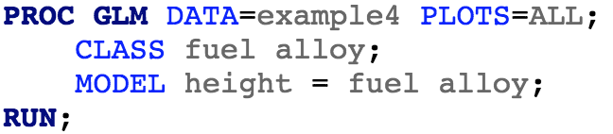
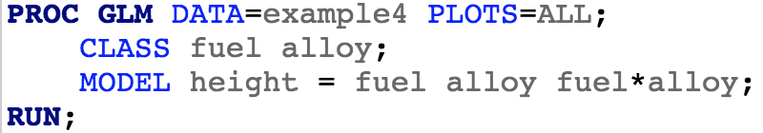
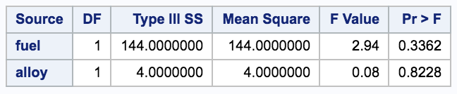
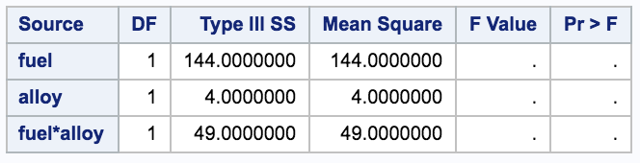
Example
Information about all model parameters, but no variance estimate
$Y_{ijk}=μ+μ_{j}+μ_{k}+ε_{ijk}$,
$Y_{ijk}=μ+μ_{j}+μ_{k}+μ_{jk}+ε_{ijk}$,

Slide 19
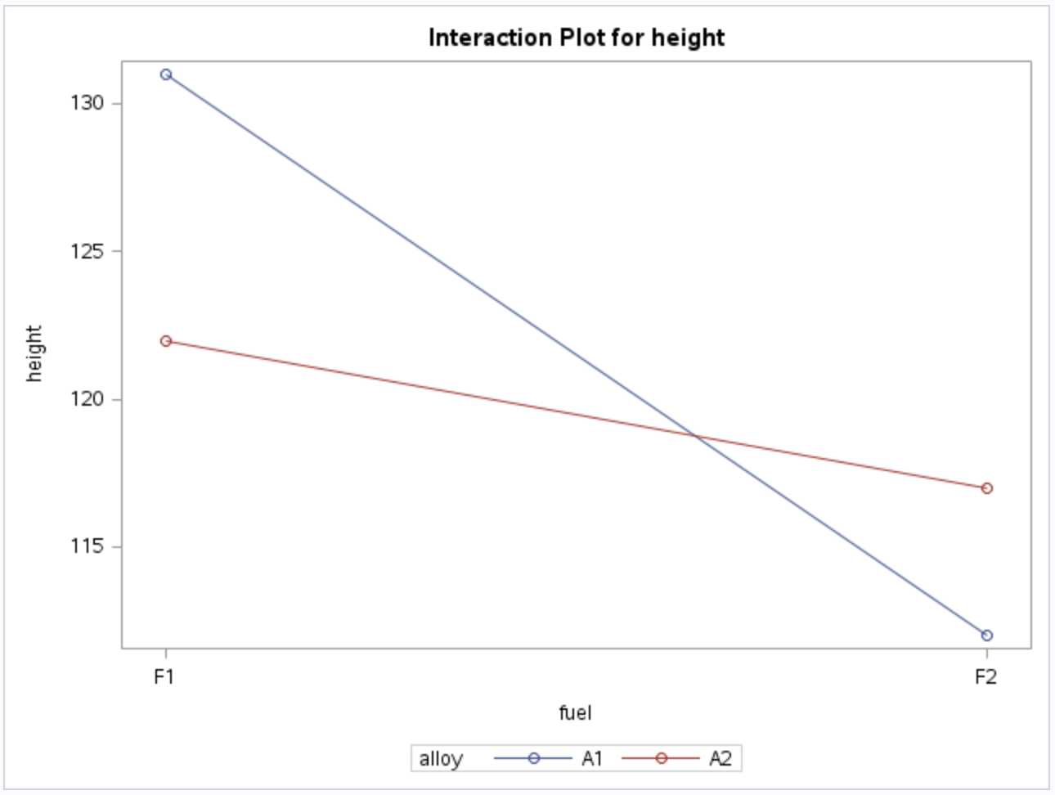
Example (Continued)
We can still estimate the means, it is just with the observations themselves
Testing is impossible w/o variance estimate
(as in basic example A.)

Slide 20
Summary
In this example, cost/time considerations demand that we can only have 4 test runs
The most informative configuration would be 1 test run at each factor level combination
If we cannot rule out the interaction before running the analysis, then the best we can do is estimate each mean
If we have reason to believe that the additive model is sufficient, then the analysis can proceed as an additive/crossed analysis as before
(Note that we can actually still do testing in the interaction model if we have an auxiliary variance estimate)

Slide 21
Random Effects

Slide 22
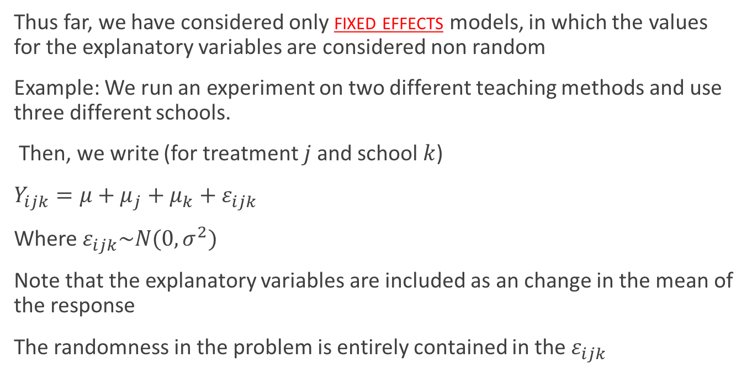
Fixed Effects
Thus far, we have considered only fixed effects models, in which the values for the explanatory variables are considered non random
Example: We run an experiment on two different teaching methods and use three different schools.
Then, we write (for treatment $j$ and school $k$)
$Y_{ijk}=μ+μ_{j}+μ_{k}+ε_{ijk}$
Where $ε_{ijk}\sim N(0,σ^{2})$
Note that the explanatory variables are included as an change in the mean of the response
The randomness in the problem is entirely contained in the $ε_{ijk}$

Slide 23
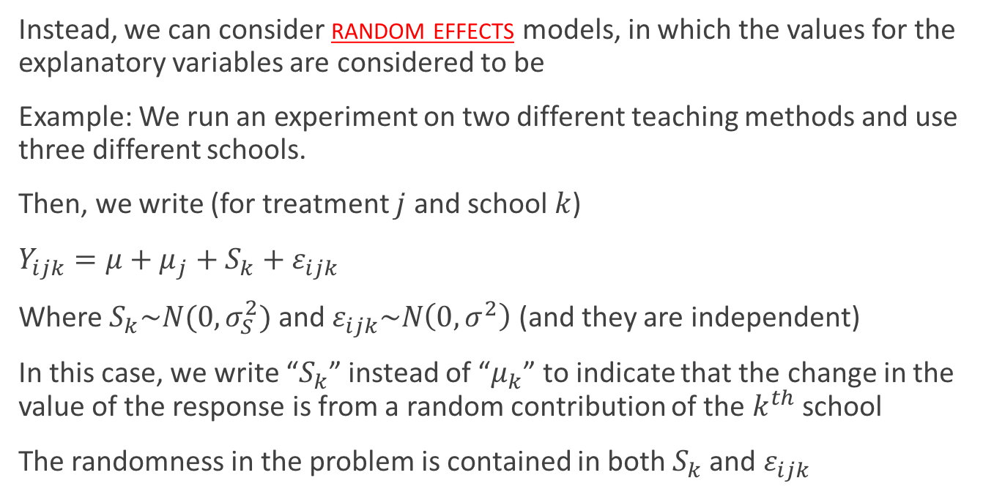
Random Effects
Instead, we can consider random effects models, in which the values for the explanatory variables are considered to be
Example: We run an experiment on two different teaching methods and use three different schools.
Then, we write (for treatment $j$ and school $k$)
$Y_{ijk}=μ+μ_{j}+S_{k}+ε_{ijk}$
Where $S_{k}\sim N(0,σ_{S}^{2})$ and $ε_{ijk}\sim N\left(0,σ^{2}\right)$ (and they are independent)
In this case, we write “$S_{k}$” instead of “$μ_{k}$” to indicate that the change in the value of the response is from a random contribution of the $k^{th}$ school
The randomness in the problem is contained in both $S_{k}$ and $ε_{ijk}$

Slide 24
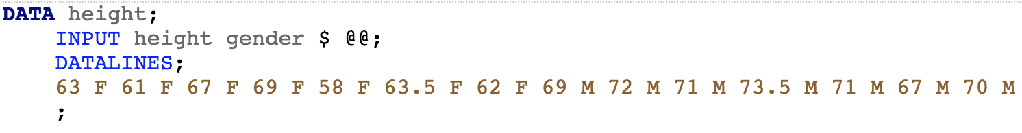
Equivalence Law of Statistics
(don’t go looking for this law, I made the name up. In fact, it is a very underappreciated but, in my opinion, incredibly important idea)
A general statement of this “law” is that there is an equivalence between mean, variance, and covariance
Instead of giving a formal proof (which is possible), I’ll give you a simple example
Example: Suppose we make observations about people’s heights:

Slide 25
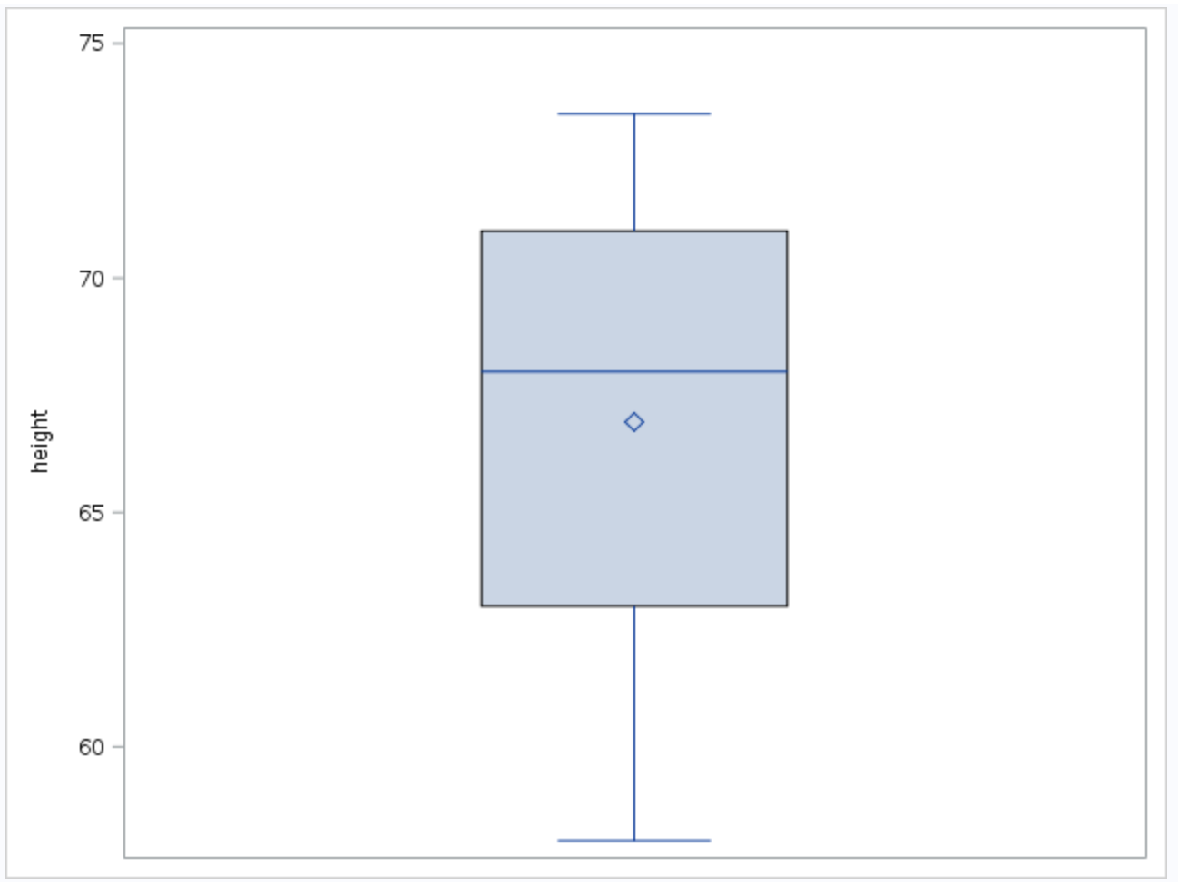
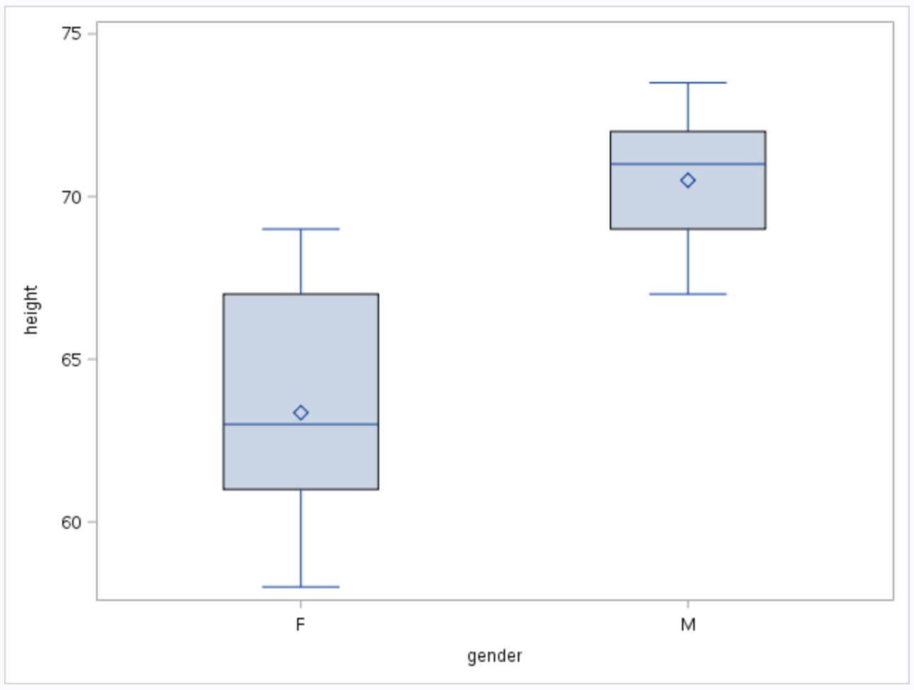
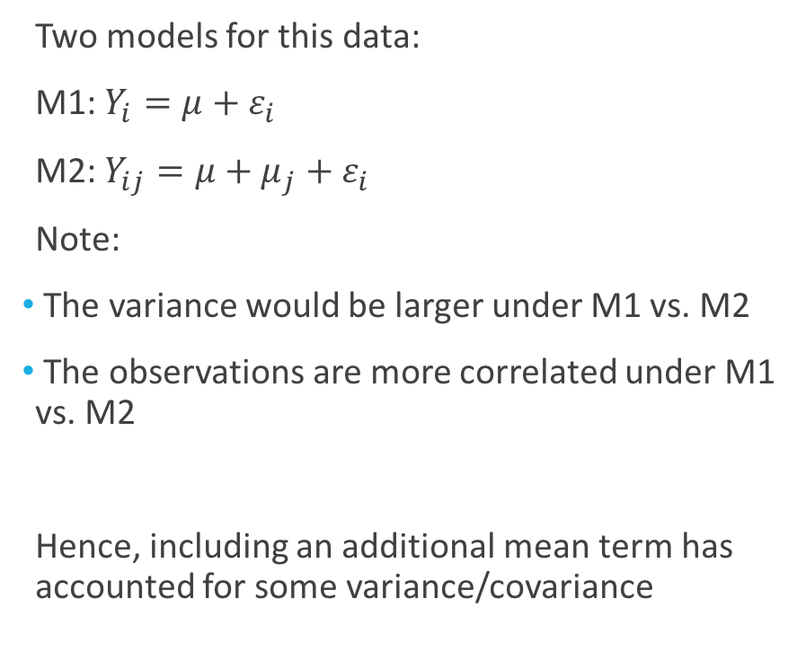
Equivalence Law of Statistics
Two models for this data:
M1: $Y_{i}=μ+ε_{i}$
M2: $Y_{ij}=μ+μ_{j}+ε_{i}$
Note:
The variance would be larger under M1 vs. M2
The observations are more correlated under M1 vs. M2
Hence, including an additional mean term has accounted for some variance/covariance

Slide 26
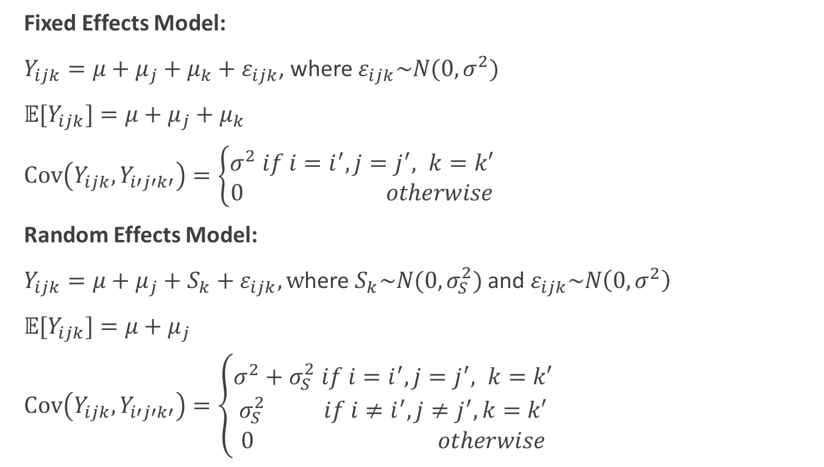
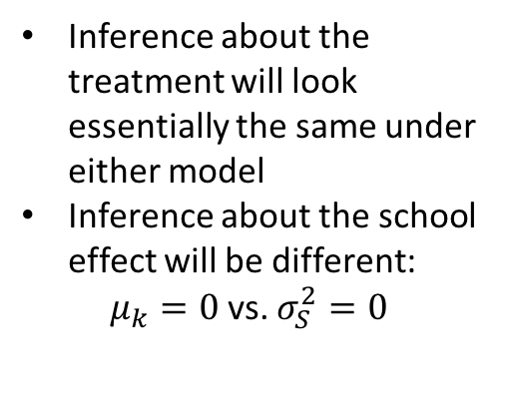
Equivalence Law of Statistics: Random Effects
Fixed Effects Model:
$Y_{ijk}=μ+μ_{j}+μ_{k}+ε_{ijk}$, where $ε_{ijk}\sim N(0,σ^{2})$
$𝔼{[Y}_{ijk}]=μ+μ_{j}+μ_{k}$
$Cov\left(Y_{ijk},Y_{i′j′k′}\right)=\left\{\begin{aligned}σ^{2} if i=i^{′},j=j^{′}, k=k′ \\ 0 otherwise\end{aligned}\right.$
Random Effects Model:
$Y_{ijk}=μ+μ_{j}+S_{k}+ε_{ijk}, w$here $S_{k}\sim N(0,σ_{S}^{2})$ and $ε_{ijk}\sim N\left(0,σ^{2}\right)$
$𝔼{[Y}_{ijk}]=μ+μ_{j}$
$Cov\left(Y_{ijk},Y_{i′j′k′}\right)=\left\{\begin{aligned}σ^{2}+σ_{S}^{2} if i=i^{′},j=j^{′}, k=k′ \\ σ_{S}^{2} if i≠i^{′},j≠j^{′}, k=k′ \\ 0 otherwise\end{aligned}\right.$
Inference about the treatment will look essentially the same under either model
Inference about the school effect will be different:
$μ_{k}=0$vs. $σ_{S}^{2}=0$

