Slide 1
Multi-way ANOVA
Concepts from Experimental design
Notation for Two-way Anova
Profile Plots

Slide 2
Motivation
Most statistical methods can be viewed as special cases of more general methods
Multi-way ANOVA is a prime example, where it can be phrased as a multiple regression with categorical explanatory variables
(a categorical explanatory variable is sometimes called a factor )
(Can you think of any other examples of special cases of more general methods?)
Reasons for considering the special case:
Assumptions are easier to check/more relevant
Relationship from science to statistics is easier to see/explain
Usually more straightforward to get more nuanced information
(In particular: decomposition into different sums of squares)

Slide 3
Some Important Ideas
Know what the “experimental design” is (or isn’t)
(here, I’m writing “experimental design” to indicate that it isn’t necessarily an experiment nor designed e.g. observational study)
The experimental design drives the analysis (e.g. what kind of model to use)
(Not the other way around…)
Think about the nature of the experiment and what is truly of interest
(why are you looking at the data at all?)
How was the data generated?

Slide 4
Some Concepts from Experimental Design

Slide 5
A Necessary Discussion
Some experimental design concepts are crucial for understanding multi-way ANOVA
Some important concepts along with heuristic definitions
Let’s define and discuss these..
(The agricultural/experiment history of statistics has influenced the terminology)
Term | Heuristic Definition
Experimental Unit | “Object that gets assigned the treatment”
Replication | “Repeating the treatment”
Block | “Remove sources of variation or confounding”
Split-plot | “Due to practical constraints, different factors can have different experimental units”
Crossed vs. Nested design | “Crossed is all combinations, nested is more limited”

Slide 6
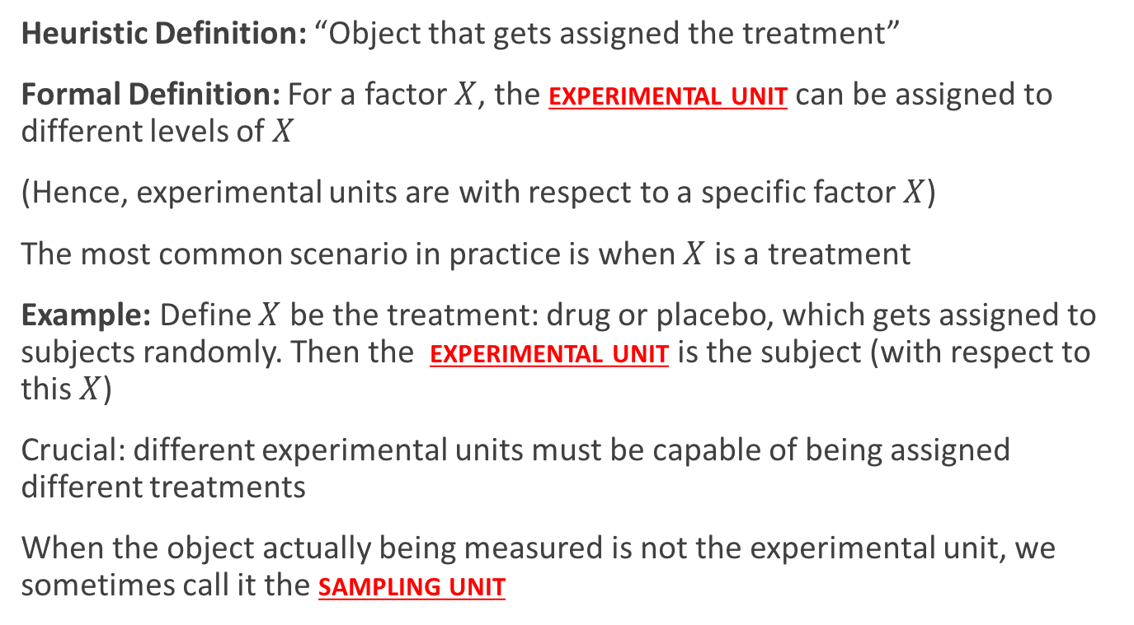
Experimental Unit
Heuristic Definition: “Object that gets assigned the treatment”
Formal Definition: For a factor $X$, the experimental unit can be assigned to different levels of $X$
(Hence, experimental units are with respect to a specific factor $X$)
The most common scenario in practice is when $X$ is a treatment
Example: Define $X$ be the treatment: drug or placebo, which gets assigned to subjects randomly. Then the experimental unit is the subject (with respect to this $X$)
Crucial: different experimental units must be capable of being assigned different treatments
When the object actually being measured is not the experimental unit, we sometimes call it the sampling unit

Slide 7
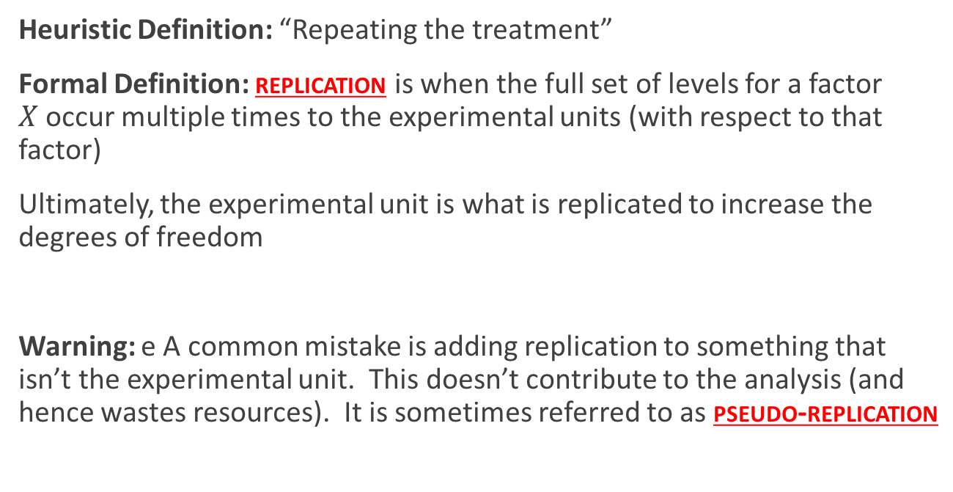
Replication
Heuristic Definition: “Repeating the treatment”
Formal Definition: replication is when the full set of levels for a factor $X$occur multiple times to the experimental units (with respect to that factor)
Ultimately, the experimental unit is what is replicated to increase the degrees of freedom
Warning: e A common mistake is adding replication to something that isn’t the experimental unit. This doesn’t contribute to the analysis (and hence wastes resources). It is sometimes referred to as pseudo-replication

Slide 8
Experimental Unit: Example
Example: Examine the relationship between pollution and fish lesions
Set up 2 aquariums, each with 10 fish
Randomly assign a water treatment (polluted vs. control) to the aquariums
Wait 30 days. Catch 5 fish from each aquarium and count the number of lesions
What is the experimental unit?
Is there replication?
(Important: increasing the number of fish is not increasing replication! We will see that more fish really has no effect)

Slide 9
Experimental Unit: Example
Example: Examine the relationship between pollution and fish lesions
Set up 10 aquariums, each with 1 fish
Randomly assign a water treatment (polluted vs. control) to the aquariums
Wait 30 days. Catch the fish from each aquarium and count the number of lesions
What is the experimental unit (with respect to the treatment)?
Is there replication?

Slide 10
Experimental Unit: Example
Example: Examine the relationship between pollution and fish lesions
Set up 10 aquariums, each with 10 fish
Randomly assign a water treatment (polluted vs. control) to the aquariums
Wait 30 days. Catch 2 fish from each aquarium and count the number of lesions
What is the experimental unit?
Is there replication?
(A two-factor design (aquarium and treatment), we will call it a 2-way ANOVA)

Slide 11
Block
Heuristic Definition: “Remove sources of variation or confounding”
Sometimes experimental units come in “groups” that are similar, but this grouping structure isn’t of direct interest.
Formal Definition: The inclusion of this “group” structure via an explanatory variable is referred to as a block
Example: We have a field of plots for experimenting between two species of corn. The field is broken up into 8 plots, but due to a slight slope in the field, 4 of the plots are “up slope” and 4 of the plots are “down slope”. This up vs. down slope factor would be a blocking explanatory variable
Example: We are testing for two ads on a website. Sometimes people view the website with Chrome, Safari, Firefox, Internet Explorer, or other. This browser variable would be a blocking explanatory variable

Slide 12
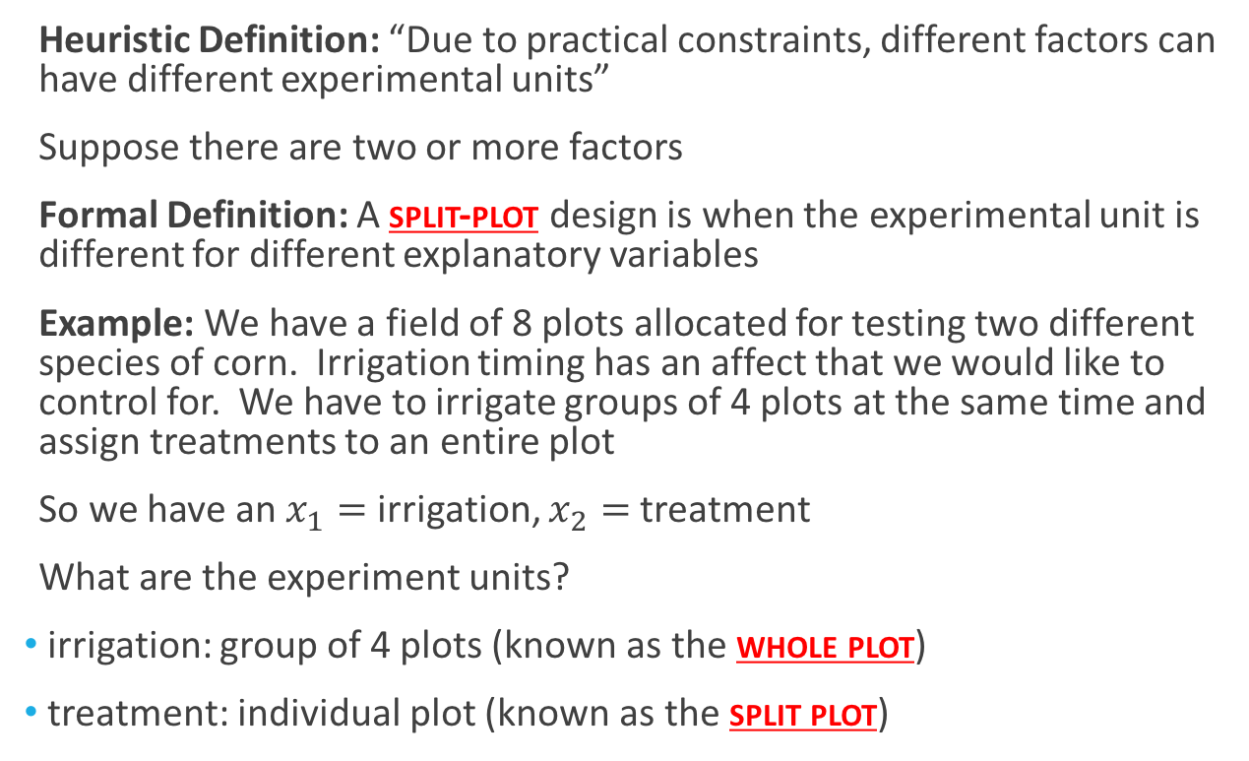
Split-plot
Heuristic Definition: “Due to practical constraints, different factors can have different experimental units”
Suppose there are two or more factors
Formal Definition: A split-plot design is when the experimental unit is different for different explanatory variables
Example: We have a field of 8 plots allocated for testing two different species of corn. Irrigation timing has an affect that we would like to control for. We have to irrigate groups of 4 plots at the same time and assign treatments to an entire plot
So we have an $x_{1}=$ irrigation, $x_{2}=$ treatment
What are the experiment units?
irrigation: group of 4 plots (known as the whole plot)
treatment: individual plot (known as the split plot)

Slide 13
Back to Fish Example
Example: Examine the relationship between polluted and fish lesions
Set up 10 aquariums, each with 5 fish
Wait 30 days and count the number of lesions per fish
Set up an experimental design given there is a single heater on one side of the room and answer:
What are the explanatory variables?
What are the experimental units?
What are the blocking variables?
Is this a split-plot design? If so, what is the whole plot and split plot?

Slide 14
Crossed vs. Nested Design
Heuristic Definition: “Crossed is all combinations, nested is more limited”
Are explanatory variables crossed or nested?
Formal Definition: If the levels of one of the factors occur at all of the levels of the other factors, then they are crossed (sometimes referred to as factorial design).
A factor B is nested in a factor A if each level of B occurs in only one level of A

Slide 15
Crossed vs. Nested Design
“A factor B is nested in a factor A if each level of B occurs in only one level of A”
Example: Two levels of a treatment correspond to a hormone therapy involving estrogen.
Due to differences in genders, standards of care demand different amounts of estrogen are administered to females than males.
In this case the treatment is nested in gender (in this case, gender is also nested in treatment, though it is more sensible the other way)
Example: I have 4 fertilizers and 2 plant species. I apply all 4 fertilizers to both plant species
In this case the these factors are crossed.
Example: I have 4 fertilizers and 2 plant species. I apply 2 fertilizers to one species and I apply the other 2 fertilizers to the other species
In this case the fertilizer is nested in species

Slide 16
Back to ANOVA

Slide 17
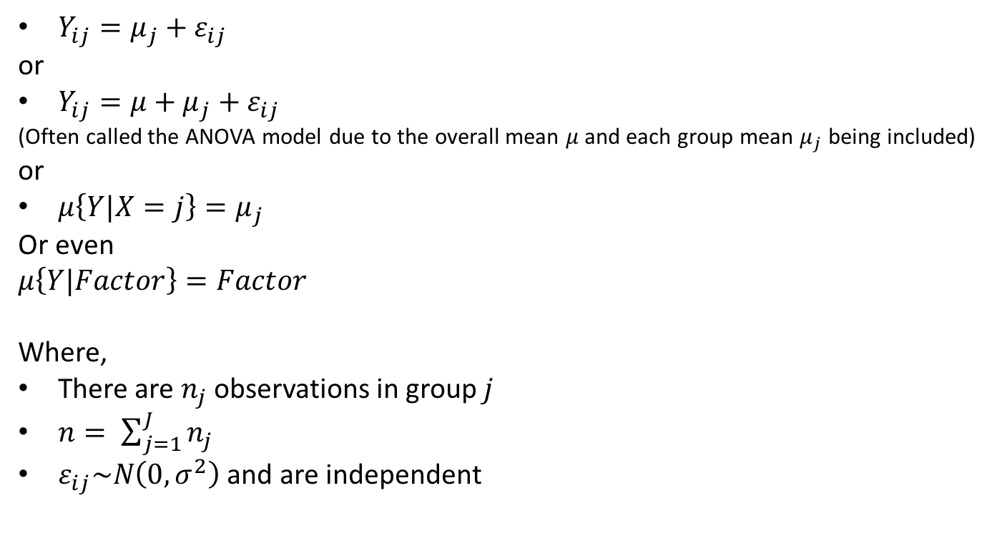
One-way ANOVA notation
$Y_{ij}=μ_{j}+ε_{ij}$
or
$Y_{ij}=μ+μ_{j}+ε_{ij}$
(Often called the ANOVA model due to the overall mean $μ$ and each group mean $μ_{j}$ being included)
or
$μ\left\{Y|X=j\right\}=μ_{j}$
Or even
$$μ\left\{Y|Factor\right\}=Factor$$
Where,
There are $n_{j}$ observations in group $j$
$n= \sum_{j=1}^{J}{n_{j}}$
$ε_{ij}\sim N\left(0,σ^{2}\right)$ and are independent

Slide 18
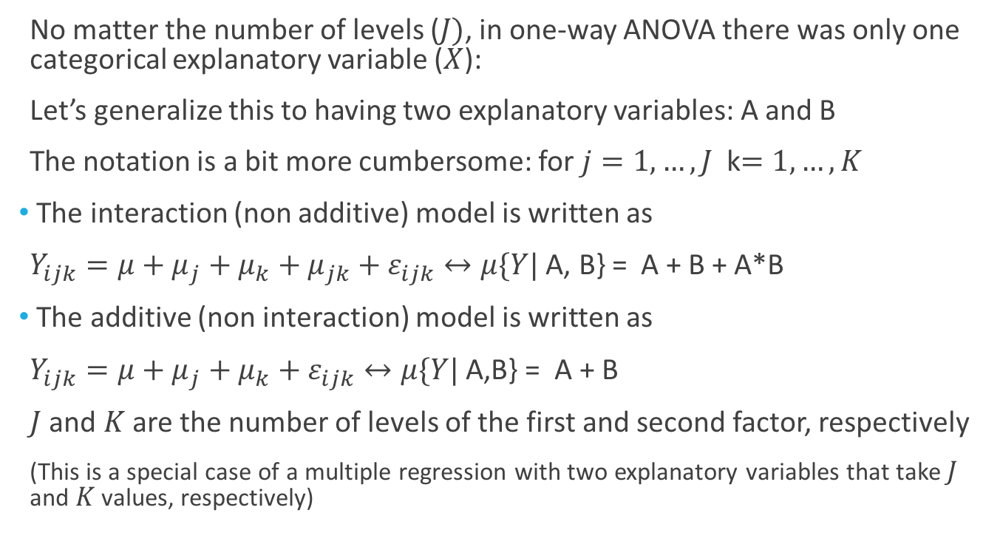
Two-way ANOVA
No matter the number of levels ($J)$, in one-way ANOVA there was only one categorical explanatory variable ($X$):
Let’s generalize this to having two explanatory variables: A and B
The notation is a bit more cumbersome: for $j=1,…,J$ k$=1,…,K$
The interaction (non additive) model is written as
$Y_{ijk}=μ+μ_{j}+μ_{k}+μ_{jk}+ε_{ijk}↔μ\{Y|$ A, B} = A + B + A*B
The additive (non interaction) model is written as
$Y_{ijk}=μ+μ_{j}+μ_{k}+ε_{ijk}↔μ\{Y|$ A,B} = A + B
$J$ and $K$ are the number of levels of the first and second factor, respectively
(This is a special case of a multiple regression with two explanatory variables that take $J$ and $K$ values, respectively)

Slide 19
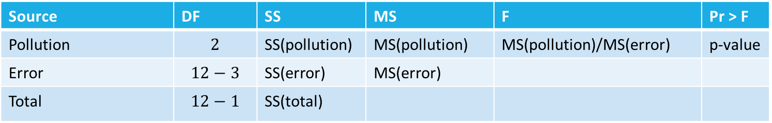
One-way ANOVA
Back to aquarium/pollution example:
Suppose we have
3 different treatments: no, low, and high pollution
Each treatment is applied to 4 aquariums
Each aquarium has 1 fish (so fish is the experiment unit)
(here, increasing fish directly affects the df of the relevant test)
Source | DF | SS | MS | F | Pr > F
Pollution | $$2$$ | SS(pollution) | MS(pollution) | MS(pollution)/MS(error) | p-value
Error | $$12−3$$ | SS(error) | MS(error)
Total | $$12−1$$ | SS(total)

Slide 20
Crossed Designs

Slide 21
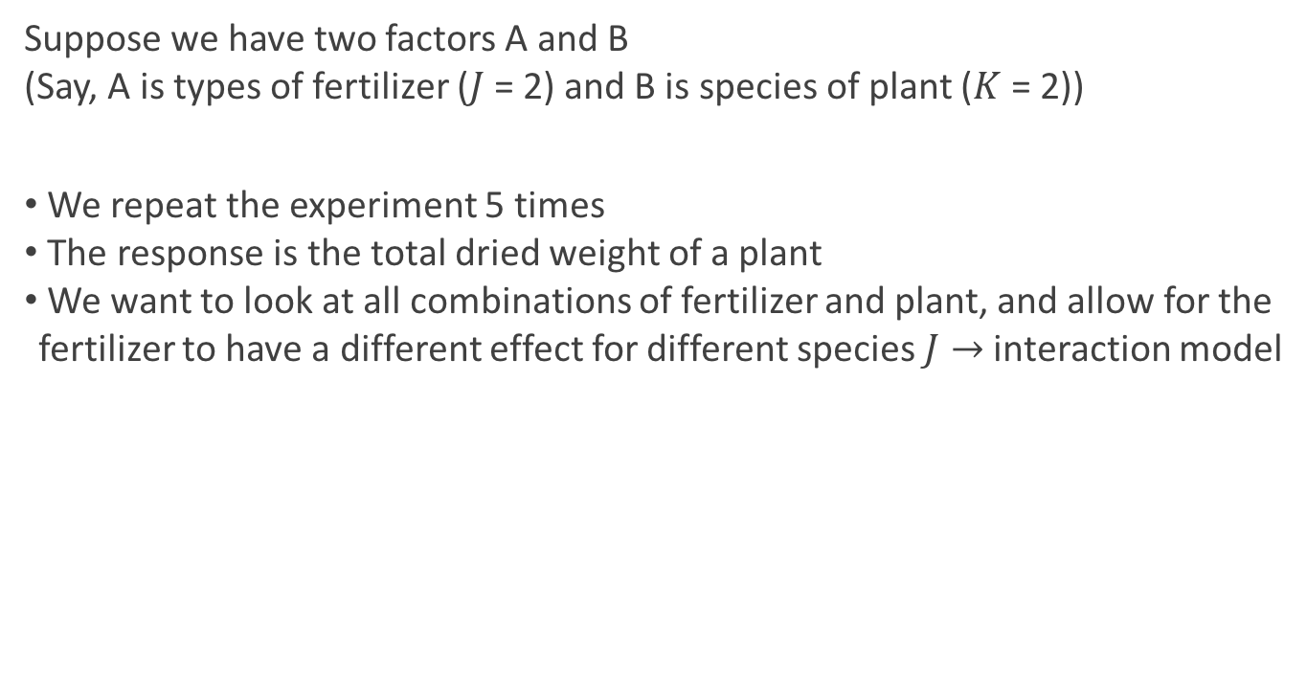
Crossed or Factorial Design: Interaction
Suppose we have two factors A and B
(Say, A is types of fertilizer ($J$ = 2) and B is species of plant ($K$ = 2))
We repeat the experiment 5 times
The response is the total dried weight of a plant
We want to look at all combinations of fertilizer and plant, and allow for the fertilizer to have a different effect for different species $J→$ interaction model

Slide 22

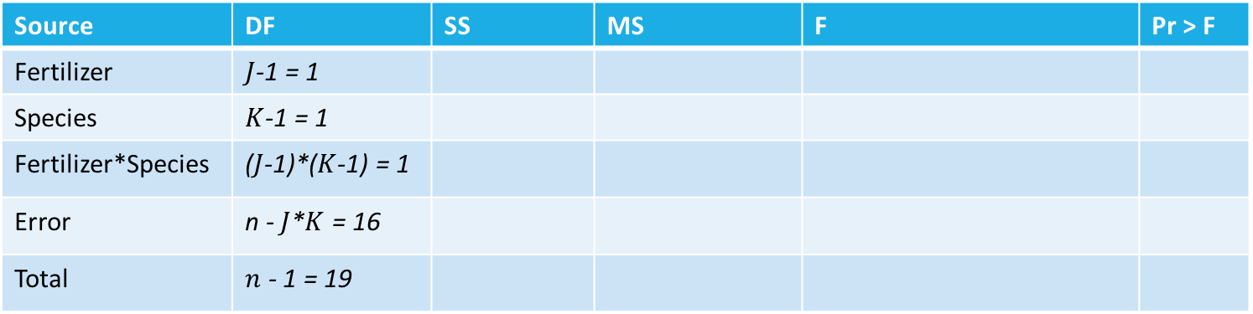
Crossed or Factorial Design: Interaction
Suppose we have two factors A and B
(Say, A is types of fertilizer ($J$ = 2) and B is species of plant ($K$ = 2))
The interaction model would be:
$Y_{ijk}=μ_{j}+μ_{k}+μ_{jk}+ε_{ijk}↔μ\{Y|$ A, B} = A + B + A*B
Source | DF | SS | MS | F | Pr > F
Fertilizer | $J$-1 = 1
Species | $K$-1 = 1
Fertilizer*Species | ($J$-1)*($K$-1) = 1
Error | n - $J$*$K$ = 16
Total | $n$ - 1 = 19

Slide 23

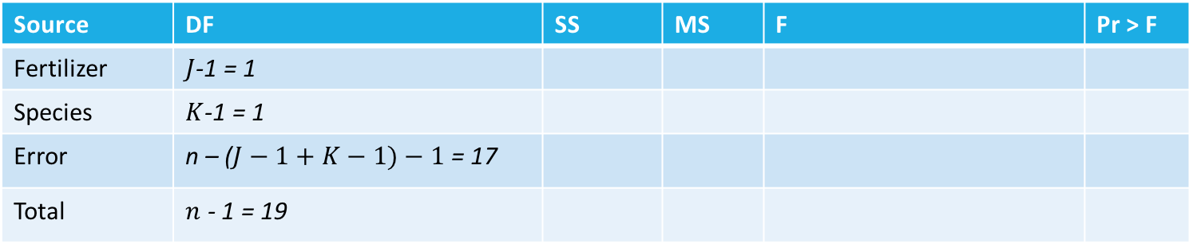
Crossed or Factorial Design: Additive
Suppose we have two factors A and B
(Say, A is types of fertilizer ($J$ = 2) and B is species of plant ($K$ = 2))
The additive model would be:
$Y_{ijk}=μ_{j}+μ_{k}+ε_{ijk}↔μ\{Y|$ A, B} = A + B
Source | DF | SS | MS | F | Pr > F
Fertilizer | $J$-1 = 1
Species | $K$-1 = 1
Error | n – ($J−1+K−1)−1$ = 17
Total | $n$ - 1 = 19

Slide 24
Profile Plots

Slide 25
Profile Plots
Some pictures (known as profile plots) will help us develop some intuition about interaction models
For two factors A and B, there will be two (piece-wise linear) lines describing the relationship between the factors
We can visually see both the additive and interaction effects
The ANOVA table helps us to formally test which situation is happening

Slide 26
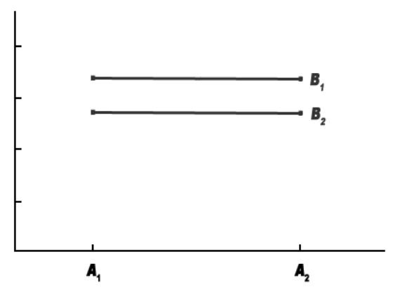
Two-Level, Two-Way ANOVA
Note: To Check for A look at avg. Y for A1 vs. A2
To Check for B, rewrite plot with B on horizontal and look at avg. Y for B1 vs. B2
To Check for interaction, look for parallel vs. not parallel lines
Y
No effect of Factor A
Small effect of Factor B
No interaction between Factor A and Factor B.

Slide 27
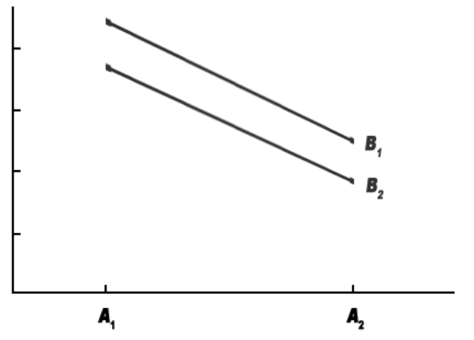
Two-Level, Two-Way ANOVA
Y
Large effect of Factor A
Small effect of Factor B
No interaction between Factor A and Factor B.

Slide 28
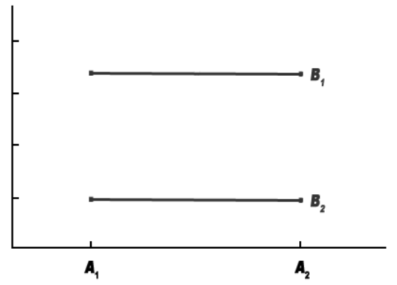
Two-Level, Two-Way ANOVA
Y
No effect of Factor A
Large effect of Factor B
No interaction between Factor A and Factor B.

Slide 29
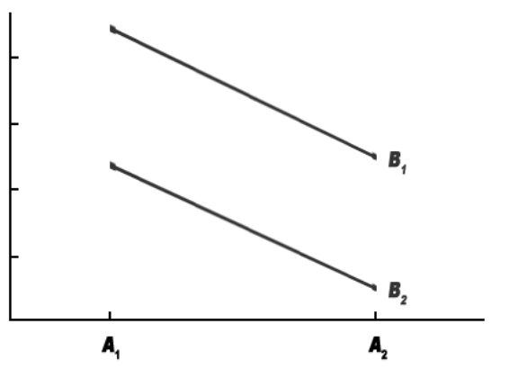
Two-Level, Two-Way ANOVA
Y
Large effect of Factor A
Large effect of Factor B
No interaction between Factor A and Factor B.

Slide 30
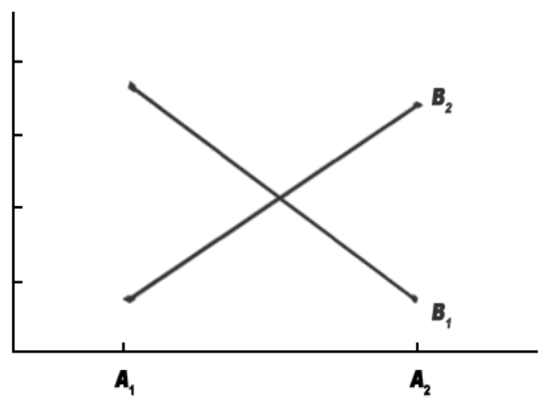
Two-Level, Two-Way ANOVA
Y
No effect of Factor A
No effect of Factor B
Large interaction between Factor A and Factor B.

Slide 31
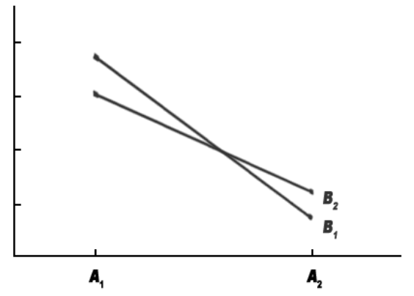
Two-Level, Two-Way ANOVA
Y
Large effect of Factor A
No effect of Factor B
Slight interaction between Factor A and Factor B.

Slide 32
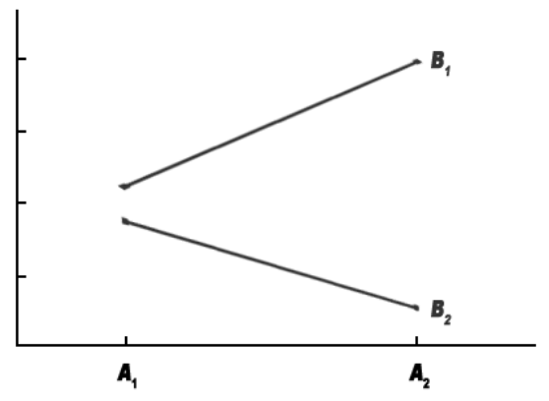
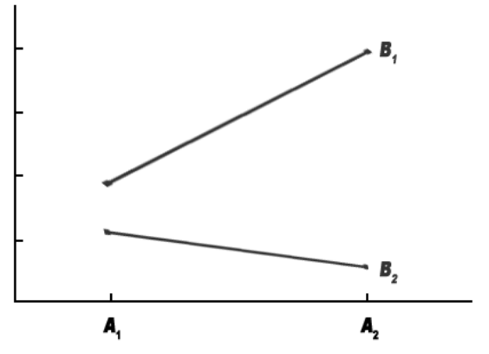
Two-Level, Two-Way ANOVA
Y
Y
No effect of Factor A
Large effect of Factor B
Very large interaction
Yes effect of Factor A
Large effect of Factor B
Large interaction

