Slide 1
Multiway ANOVA
Nested Design

Slide 2
Nested Designs

Slide 3
Crossed vs. Nested Design
Heuristic Definition: “Crossed is all combinations, nested is more limited”
Are explanatory variables crossed or nested?
Formal Definition: If the levels of one of the factors occur at all of the levels of the other factors, then they are crossed (sometimes referred to as factorial design).
A factor B is nested in a factor A if each level of B occurs in only one level of A
Example: Suppose we work for 3M and we manufacture abrasives at 3 sites. We want to examine the durability of these abrasives. Due to particulars of the manufacturing process, two different abrasives can be produced at each site. We also believe that the each site is an effect of interest.
Here, abrasives is nested in site, which is notated abrasive(site)

Slide 4
Further Specifics of this Experiment
We will use an abrasive until it deteriorates past some threshold
Each abrasive will be tested twice
As there are 6 abrasives and 2 replications, we have 12 total trials
However, as the design is nested, there isn’t the same analysis as with a cross design
Note that site is a bit like a block. However, there are two important differences:
We are interested in the site effect
All levels of the treatment don’t occur inside each site

Slide 5
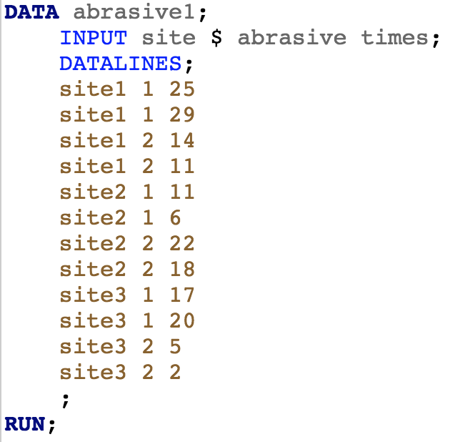
Abrasive Data
Important: abrasive = 1 doesn’t have the same meaning for different sites

Slide 6
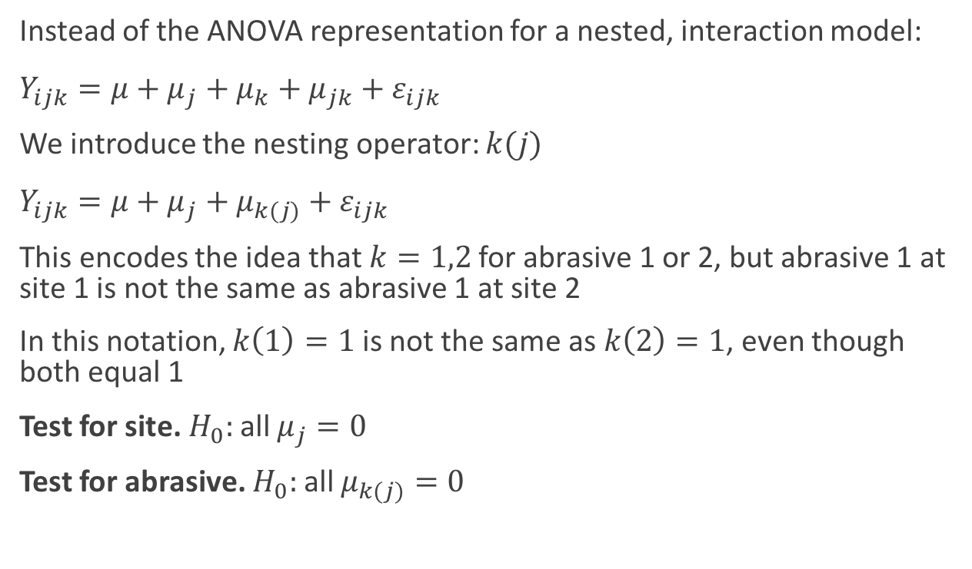
Nested Model
Instead of the ANOVA representation for a nested, interaction model:
$Y_{ijk}=μ+μ_{j}+μ_{k}+μ_{jk}+ε_{ijk}$
We introduce the nesting operator: $k(j)$
$Y_{ijk}=μ+μ_{j}+μ_{k(j)}+ε_{ijk}$
This encodes the idea that $k=1,2$ for abrasive 1 or 2, but abrasive 1 at site 1 is not the same as abrasive 1 at site 2
In this notation, $k\left(1\right)=1$ is not the same as $k\left(2\right)=1$, even though both equal 1
Test for site. $H_{0}:$all $μ_{j}=0$
Test for abrasive. $H_{0}:$all $μ_{k(j)}=0$

Slide 7
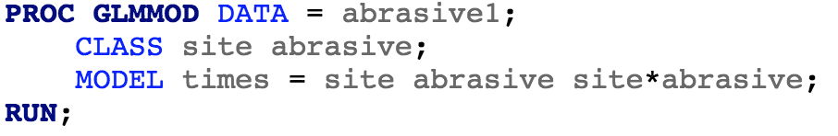
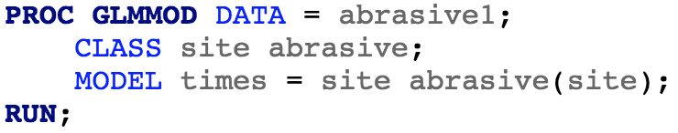
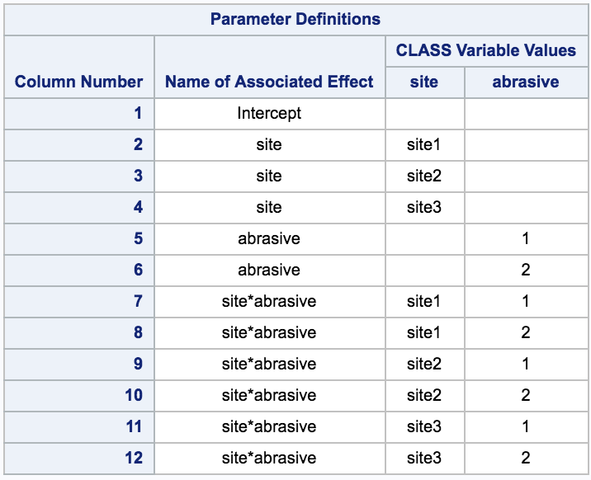
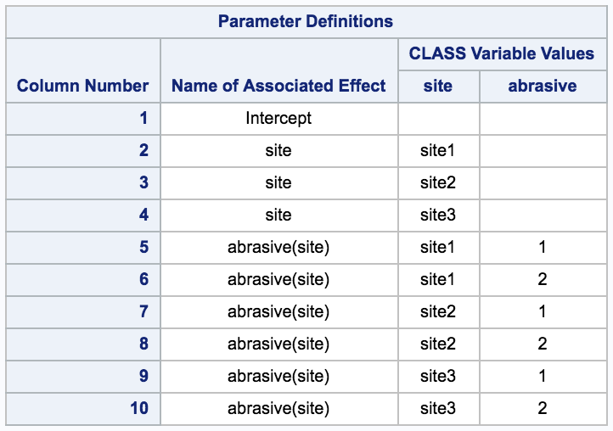
Nested Model: The Design Matrices
Crossed/Interaction
Nested

Slide 8
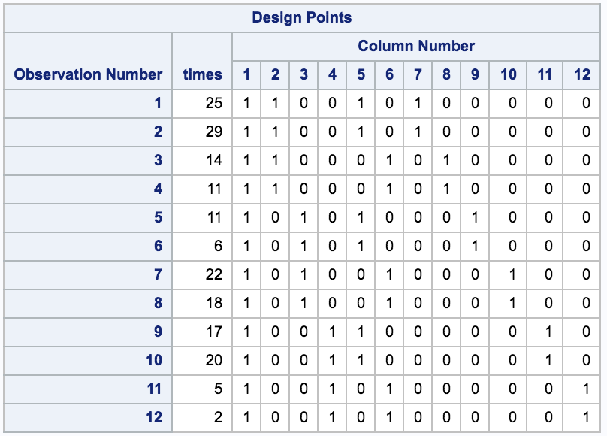
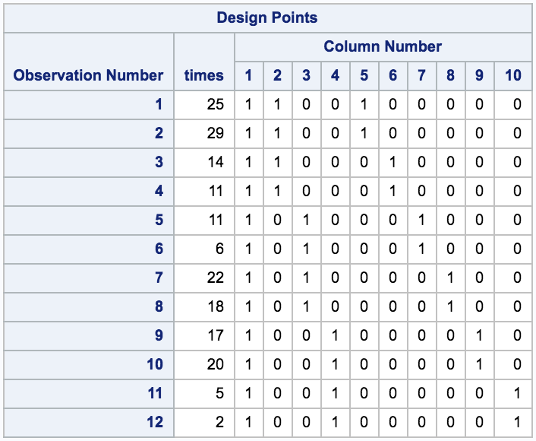
Nested Model: The Design Matrices
Crossed/Interaction
Nested

Slide 9
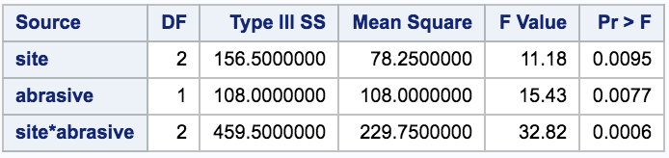
An Improper Analysis
SAS will happily run the analysis as a crossed design
However, this won’t give you the right results as this presumes the same abrasive has been tested 6 times in 3 block

Slide 10
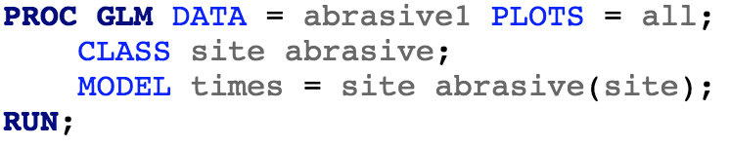
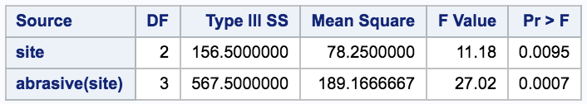
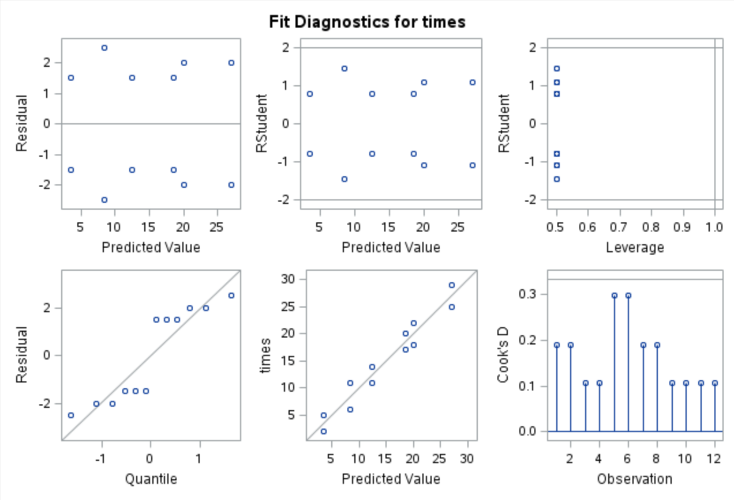
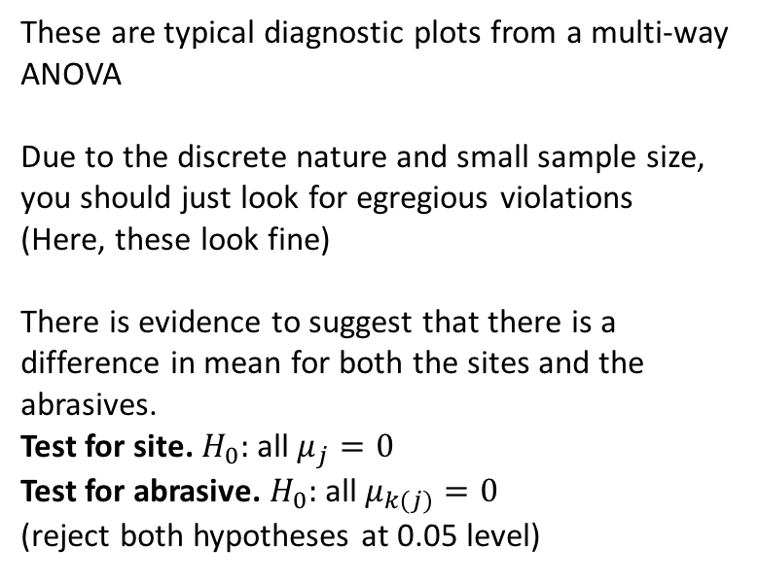
A Proper Analysis
These are typical diagnostic plots from a multi-way ANOVA
Due to the discrete nature and small sample size, you should just look for egregious violations
(Here, these look fine)
There is evidence to suggest that there is a difference in mean for both the sites and the abrasives.
Test for site. $H_{0}:$all $μ_{j}=0$
Test for abrasive. $H_{0}:$all $μ_{k(j)}=0$
(reject both hypotheses at 0.05 level)

Slide 11
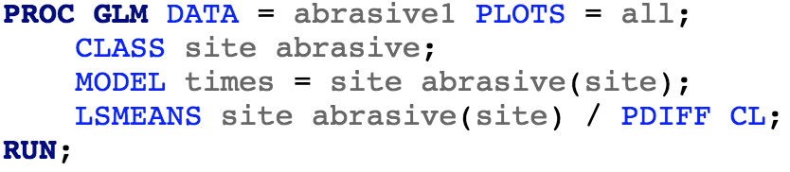
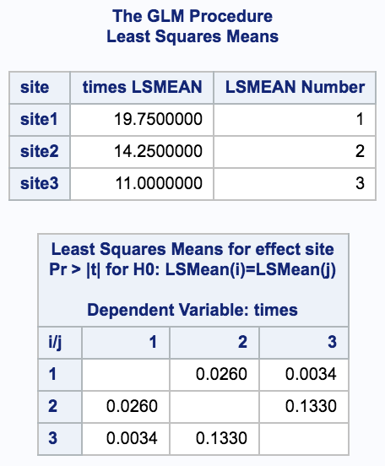
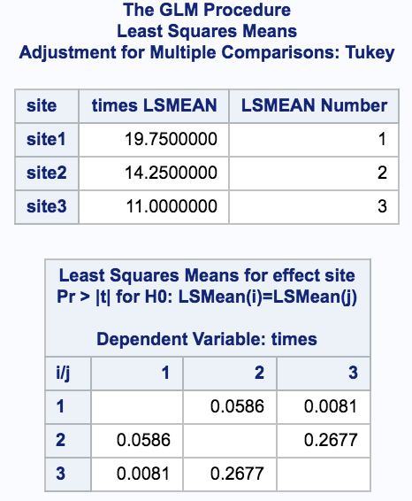
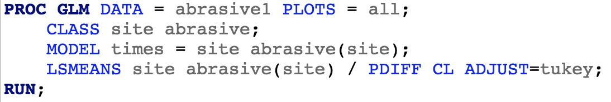
Which Means are Different? Looking at Sites
Don’t forget to correct for multiple comparisons…

Slide 12
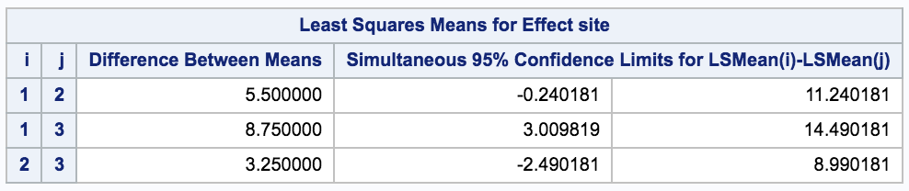
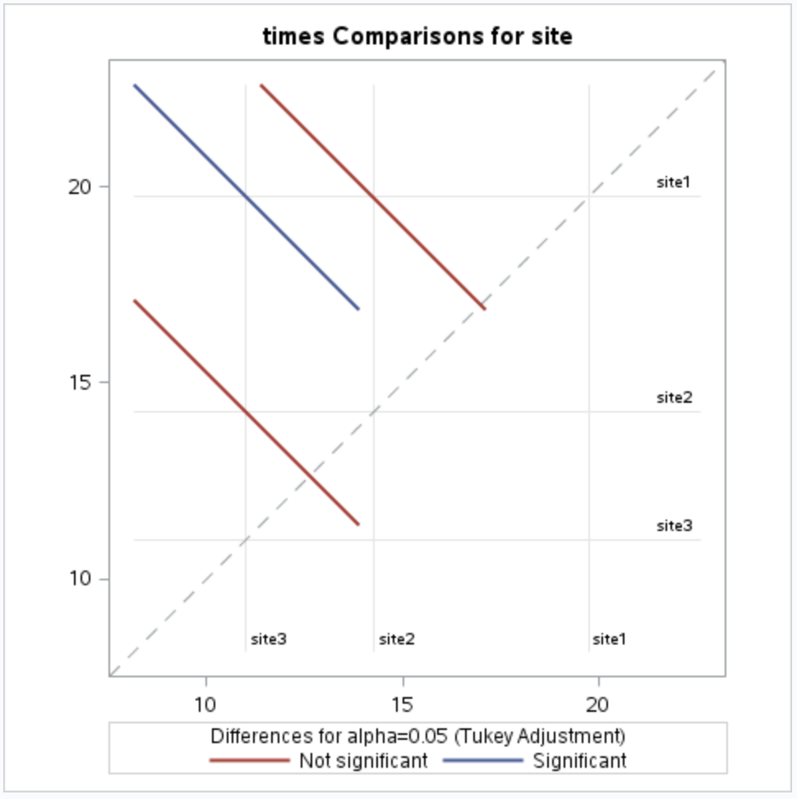
Which Means are Different? Looking at Sites
There is evidence that the means of site 1 and site 3 are different. We estimate a 8.75 s difference, (holding abrasive type constant) with a range of plausible values for this difference of 3s to 14.5s

Slide 13
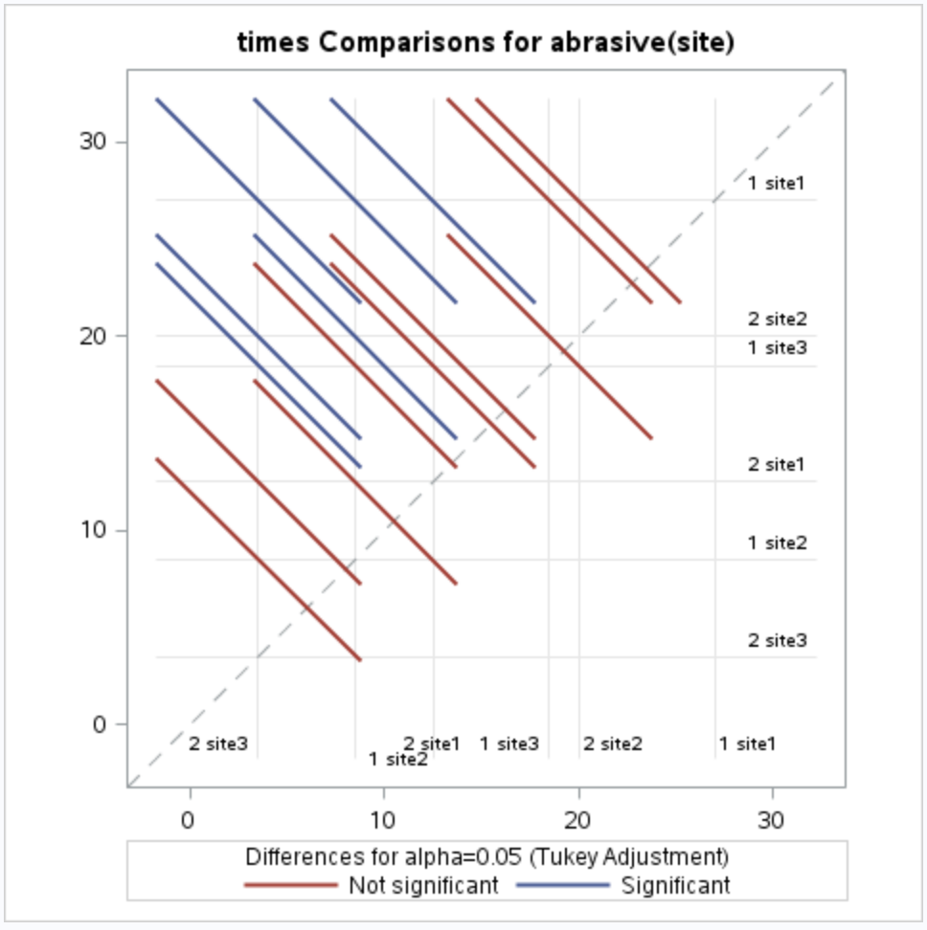
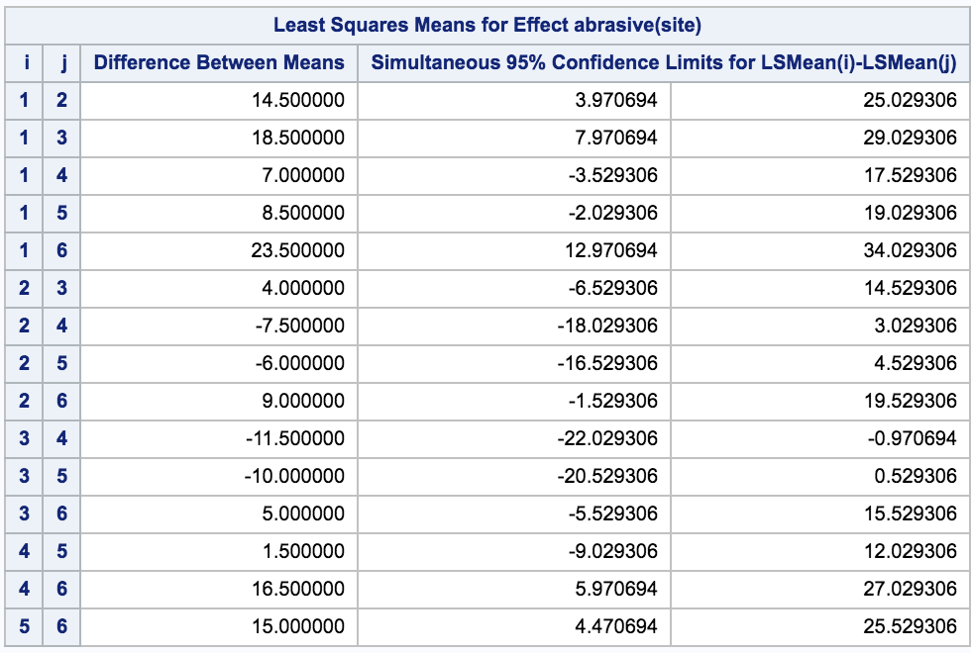
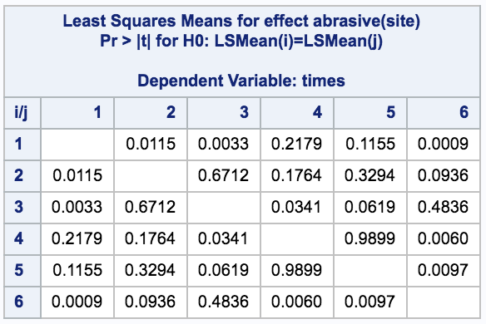
Which Means are Different? Looking at Abrasives

Slide 14
Nested vs. Crossed/Additive Model

Slide 15
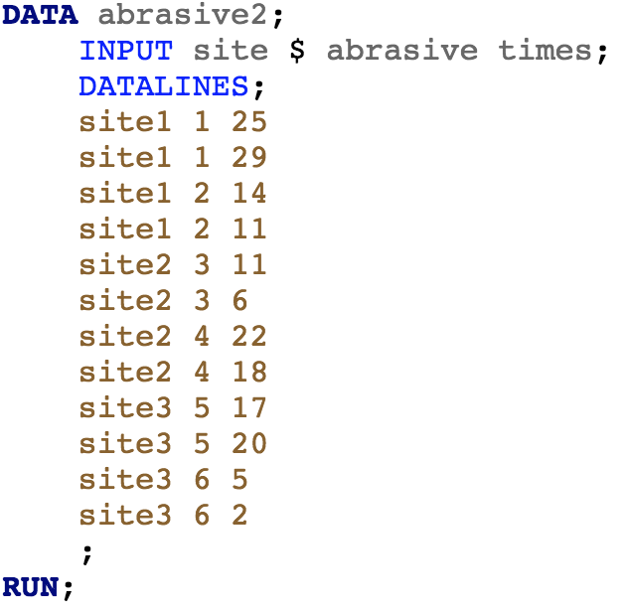
Nested vs. Crossed/Additive Model
Original data
Coding abrasive as a unique value

Slide 16
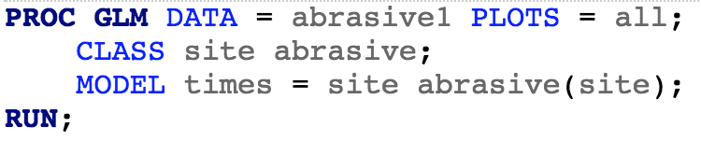
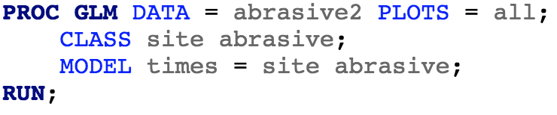
Nested vs. Crossed/Additive Model
Measures variability of…
each abrasive with respect to its site
each site with respect to the overall average
Experimental Unit for Abrasive: Test Run (yes replication)
Experimental Unit for Site: Batch of 4 test runs (no replication)
(hence this is an example of a split plot)
Measures variability of…
each abrasive with respect to the overall average
each site with respect to the overall average

Slide 17
Nested vs. Crossed/Additive Model
Nested: We get an estimate of the error by assessing the variability of abrasive around each site mean
Crossed/Additive: We cannot get an estimate of the error due to no replication for site
Measures variability of…
each abrasive with respect to its site
each site with respect to the overall average
Experimental Unit for Abrasive: Test Run (yes replication)
Experimental Unit for Site: Batch of 4 test runs (no replication)
(hence this is an example of a split plot)
Measures variability of…
each abrasive with respect to the overall average
each site with respect to the overall average

Slide 18
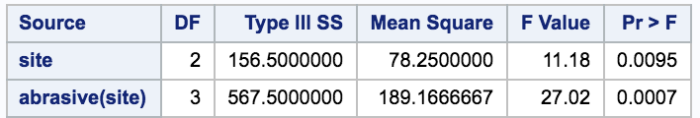
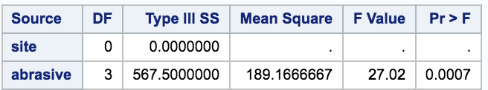
Nested vs. Crossed/Additive Model

Slide 19
Split-plot Design

Slide 20
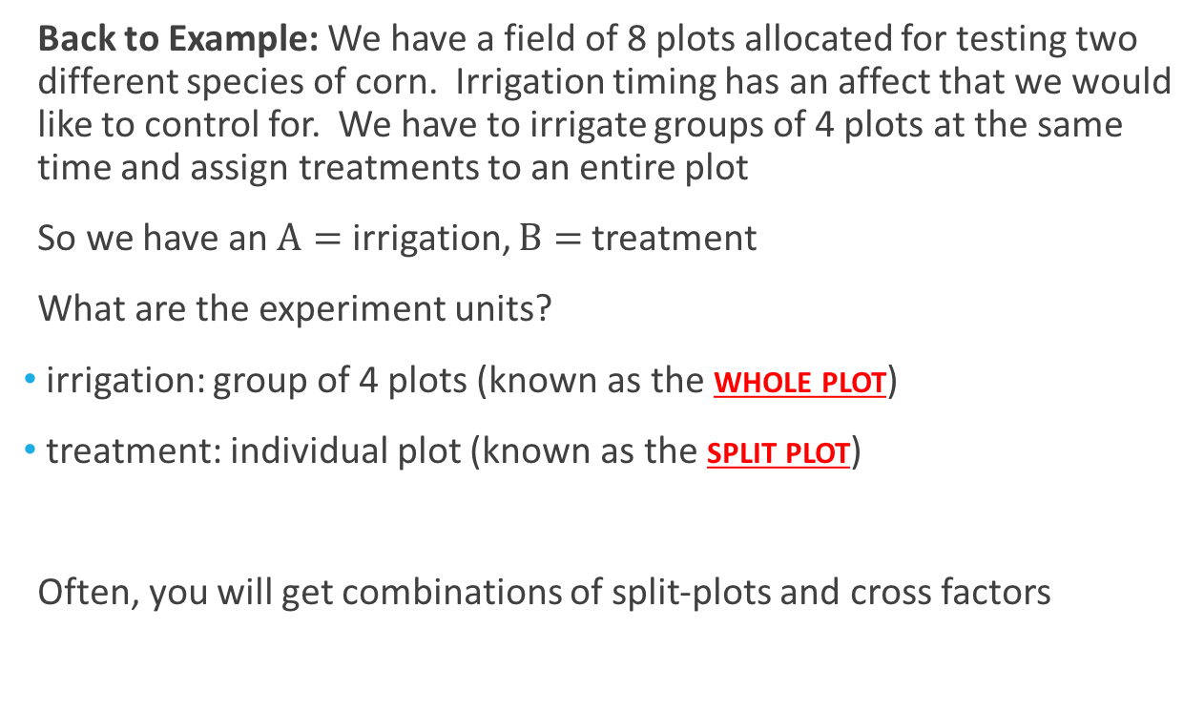
Split-plot
Back to Example: We have a field of 8 plots allocated for testing two different species of corn. Irrigation timing has an affect that we would like to control for. We have to irrigate groups of 4 plots at the same time and assign treatments to an entire plot
So we have an $A=$ irrigation, $B=$ treatment
What are the experiment units?
irrigation: group of 4 plots (known as the whole plot)
treatment: individual plot (known as the split plot)
Often, you will get combinations of split-plots and cross factors

Slide 21
Lawnmower Example
Suppose we have two manufacturers of lawnmowers
Each manufacturer produces 3 types of lawnmowers
We run each lawnmower at a “high” and a “low” setting
We record the amount of time it takes to stop the blade once power is cut (for safety) twice for each “high” and “low”
We want to compare these “cut-off” times for the lawnmowers

Slide 22
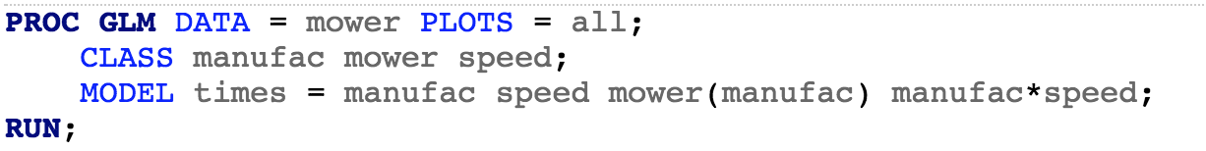
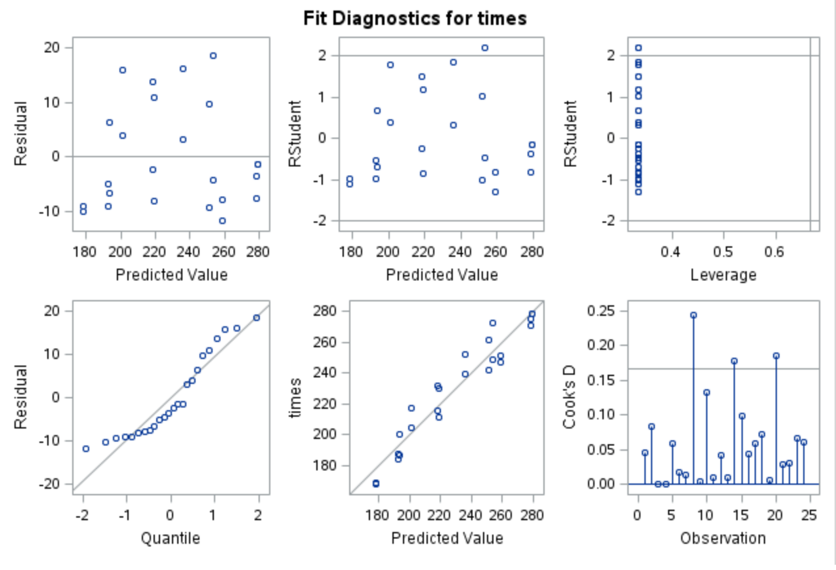
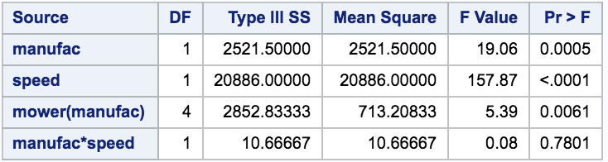
Testing for Interaction for Crossed Effect

Slide 23
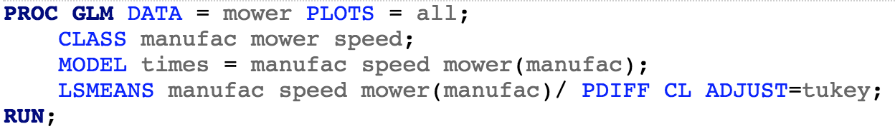
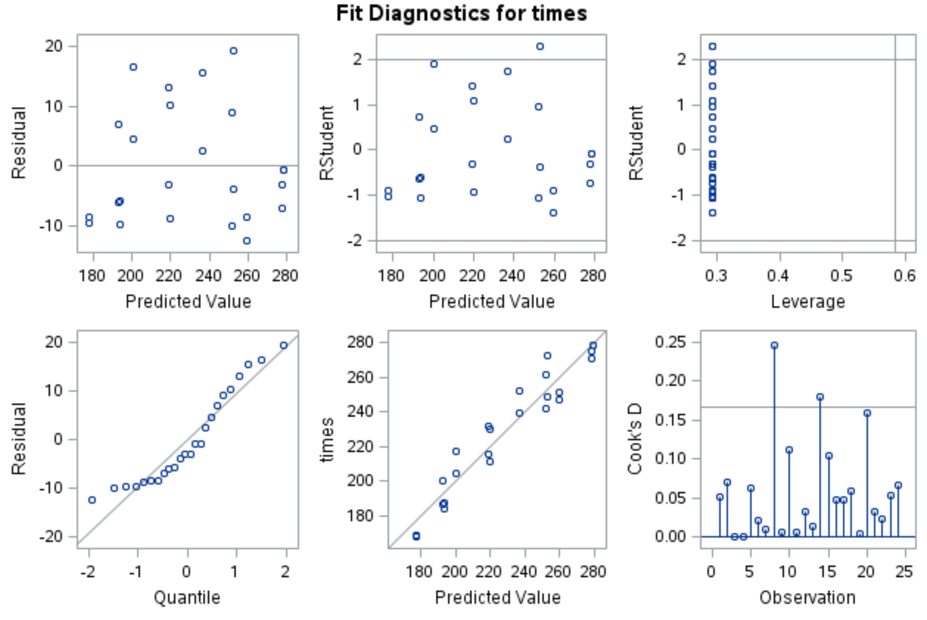
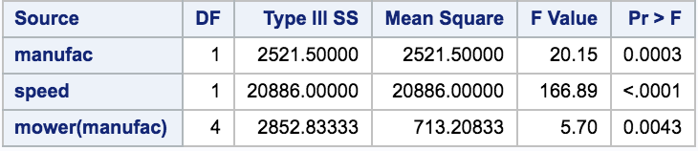
Fitted Combined Additive, Nested Model

Slide 24
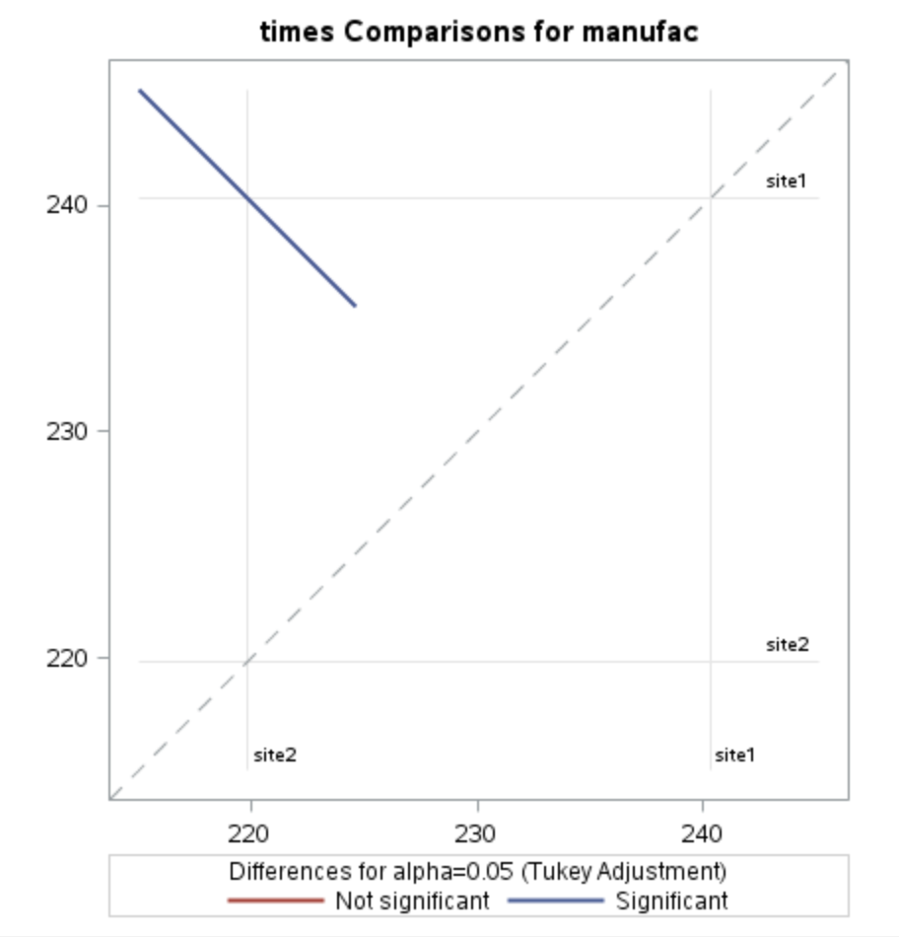
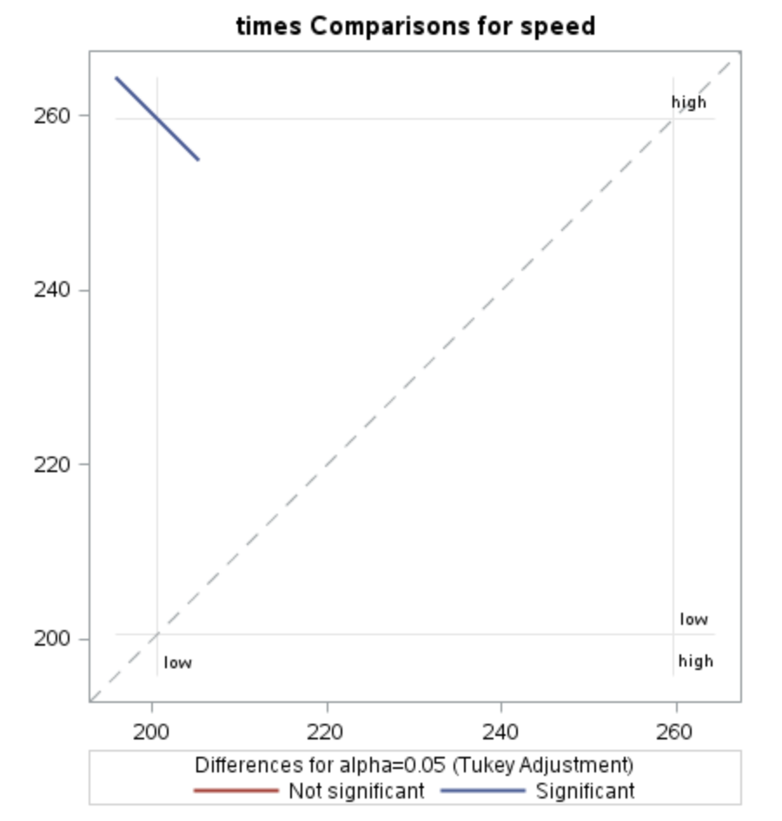
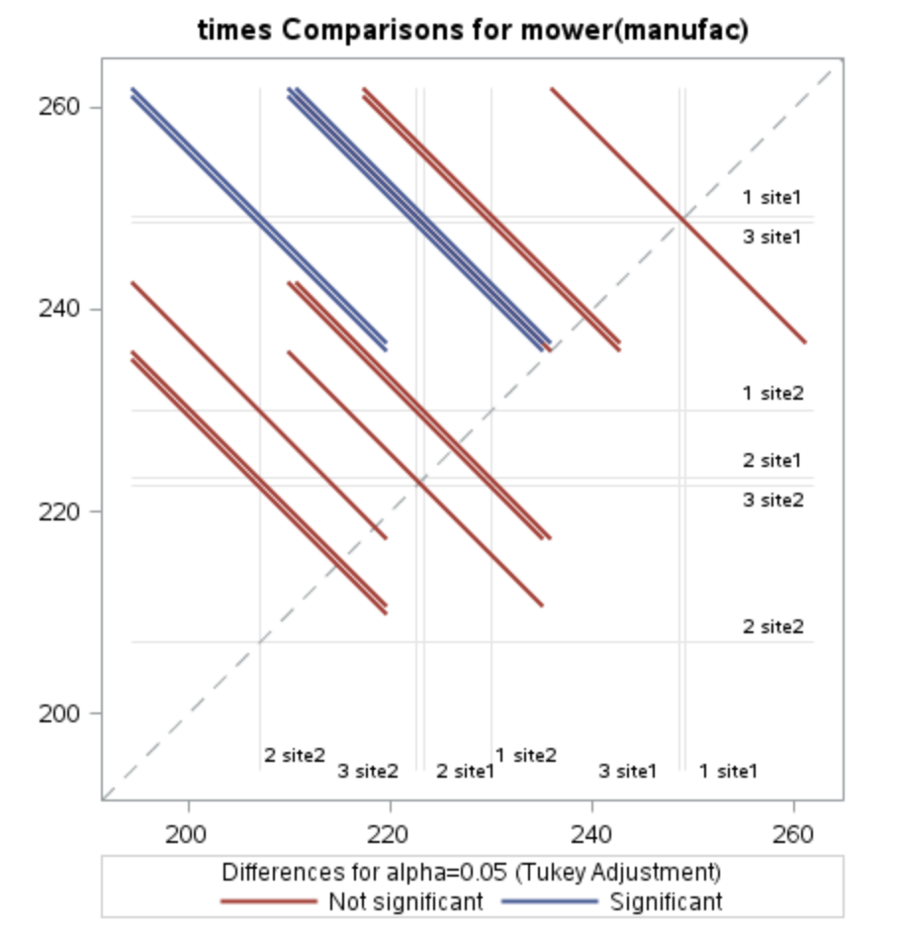
Fitted Combined Additive, Nested Model

