Slide 1
EDA

Slide 2
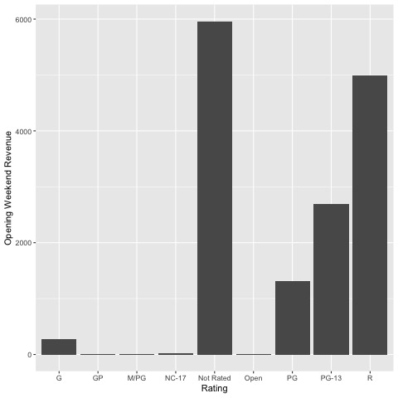
Frequency of Rating Groups
(G) - Suggested for general audiences. (PG) - Parental guidance suggested. (PG-13) - Parents strongly cautioned. (R) - Restricted – Under 17
A lot movies are not rated.
Movies that require some form of parental consent or supervision are dominant.

Slide 3
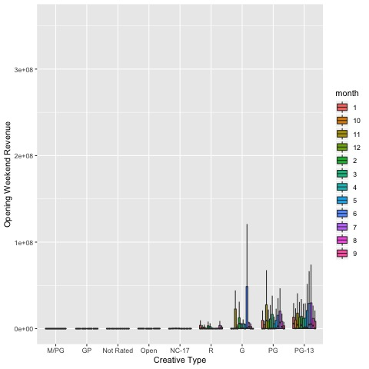
Rating/Month
Are certain “K” rated movies released in some particular months?
Most G-rated movies are released in June (Summer break?)
Similarly, most PG-13 movies are released in June and July

Slide 4
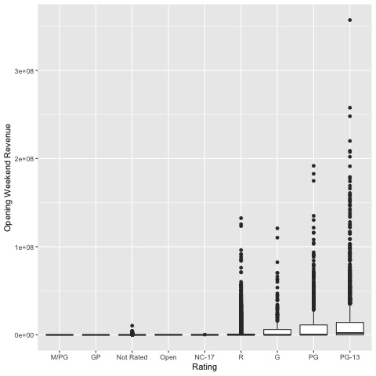
Rating
For five of the rating groups, there is no distinction in their level of weekend revenue.
PG-13 Movies seems to gross high on average, with Endgame Avengers Endgame (2019) been the top grossing.
It’s plausible to reduce the number of rating groups to 5 with no significant loss of information.

Slide 5
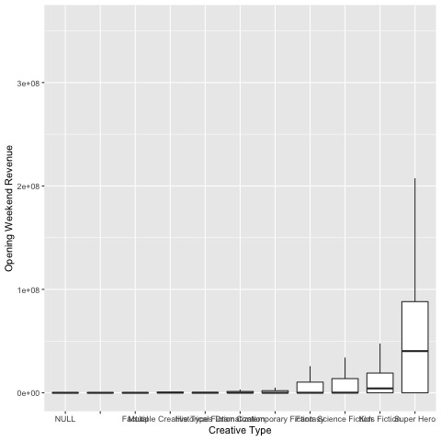
Creative Type
Superhero & fiction movies seems to dominate.
It’s possible to have about five categories and still not lose a lot of information.

Slide 6
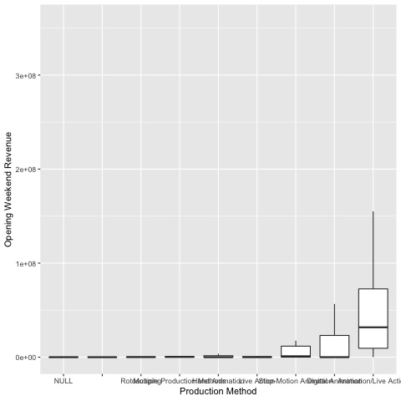
Production Method

