Slide 1
Making for Scaffold DB
for ligand-base drug design(LBDD)
(Scaffold Based Drug Discovery)
2020. 07. 08
Yea-Guen Yoon
Seung Woo Shin

Slide 2
Process
Server: 10.10.2. {1..20},{26..45},{51..70},{76..95} : total 80 servers
Data: ZINC15(10 billion), ChEMBL27(about 2million), Korea Chemical Bank(about5.5 hundred thousand)
Time line
2020-06-29: data processing
other 2 servers: ChEMBL27 (processing) and KCB data (done)
4. Estimated time to end : about 50 days

Slide 3
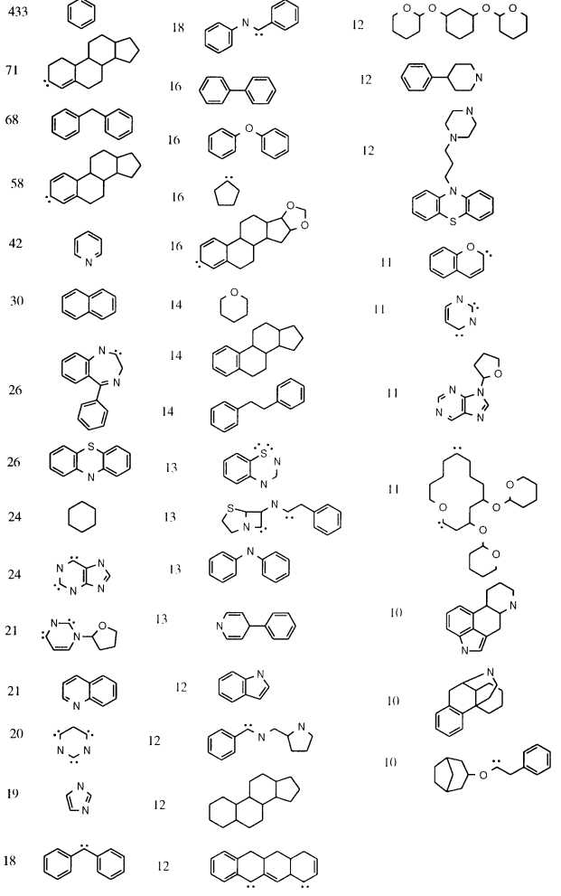
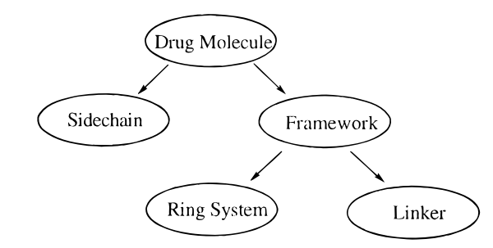
About Scaffold
"Molecular scaffold" is one of the most important and widely used concepts in medicinal chemistry. Given a chemical compound, its "scaffold" generally represents the core structures of the molecular framework.¹⁾
Molecular scaffold
1. Hierarchical description of molecules ²⁾
2. Example of scaffolds ²⁾
Hu, Y.; Stumpfe, D.; Bajorath, J. Computational Exploration of Molecular Scaffolds in Medicinal Chemistry. J Med Chem 2016, 59, 4062–76.
Bemis, Guy W., Murcko, Mark A. The Properties of Known Drugs. 1. Molecular Frameworks J. Med. Chem. 1996, 39, 15, 2887–2893

Slide 4
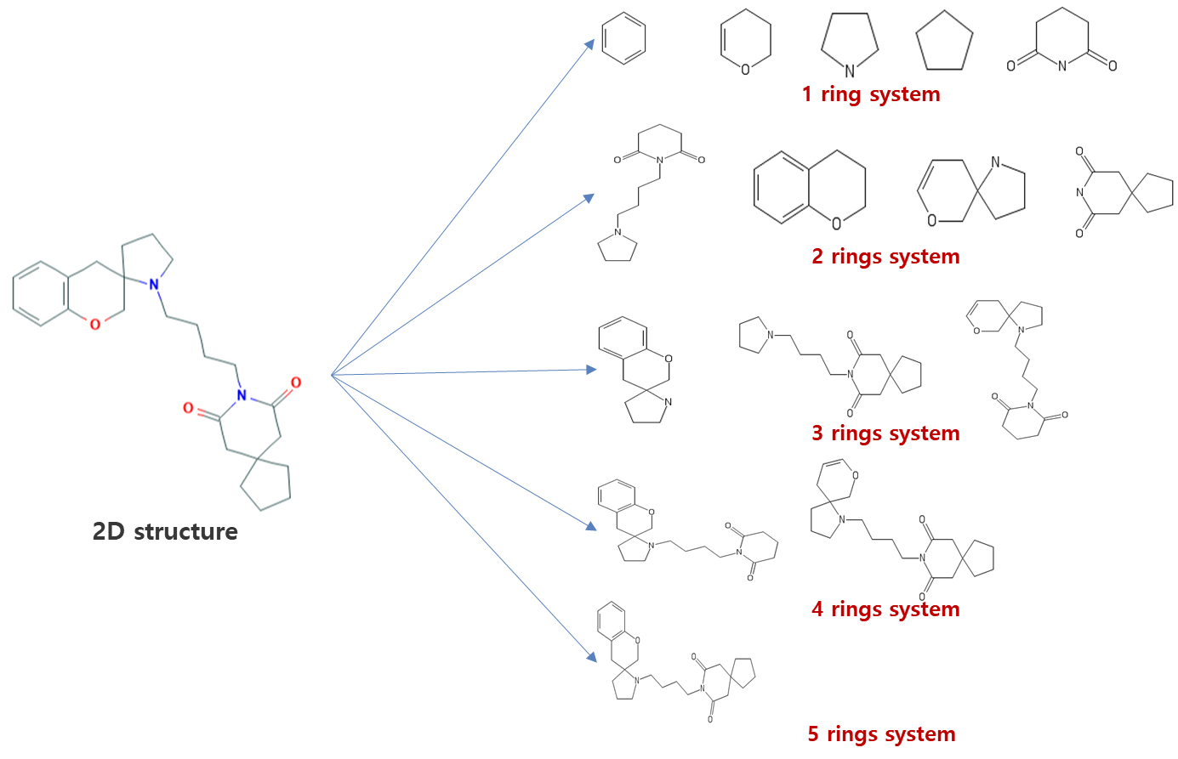
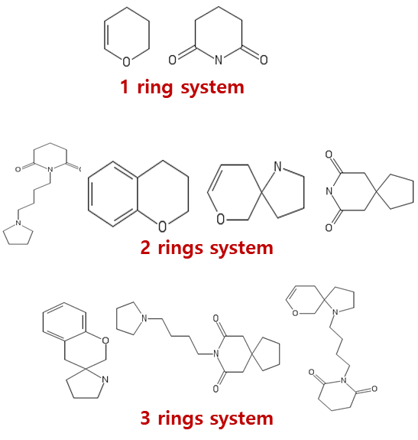
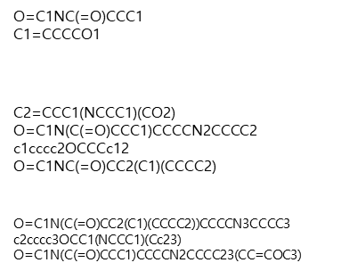



Basic approach
1. Molecular Decomposition
Sample: CHEMBL11265
SMILES:COc1cccc2c1CC1(CCCN1CCCCN1C(=O)CC3(CCCC3)CC1=O)CO2
ZINC15, ChEMBL27, KCB
:
:
Scaffold DB
1.Target
Molecular
2. Molecular
Decomposition
3.Dcaffold
Filtering
4. Convert to
SMILES
5.Scaffold
(SMILES) DB

Slide 5

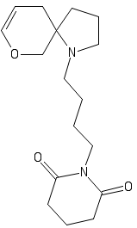
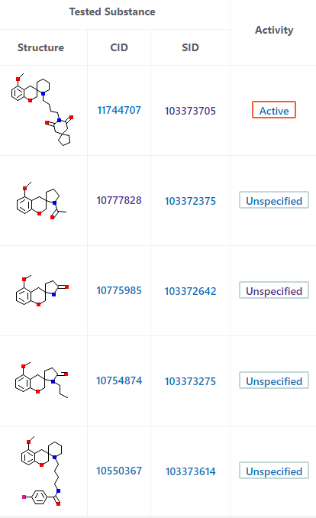
Basic approach
2. Scaffold scoring using deep learning
Data: PubChem Bioassay Data
BioAssay
Data Table
Active Ligand
Active
Ligands
True positive
Query
Scaffold
Molecular
Decomposition
Deep
Learning
Prediction Model
Inactive Ligands
True negative
Example: AID:6003
Predictive value

Slide 6
Pilot Study 1
1. FDA drug vs. Toxic ligand
Data: FDA_Hong(1308), FDA_BindingDB(944), TOXIC_DB(808)
→Remove common ligand!
Positive_Set(FDA_Hong+ FDA_BindingDB:1669), Negative_Set(808)
Result: About 81.07% for toxic prediction
FDA_Hong
(1308)
FDA ligand
(1669)
Positive
set
Training Set
(70%)
Accuracy for Training set (for 5 times) : 98.36%
FDA_bindingDB
(944)
Molecular
Decomposition
Deep
Learning
Test Set
(30%)
Accuracy for test set(for 5 times): 81.07%
Toxic ligand
(504)
Negative
set
TOXIC DB
(808)

Slide 7
Pilot Study 2
1. Active ligand vs. Inactive ligand
Data: the result of CDK7 and the result of EGFR in vitro analysis
 | Binding | No_Binding | Both Binding
CDK7 | 17 | 0 | 4
EGFR | 24 | 12 | 8

Slide 8
Pilot Study 3
Bioassay Kinase CSV files: 10251
The Num. of Intersect ligand: 1705
The Num. of Active ligand: 35565
The Num. of Inactive ligand: 293575
After decomposition
BioAct 33824
BioInact 291834
The Number of all scaffold Set1(BioAct): 17407 (0.2%)
The Number of all scaffold Set2(BioInact): 83881
The Number of Instersection Set: 36
Date and Time: 20/07/2020 16:16:57

Slide 9
Pilot Study 2
1. Active ligand vs. Inactive ligand
Data: PubChem Human Kinase(10,251) type: Confirmatory
Active ligand: 35,565
Inactive ligand: 293,575
Intersection of two types: 1,705 (4.79% of Active ligands)
Result:
Active ligand
(33,860)
Positive
set
Training Set
(70%)
Accuracy for Training set (for 5 times) : ?
PubChem Bioassay Data (10,251)
Molecular
Decomposition
Deep
Learning
Test Set
(30%)
Accuracy for test set(for 5 times): ?
Inactive ligand
(291,870)
Negative
set

Slide 10
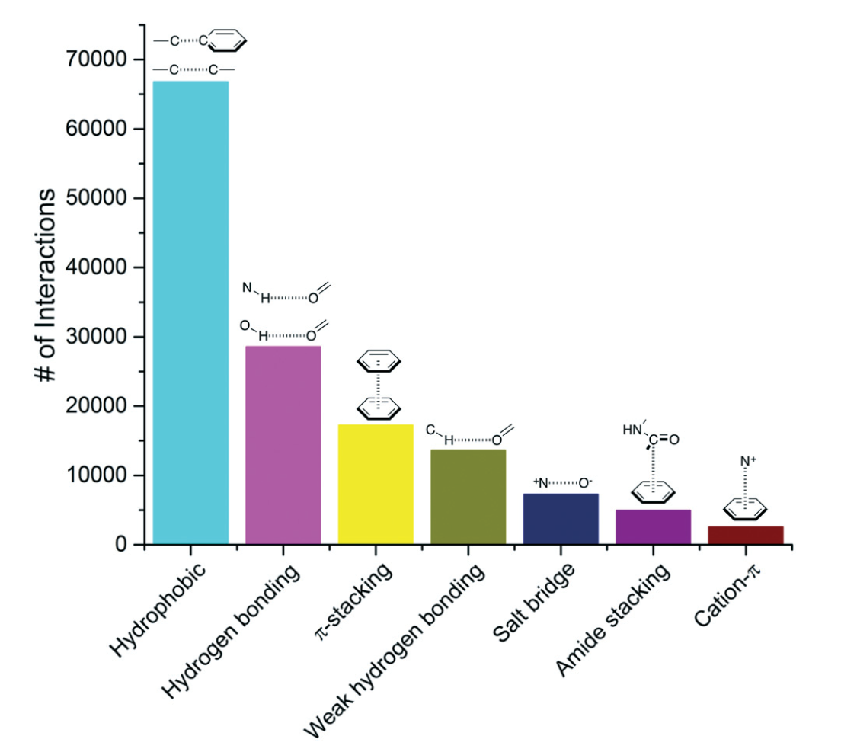

Slide 11
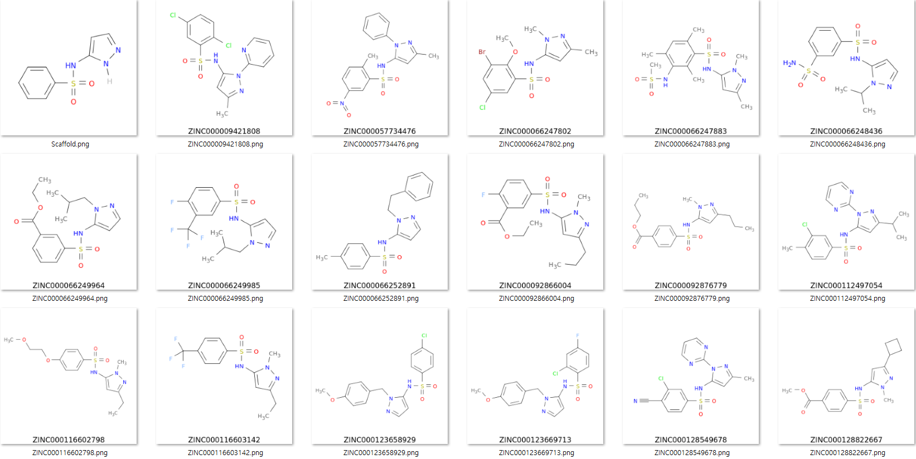
Example 1: Scaffold Searching
Scaffold SMILES : O=S(=O)(Nc1[nH]ncc1)c2ccccc2 (100%)
Scaffold SMILES

Slide 12
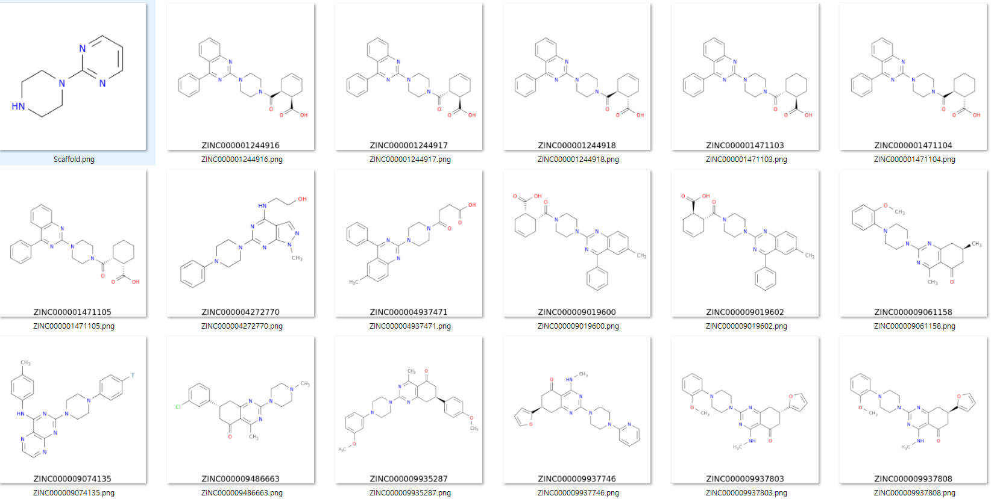
Example 2: Scaffold Searching
Scaffold SMILES : c1cnc(nc1)N2CCNCC2 (100%)
Scaffold SMILES

Slide 13
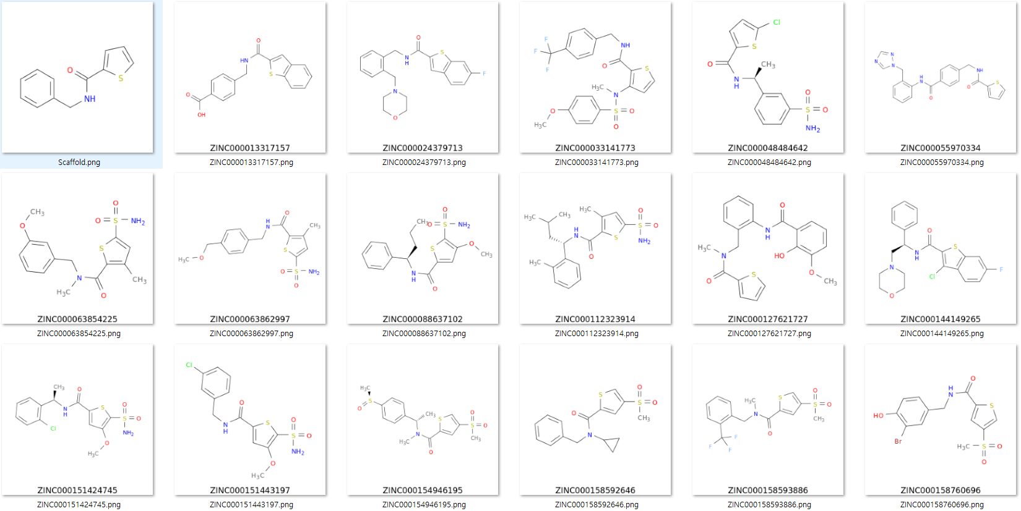
Example: 3 of Scaffold Searching
Scaffold SMILES : O=C(NCc1ccccc1)c2cccs2 (100%)
Scaffold SMILES

