Slide 1
1/2D-Scan ARS
YongKyun Lee
SeungWoo Shin

Slide 2



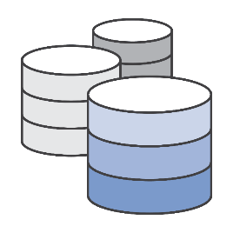
1/2D-Scan Data
ZINC15 + ChEMBL + KCB DB
ONE Billion!

Slide 3




Acceptor/Donor
feature DB
ZINC15
Scaffold DB
ChEMBL
Compound 분석툴
가상 탐색
시스템
신약후보
Functional-group DB
한국화합물은행
(KCB)
Compound feature DB

Slide 4
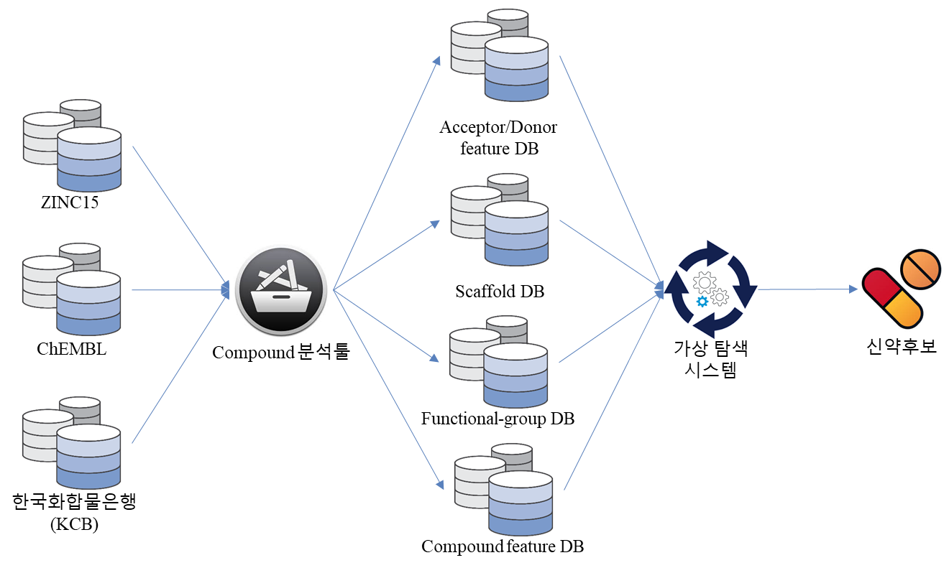
Compound DB
DB processing
Curated DB
가상탐색

Slide 5
1/2D-scan Concept

Slide 6
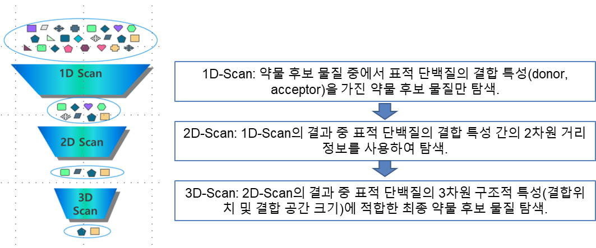
1/2D-Scan Introduction
1/2D-Scan ARS
By score function
By score function

Slide 7

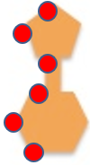

1/2D-Scan Concept
Objective: Find a new drug candidate with key feature !
A
D
A
Binding atom
P
1
A
P
D
D
A
A
P
P
P
A
Query with
key feature
(Ex: ‘ADAPP’ )
P
2
Extract the key info.
(A,D,A,P,P) from
the binding region of
target ligand
Ligand DB:
Indexed with key
:
Target Gene
A
D
A
P
1/2D-Scan ARS
P
N
Candidate ligand

Slide 8
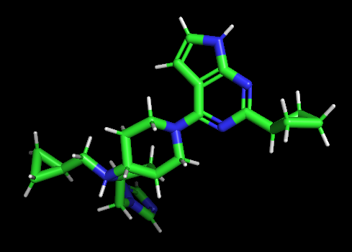
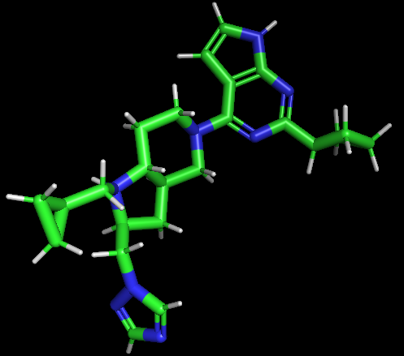
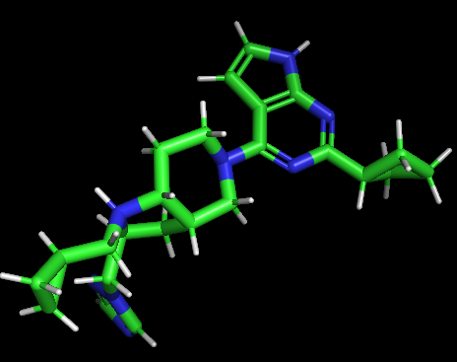
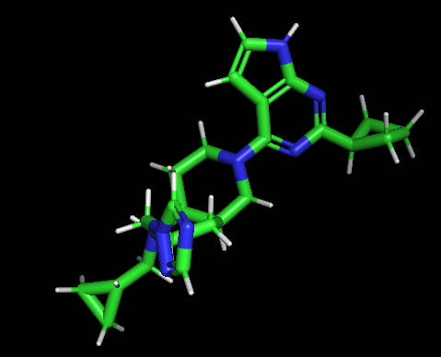
1/2D-Scan Key concept 1
Key feature: To bind to a receptor, Ligands which binding the receptor may have similar 3D scaffold and similar features. From this information, Noble ligand which binds to the ligand may be found by searching the feature of seed ligand.
Key feature
(Ex: DPPAA)
Searching similar scaffold
using feature
Seed ligand
In 1/2D-Scan ARS, in stead of searching the ligand DB using full similarity, the candidate ligands are only searched using a key features of target ligand
Barbosa, Frédérique, and Dragos Horvath. "Molecular similarity and property similarity." Current topics in medicinal chemistry 4.6 (2004): 589-600.

Slide 9
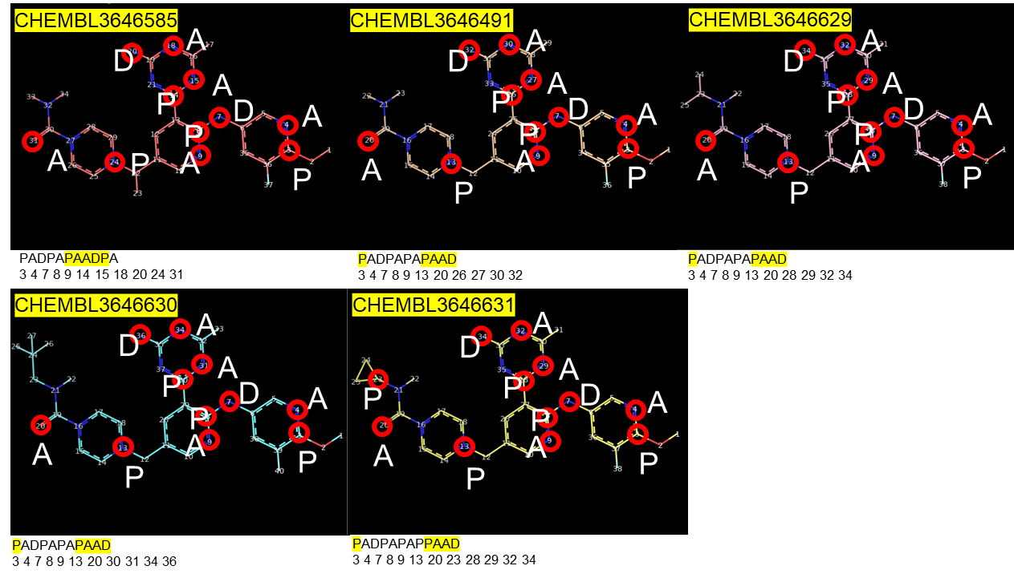
1/2D-Scan Key concept 2
Ligands having a same key, having similar 2D structure(scaffold) for key ‘PAADP’
- Select the 42 ligands binding CDK7 from CHEMBL
- Extract the common key pattern ‘PAADP’ from 42 ligands
- Compare the 2D structures of key pattern ‘PAADP’ using the Pymol

Slide 10
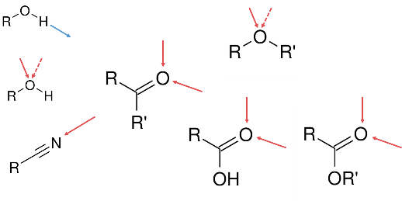
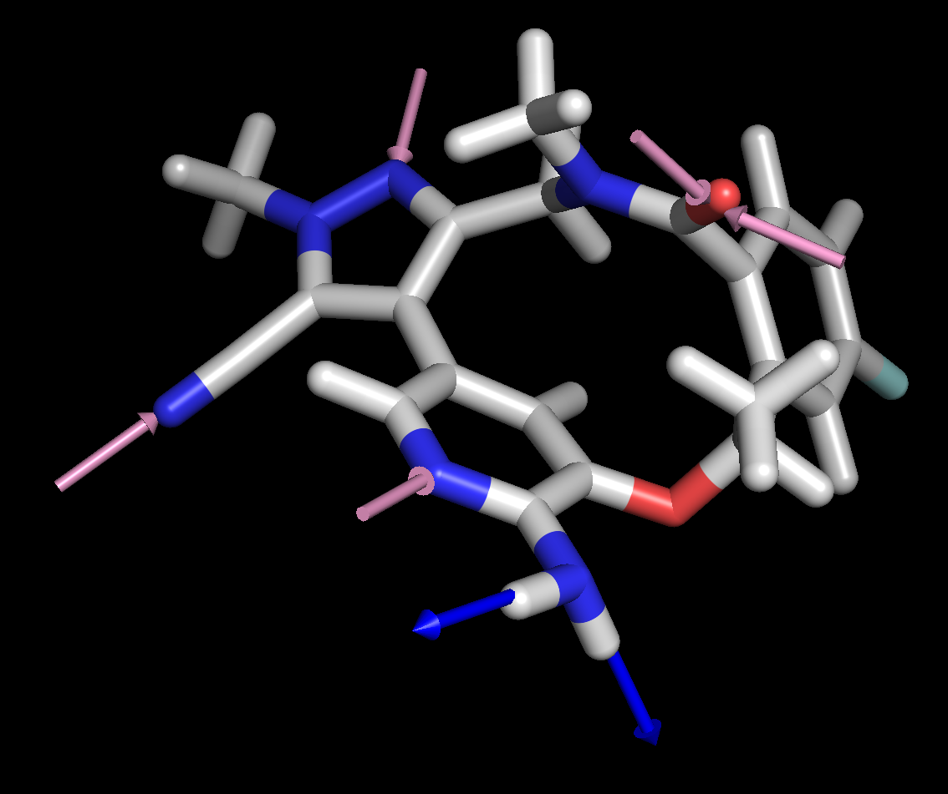
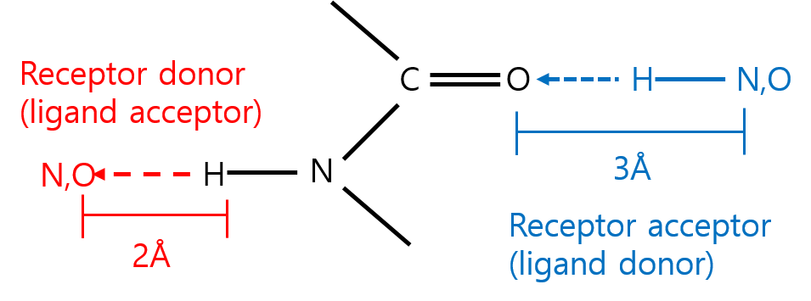
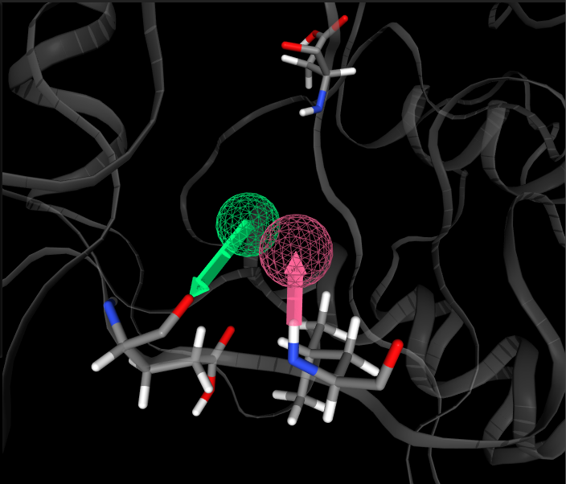
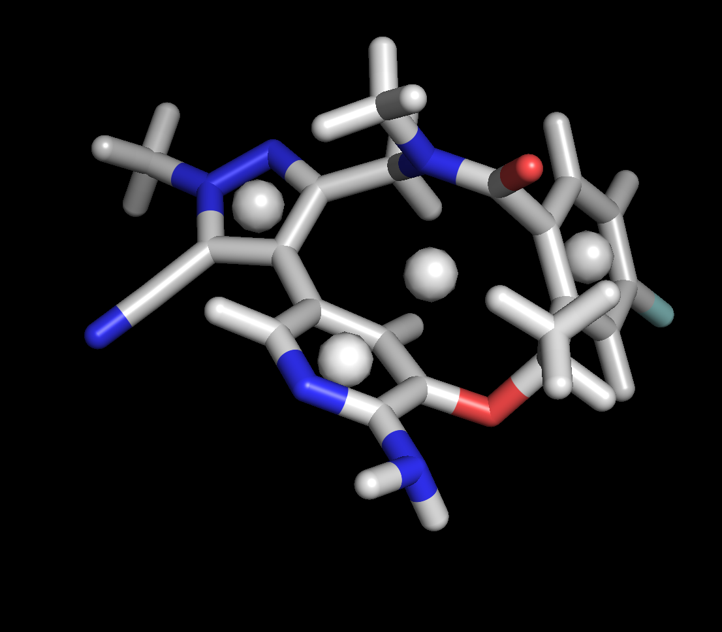
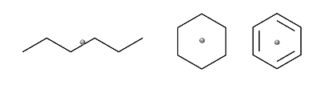
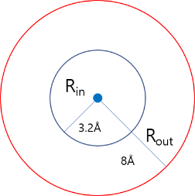
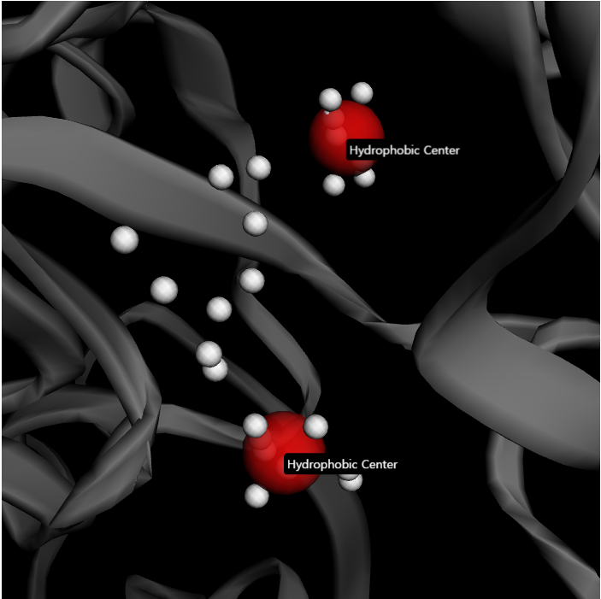
How to define 1/2D-Scan feature (A,D,P)
Hydrogen bond Donor and Acceptor
약물 후보 물질:
수소 결합이 가능한 원자와 방향을 찾아 매핑.
타겟 단백질:
수소결합이 가능한 원자를 찾아 약물 후보물질이 결합할 위치와 방향을 유추하여 매핑.
HydroPhobic center
약물 후보 물질:
고리구조와 소수성 사슬 구조를 찾아 매핑.
타겟 단백질:
단백질의 활성 부위에 격자를 만들고 각 격자점에서 작은 구와 큰 구를 만들어 작은 구에 단백질 원자가 없고 큰 구에 단백질 원자가 50개 이상인 점을 접근점으로 정의.
각 접근점을 군집화 하여 각 군집의 중심점을 hydrophobic center로 정의.
(Zoete V. et.al. J. Comput. Chem. 2016)

Slide 11
1/2D-Scan Main Process

Slide 12
1/2D-Scan Main Process
Main 3 steps
Making Main DB Tables
2. Making Keys using Seeds
3. Searching using Keys

Slide 13
1. Making Main DB Tables
1. Key DB table 1(ZINC_K.db): For all possible the length of 5 keys and ZINC15 IDs.
Key | ZID
AAAAA | ZINC0001, ZINC0023, ZINC0452, ZINC0841, ZINC0093, ZINC0282, ZINC0111
AAAAD | ZINC0101, ZINC0024, ZINC0452, ZINC0741, ZINC0043
2. Key DB table(ZINC_IDK.db): For all possible the length of 5 keys and ZINC15 IDs.
ZID | Key
ZINC0001 | AAAAA, AAADA, AAPAAA
ZINC0002 | AAADA, AAPPD
3. Feature DB table(ZINC_F.db ): For all IDs in ZINC15 and their feature.
ZID | Feature
ZINC0001 | AAAAAPPAPD
ZINC0002 | DAAAAAAPA
4. SDF File DB(ZINC_S.db) : For a sdf file search in ZINC15.
For search speed and storage efficiency, all sdf files are zipped and stored.
ZID | Zipped SDF
ZINC0001 | ZINC0001\nOpenBabel107543E\n\n50 50 0 0 1 0 0 0 0 0999 V2000\n -0.0187 1.5258 0.0104 E 0 0 0 0 0 0 \n … M END\n
ZINC0002 | ZINC0002\nOpenBabel100345678E\n\n30 21 0 0 0 1 0 0 0876 V1300\n -0.0268 2.5568 0.0363 E 0 0 0 0 0 0 \n … M END\n

Slide 14
1. Making Main DB Tables
5. RO5 annotation DB table (ZINC_FAF.db) : For all IDs in ZINC15 and their FAF-Drug2 annotation results
ZID | MW | LogP | PSA | RotatableB | RigidB | HBD | HBA | Rings | MaxSizeRing | Charge | TotalCharge | HeavyAtoms | CarbonAtoms | HeteroAtoms | ratioH/C | Lipinski_Violation | Veber_Violation | Egan_Violation | Functionnal_Group | Toxicity
ZINC0001 | 320.173 | 4.35 | 20.31 | 4 | 8 | 0 | 1 | 1 | 6 | 0 | 0 | 18 | 13 | 5 | 0.384 | 0 | FALSE | FALSE | FALSE | Non Toxic
ZINC0002 | 330.3965 | 3.2 | 49.41 | 4 | 20 | 1 | 2 | 3 | 6 | 0 | 0 | 24 | 19 | 5 | 0.263 | 0 | FALSE | FALSE | TRUE | Toxic
6. FDA annotation DB table(ZINC_FDA.db) : For all IDs in ZINC15 and their FDA chemprop annotation results
ZID | FDA chemprop score
ZINC0001 | 0.05
ZINC0002 | 0.12
7. Scaffold DB table(ZINC_S.db) : For all IDs in ZINC15 and their scaffold
Scaffold_SMILES | ID
Brc1ccc2OCC(=O)Nc2c1 | ZINC0001, ZINC0002, ZINC0003
N=C1C=CNC1(=O) | ZINC0004, ZINC0005, ZINC0006

Slide 15

2. Making Keys using Seeds
Key Table
Ligand 1
'ADPAA', 3
PPPADPAADDA
Find common keys
in cluster 1
'PADPA', 3
Ligand 1
Ligand 3
⁞
Ligand 2
PPPADPAADDA
PPPADPAADAD
PADPAAPDA
Cluster 1
:
'PAADD', 1
Clustering
by Tanimoto score
Keys with count
Ligand 3
PPPADPAADAD
Ligand 4
'PPPPA', 2
PPPDAPPPPAA
Ligand 2
PADPAAPDA
Find common keys
in cluster N
Ligand 4
'PPDAP', 2
Ligand N
PPPDAPPPPAA
⁞
PPPPPAAPPDAP
Ligand 5
PPPPPAAPPDAP
'PPPAA', 2
Cluster N

Slide 16
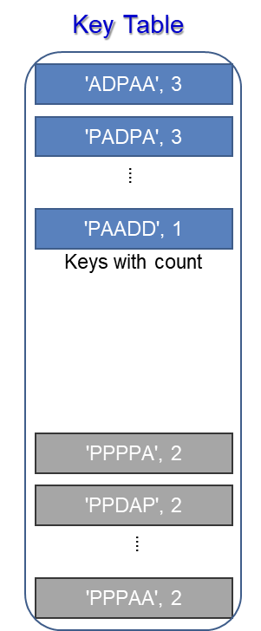


3. Searching using Keys
Ligand 1
:
Scoring function
Key DB
Sort by score
&
Select N
candidate!
Ligand n
Candidate ligands for
Deep Matcher
Keys for searching

Slide 17
1/2D-Scan Detail Process

Slide 18
1/2DScan DB 생성
1. 계산용 server IP: 10.0.3.16 ~ 25
2. DB를 생성시 ID의 중복때문에 multiprocessing을 하지 않음.
→ Sequential 하게 처리
3. 각 서버의 zinc_work/zinc_split/XIn_181/merge_sdf에 있는 sdf 파일을 이용.
4. 대용량 메모리 필요한 관계로 시스템에 있는 고성능 서버를 이용(256G ram)
5. 현재는 고성능 서버에 merge_sdf 파일이 있다고 가정함(실제 복사해야 됨.)
F_DB: Make_ZINC15_F_DB.G.v6.py
IDK_DB: Make_ZINC15_IDK_DB.G.v3.py
K_DB: Make_ZINC15_K_DB.G.v9.py
Scaffold DB: Make_ZINC15_1.Scaffold_pickle.v1.py →
Make_ZINC15_2.ScaffoldDB_from_pickle.v1.py
ZINC_FAF.db: Make_ZINC15_FAF.G.v1.py
ZINC_FDA.db: Make_ZINC15_1.chemprop.apsw.v1.py

Slide 19
1/2DScan-ARS Schema
Input
Main process
Sub process
Seed for searching
Extract key
Cluster seed
Make key table
Key DB
Search key
& Score
Select main keys
Search with keys
Feature DB
Score results
SDF DB
Extract the SDF
& Filter (RO5, FDA)
Extract SDFs
Annotation DB (RO5, FDA)
Filter by RO5, FDA
Convert SDF to PDB
Convert SDF to PDB

Slide 20
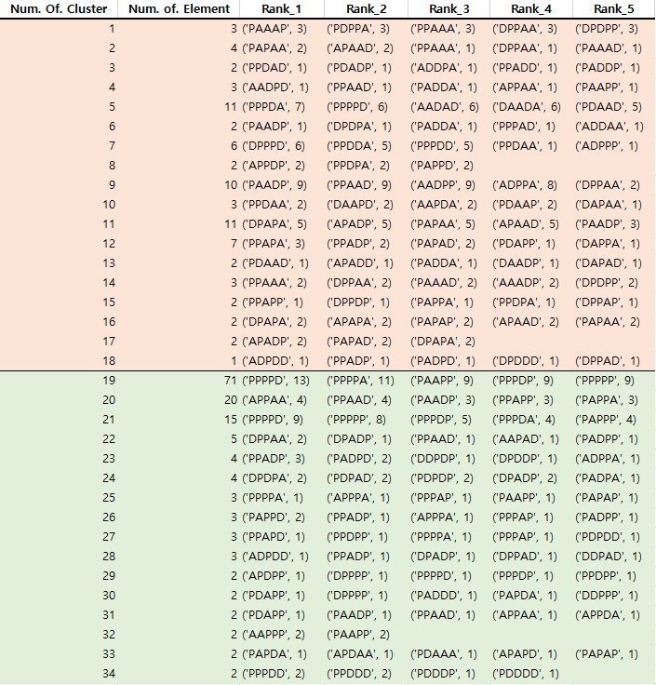
1) Extract key
Cluster the seeds. (Tanimoto score 0.7)
DBSCAN
Make key table from clusters.
> tanimoto score 0.7
DBSCAN
< tanimoto score 0.7
DBSCAN

Slide 21
2) Search key & Score
Select main keys from key table. (8 Methods)
1. 모든 key을 추출하여 가장 많이 나타나는 10 key 선택 → 1 set
2. Tanimoto > 0.7에서 member수가 3개이상인 cluster의 모든 key 선택 → 1 set
3. Tanimoto > 0.7의 각 cluster에서 Rank1에 해당하는 모든 key 선택 → 1 set
4. Tanimoto > 0.7에서 occurrence frequency of key top 10 선택 → 1 set
5. Tanimoto > 0.7에서 occurrence frequency of key top 5 선택, Tanimoto < 0.7에서 occurrence frequency of key top 5 선택.
단 타이가 많을 땐 클러스터 member수가 많은 cluster를 중심으로→ 1 set
6. Cluster member의 개수로 sorting하여 상위 10개 cluster의 rank 1 key을 선택 단 cluster 개수가 10개 이하면, cluster 갯수만큼 → 1 set
7. Tanimoto > 0.7에서 member수가 가장 적은 cluster(2이하)의 occurrence frequency가 낮은 것(1인 것만) Max 20개 key 선택 → 1 set
8. Tanimoto < 0.7 에서 각 member수가 가장 적은 cluster(2이하)의 occurrence frequency가 낮은 것(1인 것만) Max 20개 key 선택 → 1 set
- 1~6에서는 상위 occurrence frequency을 위주로 Key를 추출하여 선택하였으나 7~8에서는 다양성을 보완하기 위하여 하위 occurrence frequency을 위주로 Key를 선택함.
Example of method 3
> tanimoto score 0.7
DBSCAN
< tanimoto score 0.7
DBSCAN

Slide 22
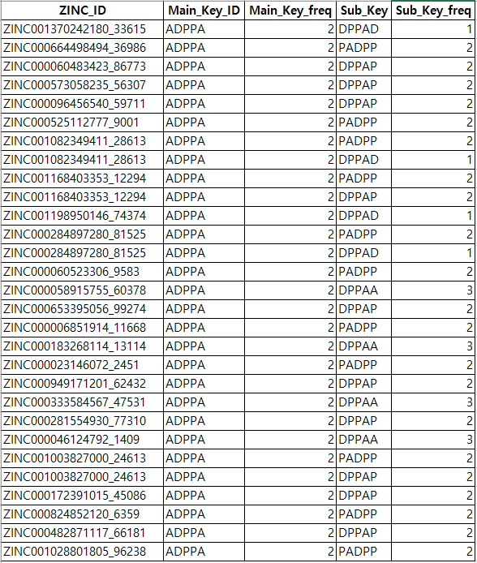
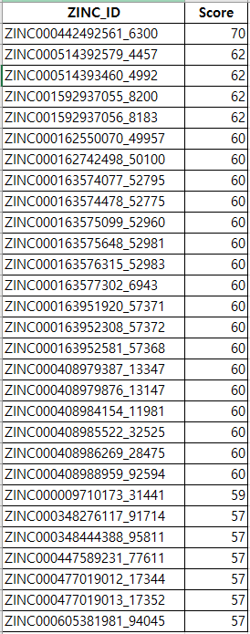
2) Search key & Score
Find IDs which have been selected main keys.
Cluster to make sub keys.
Score ID.
score = ID_freq + Main_Key_freq + Sub_Key_freq

Slide 23
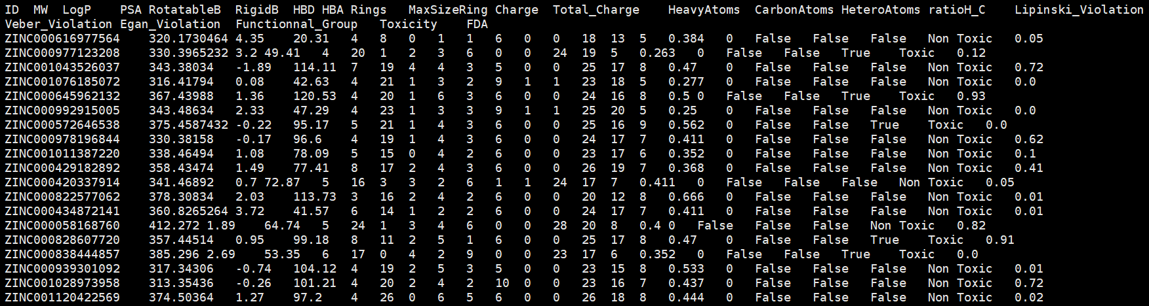
3) Extract the SDF & Filter (RO5, FDA DL)
Extract the SDF by using DB.
Filter by RO5 annotation. (ADMET)
FAF-Drug2 (Filter : MW ≤ 500, LogP ≤ 5, HBD ≤ 5, HBA ≤ 10)
Filter by FDA annotation.
Deep Learning chemprop (Filter : FDA ≥ 0.5)
Only ZINC15 results existed. (0~1)
ChEMBL or KCB has no result. (So, a random number 1 was assigned.)
David Lagorce, Olivier Sperandio, Hervé Galons, Maria A Miteva, Bruno O Villoutreix "FAF-Drugs2: Free ADME/tox filtering tool to assist drug discovery and chemical biology projects "BMC Bioinformatics. 2008; 9: 396

Slide 24
3) Extract the SDF & Filter (RO5, FDA DL)
FAF-Drug2
Annotation | Information | Example
ID | ID | ZINC0001
MW | Molecular weight | 320.173
LogP | Log of the octanol/water partition coefficient (including implicit hydrogens). | 4.35
PSA | Topological Polar Surface Area | 20.31
RotatableB | Number of rotatable bonds | 4
RigidB | Number of rigid bonds | 8
HBD | Numbers of Hydrogen bond donors | 0
HBA | Numbers of hydrogen bond acceptors | 1
Rings | Number of rings | 1
MaxSizeRing | Maximum size of ring | 6
Charge | Number of atom with a net charge | 0
TotalCharge | Sum of formal charges | 0
HeavyAtoms | Number of heavy atoms | 18
CarbonAtoms | Number of carbon atoms | 13
HeteroAtoms | Number of hetero-atoms | 5
ratioH/C | Value of ratio het/c (number of carbon atoms, number of hetero-atoms). | 0.384
Lipinski_Violation | Number of violations of Lipinski's RO5 | 0
Veber_Violation | Veber Rule: defined as TPSA>140Å or number of rotatable bonds>10 | FALSE
Egan_Violation | Egan Rule: defined as TPSA > 131.6Å or log P > 5.88 | FALSE
Functional_Group | Reactive or undesirable functional groups | FALSE
Toxicity | Toxicity | Non Toxic

Slide 25
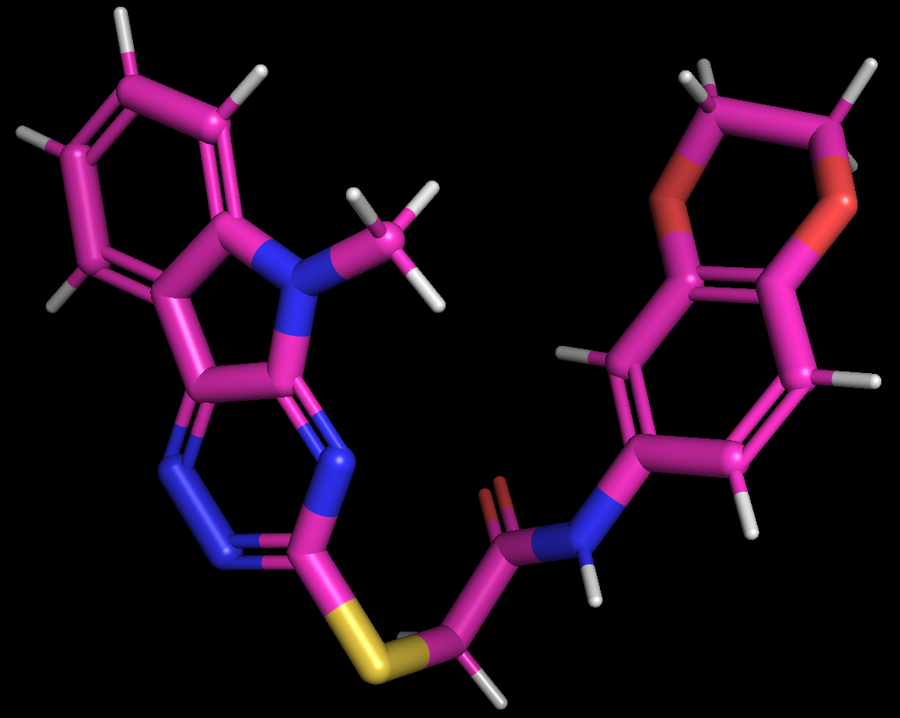
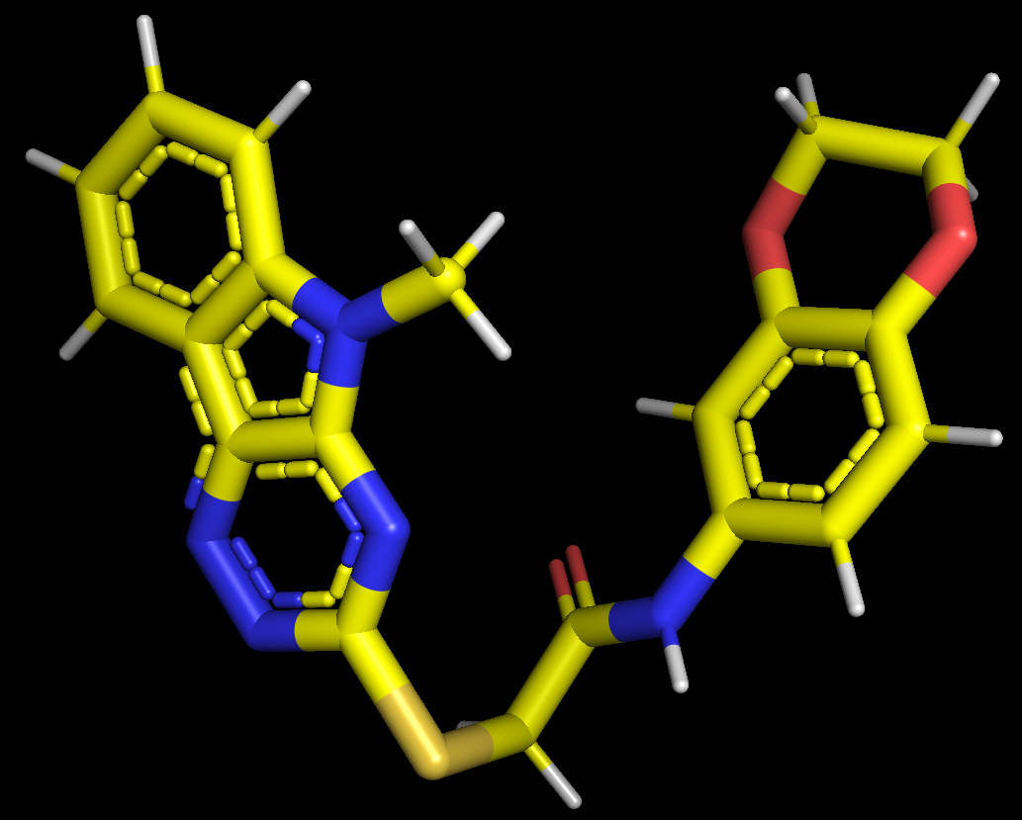
4) Convert SDF to PDB
Convert 3D SDF files to 3D PDB files.
BABEL
3D SDF
3D PDB
BABEL
Example :ZINC000000719821_7563

Slide 26
1/2D-Scan ARS 실행방법

Slide 27
1/2DScan ARS 환경 설정
1. miniconda2 설치
$ bash Miniconda2-latest-Linux-x86_64.sh
- /lwork01/miniconda2
$ source ~/.bashrc
2. conda update
$ conda update -n base -c defaults conda
3. conda 환경 생성
$ conda env create -f ~/environment_Env.yml
(주석처리# - jpeg=9b=2, # - libiconv=1.15=0,
pip 영역으로 옮긴 후 - matplotlib=2.2.2 주석처리#=py27_1)
4. conda 환경 활성화
$ conda activate Env
5. OS영역 의존성 라이브러리 패키지 설치
$ sudo yum install libXrender libXext -y

Slide 28
1/2DScan ARS Seed DB 생성 방법
1. Use the PHscan_Make_Input.
2. Put the seed ligand files in "/PHscan_Make_Input/data/input". (원본 백업 필수)
3. Remove the contents in "/PHscan_Make_Input/data/PHscan_out".
4. Run "python make_input.py -j 20" at "/PHscan_Make_Input" and "20" means the number of cpu.
5. Go to "/PHscan_Make_Input/util/tools".
6. Run "python read_dump.py > re.2038.txt" and "re.2038.txt" means the name of output file.
7. Cp the "re.2038.txt" to "/zinc_work/Re_In_N_Seed"
8. We will make two database tables: "Seed_F.db and Seed_K.db".
9. Go to "/zinc_work"
10. Run "python Make_ZINC15_F_DB.v5.py -t c -d ./Re_In_N_Seed/"
-t "c": create new db, "a":add the content to exsiting db
-d "./Re_In_N_Seed/": to make seed db, "Re_In_N": to make ZINC15 db
If the program shows the ligands list, remove the these ligands from the input seed list.
Because the length of their keys is less than '5'
11. Run "python Make_ZINC15_K_DB.v7.py -t c -d ./Re_In_N_Seed/"
12. Move the two db tables(Seed_F.db and Seed_K.db) at "/zinc_work/Out_ZINC_DB" to "/PHscan_1D_ZINC15_M/Data/DB_Table"

Slide 29
1. 1/2D-Scan ARS 실행 방법-1
1.1/2D-Scan ARS 실행 방법1 (full-automatics, key table 자동 생성)
1. 1D_Scan.v2 디렉토리로 이동한다.
Command: $cd 1D_Scan.v2
→ input: ./Data : Seed sdf file들이 있는 폴더
2. Input 폴더에 분석할 sdf 파일을 넣는다.
Command: $ mv *.sdf ./Input
3. 1DScan_Start.sh를 실행한다. (No parameter)
Command: $ ./1DScan_Start.sh
4. 최종 생성된 라운드별 PDB 파일을 확인한다.
→ output: ./Data/Dic_Lib_Output_PDB폴더에 최종 PDB 파일들이 존재한다.
2. 1/2D-Scan ARS 실행 방법2 (key 수동 생성)
1. 1D_Scan.v2 디렉토리로 이동한다.
Command: $cd 1D_Scan.v2
2. input.key.m.list.txt 파일을 생성한다. (자세한 format은 다음 슬라이드 참조)
Command: $ vi input.key.m.list.txt
→ input: input.key.m.list.txt 파일
3. 1DScan_Start.sh를 실행한다. (Parameter : m)
Command: $ ./1DScan_Start.sh m
4. 최종 생성된 라운드별 PDB 파일을 확인한다.
→ output: ./Data/Dic_Lib_Output_PDB폴더에 최종 PDB 파일들이 존재한다.

Slide 30
1. 1/2D-Scan ARS 실행 방법-2
1/2D-Scan ARS 실행 방법2: (key 수동 생성) 추가 설명
$ vi input.key.m.list.txt
PAADP PPAAD PPDPA PDDPA AADPP DPAPP PPPAP PADPA PPPPA PDPAA
PPADP PPDPP AADDA PPAAD ADDAD ADPAA DPAPP PAADD DDADP PADPA
PPADP PDAPP AADDA PAADP PPPPA ADPAA PAPPA DPAPP
PPADP AADDA PAADP PPPPA DPAPA PAADD PDDPA PPDPA ADDAD DDADP
PPADP AADDA PAADP PPPPA PPPAP DPAPA ADPAD PAADD PDDPA PPDDP PPDPA PDPPA ADDAD DDADP PADPA ADPPD PDPPD
PPADP PDAPP AADDA PAADP PPPPA PDDDD ADPAA PAPPA PAAPD DPAPP ADPPD
PPADP DPAAD DPADP PPDAD PAAPP PPPDP PAPPD PPAAD PPAPP DADAP DDPAP PDPPA DPPPD DPAPA PPPDA PDPDA APPAP APPAA ADAPP
PPADP DPDPD PPDDP PPPPA DAADA PPDAD AAPDP APPDP DPAPA APPAA PAAPP PDDPA DPPDP PAPPA DPPAA DDPPA PDPPP DDPPD PPDDA
Important
→ 수동으로 Key set를 정의 할 수 있다. 실행은 line by line으로 실행되며, 한 라인(a key set)에 들어갈 수 있는 key 수는 limit는 없으나 보통 20이하를 권장한다. 또한 key의 길이는 5로 한정한다. 라인 수의 limit는 존재하지 않으나 10개 이하를 권장한다.

Slide 31
1. 1/2D-Scan ARS directory and file 정보
1. 1/2D-Scan ARS directory 정보
Directory (Data) | File Information
Input | 입력 Seed SDF files이 저장되는 폴더
Table | Key table이 저장되는 폴더
1D_Out_nR | 1~8가지 방법으로 나온 결과물이 저장되는 폴더
Dic_Lib_Input | 1~8가지 방법으로 나온 결과물이 score에 의해서 정렬된 자료가 저장되는 폴더
Dic_Lib_Output_SDF | 주어진 key로 Ligand DB를 검색하여 추출한 SDF 파일이 저장되는 폴더
PASS | 원하는 필터링 조건을 만족하는 최종 SDF 파일이 저장되는 폴더
Dic_Lib_Output_PDB | 최종 PDB 파일이 저장되는 폴더
Annotation | FAFDrugs2 tool과 FDA chemprop을 이용해 최종 SDF 파일에 대한 annotation 정보가 저장되는 폴더

Slide 32
1. 1/2D-Scan ARS directory and file 정보
2. 1/2D-Scan ARS file 정보
File (Tools) | File Information
1DScan_Start.sh | 1/2D-Scan ARS실행파일
Key_gen.M.v2.db.py | Seed로 부터 key을 추출하는 파일
Make_Key_Table.v3.sh | Seed를 클러스터링(tanimoto score >= 0.7)하여 key table을 만드는 파일
Clustering_Input_ligand.DBSCAN.v5.yg.py | BABEL, DBSCAN tool 사용해 Seed를 클러스터링(tanimoto score > 0.7)하는 파일
select_clustered_sdf.v3.py | 클러스터링 안된 SDF파일 선택하는 파일
Clustering_Input_ligand.DBSCAN.v5.yg.py | BABEL, DBSCAN tool 사용해 Seed를 클러스터링(tanimoto score < 0.7)하는 파일
Key_gen.v3.yg.py | Key table을 만드는 파일 (Tanimoto score 0.7)
Extrat_Key_from_Table.M.py | Key table에서 8가지 방법으로 key set을 추출하는 파일
1DScan_Only_Key.ZINC.list.FP.v6.db.py | 주어진 key로 Ligand DB를 검색하는 파일
Filter.re.ZINC.v2.db.FP.py | 결과로 나온 파일을 filtering하는 파일
Extract_sdf_DB.v5.py | 결과로 나온 ID를 Ligand DB에서 찾아 SDF file을 추출하는 파일 (설정된 개수)
Annotation_FAF_chemprop.v3.py | ADMET, FDA chemprop annotation을 하는 파일
Final_Filtering.v2.py | 최종 SDF 파일에 대해 RO5 필터링하는 파일
Final_Extract_PDB.v2.py | Ligand ID를 클러스터링(tanimoto score 0.9)하여 최종 ZINC PDB 생성하는 파일
l_clustering.v3.py | BABEL, ICLIQ tool 사용해 Seed를 클러스터링(tanimoto score >= 0.9)하는 파일
sdf2pdb_with_cluster.py | 최종 SDF 파일을 PDB 파일로 변환하는 파일
sdf2pdb_without_cluster.py | 최종 SDF 파일을 PDB 파일로 변환하는 파일

Slide 33
1/2D-Scan ARS 실행 시간
총 38.5시간 소요
Input sdf 개수 : 132개
Input key 개수 : 126개

Slide 34
1/2D-Scan ARS Protocol

Slide 35
1/2D-Scan ARS protocol
Round | Database | Number of input | Input | Date | Process
1 | ChEMBL | 52 | ChEMBL data | 2019.11
2 | ChEMBL | 185 | ATP,IP2,IP3,IP4 | 2019.12 | Clustering(tanimoto score, manual)
3 | ChEMBL | 112 | CDK7(CDK2,CDK6) | 2020.01
4 | ChEMBL | 55 | FDA approved | 2020.01
5 | ZINC12 | 297 | ATP,IP2,IP3,IP4,CDK7(CDK2,CDK6) | 2020.01
6 | ZINC12 | 55 | FDA approved | 2020.01
* | ZINC12 | 174 | EGFR | 2020.02
7 | ZINC15 | 270 | ATP,IP4,CDK7(CDK2,CDK6),FDA approved | 2020.04
8 | ZINC15 | 1876 | Kinase inhibitor | 2020.05

Slide 36
ChEMBL 1st
ChEMBL 1st selection
52 ChEMBL
ligands
Extract the Main Key by occurrence frequency
(PDPPD, PPAAP, PPPAP, PPPPA, PPPPD, PPPPP)
Query using Main Key
Preprocessed
ChEMBL DB(1.8M)
323,350
Ligand retrieval
1.Sub clustering using Sub_Key
2.Select ligands by ChEMBL_ID occurrence frequency which satisfies the RO5
Select 1,383
ligands
3.Clustering using babel(Tanimoto >0.9) and iclliq
Select 908 ligands
Deep Matcher

Slide 37

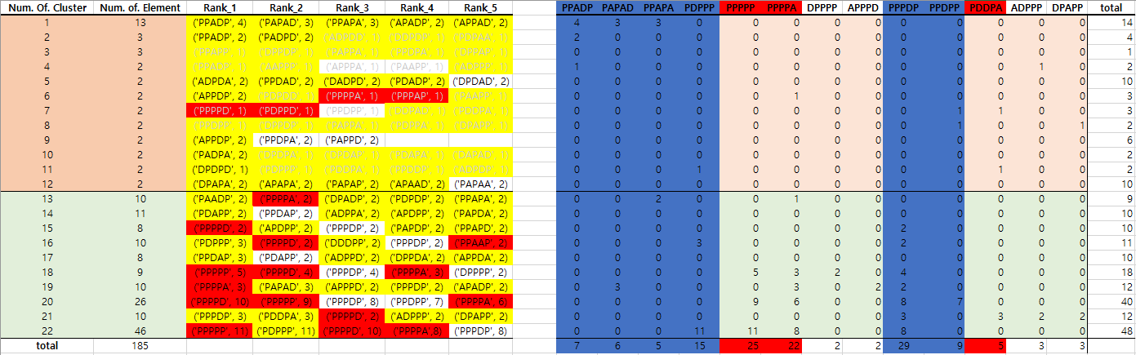
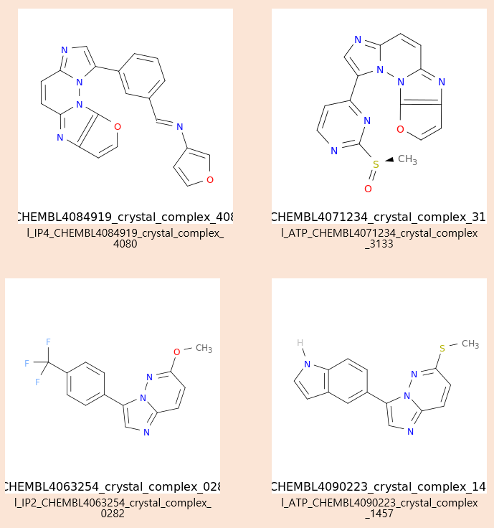
ChEMBL 2nd
ChEMBL 2nd selection
185 ChEMBL
ligands
Extract the Main Key
(PAPAD, PDPPP, PPADP, PPAPA, PPDPP, PPPDP)
Different Input!
Query using Main Key
Tanimoto >0.7
Preprocessed
ChEMBL DB(1.8M)
Using Clustering algorithm
Manually clustering
532,777
Ligand retrieval
1.Sub clustering using Sub_Key
2.Select ligands by ChEMBL_ID occurrence frequency which satisfies the RO5
Select 1,496 ligands
3.Clustering using babel(Tanimoto >0.9) and iclliq
Select 935 ligands
Deep Matcher

Slide 38
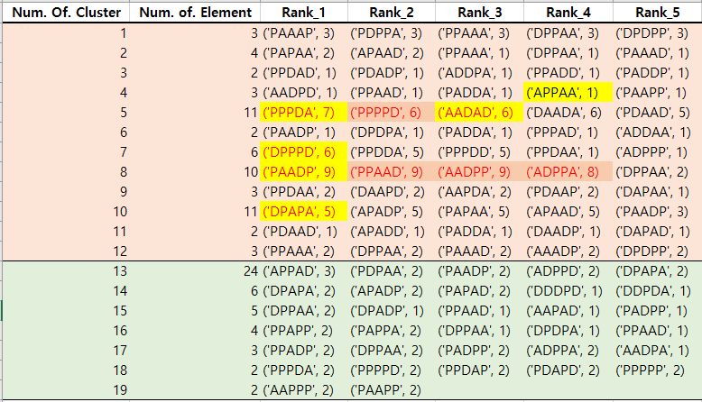
ChEMBL 3rd
ChEMBL 3th selection
Extract the Main Key
(APPAA, PPPDA, AADAD, DPPPD, PAADP, DPAPA)
122 ChEMBL
ligands
Query using Main Key
Different Input!
Preprocessed
ChEMBL DB(1.8M)
685,777
Ligand retrieval
Tanimoto >0.7
1.Sub clustering using Sub_Key
2.Select ligands by ChEMBL_ID occurrence frequency which satisfies the RO5
DBSCAN clustering
Select 1,685 ligands
3.Clustering using babel(Tanimoto >0.9) and iclliq
Select 996 ligands
Deep Matcher

Slide 39
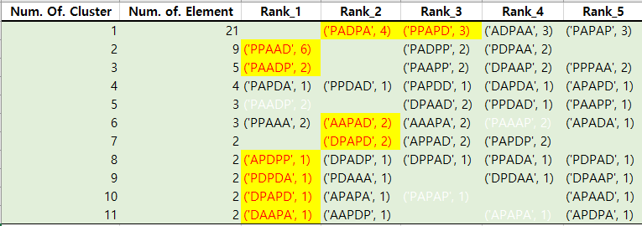
ChEMBL 4th
ChEMBL 4th selection
Kinase inhibitors
(FDA approved)
96 ligands
Extract the Main Key
(PADPA, PPAPD, PPAAD ,PAADP, AAPAD, DPAPD, APDPP, PDPDA, DPAPD, DAAPA)
Different Input!
Remove redundancy
Query using Main Key
55 ChEMBL
ligands
Preprocessed
ChEMBL DB(1.8M)
696,702
Ligand retrieval
DBSCAN clustering
1.Sub clustering using Sub_Key
2.Select ligands by ChEMBL_ID occurrence frequency which satisfies the RO5
Select 1,496 ligands
No cluster: Tanimoto >0.7
3.Clustering using babel(Tanimoto >0.9) and iclliq
Select 1,019 ligands
Deep Matcher

Slide 40
ZINC12 5th
ZINC12 5th selection
Different Input!
Extract the Main Key
(APPAA, PPPDA, AADAD, DPPPD, PAADP, DPAPA)
ATP, IP2, IP3, IP4, CDK2, CDK6,Kinase inhibitors
Query using Main Key
297 Seed ligands
Preprocessed
ZINC12 DB(8.5M)
Ligand retrieval
Tanimoto >0.7
1.Sub clustering using Sub_Key
2.Select ligands by ChEMBL_ID occurrence frequency which satisfies the RO5
DBSCAN clustering
Select 23,655 ligands
3.Clustering using babel(Tanimoto >0.9) and iclliq
Select 10,235 ligands
Deep Matcher

Slide 41
ZINC12 6th
ZINC12 6th selection
Kinase inhibitors
(FDA approved)
96 ligands
Extract the Main Key
(PADPA, PPAPD, PPAAD ,PAADP, AAPAD, DPAPD, APDPP, PDPDA, DPAPD, DAAPA)
Different Input!
Remove redundancy
Query using Main Key
55 Seed
ligands
Preprocessed
ZINC12 DB(8.5M)
Ligand retrieval
DBSCAN clustering
1.Sub clustering using Sub_Key
2.Select ligands by ChEMBL_ID occurrence frequency which satisfies the RO5
Select 21,829 ligands
No cluster: Tanimoto >0.7
3.Clustering using babel(Tanimoto >0.9) and iclliq
Select 6,243 ligands
Deep Matcher

Slide 42
ZINC15 7th
ZINC15 7th selection
Different Input! and DB(ZINC15)
Extract the Main Key
ATP, IP4, CDK2, CDK6,Kinase inhibitors
Query using Main Key
Preprocessed
ZINC15 DB(650M)
272 Seed ligands
800,000
Ligand retrieval
RO5 filtering
Tanimoto >0.7
1. Filter by FDA Model
2. Filter by CDK7 Model
DBSCAN clustering
Select 61,098 ligands
Select 16,129
ligands
Deep Matcher 1
Deep Matcher 2

Slide 43
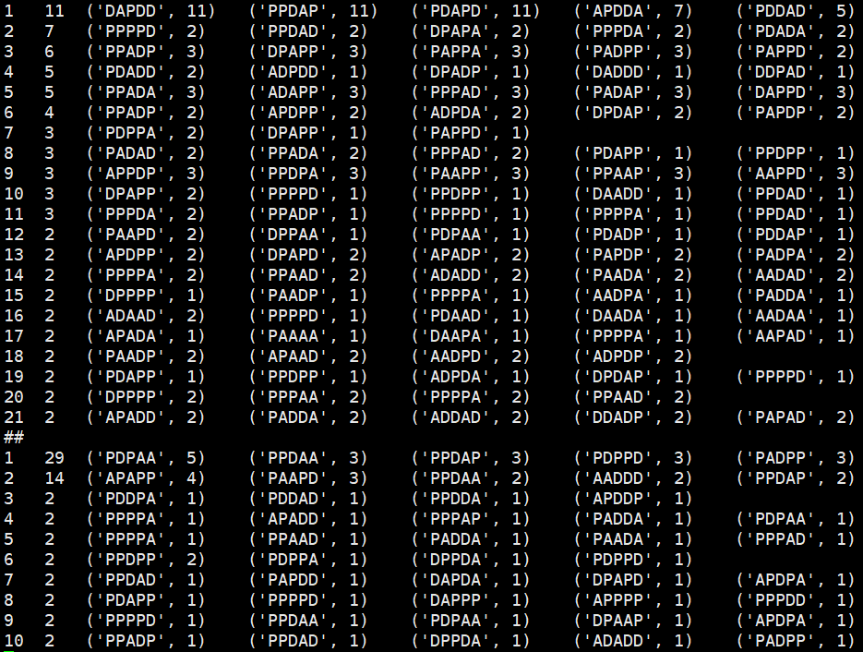
ZINC15 8th
ZINC15 8th selection
Extract the Main Key
←For each group!!!
Query using Main Key
Different Input! and DB(ZINC15)
Preprocessed
ZINC15 DB(650M)
Kinase inhibitors
(By KLIFS DB and bindingDB)
1876 Seed ligands
100,000
Ligand retrieval
9 Kinase Group
(AGC, Atypical, CAMK, CK1, CMGC, Other, STE, TK, TKL)
RO5 filtering
Filter by FDA Deep learning model
Select N ligands
Tanimoto > 0.7
Filter by Kinase deep learning model
Select N ligands
Filter by Scaffold model
Tanimoto < 0.7
Deep Matcher
ex) AGC group

Slide 44
1/2DScan Validation (1/2DScan 5th, 6th)

Slide 45
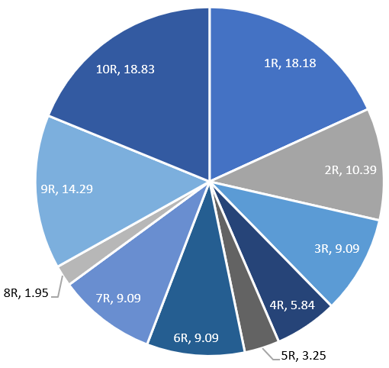
Final result of Phscan(1/2D,3D)
As a final result of Phscan(1/2D,3D), 151 ZINC_ID have high HBQI(>=5). We divided them into rounds.
Data / Round | 1R | 2R | 3R | 4R | 5R | 6R | 7R | 8R | 9R | 10R | Total (count)
5차 Seed : 297 | 8 | 13 | 14 | 8 | 2 | 10 | 12 | 2 | 15 | 11 | 59
6차 Seed : 55 | 20 | 3 | 0 | 1 | 3 | 4 | 2 | 1 | 7 | 18 | 95
Total (%) | 18.18 | 10.39 | 9.09 | 5.84 | 3.25 | 9.09 | 9.09 | 1.95 | 14.29 | 18.83
5차 Seed (297개) : CDK7
6차 Seed (174개) : FDA 승인 kinase
How to Select Keys by Round
1. 모든 key을 추출하여 가장 많이 나타나는 10 key 선택
2. Tanimoto > 0.7에서 member수가 3개이상인 cluster에서 모든 key 선택
3. Tanimoto > 0.7의 각 cluster에서 Rank1에 해당하는 모든 key 선택
4. Tanimoto > 0.7에서 occurrence frequency of key에서 top 10 선택
5. Tanimoto > 0.7에서 occurrence frequency of key에서 top 5 선택, Tanimoto < 0.7에서 occurrence frequency of key에서 top 5 선택
6. Cluster member의 개수로 sorting하여 상위 10개 cluster의 rank 1 key을 선택
7. Tanimoto > 0.7에서 member수가 가장 적은 cluster(2이하)에서 occurrence frequency가 1인 것만 Max 20개 key 선택
8. Tanimoto < 0.7 에서 각 member수가 가장 적은 cluster(2이하)에서 occurrence frequency가 1인 것만 Max 20개 key 선택

Slide 46
1/2D-Scan validation
1. Goal : To validate the ranking algorithm
2. Data set: Final result (151 ligands)
Figure 1. The count of ligand for the rank

Slide 47
1/2D-Scan validation
1. Goal : To validate the ranking algorithm
2. Data set: Final result (151 ligands)
Figure 2. The count of ligand for the rank and round

Slide 48
1/2D-Scan validation
1. Goal : To validate the ranking algorithm
2. Data set: Final result (151 ligands)
Rank / Round | 1R | 2R | 3R | 4R | 5R | 6R | 7R | 8R | 9R | 10R | 총합계 (%) | 누적합계(%)
1-100 | 1 | 3 | 1 | 0 | 0 | 0 | 3 | 0 | 0 | 12 | 12.99 | 40.26
101-200 | 1 | 0 | 1 | 0 | 0 | 0 | 0 | 0 | 1 | 2 | 3.25
201-300 | 1 | 2 | 2 | 2 | 0 | 0 | 2 | 0 | 1 | 5 | 9.74
301-400 | 5 | 0 | 0 | 1 | 0 | 0 | 1 | 0 | 3 | 2 | 7.79
401-500 | 2 | 0 | 0 | 2 | 0 | 1 | 0 | 0 | 4 | 1 | 6.49
501-600 | 4 | 0 | 0 | 0 | 1 | 0 | 1 | 0 | 2 | 1 | 5.84 | 68.18
601-700 | 1 | 1 | 2 | 1 | 0 | 2 | 0 | 0 | 3 | 1 | 7.14
701-800 | 0 | 2 | 1 | 0 | 0 | 0 | 3 | 0 | 0 | 0 | 3.90
801-900 | 2 | 0 | 1 | 1 | 0 | 1 | 2 | 3 | 0 | 0 | 6.49
901-1000 | 3 | 0 | 0 | 2 | 0 | 0 | 0 | 1 | 0 | 1 | 4.55
1001-1100 | 0 | 2 | 1 | 0 | 0 | 4 | 0 | 1 | 0 | 0 | 5.19 | 84.42
1101-1200 | 1 | 1 | 2 | 0 | 0 | 2 | 0 | 0 | 0 | 0 | 3.90
1201-1300 | 0 | 0 | 1 | 0 | 0 | 0 | 0 | 0 | 0 | 0 | 0.65
1301-1400 | 1 | 2 | 0 | 0 | 0 | 0 | 0 | 0 | 2 | 0 | 3.25
1401-1500 | 1 | 1 | 1 | 0 | 0 | 0 | 0 | 0 | 2 | 0 | 3.25
1501-1600 | 2 | 0 | 1 | 0 | 0 | 0 | 0 | 0 | 1 | 1 | 3.25 | 92.21
1601-1700 | 0 | 0 | 0 | 0 | 1 | 0 | 0 | 0 | 0 | 0 | 0.65
1701-1800 | 0 | 0 | 0 | 0 | 0 | 0 | 0 | 0 | 1 | 1 | 1.30
1801-1900 | 2 | 0 | 0 | 0 | 0 | 0 | 0 | 0 | 2 | 0 | 2.60
1901-2000 | 0 | 0 | 0 | 0 | 0 | 0 | 0 | 0 | 0 | 0 | 0.00
2001-2100 | 1 | 0 | 0 | 0 | 3 | 0 | 0 | 0 | 0 | 2 | 3.90 | 100.00
2101-2200 | 0 | 0 | 0 | 0 | 0 | 1 | 0 | 0 | 0 | 0 | 0.65
2201-2300 | 0 | 2 | 0 | 0 | 0 | 1 | 0 | 0 | 0 | 0 | 1.95
2301-2400 | 0 | 0 | 0 | 0 | 0 | 1 | 0 | 0 | 0 | 0 | 0.65
2401-2500 | 0 | 0 | 0 | 0 | 0 | 1 | 0 | 0 | 0 | 0 | 0.65
총합계 (%) | 18.18 | 10.39 | 9.09 | 5.84 | 3.25 | 9.09 | 7.79 | 3.25 | 14.29 | 18.83 | 100
Table 1. The analysis between the count of ligand and the rank
→ Select max rank 2500

Slide 49
1/2D-Scan validation
1. Goal : To validate the ranking algorithm
2. Data set: Final result (151 ligands)
Figure 3. The average of ligand score for the rank
→ Select max rank 2500

Slide 50
1/2D-Scan ARS 8th

Slide 51
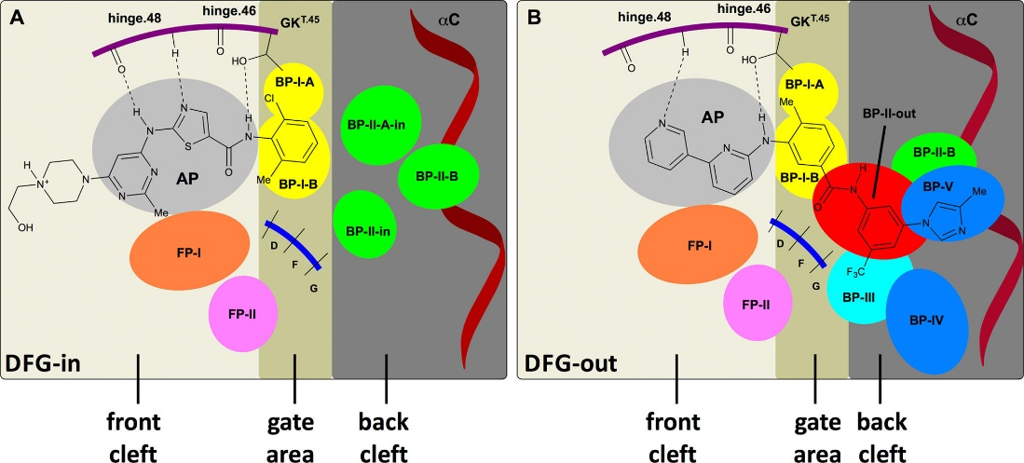

1. Select the ligands (about 2,000)
Goal : To select the 2,000 ligands
Data: Kinase-Ligand Interaction Fingerprints and Structures DB (KLIFS) and other DBs
Data Type
Type1 : Binding DFG front cleft site(hinge site)
Type2 : Binding DFG gate and back cleft site
Type3 : No such a information (368개) from BindingDB
From PDB
Type1 : 1,485
Type2: 23
Type3: 368
Total: 1,508 (remove redundant)
Total: 1,876 Seeds

Slide 52
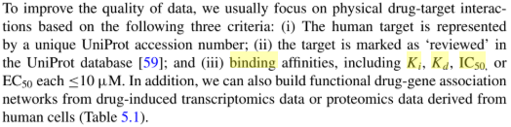
1. Select the ligands (about 2,000)
Used Database
1. Kinase-Ligand Interaction Fingerprints and Structures database (KLIFS) (from PDB)
2. BindingDB
Ki or IC50 or Kd or EC50 <= 100nM
Huixiao Hond, <Advances in Computational Toxicology>, Springer(2019), p79

Slide 53
2. Analysis of Seeds
80 Gene Kinase kinome 분포
Kinase Groups | Num. | Percent
AGC | 7 | 8.75
CAMK | 3 | 3.75
CK1 | 4 | 5
CMGC | 8 | 10
STE | 2 | 2.5
TK | 43 | 53.75
TKL | 5 | 6.25
Atypical | 0 | 0
Other | 8 | 10
Total | 80 | 100
1876 Seeds Kinase kinome 분포
Kinase_Groups | Num. | Percent | Type_1 | Type_2 | Type_3 | Location
CMGC | 699 | 37.26 | 495 | 9 | 195 | serine/threonine-specific
TK | 348 | 18.55 | 333 | 2 | 13 | tyrosine residues
CAMK | 302 | 16.10 | 253 | 0 | 49 | serine/threonine-specific
Other | 142 | 7.57 | 121 | 0 | 21
AGC | 132 | 7.04 | 108 | 0 | 24 | serine/threonine-specific
TKL | 118 | 6.29 | 70 | 12 | 36 | tyrosine residues
STE | 63 | 3.36 | 62 | 0 | 1
Atypical | 60 | 3.20 | 31 | 0 | 29
CK1 | 12 | 0.64 | 12 | 0 | 0 | serine/threonine-specific
Total | 1876 | 100 | 1485 | 23 | 368
Genomic analysis of the eukaryotic protein kinase superfamily: a perspective Genome Biol. 2003; 4(5): 111. Published online 2003 Apr 29. doi: 10.1186/gb-2003-4-5-111

Slide 54

3. Filtering of candidate ligands and results
1. Used filter: RO5, FDA (chemprop version)
Kinase ligand (chemprop version not used → Prediction ratio only 77% !!!)
자체 Kinase ligand deep learning model: Prediction ratio 95%!!
1,876 Seeds
4,166,762
Candidate ligands
Filter
1.RO5 model
(MW ≤ 500, LogP ≤ 5, HBD ≤ 5, HBA ≤ 10)
2.FDA model (chemprop)
3. Kinase ligand model(자체 kinase DL)
663,513
Final candidate ligands
1/2D-Scan
1/2D-Scan Data flow
2.Results
1/2D-Scan Results
Kinase Groups | Total | After FDA+RO5 | After Kinase DL (Final)
CMGC | 372,060 | 59,434 | 59,128
TK | 506,413 | 76,734 | 76,287
CAMK | 581,692 | 92,606 | 91,832
Other | 703,526 | 103,731 | 103,024
AGC | 383,245 | 62,018 | 61,572
TKL | 444,972 | 69,233 | 68,687
STE | 536,430 | 99,410 | 98,334
Atypical | 242,429 | 44,103 | 43,837
CK1 | 395,995 | 61,626 | 60,812
Total | 4,166,762 | 668,895 | 663,513

Slide 55
1/2D-Scan Scaffold

Slide 56
1/2D-Scan Scaffold 탐색 방법
Input 화합물의 scaffold 파일 생성 (./Data/Input_SCF 위치에 smi 생성)
cd Tools
python Make_Scaffold_from_Input.M.v2.py
Input 화합물의 scaffold를 가지는 화합물 탐색
cd ..
python 1DScan_Only_SCF.v1.db.py

