Slide 1

1st to 8th round protocol
2020.05.27
YeaGuen Yoon
SeungWoo Shin
: 이전 차수랑 다른 점 !!!

Slide 2
ChEMBL 1st selection
52 ChEMBL
ligands
Extract the Main Key by occurrence frequency
(PDPPD, PPAAP, PPPAP, PPPPA, PPPPD, PPPPP)
Query using Main Key
Preprocessed
ChEMBL DB(1.8M)
323,350
Ligand retrieval
1.Sub clustering using Sub_Key
2.Select ligands by ChEMBL_ID occurrence frequency which satisfies the RO5
Select 1,383
ligands
3.Clustering using babel(Tanimoto >0.9) and iclliq
Select 908 ligands
Deep Matcher

Slide 3
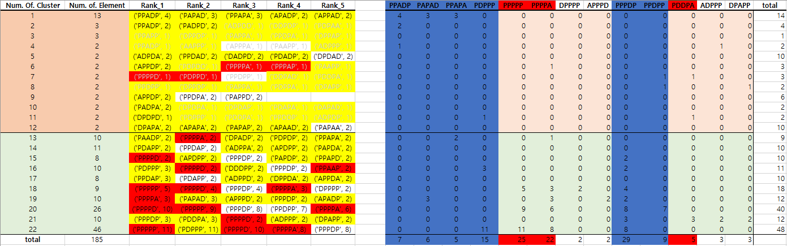
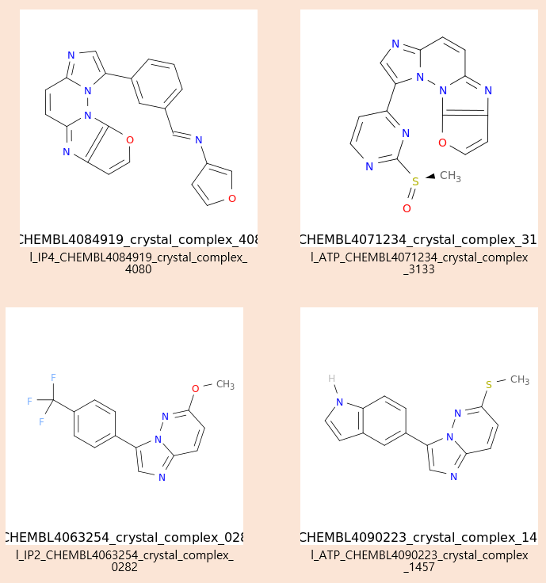
ChEMBL 2nd selection
185 ChEMBL
ligands
Extract the Main Key
(PAPAD, PDPPP, PPADP, PPAPA, PPDPP, PPPDP)
Query using Main Key
Tanimoto >0.7
Preprocessed
ChEMBL DB(1.8M)
Using Clustering algorithm
Manually clustering
532,777
Ligand retrieval
1.Sub clustering using Sub_Key
2.Select ligands by ChEMBL_ID occurrence frequency which satisfies the RO5
Select 1,496 ligands
3.Clustering using babel(Tanimoto >0.9) and iclliq
Select 935 ligands
Deep Matcher

Slide 4
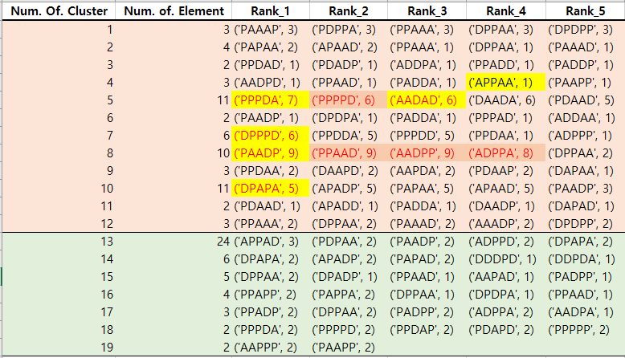
ChEMBL 3rd selection
Kinase ligand drug
CDK2:112,CDK6:2
Extract the Main Key
(APPAA, PPPDA, AADAD, DPPPD, PAADP, DPAPA)
Different Input!
Query using Main Key
122 ChEMBL
ligands
Preprocessed
ChEMBL DB(1.8M)
685,777
Ligand retrieval
Tanimoto >0.7
1.Sub clustering using Sub_Key
2.Select ligands by ChEMBL_ID occurrence frequency which satisfies the RO5
DBSCAN clustering
Select 1,685 ligands
3.Clustering using babel(Tanimoto >0.9) and iclliq
Select 996 ligands
Deep Matcher

Slide 5
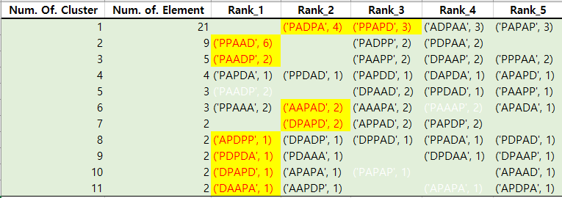
ChEMBL 4th selection
Kinase inhibitors
(FDA approved)
96 ligands
Extract the Main Key
(PADPA, PPAPD, PPAAD ,PAADP, AAPAD, DPAPD, APDPP, PDPDA, DPAPD, DAAPA)
Different Input!
Remove redundancy
Query using Main Key
55 ChEMBL
ligands
Preprocessed
ChEMBL DB(1.8M)
696,702
Ligand retrieval
DBSCAN clustering
1.Sub clustering using Sub_Key
2.Select ligands by ChEMBL_ID occurrence frequency which satisfies the RO5
Select 1,496 ligands
No cluster: Tanimoto >0.7
3.Clustering using babel(Tanimoto >0.9) and iclliq
Select 1,019 ligands
Deep Matcher

Slide 6
ZINC12 5th selection
Extract the Main Key
(APPAA, PPPDA, AADAD, DPPPD, PAADP, DPAPA)
Different Input!
ATP, IP2, IP3, IP4, CDK2, CDK6,Kinase inhibitors
Query using Main Key
297 Seed ligands
Preprocessed
ZINC12 DB(8.5M)
Ligand retrieval
Tanimoto >0.7
1.Sub clustering using Sub_Key
2.Select ligands by ChEMBL_ID occurrence frequency which satisfies the RO5
DBSCAN clustering
Select 23,655 ligands
3.Clustering using babel(Tanimoto >0.9) and iclliq
Select 10,235 ligands
Deep Matcher

Slide 7
ZINC12 6th selection
Kinase inhibitors
(FDA approved)
96 ligands
Extract the Main Key
(PADPA, PPAPD, PPAAD ,PAADP, AAPAD, DPAPD, APDPP, PDPDA, DPAPD, DAAPA)
Different Input!
Remove redundancy
Query using Main Key
55 Seed
ligands
Preprocessed
ZINC12 DB(8.5M)
Ligand retrieval
DBSCAN clustering
1.Sub clustering using Sub_Key
2.Select ligands by ChEMBL_ID occurrence frequency which satisfies the RO5
Select 21,829 ligands
No cluster: Tanimoto >0.7
3.Clustering using babel(Tanimoto >0.9) and iclliq
Select 6,243 ligands
Deep Matcher

Slide 8
ZINC15 7th selection
Extract the Main Key
Different Input! and DB(ZINC15)
ATP, IP4, CDK2, CDK6,Kinase inhibitors
Query using Main Key
Preprocessed
ZINC15 DB(650M)
272 Seed ligands
800,000
Ligand retrieval
RO5 filtering
Tanimoto >0.7
1. Filter by FDA Model
2. Filter by CDK7 Model
DBSCAN clustering
Select 61,098 ligands
Select 16,129
ligands
Deep Matcher 1
Deep Matcher 2

Slide 9
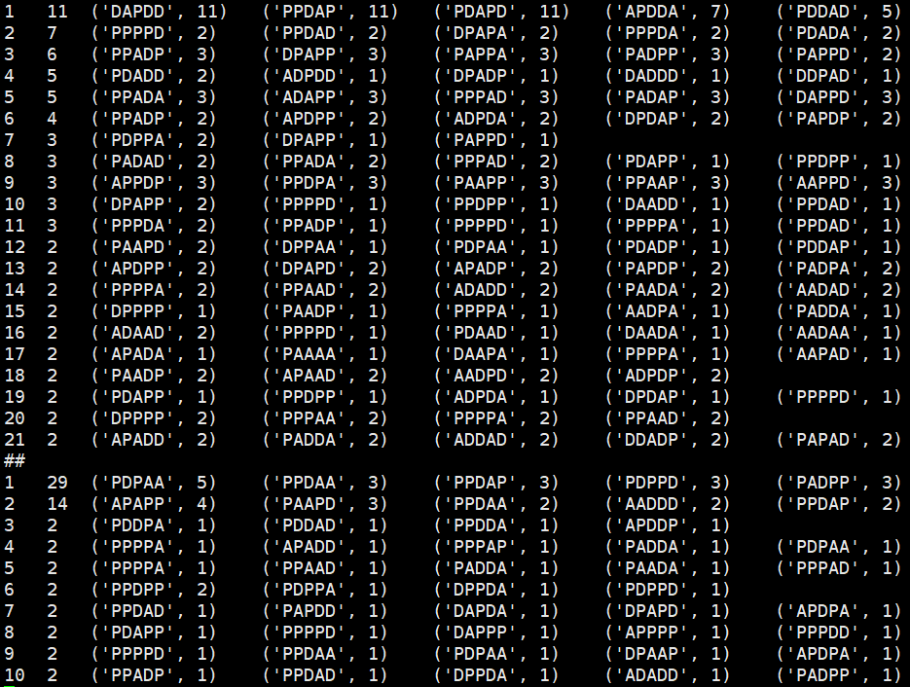
ZINC15 8th selection
Extract the Main Key
←For each group!!!
Query using Main Key
Different Input! and DB(ZINC15)
Preprocessed
ZINC15 DB(650M)
Kinase inhibitors
(By KLIFS DB and bindingDB)
1876 Seed ligands
100,000
Ligand retrieval
9 Kinase Group
(AGC, Atypical, CAMK, CK1, CMGC, Other, STE, TK, TKL)
RO5 filtering
Filter by FDA Deep learning model
Select N ligands
Tanimoto > 0.7
Filter by Kinase deep learning model
Select N ligands
Filter by Scaffold model
Tanimoto < 0.7
Deep Matcher
ex) AGC group

Slide 10
1/2DScan selection 8 methods
1. 모든 key을 추출하여 가장 많이 나타나는 10 key 선택 → 1 set
2. Tanimoto > 0.7에서 member수가 3개이상인 cluster에서 모든 key 선택 → 1 set
3. Tanimoto > 0.7의 각 cluster에서 Rank1에 해당하는 모든 key 선택 → 1 set
4. Tanimoto > 0.7에서 occurrence frequency of key에서 top 10 선택 → 1 set
5. Tanimoto > 0.7에서 occurrence frequency of key에서 top 5 선택, Tanimoto < 0.7 중 다른 clustering
기법(DBSCAN)에서 occurrence frequency of key에서 top 5 선택. 단 타이가 많을 땐 클러스터 member수가
많은 cluster를 중심으로→ 1 set
6. Cluster member의 개수로 sorting하여 상위 10개 cluster의 rank 1 key을 선택 단 cluster 개수가 10개 이하면, cluster 갯수만큼 → 1 set
7. Tanimoto > 0.7에서 member수가 가장 적은 cluster(2이하)에서 occurrence frequency가 낮은 것(1인 것만) Max 20개 key 선택 → 1 set
8. Tanimoto < 0.7 에서 각 member수가 가장 적은 cluster(2이하)에서 occurrence frequency가 낮은 것(1인 것만) Max 20개 key 선택 → 1 set
- 1~6에서는 상위 occurrence frequency을 위주로 Key를 추출하여 선택하였으나 7~8에서는 다양성을 보완하기 위하여 하위 occurrence frequency을 위주로 Key를 선택함.

