Slide 1
 | FDA |  | PDB |  | DMC |  | Total
Num. of Ring | Frequency | Percent | Frequency | Percent | Frequency | Percent | Frequency | Percent
0 | 112 | 6.64 | 435 | 8.97 | 117 | 2.21 | 664 | 5.61
1 | 314 | 18.61 | 815 | 16.80 | 158 | 2.98 | 1287 | 10.87
2 | 417 | 24.72 | 1049 | 21.62 | 575 | 10.84 | 2041 | 17.23
3 | 359 | 21.28 | 1138 | 23.45 | 1499 | 28.26 | 2996 | 25.30
4 | 312 | 18.49 | 812 | 16.74 | 1647 | 31.05 | 2771 | 23.40
5 | 110 | 6.52 | 431 | 8.88 | 1010 | 19.04 | 1551 | 13.10
6 | 27 | 1.60 | 109 | 2.25 | 244 | 4.60 | 380 | 3.21
7 | 13 | 0.77 | 47 | 0.97 | 36 | 0.68 | 96 | 0.81
8 | 14 | 0.83 | 13 | 0.27 | 13 | 0.25 | 40 | 0.34
9 | 4 | 0.24 | 3 | 0.06 | 2 | 0.04 | 9 | 0.08
10 | 2 | 0.12 |  |  |  |  | 2 | 0.02
11 | 1 | 0.06 |  |  |  |  | 1 | 0.01
13 | 1 | 0.06 |  |  |  |  | 3 | 0.03
14 | 1 | 0.06 |  |  |  |  | 1 | 0.01
Total | 1687 | 100 | 4852 | 100 | 5305 | 100 | 11844 | 100

Slide 2

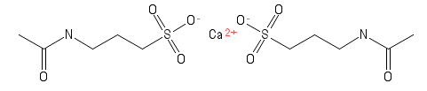
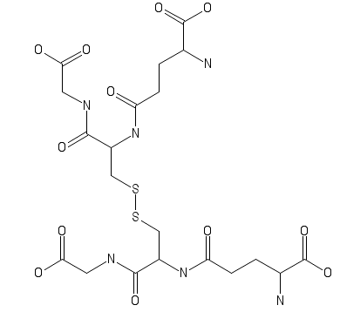
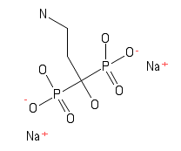
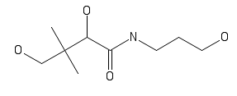
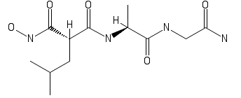
Backbone with no rings

Slide 3
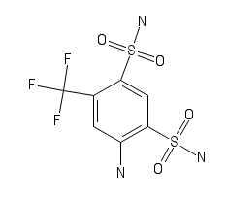

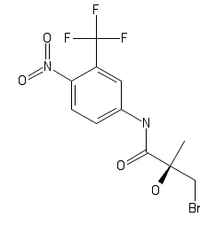
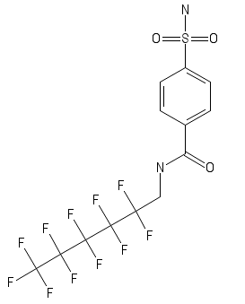
Backbone with one ring (example)
c1ccccc1: freq. 666

Slide 4
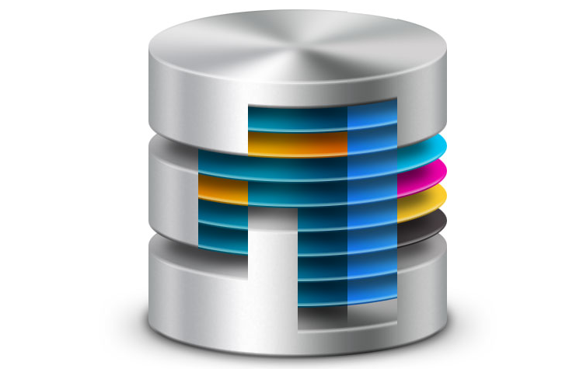
1 . 3D-Scan flow
Input template
Analyze Input
Extract Backbone
Backbone DB
Exact
Matching
Backbone
1.Extract chemical property of the input:
MW, LogP, HBA, HBD…
2.Extract the Ring system
Ing……
Candidate ligand
Ligand
No
Ing……
Yes
Query with the chem. Pro. and Ring info
BBR DB
Filtered candidate
Chemical property DB
Structural alignment (Find Maximal common structural)
Candidate
Ranked by score

