Slide 1
 | FDA |  | PDB |  | DMC |  | Total
Num. of Ring | Frequency | Percent | Frequency | Percent | Frequency | Percent | Frequency | Percent
0 | 112 | 6.64 | 435 | 8.97 | 117 | 2.21 | 664 | 5.61
1 | 314 | 18.61 | 815 | 16.80 | 158 | 2.98 | 1287 | 10.87
2 | 417 | 24.72 | 1049 | 21.62 | 575 | 10.84 | 2041 | 17.23
3 | 359 | 21.28 | 1138 | 23.45 | 1499 | 28.26 | 2996 | 25.30
4 | 312 | 18.49 | 812 | 16.74 | 1647 | 31.05 | 2771 | 23.40
5 | 110 | 6.52 | 431 | 8.88 | 1010 | 19.04 | 1551 | 13.10
6 | 27 | 1.60 | 109 | 2.25 | 244 | 4.60 | 380 | 3.21
7 | 13 | 0.77 | 47 | 0.97 | 36 | 0.68 | 96 | 0.81
8 | 14 | 0.83 | 13 | 0.27 | 13 | 0.25 | 40 | 0.34
9 | 4 | 0.24 | 3 | 0.06 | 2 | 0.04 | 9 | 0.08
10 | 2 | 0.12 |  |  |  |  | 2 | 0.02
11 | 1 | 0.06 |  |  |  |  | 1 | 0.01
13 | 1 | 0.06 |  |  |  |  | 3 | 0.03
14 | 1 | 0.06 |  |  |  |  | 1 | 0.01
Total | 1687 | 100 | 4852 | 100 | 5305 | 100 | 11844 | 100

Slide 2

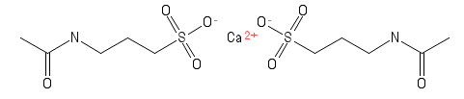
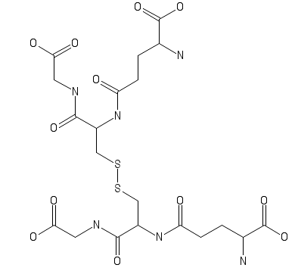
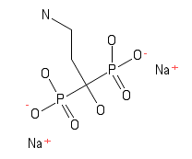
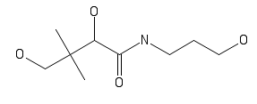
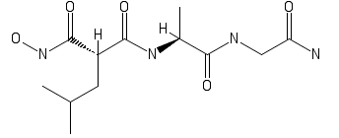
Backbone with no rings

Slide 3
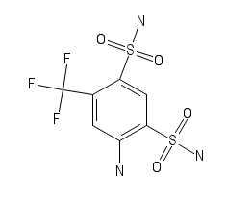

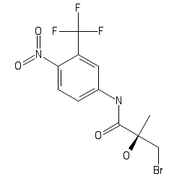
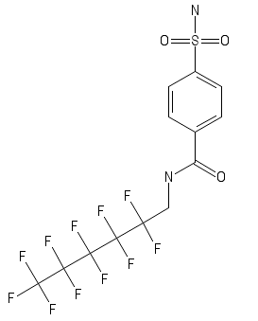
Backbone with one ring (example)
c1ccccc1: freq. 666

Slide 4

1 . 3D-Scan flow
Input template
Analyze Input
Extract Backbone
Backbone DB
Exact
Matching
Backbone
1.Extract chemical property of the input:
MW, LogP, HBA, HBD…
2.Extract the Ring system
Ing……
Candidate ligand
Ligand
No
Ing……
Yes
Query with the chem. Pro. and Ring info
BBR DB
Filtered candidate
Chemical property DB
Structural alignment (Find Maximal common structural)
Candidate
Ranked by score

Slide 5
Chemical Backbone DB Table (ZINC_BB.db)
chemical properties for identifying duplicate BB
BB | MW | LogP | HBA | HBD | TPSA | Ring | IDs
c1nc3c(cc1)NC(=O)c2cc(cnc2N3)CCc4ccncc4 | 317.3446 | 2.5418 | 4 | 2 | 87.32 | 4 | 'CHEMBL100833','CHEMBL321544'
c3nc4C=CC(=Cc1ccc(cc1)c2ccccc2)c4(cc3) | 281.3505 | 5.316 | 1 | 0 | 12.89 | 4 | CHEMBL1087156
all index : 54,353,568
filtering by chemical property (Num of Uniq BB) : 21,929,461
count by Ring=0 : 1,010,040
count by Ring=1 : 6,844
Maximum of Rings : 85(CHEMBL1077165)
Which rings have max number of BackBone ? : 4 (9,292,278 개)
Ring 3 and 4 have 80.39564% backbone of all
schema : CREATE TABLE BB_Table(BB txt PRIMARY KEY,MW float,LogP float,HBA tinyint,HBD tinyint,TPSA float,Ring tinyint,IDs text);

Slide 6
Chemical Backbone DB Table (ZINC_BB.db)
 | Total
Num. of Ring | Frequency | Percent
0 | 1,010,040 | 4.605858758
1 | 6,844 | 0.031209157
2 | 1,442,541 | 6.578096014
3 | 8,338,053 | 38.02215203
4 | 9,292,278 | 42.37349016
5 | 1,678,843 | 7.655650998
6 | 127,284 | 0.580424663
7 | 17,171 | 0.078301058
8 | 6,794 | 0.030981154
9 | 3,107 | 0.014168155
10 | 1,919 | 0.008750785
11 | 1,240 | 0.005654494
13 | 666 | 0.00303701
14 | 332 | 0.001513945
Total | 21,927,112 | 99.98928838

