Slide 1
Revolution Robotics Bluetooth testing manual
2024/07/18
Laszlo B.

Slide 2
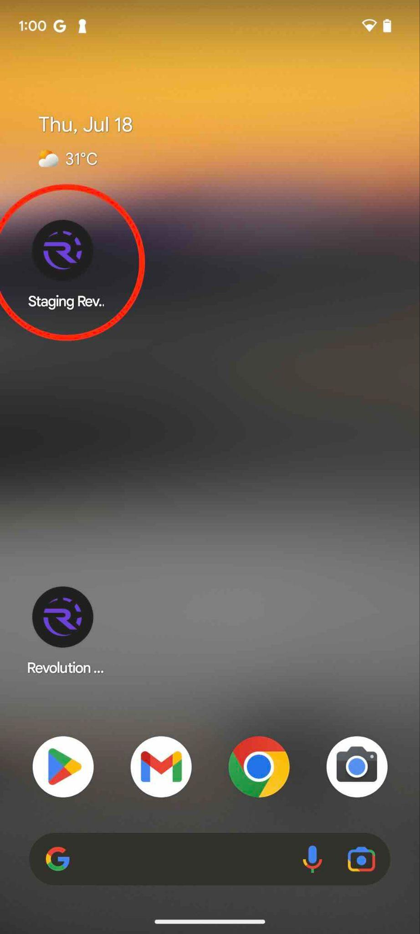
1) Install the provided APK
Use an Android phone
A “Staging Revolution Robotics” app should appear
This is the test version of the application, same as in the app store.
Open the app

Slide 3
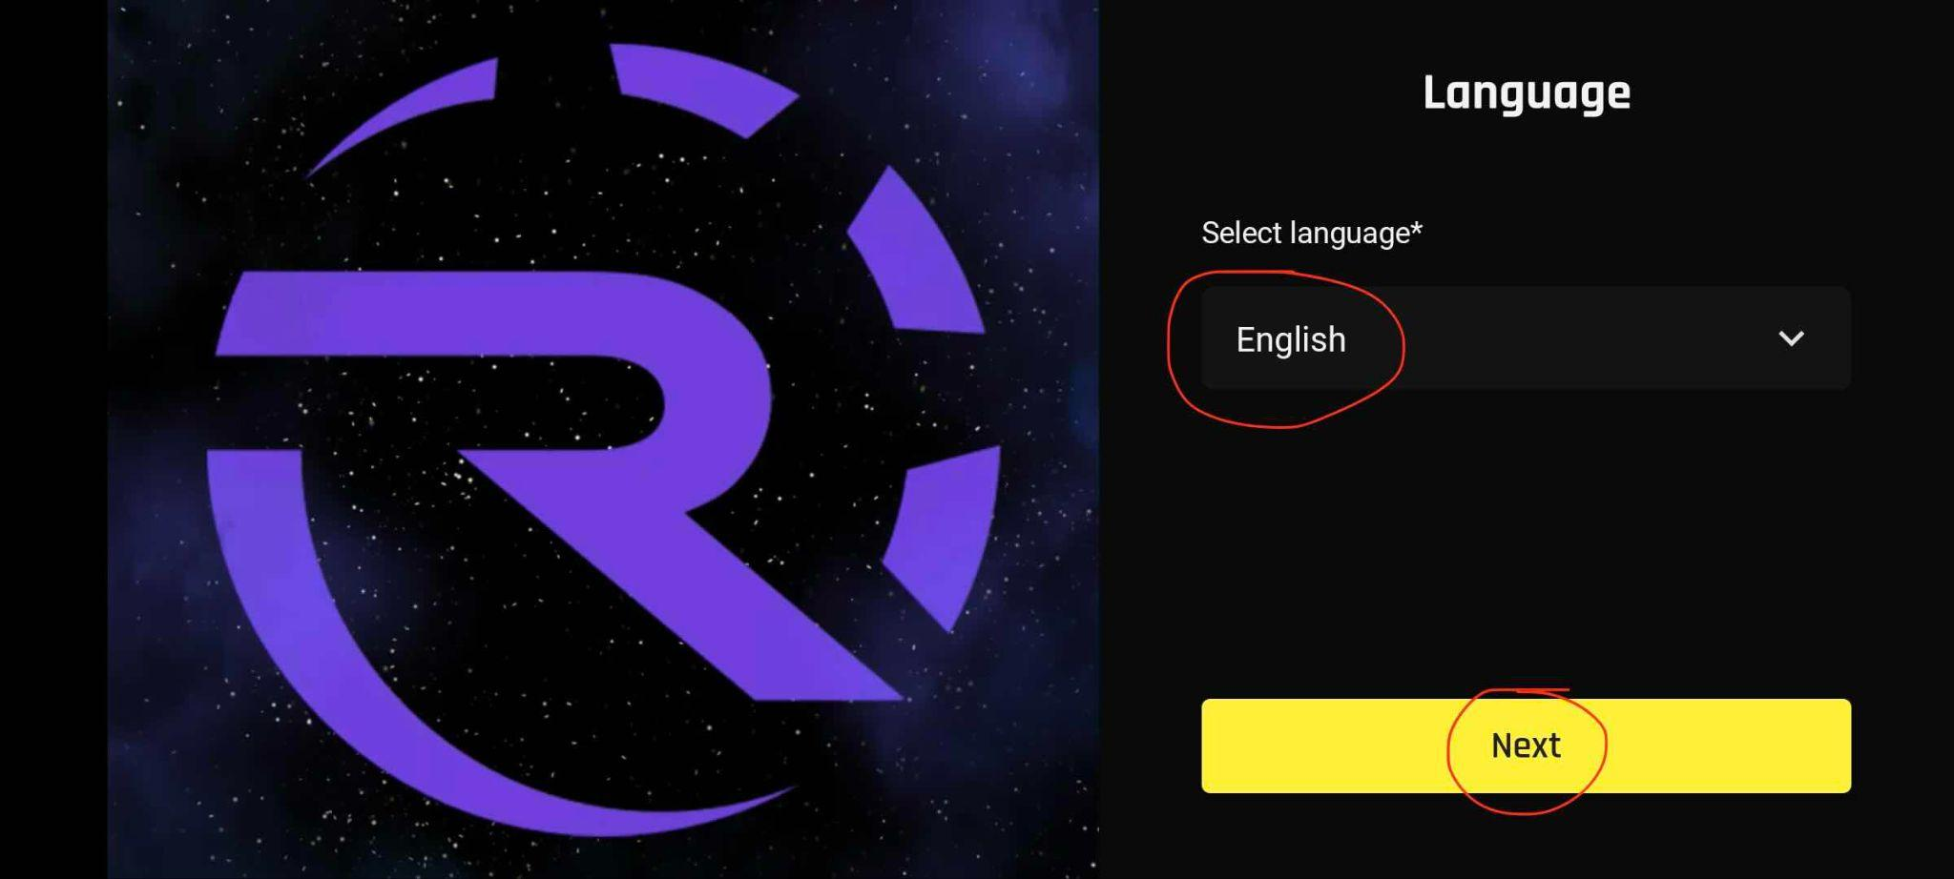
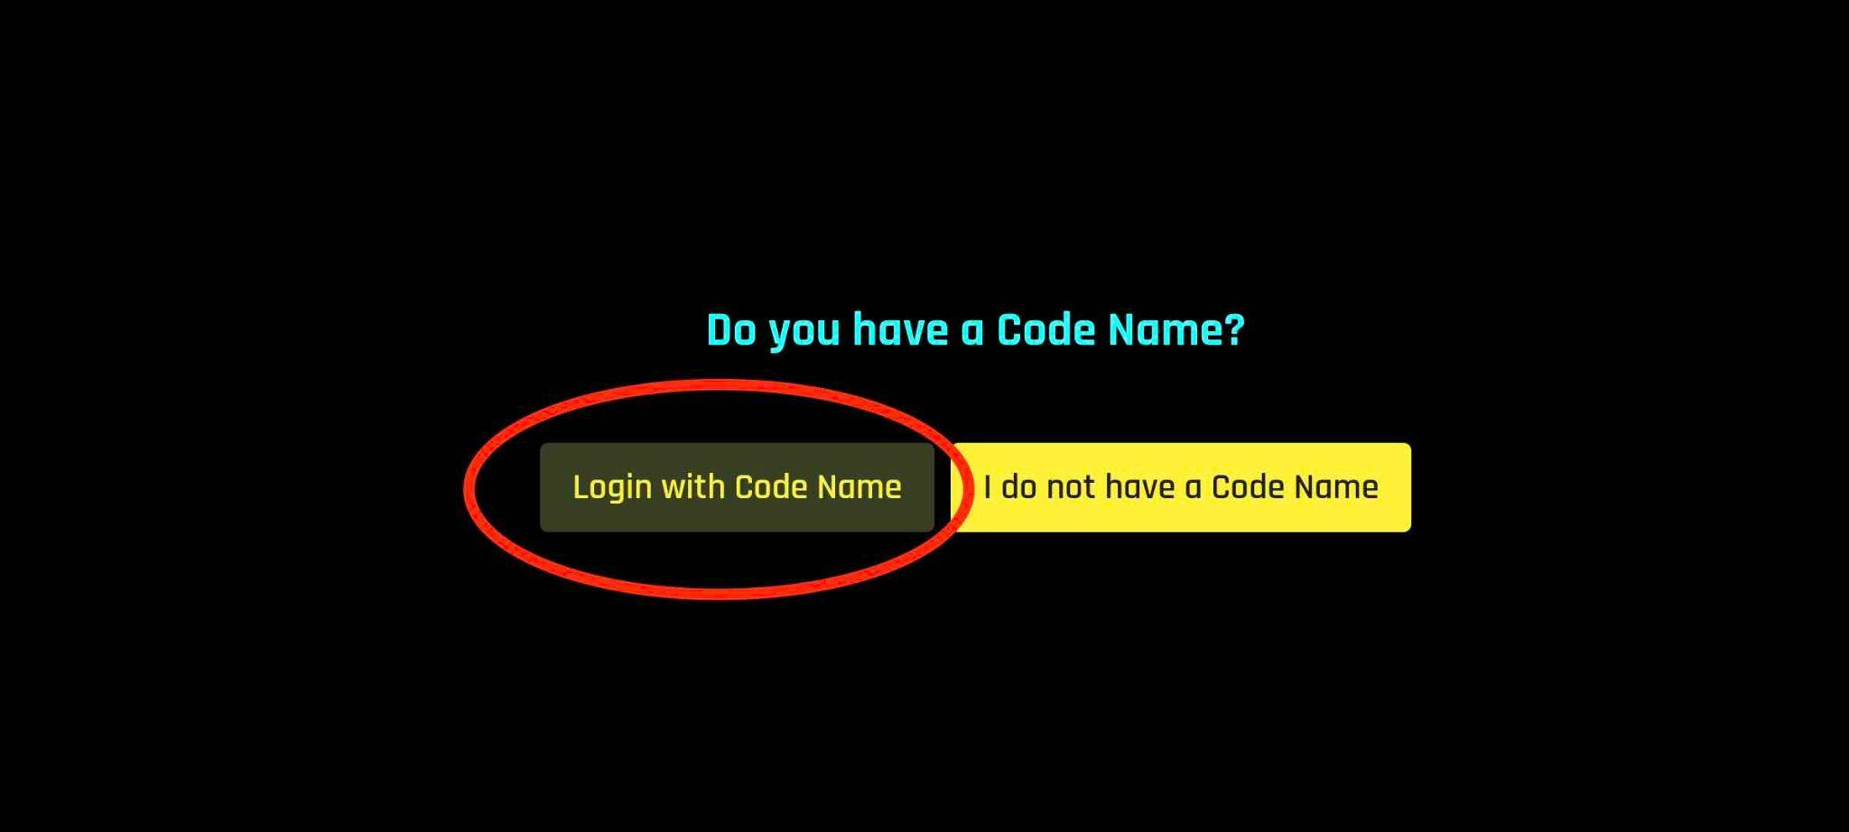
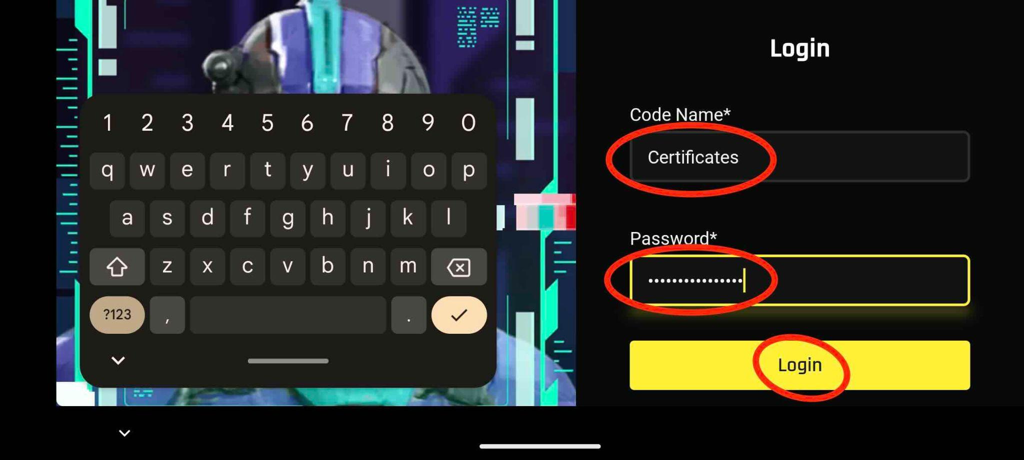
2) Log in
Select language to be English, click next
Select “Login with Code Name”
Use credentials
code name: Certificates
pass: Certificates123

Slide 4
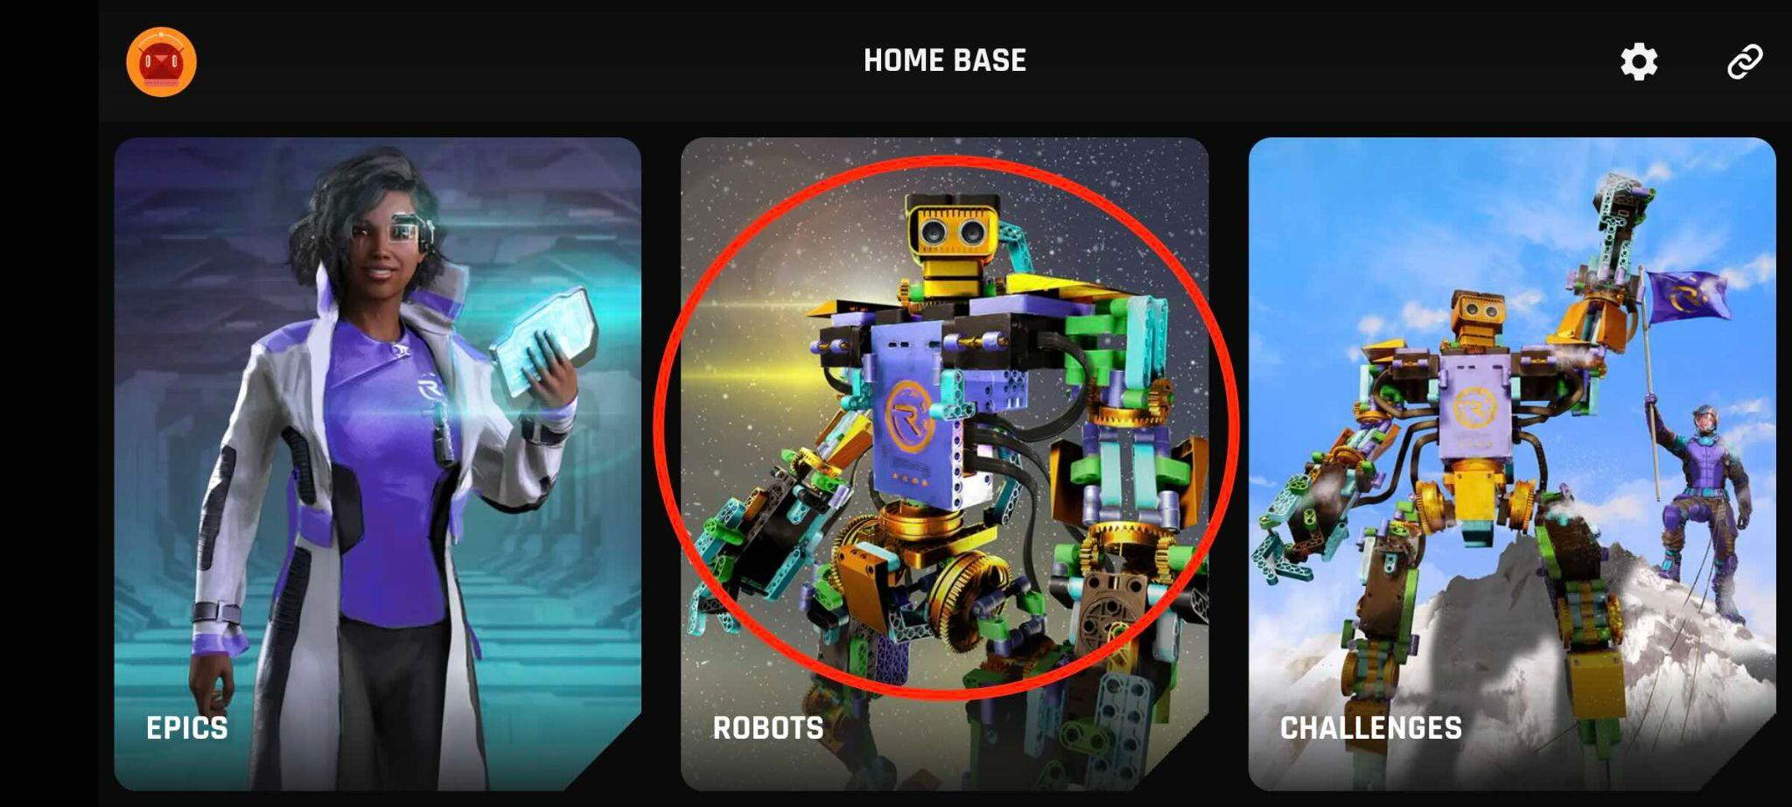
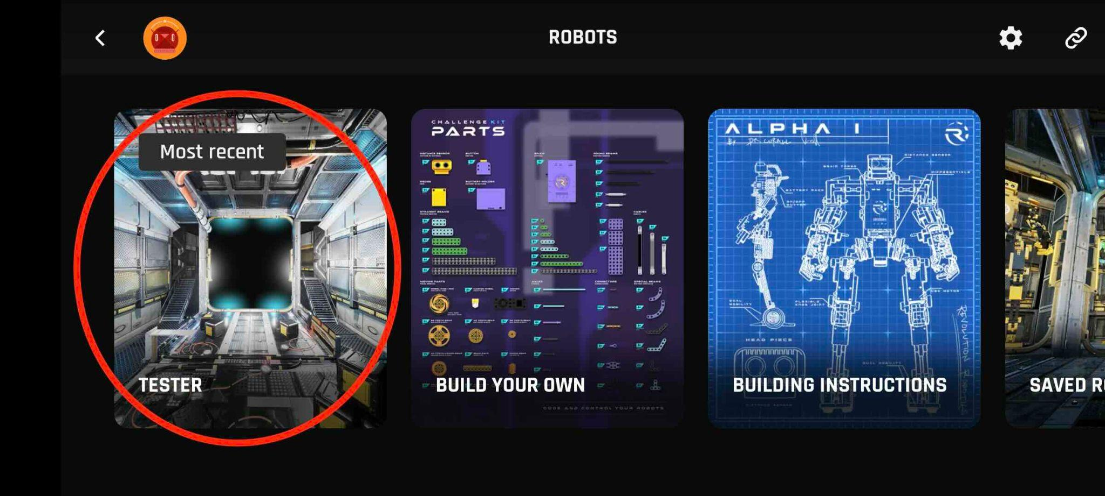
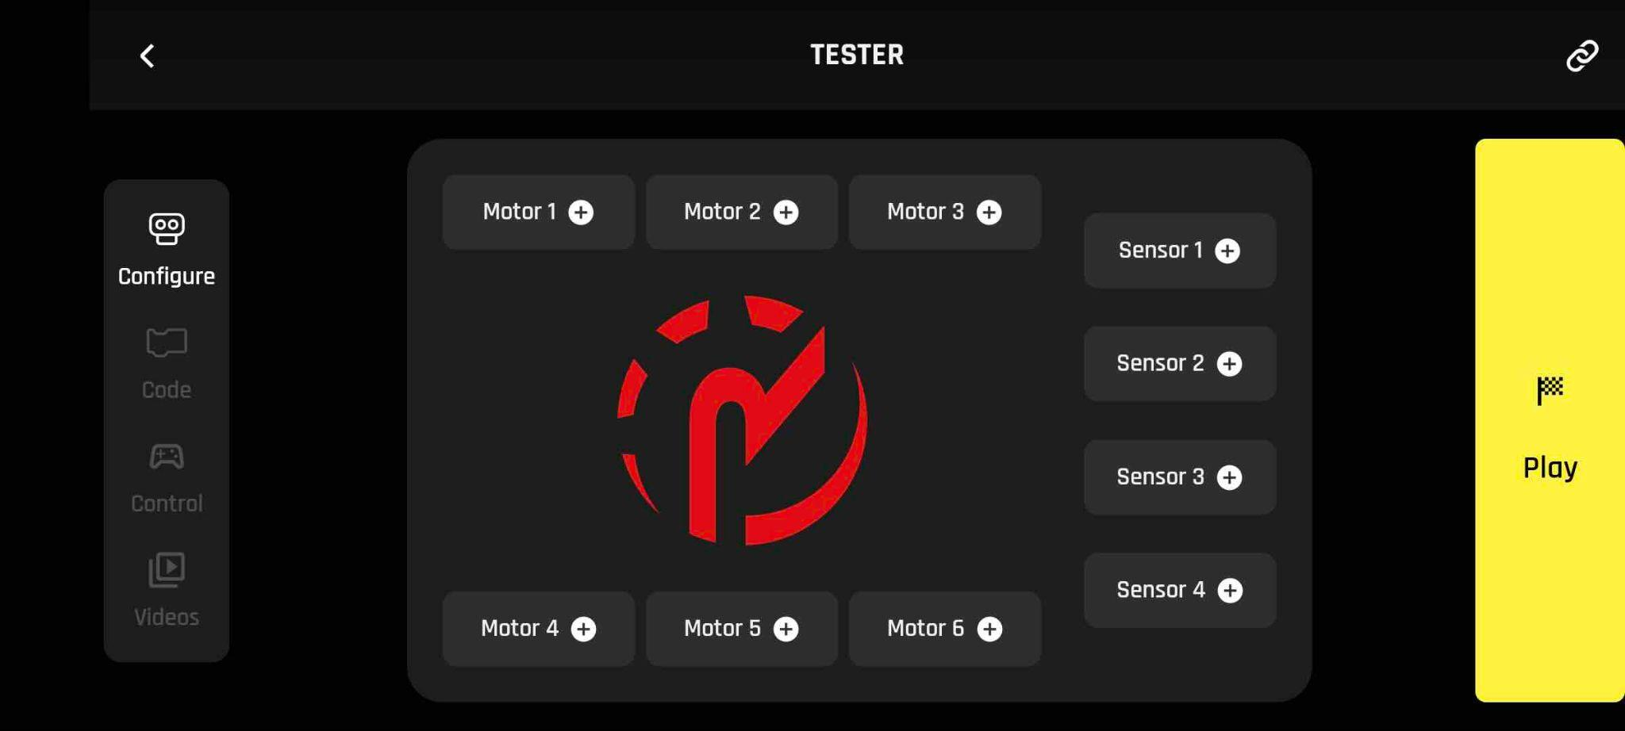
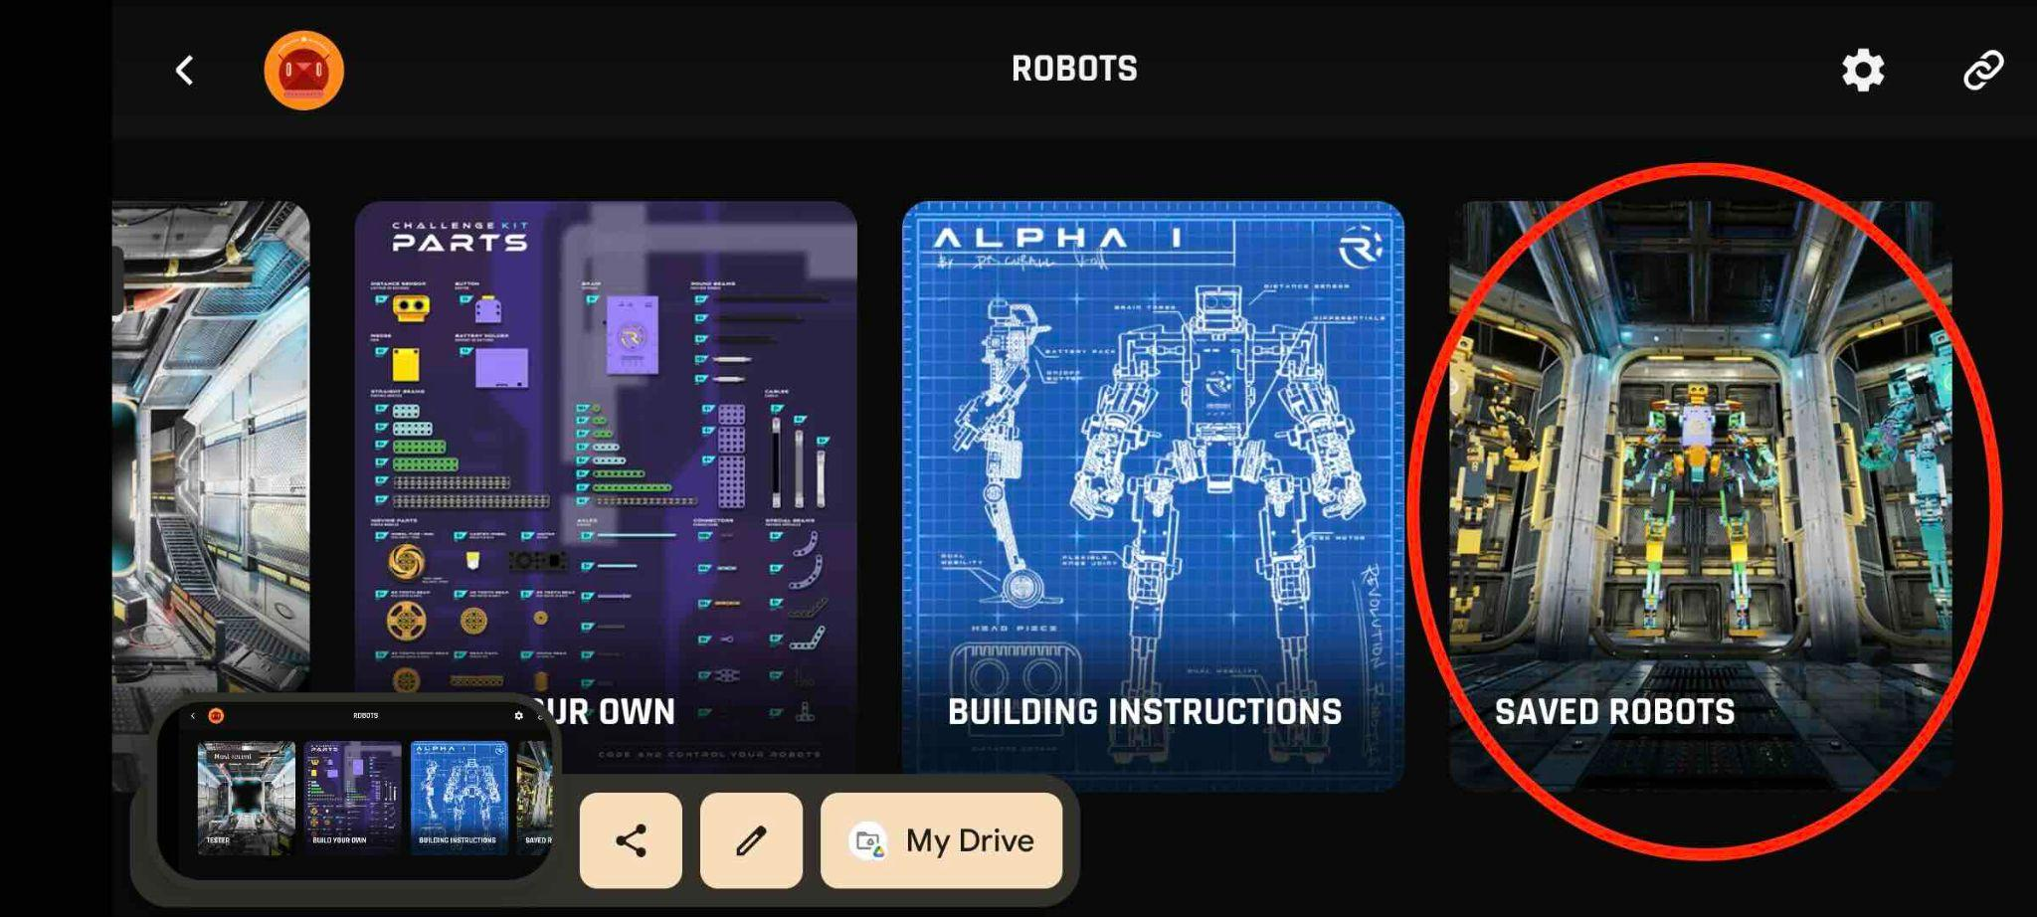
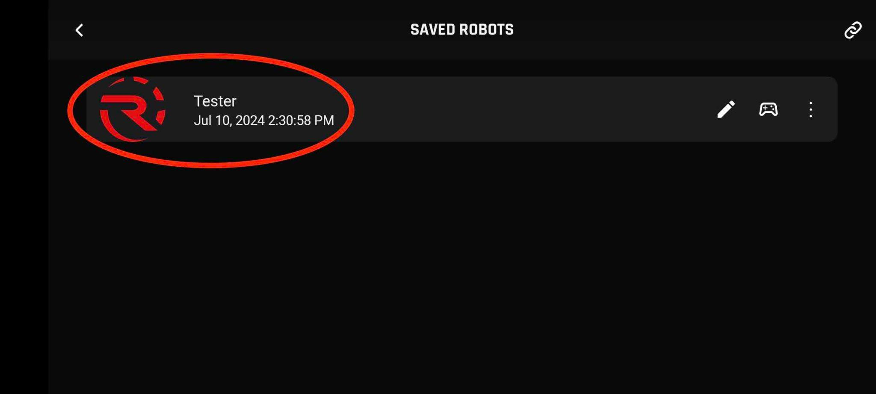
3) Find the testing robot
Select “Robots”
Locate the robot named “TESTER”
Either in the “Most recent” section
Or in the “Saved Robots” section”
You will arrive to the configuration screen
2a
2b

Slide 5
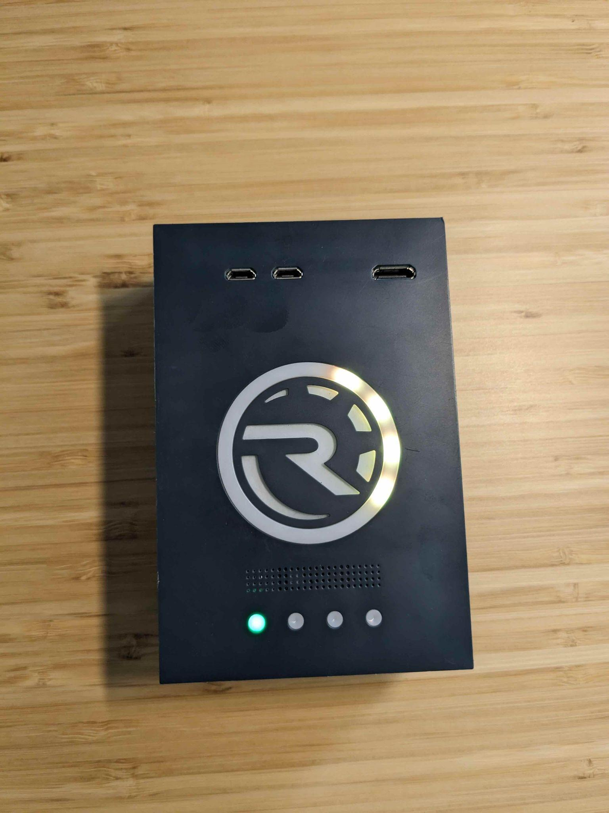
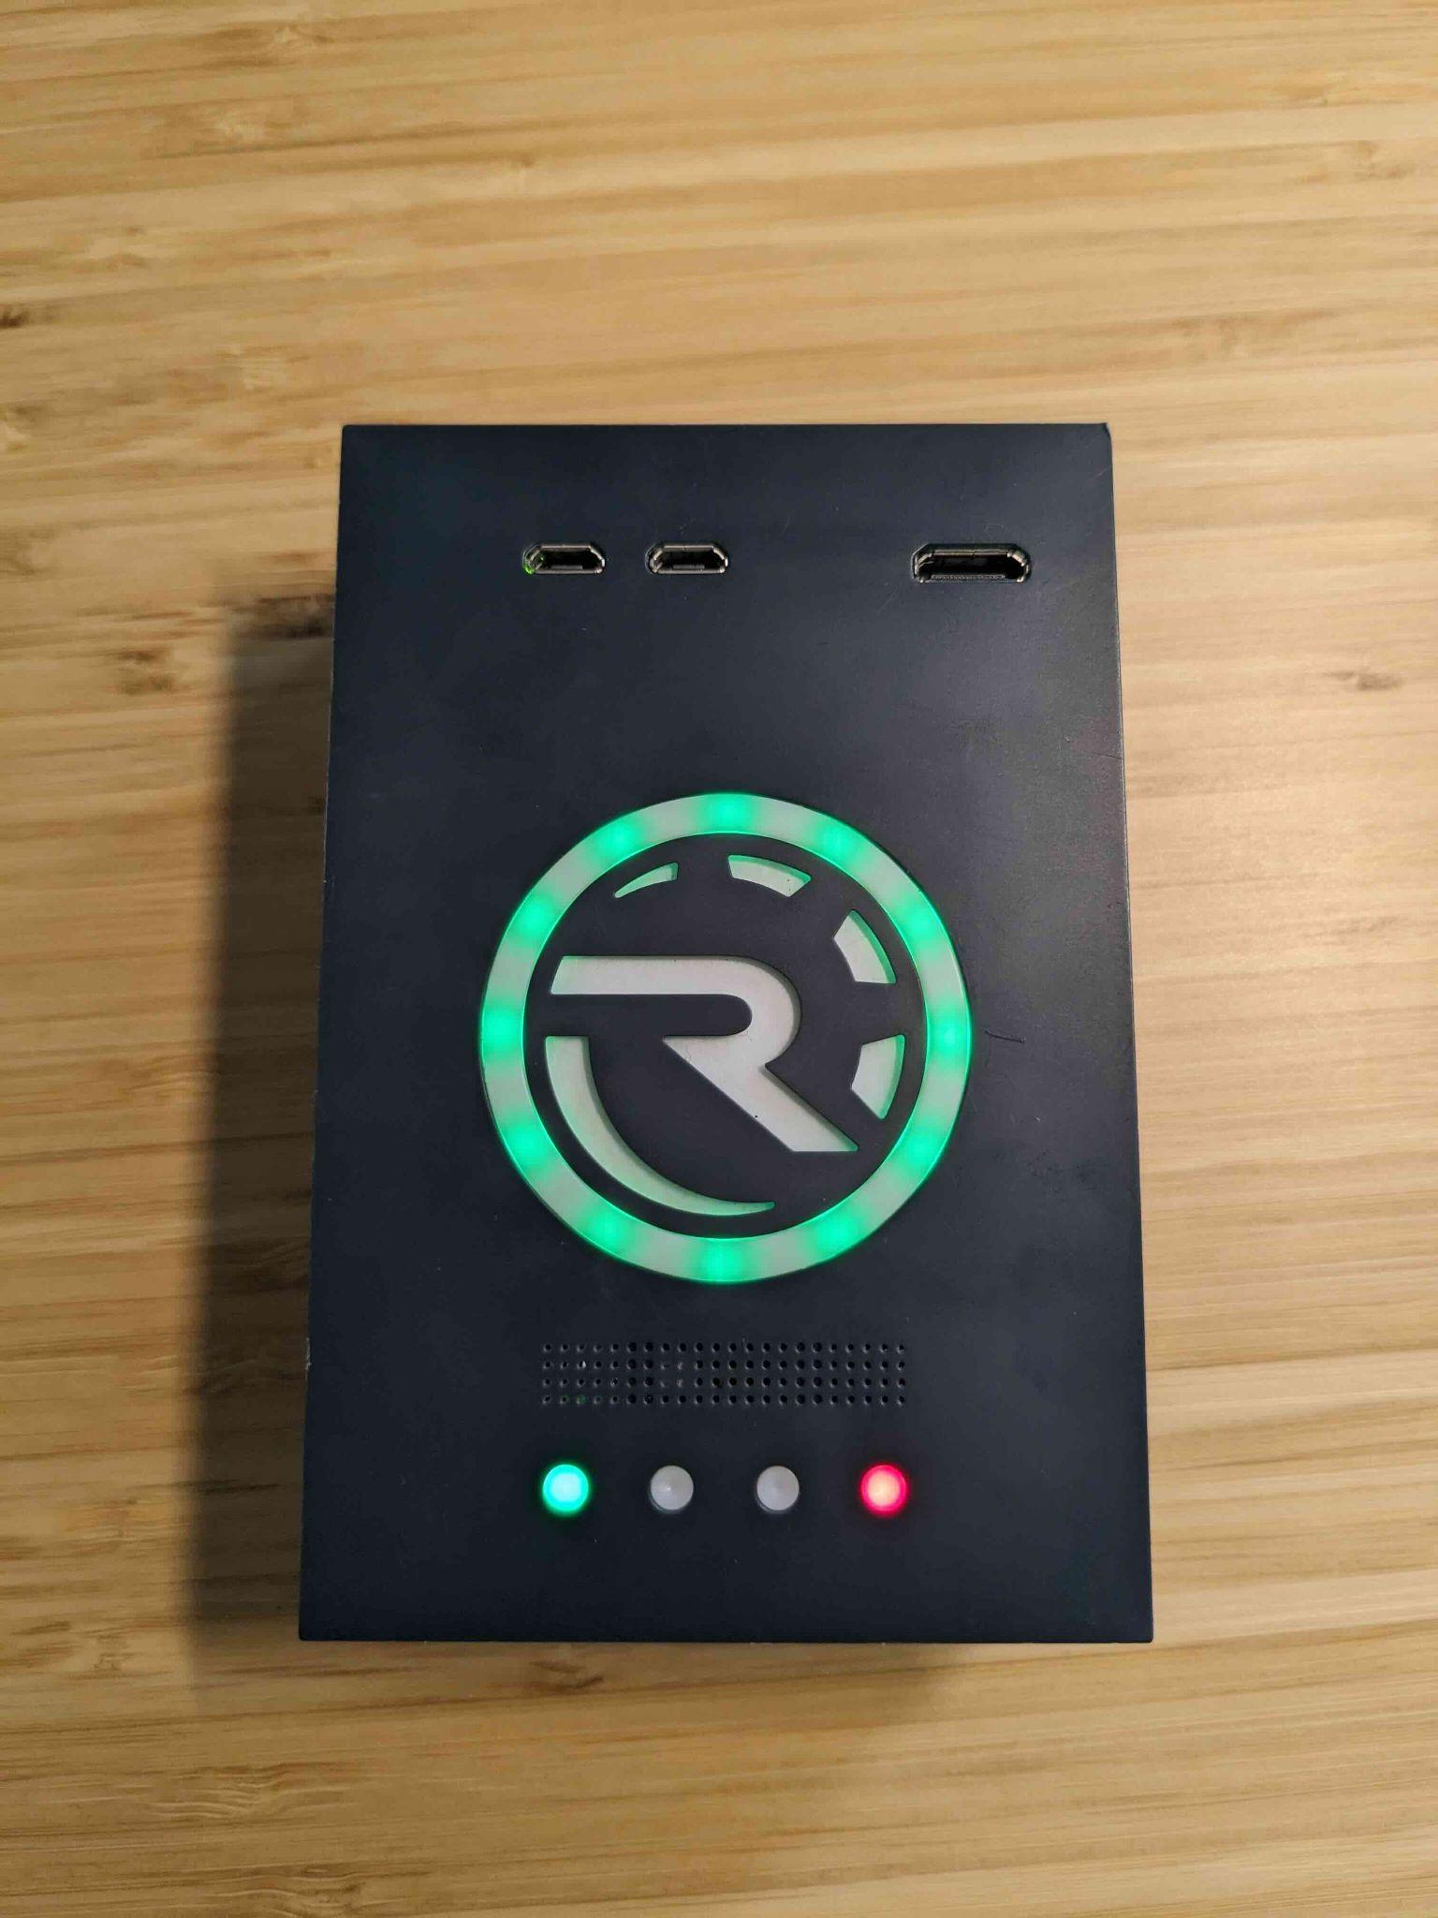
4) Turn on the brain
Wait for the loading sequence (yellow light goes round)
Wait until all LEDs are green, fading in and out. Also there will be a confirmation sound by the robot.

Slide 6
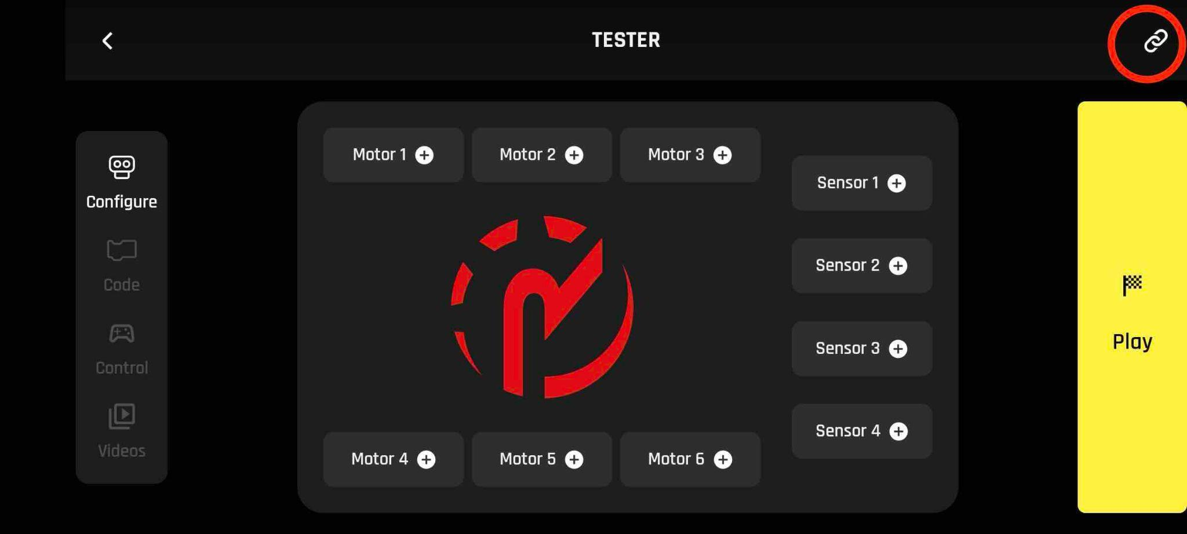
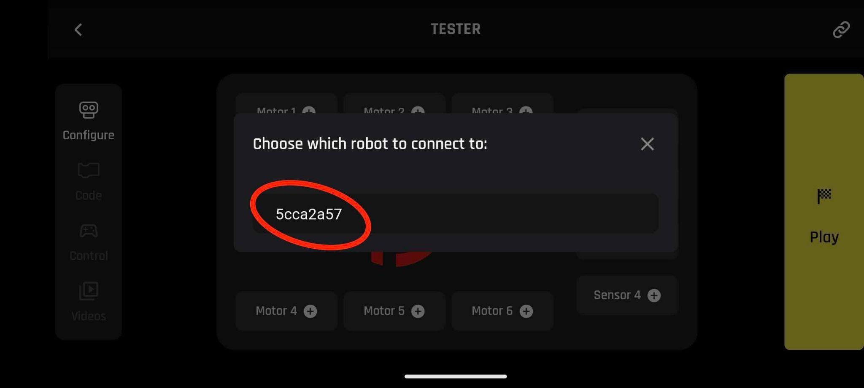
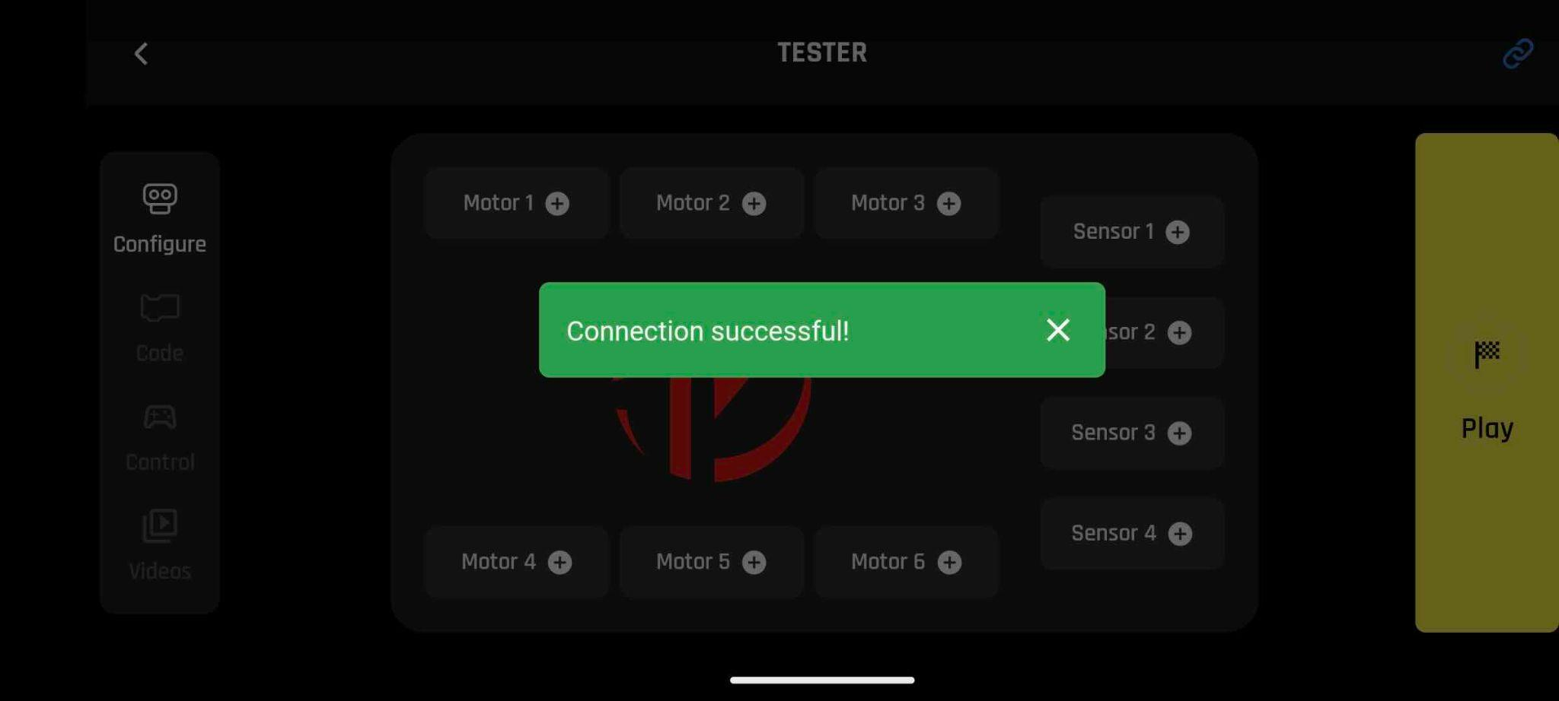

5) Connect to the brain
Connect to the brain by clicking on the chain icon on the top right of the screen
Select the brain ID (Note: it will be different for every brain)
Wait for connection.The robot will make a sound and the chain icon will turn blue

Slide 7
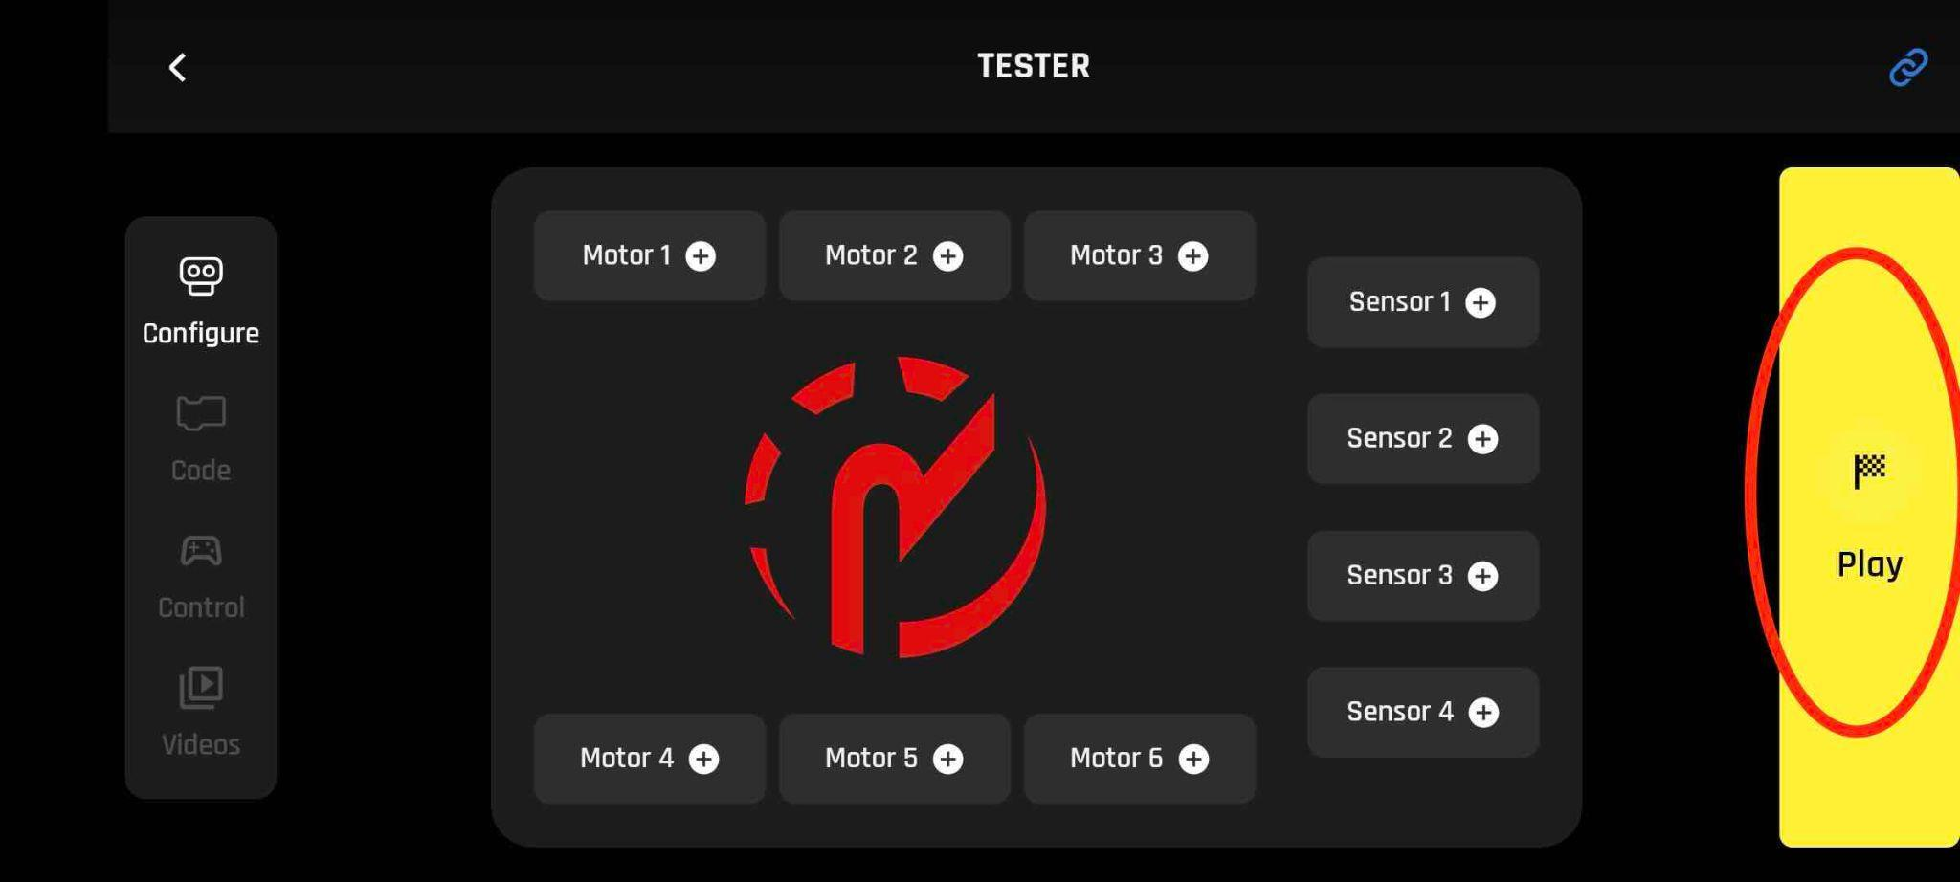
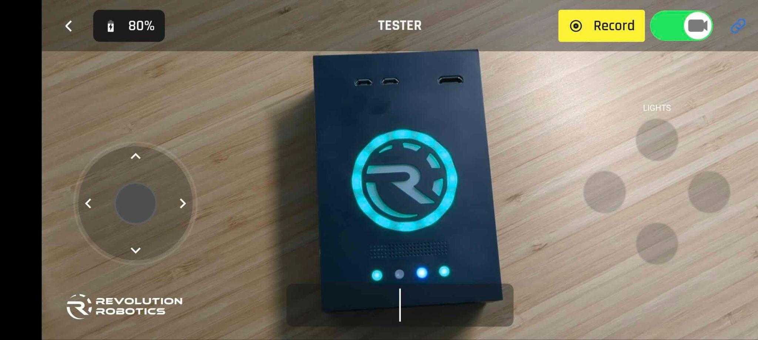
6) Enter play mode
Click “Play”
A joystick should appear with one program called “Lights”

Slide 8
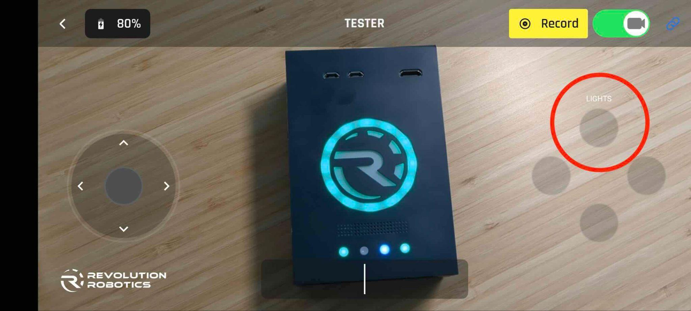
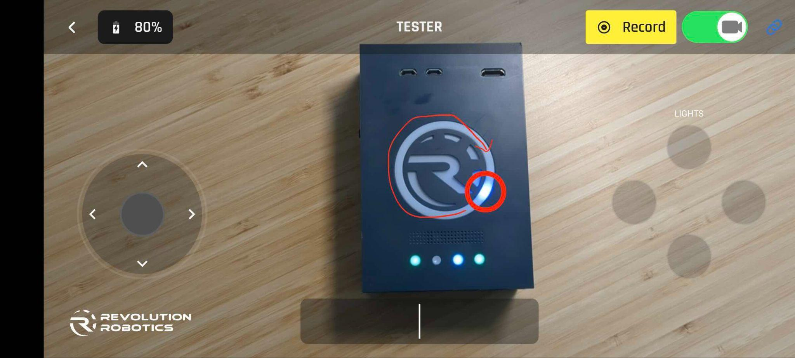
7) Run the program
Click on the program called “Lights”.
A single blue LED should go round and round in the circle indicating that the program is running

Slide 9
8) Do the measurements
While the blue LED goes in circles, Bluetooth connection is continuous between the phone / tablet and the robot.

