Slide 1
Revolution Robotics
Block diagram
2024/07/18
Laszlo B.

Slide 2
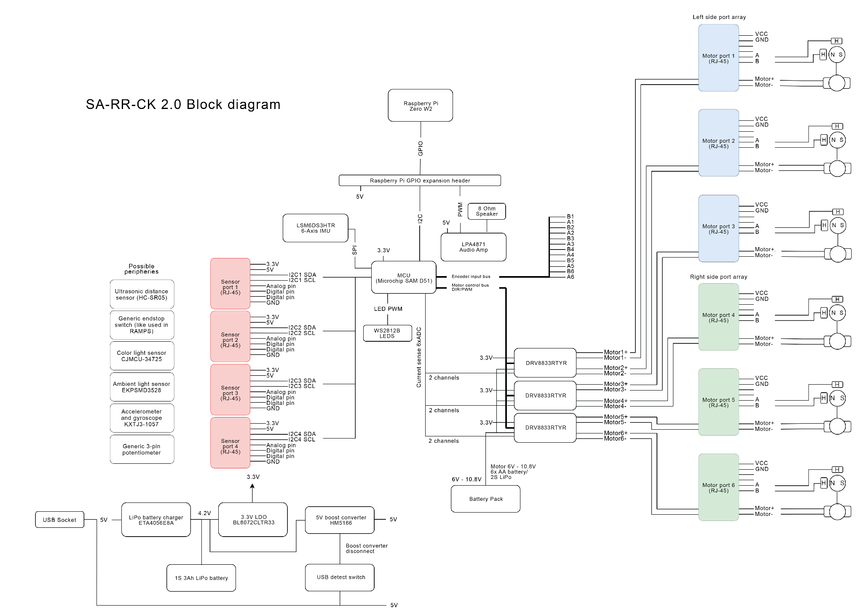

Slide 3
