Slide 1
LAYING TV CABLES USING MINIMUM SPANNING TREE
DONE BY:
D.STEFFY(140071601072)
R.TASNIM TABASUM(140071601080)
THIRD YEAR CSE-B
ALGORITHM DESIGN AND ANALYSIS LAB(CSB 3105)
B.S.ABDUR RAHMAN UNIVERSITY
Notes:
We designed this template so that each member of the project team has a set of slides with its own theme. Members, here’s how you add a new slide to just your set:
Mark where you want to add the slide: Select an existing one in the Thumbnails pane, click the New Slide button, then choose a layout. The new slide gets the same theme as the other slides in your set.
Careful! Don’t annoy your fellow presenters by accidentally changing their themes. That can happen if you choose a different theme from the Design tab, which changes all of the slides in the presentation to that look.

Slide 2
CONTENTS
Problem Identification
Definition Of Spanning Tree &Minimum Spanning Tree
Algorithms used and its design
Algorithm analysis
Scenario Explanation
Comparison between prim’s and Kruskal's algorithm
Properties of Minimum Spanning Tree

Slide 3
PROBLEM IDENTIFICATION
Notes:
We designed this template so that each member of the project team has a set of slides with its own theme. Members, here’s how you add a new slide to just your set:
Mark where you want to add the slide: Select an existing one in the Thumbnails pane, click the New Slide button, then choose a layout. The new slide gets the same theme as the other slides in your set.
Careful! Don’t annoy your fellow presenters by accidentally changing their themes. That can happen if you choose a different theme from the Design tab, which changes all of the slides in the presentation to that look.

Slide 4
PROBLEM IDENTIFICATION
A cable TV company is laying cable in a new neighborhood. There is a condition for them to bury the cable only along certain paths .
In those paths, some might be very expensive to bury the cable because they are longer, or require the cable to be buried deeper.
A minimum spanning tree is a spanning tree which has a minimum total cost.

Slide 5
Definition : Spanning Tree & Minimum Spanning Tree
A spanning Tree of a connected graph G is its connected sub graph that contains all the vertices of the graph.
A Minimum Spanning Tree of a weighted connected graph G is its spanning tree of the smallest weight where the weight of the tree is defined as the sum of the weights on all its edges.
A Minimum Spanning Tree exists if and only if G is connected.

Slide 6
ALGORITHM USED & ITS DESIGN
Notes:
We designed this template so that each member of the project team has a set of slides with its own theme. Members, here’s how you add a new slide to just your set:
Mark where you want to add the slide: Select an existing one in the Thumbnails pane, click the New Slide button, then choose a layout. The new slide gets the same theme as the other slides in your set.
Careful! Don’t annoy your fellow presenters by accidentally changing their themes. That can happen if you choose a different theme from the Design tab, which changes all of the slides in the presentation to that look.

Slide 7
Algorithms used To Find Minimum Spanning Tree
There are two algorithms used to find the minimum spanning tree of a connected graph G.
Algorithms
Prim’s Algorithm
Kruskal’s Algorithm

Slide 8
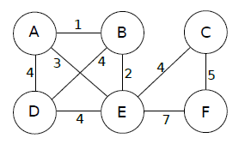
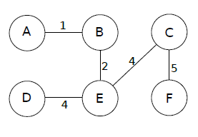
Prim’s Algorithm
Prim’s algorithm is one of the way to compute a minimum spanning tree.
Initially discovered in 1930 by Vojtěch Jarník, then rediscovered in 1957 by Robert C. Prim.
This algorithm begins with a set U initialized to{1}.It then grows a spanning tree , one edge at a time.
At each step , it finds a shortest edge (u ,v ) such that the cost of (u , v) is the smallest among all edges , where u is in Minimum Spanning Tree and V is not in Minimum Spanning Tree
Complexity:O(v2)

Slide 9
Kruskal’s Algorithm
Step 1: Sort all edges in non-decreasing order of their weight.
Step 2: Pick the smallest edge.
Step 3:Check if it forms a cycle with Spanning Tree formed so far.
Step 4:If cycle is not formed , include this edge else discard it.
Step 5:Repeat Union-Find algorithm until there are V-1 edges in the spanning tree.
Complexity:O(ElogV)

Slide 10
ALGORITHM ANALYSIS
Notes:
We designed this template so that each member of the project team has a set of slides with its own theme. Members, here’s how you add a new slide to just your set:
Mark where you want to add the slide: Select an existing one in the Thumbnails pane, click the New Slide button, then choose a layout. The new slide gets the same theme as the other slides in your set.
Careful! Don’t annoy your fellow presenters by accidentally changing their themes. That can happen if you choose a different theme from the Design tab, which changes all of the slides in the presentation to that look.

Slide 11
ALGORITHMS
Two algorithms are used to find minimum spanning tree.
PRIM’S ALGORITHM
KRUSKAL’S ALGORITHM

Slide 12
PRIM’S ALGORITHM AND ITS ANALYSIS
Notes:
We designed this template so that each member of the project team has a set of slides with its own theme. Members, here’s how you add a new slide to just your set:
Mark where you want to add the slide: Select an existing one in the Thumbnails pane, click the New Slide button, then choose a layout. The new slide gets the same theme as the other slides in your set.
Careful! Don’t annoy your fellow presenters by accidentally changing their themes. That can happen if you choose a different theme from the Design tab, which changes all of the slides in the presentation to that look.

Slide 13
PRIM’S ALGORITHM
Place the starting node in the tree.
Repeat until all nodes are in the tree are visited:
Find all edges which is adjacent to source vertex.
Of those edges, choose one with the minimum weight.
Add that edge and the connected node to the tree.
A
B
C

Slide 14
ANALYSIS
At every iteration of the loop, we add one node to the tree. Since there are V nodes, it follows that there are O (V) iterations of this loop.
If there are E edges, the naive searching implementation uses O (E) to find the edge with minimum weight.
So in combination, we should expect the complexity to be O (VE), which may be O (V^3) in the worst case.

Slide 15
CONTINUES……..
Prim’s algorithm complexity varies based on the representation of the graph.
In adjacency matrix representation, prim’s algorithm requires O(V2) running time.
Because, in adjacency representation linearly searching an array of weights to find the minimum weight edge and to add that edge will require O(v2) running time.

Slide 16
KRUSKAL’S ALGORITHM AND ITS ANALYSIS
Notes:
We designed this template so that each member of the project team has a set of slides with its own theme. Members, here’s how you add a new slide to just your set:
Mark where you want to add the slide: Select an existing one in the Thumbnails pane, click the New Slide button, then choose a layout. The new slide gets the same theme as the other slides in your set.
Careful! Don’t annoy your fellow presenters by accidentally changing their themes. That can happen if you choose a different theme from the Design tab, which changes all of the slides in the presentation to that look.

Slide 17
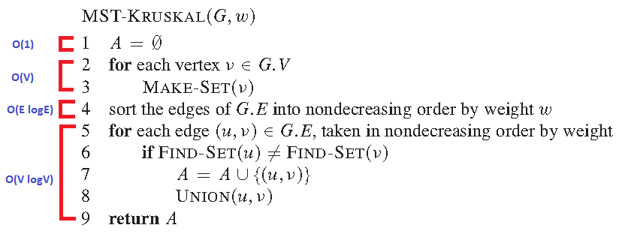
ALGORITHM

Slide 18
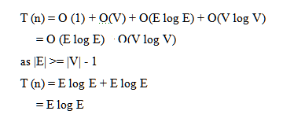
CONTINUES………

Slide 19
SCENARIO EXPLANATION
Notes:
We designed this template so that each member of the project team has a set of slides with its own theme. Members, here’s how you add a new slide to just your set:
Mark where you want to add the slide: Select an existing one in the Thumbnails pane, click the New Slide button, then choose a layout. The new slide gets the same theme as the other slides in your set.
Careful! Don’t annoy your fellow presenters by accidentally changing their themes. That can happen if you choose a different theme from the Design tab, which changes all of the slides in the presentation to that look.

Slide 20
Problem : Laying TV Cable
Central office

Slide 21
Graph G
V | Known | dv | Pv
A | 0 | 0 | 0
B | 0 | ∞ | 0
C | 0 | ∞ | 0
D | 0 | ∞ | 0
E | 0 | ∞ | 0
F | 0 | ∞ | 0
G | 0 | ∞ | 0
H | 0 | ∞ | 0
CO | 0 | ∞ | 0
A
2
E
D
18
1
B
4
3
5
3
7
9
5
Central office
C
8
16
F
10
G
1
H
2
Expensive!!!! & cost:94

Slide 22
WHY PRIM’S ALGORITHM?
Graph is a connected graph
Since ,Graph which represents this scenario is looks like a dense graph.
Prim’s algorithm works well in dense graphs.
Prim’s algorithm complexity will be O(v2)

Slide 23
Problem : Laying TV Cable->Step 1
Source vertex
A
E
D
B
F
Central office
C
G
H

Slide 24
Problem : Laying TV Cable->step 2
V | Known | dv | Pv
A | 1 | 0 | 0
B | 0 | 1 | A
C | 0 | ∞ | 0
D | 0 | ∞ | 0
E | 0 | ∞ | 0
F | 0 | ∞ | 0
G | 0 | ∞ | 0
H | 0 | ∞ | 0
CO | 0 | ∞ | 0
A
E
D
1
B
F
Central office
C
G
H

Slide 25
Problem : Laying TV Cable
A
V | Known | dv | Pv
A | 1 | 0 | 0
B | 1 | 1 | A
C | 0 | 3 | B
D | 0 | ∞ | 0
E | 0 | ∞ | 0
F | 0 | ∞ | 0
G | 0 | ∞ | 0
H | 0 | ∞ | 0
CO | 0 | ∞ | 0
E
D
1
B
3
F
Central office
C
G
H

Slide 26
Problem : Laying TV Cable->step 3
V | Known | dv | Pv
A | 1 | 0 | 0
B | 1 | 1 | A
C | 1 | 3 | B
D | 0 | 5 | c
E | 0 | ∞ | 0
F | 0 | ∞ | 0
G | 0 | ∞ | 0
H | 0 | ∞ | 0
CO | 0 | ∞ | 0
A
E
D
1
B
5
F
3
Central office
C
G
H

Slide 27
Final step : Minimum Spanning Tree
A
E
V | Known | dv | Pv
A | 1 | 0 | 0
B | 1 | 1 | A
C | 1 | 3 | B
D | 1 | 5 | C
E | 1 | 3 | CO
F | 1 | 5 | E
G | 1 | 2 | F
H | 0 | 1 | G
CO | 1 | 4 | D
1
D
B
3
4
5
5
3
Central office
C
2
F
1
G
H
Minimum Cost=24

Slide 28
COMPARISON BETWEEN PRIM’S ALGORITHM & KRUSKAL’S ALGORITHM
Notes:
We designed this template so that each member of the project team has a set of slides with its own theme. Members, here’s how you add a new slide to just your set:
Mark where you want to add the slide: Select an existing one in the Thumbnails pane, click the New Slide button, then choose a layout. The new slide gets the same theme as the other slides in your set.
Careful! Don’t annoy your fellow presenters by accidentally changing their themes. That can happen if you choose a different theme from the Design tab, which changes all of the slides in the presentation to that look.

Slide 29
COMPARISON
PRIM’S ALGORITHM
KRUSKAL’S ALGORITHM
Initializes with node
MST grows like a tree
Graph must be a connected graph
Time complexity is O(v2)
Works well in dense graphs
Initializes with an edge
MST grows like a forest
Works well in non connected graphs also.
Time complexity is O(E log E)
Works well in sparse graphs

Slide 30
PROPERTIES
Notes:
We designed this template so that each member of the project team has a set of slides with its own theme. Members, here’s how you add a new slide to just your set:
Mark where you want to add the slide: Select an existing one in the Thumbnails pane, click the New Slide button, then choose a layout. The new slide gets the same theme as the other slides in your set.
Careful! Don’t annoy your fellow presenters by accidentally changing their themes. That can happen if you choose a different theme from the Design tab, which changes all of the slides in the presentation to that look.

Slide 31
Properties Of Minimum Spanning Tree
1.Possible Multiplicity:
There may be several minimum spanning trees of the same weight having a minimum number of edges
If all the edge weights of a given graph are the same, then every spanning tree of that graph is minimum.
If there are n vertices in the graph, then each minimum spanning tree has n-1 edges.

Slide 32
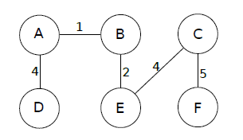
Example:
Graph G
Minimum spanning tree 1
Minimum spanning tree 2

Slide 33
Continues….
2.Uniqueness:
If each edge has a distinct weight then there will be only one, unique minimum spanning tree.
3.Cyclic property:
For any cycle C in the graph G , if the weight of an edge of e of c is larger than the individual weights of all other edges of c , then this edge cannot belong to MST.
C

Slide 34
Continues….
4.Minimum Cost Edge:
If the minimum cost edge e of a graph is unique, then this edge is included in any MST.

Slide 35
Thank you

