Slide 1
Quick Introduction to Accessible Maths
Science & Engineering Faculty, University of Limerick Emma Cliffe

Slide 2
Plan

Slide 3
Why worry about maths access?
What is the maths specific problem?
What do solutions look like?
How do you get started?
Live document: https://stem-enable.github.io/Quick-introduction-to-accessible-maths-2026/

Slide 4
Why worry about maths¹ access?

Slide 5
The legal
Accessibility is a legal requirement… I am not a lawyer². Seek advice.
Equal access:
England, Scotland, Wales: Equality Act 2010
Northern Ireland: Disability Discrimination Act 1995, (as amended), including SENDO 2005
Ireland: Equal Status Acts 2000 - 2018
Accessible digital content (including university websites, web services and most VLE content):
UK: Public Sector Bodies (Websites and Mobile Applications) (No. 2) Accessibility Regulations 2018
Ireland: European Union (Accessibility of Websites and Mobile Applications of Public Sector Bodies) Regulations 2020

Slide 6
But we should care anyway…
We want students to spend their effort engaging with concepts, not overcoming barriers in our resources.
Students with print disabilities or difficulties with reading, note-taking, memory or concentration may expend significant effort accessing information before learning can begin.
As educators, we should make information accessible in multiple ways.
Rich, interactive resources can benefit all students.
Poorly designed resources create practical and technical barriers:
Notation inaccessible via speech, magnification, Braille or small screens
Difficult keyboard-only navigation
Meaning conveyed by colour alone
Poorly scalable graphics

Slide 7
What is the maths specific problem?

Slide 8
Structured text can be unexpectedly inaccessible
Video demonstration
Video demonstration

Slide 9
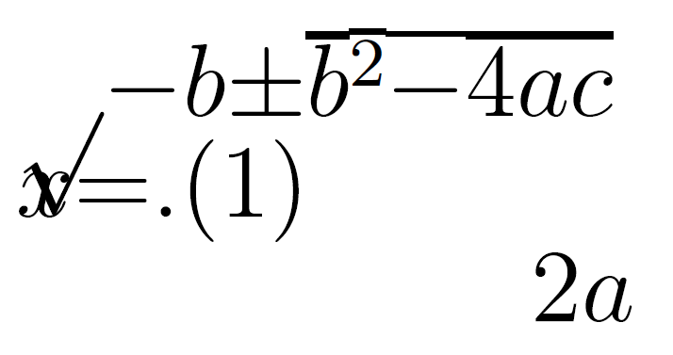
Could we solve it by…?
Can we not solve this by ensuring that the PDF is accessible? Unfortunately, the answer is currently, not yet³. In current software and typically in-use PDF standards, the act of creating the PDF destroys the structure of mathematical, and similar, expressions. Reflow on a small screen produces…
Quadratic equation destroyed by reflow

Slide 10
What do solutions look like?

Slide 11
Structure + software
Being able to adapt how text is presented, whether for small screens or via assistive software requires:
Authors to produce accessible materials which maintains the encoding of the structured text
Readers to have software and assistive technology which can manipulate the specific format
Until all this work is finished for PDF, only four formats of mathematical text are technically accessible:
HTML using MathJax to render the mathematics
Word/PowerPoint using the inbuilt equation editor
Word/PowerPoint using MathType
EPub3 using MathML
You must supply at least one to meet the public bodies requirement.
Supply your full course content ‘spine’ in this format.

Slide 12
So, job done?
Afraid not…
Not all reader assistive technology can access maths in all formats!
Equal access acts mean we must meet individual needs - so may need to produce other formats.
Some formats cannot not be transformed easily to others
For authors using Word/PowerPoint, standard accessiblity guidance is not enough.
For authors using the LaTeX scientific document preparation system none of the above formats are native outputs. And if a student can’t make their own clear print and print it you also may need to supply variants on inaccessible PDF!
Not all accessibility is about technical access
Clear print⁴ PDF is selected most often by disabled students in the Department of Mathematical Sciences at the University of Bath⁵.

Slide 13
How do you get started?

Slide 14
Word/PowerPoint 365
Use the inbuilt Accessibility Checker and information on e.g. Making your Word documents accessible
Write all mathematical text written using the MS 365 equation editor. E.g. if you are writing about the variable ($x$) or ($θ$) it should be written as an equation. If you are writing ($x^{2}$) it should be written as an equation.
Never use insert symbol.
Never write superscripts, subscripts, fractions etc. using font or style changes and standard keyboard input alone
Never use an image of an equation.
Use Review -> Read Aloud (Alt + Ctrl + Space) to check the maths
Quick example

Slide 15
Word/PowerPoint transforms and tools
Effective (keyboard-only) input of maths in Word.
Central Access Reader
Transforms to specially set up HTML for screenreaders
Can output MP3
Can be used as text to speech software (but is not screenreader compatible)
Transform to MathType
Student can convert to MathType - supply standard format
Conversion back to Word is not possible in bulk
At the time of writing transforming from (any) PowerPoint is tricky. Best not to use this as a source format. If making slides, I would use Quarto (used to make this!).

Slide 16
HTML (WCAG 2.2 AA) + MathJax!
Check it meets the legal requirement of WCAG 2.2 Level AA with e.g. Accessibility Insights for Web plugin for Chrome
Check it is MathJax… Right click!
$$x=\frac{−b±\sqrt{b^{2}−4ac}}{2a}$$
Provides/enables: navigation, chunking, zoom, copy/paste, colour, size and layout changes…
Encoded structure enables assistive technology including text-to-speech, screenreaders, electronic Braille
Fallback for ARIA-aware AT without native support
AT providers without native support and not ARIA aware are a problem but not your problem.
We recommend using MathJax 2.7.9 or MathJax 4.* as MathJax 3.* does not enable reflow on zoom (a requirement for WCAG 2.2 AA).

Slide 17
Scientific document preparation systems
Attempt to transform the LaTeX⁶ to HTML with MathJax using Chirun, BookML or lwarp
What happens depends on what you are doing in LaTeX
Keep your preamble clean, start with a minimal document, add in sections recompiling to all required output formats after each addition
Some documents cannot be converted
I don’t know of a Beamer solution at time of writing
Work in a Markdown format, using LaTeX for equations, with HTML has the primary output (can also output LaTeX/PDF); can create slides and single-source slides and documents (like Beamer)
Quarto is recommended in most cases
Bookdown continues to be fine but start new projects in Quarto
RMarkdown can be a helpful starting point for those completely new
Clavertondown, built using RMarkdown and Bookdown; only if other methods can’t meet needs

Slide 18
Non-text elements
Graphical elements
Desmos was designed to work and tested with screenreaders and written to conform to WCAG 2.2
Geogebra aims to meet WCAG 2.1 AA
Project Beyond alt text between Bath and Coventry produced guidelines
BrailleR is a project by and for blind statisticians who use R
Complex images - making sense for accessibility
DIAGRAM Center has some great resources for those new to diagram description:
Poet Image Description Training Tool, Image description guidelines and Sample book
Webinar on complex images
Maths e-assessment
Numbas aims to meet WCAG 2.1 AA
Stack aims to meet WCAG 2.1 AA

Slide 19
Next steps

Slide 20
The ideal can feel a long way off…
Pick a place to start which feels achievable and start!
The journey is less lonely if we share experiences and learn from each other
Consider setting up an institution community of practice, after 6 years our Markdown/Bookdown/ClavertonDown/Quarto CoP answers many questions between themselves without help from me, my team or the specialist STEM learning technologists (who we are very lucky to have)
In the UK there is the JISC Accessibility Community Maths Working Group.
Is there anything similar in Ireland?
It may be worth exploring whether links can be made with them from Ireland
Want to see how I built this single-source, multiple-outputs document? Github repository source - see qmd file

Slide 21
Notes
1. I will use the word maths as a shorthand for all mathematical and statistical content used across any STEM degree. Although I won’t be talking about specialist chemical notations and diagrams the same issues apply.
2. Legislation is cited for awareness only and this does not constitute legal advice. Specific legal questions should be referred to your University legal team.
3. Work is ongoing to add encoding within a new PDF standard (PDF/UA-2 and WTPDF (Well-Tagged PDF) standards), create a version of LaTeX which can do this (itself, a multi-year project currently in stage 4 of enabling package authors to apply changes), and software which works with the extra encoding. The assistive technology vendors would then also need to support all of this. In the meantime we need to either convert the LaTeX to other formats or switch to a different scientific document preparation system.
4. Adhering as closely as possible to RNIB clear print guidelines
5. Last year we had to assist an author to create a printable PDF for a disabled student after the author had made a whole (and completely technically accessible) course using ProTeXt - but couldn’t get PDF working and the HTML produced poor print output…
6. It is not possible to convert LaTeX to html in the general case. It is easy to ‘fall out’ of the convertible subset without realising or knowing why, the addition of a package, change of preamble order, use of a seemingly innocent command…

