Slide 1
Lecture 01 EARTH AND LIFE SCIENCE: Universe and the Solar System
Genesis Julyus T. Agcaoili, M.Sc.
genesisjagcaoili@gmail.com
Instructor
Las Piñas City National Science Senior High School
Integrated and Talon Campus

Slide 2
Objectives
Demonstrate an understanding of the formation of the universe
State the different hypotheses and theories explaining the origin of the universe
Describe the structure and composition of the Universe
Explain the red-shift and how It is used as proof of an expanding universe
Explain the Big Bang Theory and evidences supporting the theory

Slide 3
Important Terms
Dark energy
Light Years
Protostar
Thermonuclear reaction
Baryonic matter
Dark matter
Main Sequence Stars

Slide 4
(Group Number) space (ANSWER) send to
09985535461

Slide 5
Baryonic Matter
“ordinary” matter consisting of protons, electrons, and neutrons that comprises atoms, planets, stars, galaxies, and other bodies

Slide 6
Dark Matter
Matter that has gravity but does not emit light

Slide 7
Dark Energy
A source of anti-gravity; a force that counteracts gravity and causes the universe to expand

Slide 8
Protostar
An early stage in the formation of a star resulting from the gravitational collapse of gases

Slide 9
Thermonuclear reaction
A nuclear fusion reaction responsible for the energy produced by stars

Slide 10
Main Sequence Stars
Stars that fuse hydrogen atoms to form helium atoms in their cores; outward pressure resulting from nuclear fusion is balanced by gravitational forces

Slide 11
Light Years
The distance light can travel in a year; a unit of length used to measure astronomical distance

Slide 12
Question
What do you know about the universe?

Slide 13
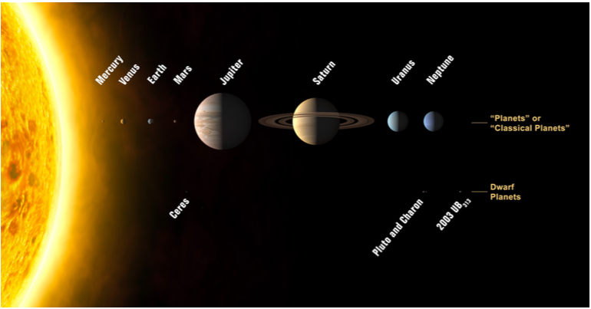
Source: The Solar System (https://upload.wikimedia.org/wikipedia/commons/d/d9/Solar_System_(annotated).jpg)

Slide 14
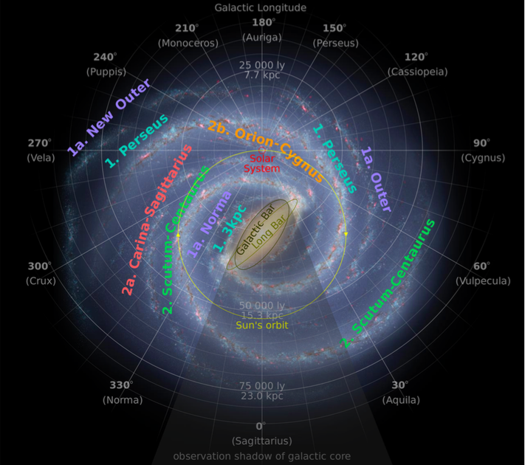
Source: The Milky Way (https://upload.wikimedia.org/wikipedia/commons/thumb/a/a7/ Milky_Way_Arms_ssc2008-10.svg/2000px-Milky_Way_Arms_ssc2008-10.svg.png)

Slide 15
QUESTION
Is there a center in the universe?
How about in the galaxy?

Slide 16
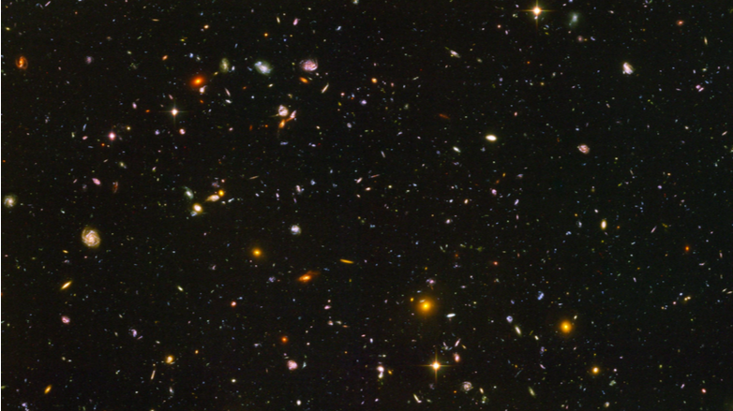
Source: The Hubble Deep Field (https://www.google.com.ph/url sa=i&rct=j&q=&esrc=s&source=images&cd=&ved =0ahUKEwjOuKaQlaTNAhXCqJQKHStrA5kQjBwIBA&url=http%3A%2F%2Fwallpapercave.com% 2Fwp%2FTlqblsL.jpg&psig=AFQjCNFfHuF9reOYsnpNIuRLoYAVcVeObA&ust=1465878504806484)

Slide 17
Universe
Comprises all space and time and all matter and energy in it
Made of 4.6% baryonic matter
Made of 24% cold dark matter
Made of 71.4% dark energy
Hydrogen, Helium and Lithium most abundant elements

Slide 18
Stars
Building block of galaxies
Formed out of clouds of gas and dust in galaxies
Gravitational collapse, rotation, heating up and transformation
Protostar – hot core of a future star

Slide 19
Birth, Evolution, Death, and Rebirth of Stars
Galaxy – cluster of billions of stars and clusters of galaxies from super clusters
13.8 billion years old
Infinite diameter (91 billion light years)
Density = 4.5 x 10e-31 g/cm3

Slide 20
Expanding Universe
Edwin Hubble
1929
“REDSHIFT”
Galaxies are moving away from each other, hence as evidence for an expanding universe
Spectral lines of starlight made to pass through a prism shifted toward the red part of the electromagnetic spectrum
Einstein’s Theory of Relativity

Slide 21
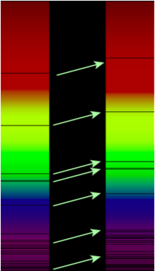
RED SHIFT
Evidence for an expanding universe
The positions of the absorptions lines for He for light coming from the Sun are shifted towards the red end as compared with those distant star

Slide 23
ACTIVITY
Where is the horn coming from?
Inside?
Outside? Where?

Slide 24
Cosmic Microwave Background
Accidental discovery in 1964 by Arno Penzias and Robert Woodrow Wilson earned them the physics Nobel Prize in 1978.
It can be observed as a strikingly uniform faint glow in the microwave band coming from all directions-blackbody radiation with an average temperature of about 2.7 degrees above absolute zero

Slide 25
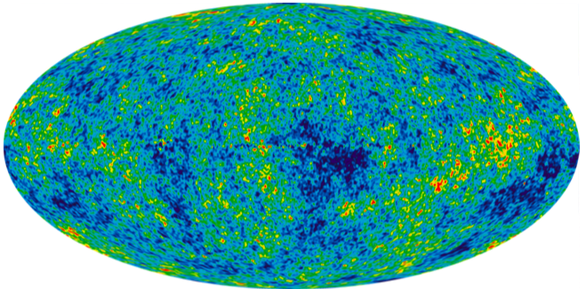
Source: Cosmic microwave background radiation map showing small variations from WMAP - (Wilkinson Microwave Anisotropy Probe) (https:// www.google.com.ph/url? sa=i&rct=j&q=&esrc=s&source=images&cd =&ved=0ahUKEwi- ia2AmqTNAhUHI5QKHcOjBjoQjBwIBA&url =https%3A%2F%2Fupload.wikimedia.org %2Fwikipedia%2Fcommons%2F3%2F3c %2FIlc_9yr_moll4096.png&bvm=bv. 124272578,d.dGo&psig=AFQjCNFKLayV4r Tg0JLSNVx2R6LonF7X_w&ust=1465879811 382467)

Slide 26
ORIGIN OF THE UNIVERSE

Slide 27
Non-Scientific Thought
Egyptians – Gods and Myths (world arose from an infinite sea at the first rising of the sun)
Kuba people of Central Africa – Creator god Mbombo, alone in a dark and water-covered Earth, felt an intense stomach pain and then vomited the stars, sun and moon
India – Gods sacrificed Purusha, the primal man whose head, feet, eyes, and mind became the sky, earth, sun, and moon

Slide 28
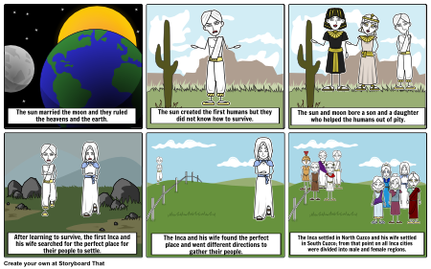
https://www.google.com.ph/search?q=mbombo&espv=2&biw=1363&bih=583&source=lnms&tbm=isch&sa=X&ved=0ahUKEwi40YDOhLHNAhWJjJQKHSz3A3gQ_AUIBigB#tbm=isch&q=egyptian+creation+myth&imgrc=fR8JXGE3O8gvvM%3A

Slide 29
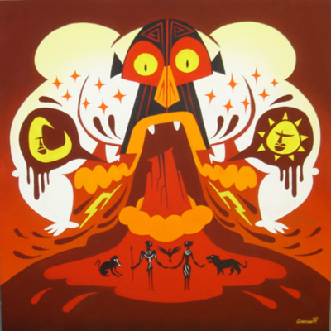
https://www.google.com.ph/search?q=mbombo&espv=2&biw=1363&bih=583&source=lnms&tbm=isch&sa=X&ved=0ahUKEwi40YDOhLHNAhWJjJQKHSz3A3gQ_AUIBigB#tbm=isch&q=mbombo+creation+myth&imgrc=mUzxsSOsXlgUCM%3A

Slide 30
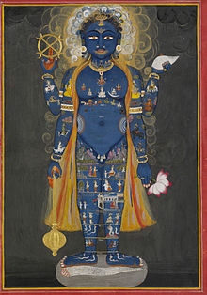
https://www.google.com.ph/search?q=mbombo&espv=2&biw=1363&bih=583&source=lnms&tbm=isch&sa=X&ved=0ahUKEwi40YDOhLHNAhWJjJQKHSz3A3gQ_AUIBigB#tbm=isch&q=purusha+the+cosmic+man&imgrc=3Kz26nOo3v-GEM%3A

Slide 31
Religious Thought
Monotheistic religions of Judaism, Christianity, and Islam claim that a supreme being created the universe, including man and other living organisms

Slide 32
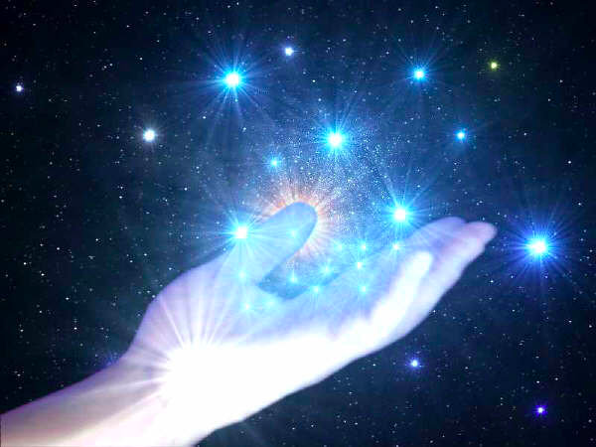
https://www.google.com.ph/search?q=mbombo&espv=2&biw=1363&bih=583&source=lnms&tbm=isch&sa=X&ved=0ahUKEwi40YDOhLHNAhWJjJQKHSz3A3gQ_AUIBigB#tbm=isch&q=supreme+being+creation+myth&imgrc=Bp9Bz1wLviSkfM%3A

Slide 33
Steady State Model
Sir Hermann Bondi, Thomas Gold, and Fred Hoyle
Proposed in 1948
Adopted the “Perfect Cosmological Principle”
New matter is created as the universe expands thereby maintaining its density
Constant cycle of matter being created and destroyed
There was no beginning to the universe
There will be no end

Slide 34

https://www.google.com.ph/search?q=steady+state+theory&espv=2&biw=1363&bih=583&source=lnms&tbm=isch&sa=X&ved=0ahUKEwjtr4Lyh7HNAhUBMZQKHbrqB6MQ_AUIBigB#imgrc=eYqLJ3cFLPCoWM%3A

Slide 35
Nebular Hypothesis
Proposed by Immanuel Kant and Pierre Laplace
The sun, earth, and the rest of the solar system formed from a nebula, or a cloud of dust and gas

Slide 36
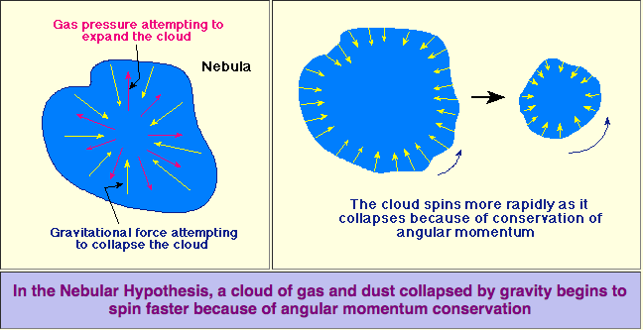
Collapsing Clouds of Gas and Dust
http://csep10.phys.utk.edu/astr161/lect/solarsys/nebular.html

Slide 37
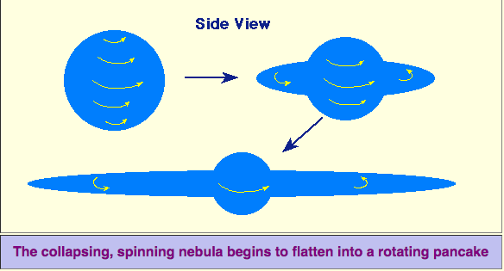
The Spinning Nebula Flattens
http://csep10.phys.utk.edu/astr161/lect/solarsys/nebular.html

Slide 38
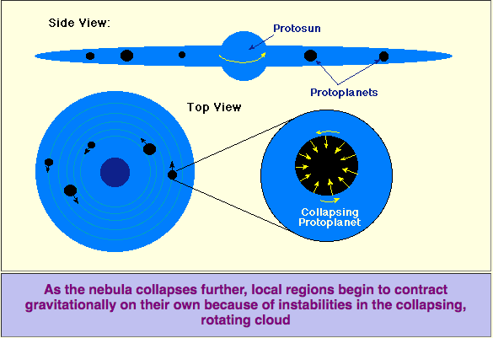
Condensation of Protosun and Protoplanets
http://csep10.phys.utk.edu/astr161/lect/solarsys/nebular.html

Slide 39
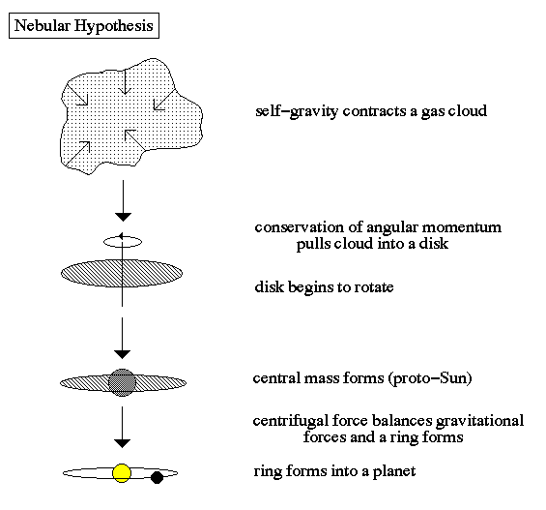
https://www.google.com.ph/search?q=planetesimal+theory&espv=2&biw=1363&bih=583&source=lnms&tbm=isch&sa=X&ved=0ahUKEwj-6YjajbHNAhVEjZQKHbzdDtsQ_AUIBigB#imgrc=186RqGCM1DLz2M%3A

Slide 40
Planetisimal Hypothesis
Proposed by Victor Safronov
When a planetary system is forming, there is a protoplanetary disk with materials from the nebulae from which the system came.
The material is gradually pulled together by gravity to form small chunks.
The materials formed together until they form planetisimals

Slide 41
The sun existed before the formation of planets
A star came close to the sun
Because of the gravitational pull of the star, small gaseous bodies were separated from the sun
These bodies cool down and became small planets
During rotation the small planets collided and form planets

Slide 42
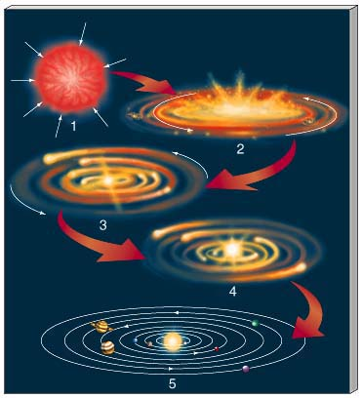
https://www.google.com.ph/search?q=planetesimal+theory&espv=2&biw=1363&bih=583&source=lnms&tbm=isch&sa=X&ved=0ahUKEwj-6YjajbHNAhVEjZQKHbzdDtsQ_AUIBigB#imgrc=yeM7_MrYlOytKM%3A

Slide 43
Gaseous-Tidal Hypothesis
Proposed by James Jeans and Harold Jeffreys
Origin of the solar system as a result of a close encounter between the Sun and a second star
The tidal interaction between the sun and a passing star would raise tides on the Sun resulting in the loss of a single cigar-shaped filament of hot gas.

Slide 44
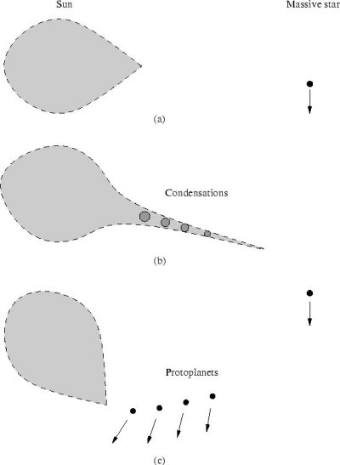
Schematic representation of the Jeans-Jeffreys tidal hypothesis. (a) A tidal bulge is induced. (b) A filament of material is drawn out in which condensations form. (c) The produced protoplanets orbit the Sun with high eccentricities. Image credit: Stephen Oxley, doctoral thesis, Univ. of York, 1999
http://www.daviddarling.info/images/tidal_hypothesis.jpg

Slide 45
Protoplanet Hypothesis
Proposed by Carl von Weizsacker and Gerard Kuiper
Suggests that about 5 billion years ago a great cloud of gas and dust rotated slowly in space.
An enormous, rotating gas cloud begins to collapse
Most of the material collects in the center, eventually becomes the sun
Gravity compressed the gas
Other smaller, gas and dust masses shrank into protoplanets

