Slide 1
Eight Queens and
Brute Force Using Python

Slide 2
Wikipedia, “The eight queens puzzle is the problem of placing eight chess queens on an 8x8 chessboard so that no two queens attack each other. Thus, a solution requires that no two queens share the same row, column, or diagonal.

Slide 3
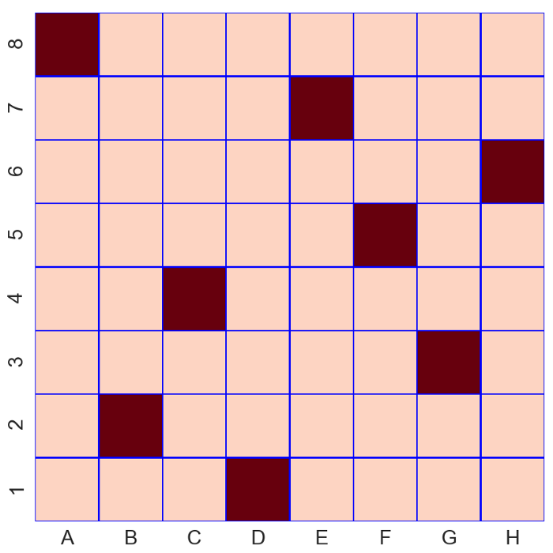

Slide 4
C(64,8)=64C8=64!/(8!⋅(64−8)!)=4,426,165,368

Slide 5
Observations:
1. No two queens share a column. 2. No two queens share a row. 3. No two queens share a top-right to left-bottom diagonal. 4. No two queens share a top-left to bottom-right diagonal.

Slide 6
X
X,Y
. . . Q . . . .
Q . . . . . . .
. . . . Q . . .
. . . . . . . Q
. . . . . Q . .
. . Q . . . . .
. . . . . . Q .
. Q . . . . . .
X
4
1
5
8
6
3
7
2
4,1
1,2
5,3
8,4
6,5
3,6
7,7
2,8
Y

Slide 7
. . . Q . . . .
Q . . . . . . .
. . . . Q . . .
. . . . . . . Q
. . . . . Q . .
. . Q . . . . .
. . . . . . Q .
. Q . . . . . .
X
X, Y
4,1 >> x0 = 4, y0 = 1
3,2 >> x1 = 3, y1 = 2
1,4
dx = abs (x1 – x0) = 1
dy = abs (y1 – y0) = 1
dx = dy
Y

Slide 8
Arrangements of 1 queen per row. If we restrict one queen per row, each queen has 8 possible places, so the total arrangements is 8⁸ = 16,777,216 ways. This is approximately 264 times better than the previous one. In python, this can be achieved by nested for loops.

Slide 9
Permutations of 8 queens, 1 queen per row. Can we do better than the previous? Of course! If we only take care of the permutations of the numbers 1 to 8, and map the first place to row 1, the second place to row 2, and so on, we do not worry anymore about being in the same row or being in the same column. The total arrangements in this case is 8! = 40,320, which is 416 times better than the previous!

