Slide 1
Gráficos_Base
Stefanny Vega

Slide 2
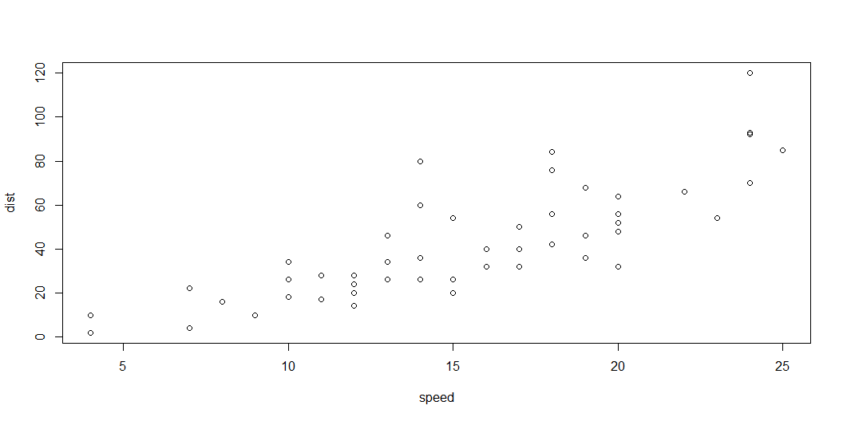
##Gráfico del sistema de base de R ## Gráfico de Dispersión
Muestra la relación entre dos variables númericas

Slide 3
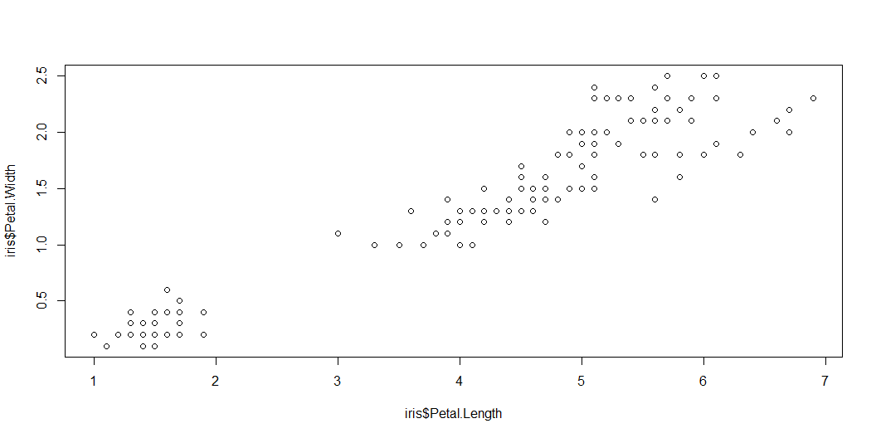
Relación entre entre longitud y ancho de los petalos de las flores de genero “iris”

Slide 4
Quarto
Quarto enables you to weave together content and executable code into a finished document. To learn more about Quarto see https://quarto.org.

Slide 5
Running Code
When you click the Render button a document will be generated that includes both content and the output of embedded code. You can embed code like this:
[1] 2
You can add options to executable code like this
[1] 4
The echo: false option disables the printing of code (only output is displayed).

