Slide 1
The efficiency of central bank communication
Hypothesis: A central bank’s communication should be consistent with the level of interest rates in the economy. Furthermore, it should also help markets anticipate future changes to such interest rates

Slide 2
Key questions:
Is the central bank communication consistent with its policy stance
Do policy statements allow us to infer enough information about it?
Is analyzing words (counting words) in those statements of any help?
Can statements provide data not only of present, but also future rates?
…Apparently they can!
Why should we care?
Inflation is a regressive tax, and can have damaging consequences
Efficient communication helps CBs keep inflation expectations of check
This also allows economic agents to take better decisions

Slide 3
Data needs To undertake this task we need a small set of things: - Access to Mexico central bank’s (Banxico) statements - Data on interest rates and foreign exchange (peso) Are these readily available? - Statements are available in Banxico’s website…but just in PDF! - Data, in contrast, are provided through Banxico’s free API

Slide 4
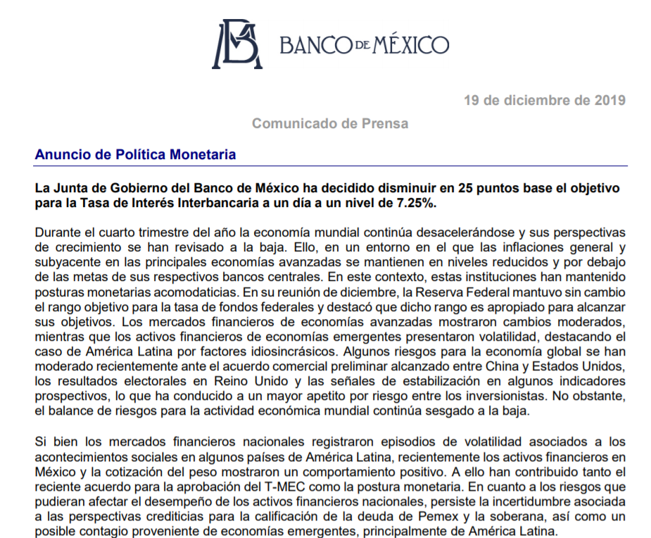
We need to get from this…

Slide 5
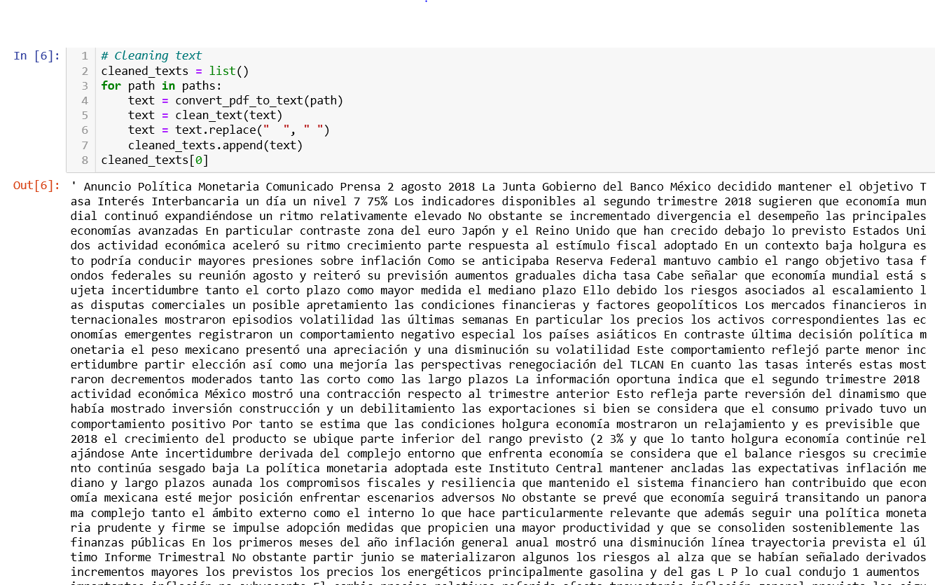
…to this…

Slide 6
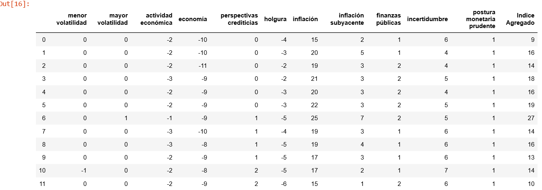
…and this

Slide 7
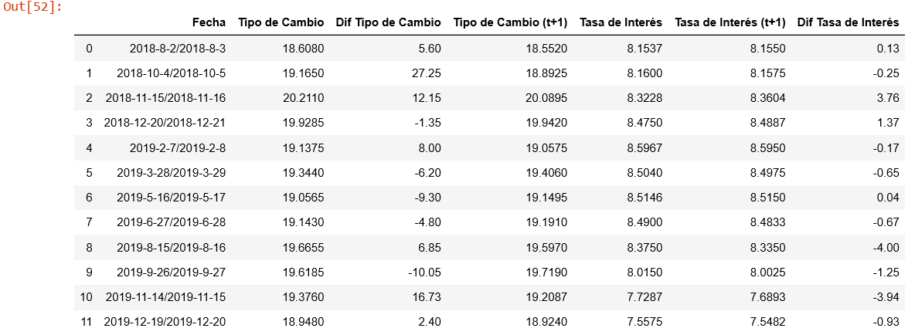
Also, we lean on Banxico’s API to build the following…

Slide 8
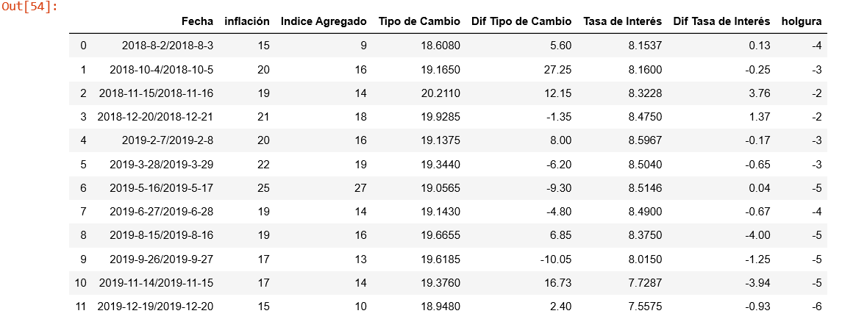
Finally…we merge the two and obtain

Slide 9
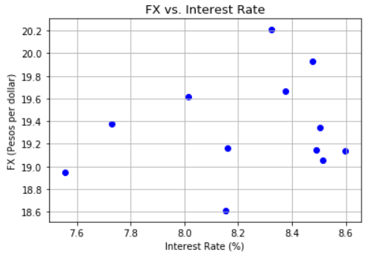
What should we be looking at, FX or rates? - FX can respond to much more global factors than rates - It can also have different contradicting behavior: - A depreciated FX can lead to higher rates… …while higher rates can lead to an appreciated FX - This makes it a less suitable candidate for our analysis

Slide 10
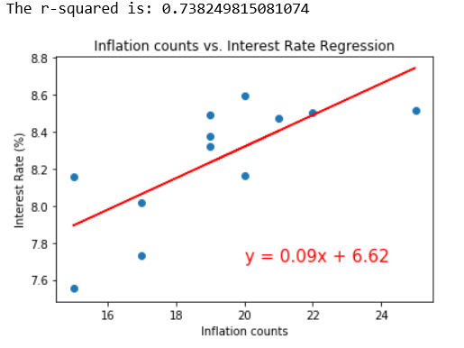
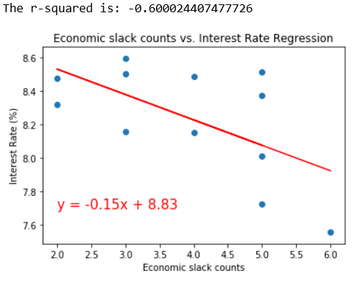
Word counting is helpful to predict rate level - High (low) inflation is usually associated with higher (lower) rates - Strong (weak) economic growth is associated with higher (lower) rates - Central bank communication is consistent with this…

Slide 11
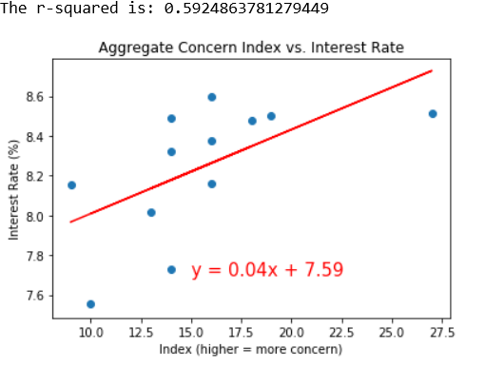
Our aggregate indicator, however, needs more work…

Slide 12
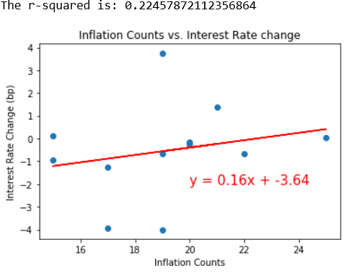
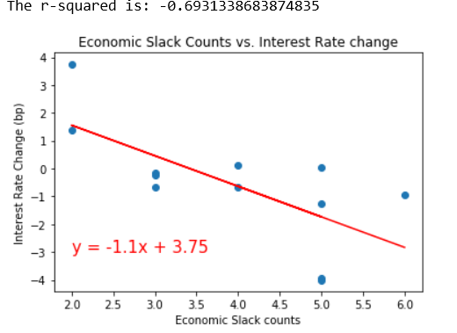
That said, the word counter not only helps predict current rates, but also future rates!

Slide 13
Conclusions - Inflation is damaging in many ways, not least by acting as a regressive tax - An efficient central bank communication helps contain inflation - A central bank that reacts predictably to economic data should be more efficient - Data analytics provide tools to test such efficiency - We find that analyzing words used in CBs statements help predict rates… …and not only current rates, but future rates too! - This is important as efforts to communicate clearly seem to pay off… …at least if you know where to search for - Correctly interpreting a CB’s communication can help improve the economy’s functioning

