Slide 1



HEXITEC Processing
TLDR Version
M. C. Veale
05/01/2021

Slide 2
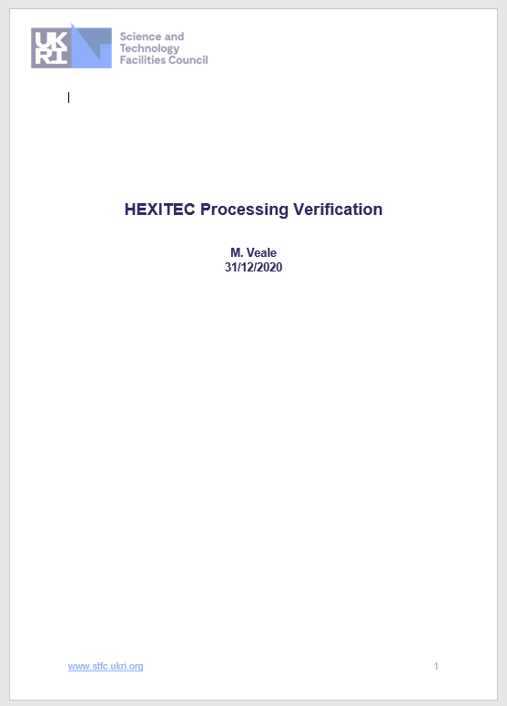
Background
These slides provide a brief summary of my current data processing technique for HEXITEC.
All my current scripts are implemented in Matlab and make use of the Imaging Toolbox.
The full details can be found in the report in Github.

Slide 3

The Analysis Process
Noise Threshold Calculation
Cluster Identification
Charge Sharing Correction
Initial Calibration
Refined Calibration
Threshold Application
Veale_HEXITEC_Calibration_Generation_Dec_2020.m
Threshold Application
Cluster Identification
Charge Sharing Correction
Multiplicity Analysis
Spectroscopic Performance
Calibration Application
HEXITEC_Calibrated_Playback_Veale_Dec_20.m

Slide 4
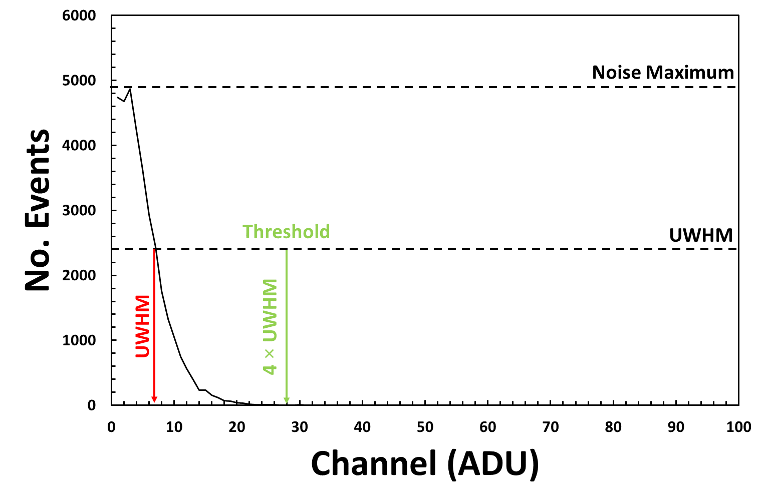
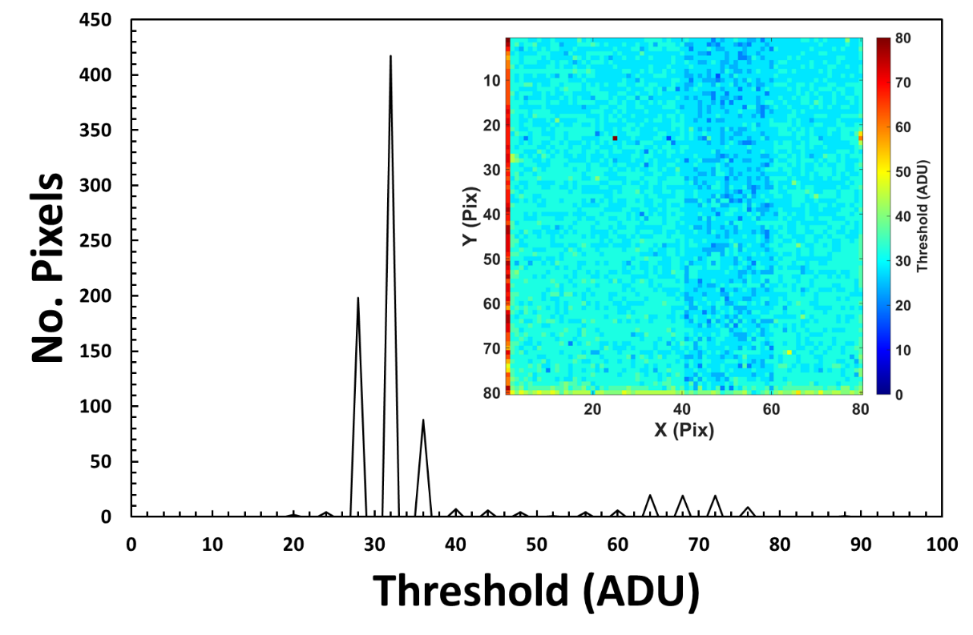
Noise Threshold
A noise threshold is defined per pixel
This is calculated from the first 50k frames
A histogram of the events < 100 ADU is produced
The threshold is defined as nt × UWHM of the noise distribution
For the CdTe sensor nt = 4

Slide 5
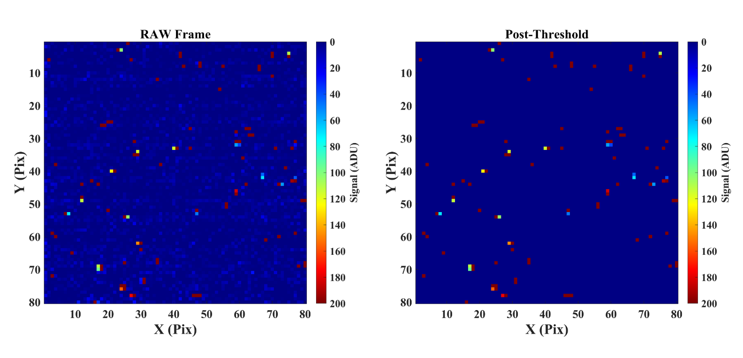
Applying the Threshold

Slide 6
Noisy Frames Suppression

Slide 7
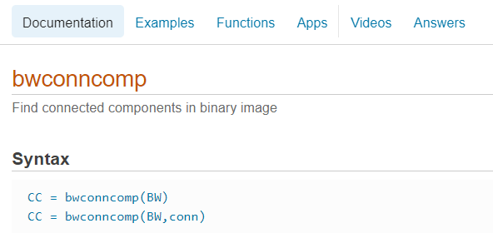
Cluster Identification
I’m no longer using the 3×3 window technique
Now using the bwconncomp function in the Matlab Imaging Toolbox
Images are converted to binary
The function then identifies connected pixels, this includes diagonals
These clusters are then used to complete charge sharing corrections

Slide 8
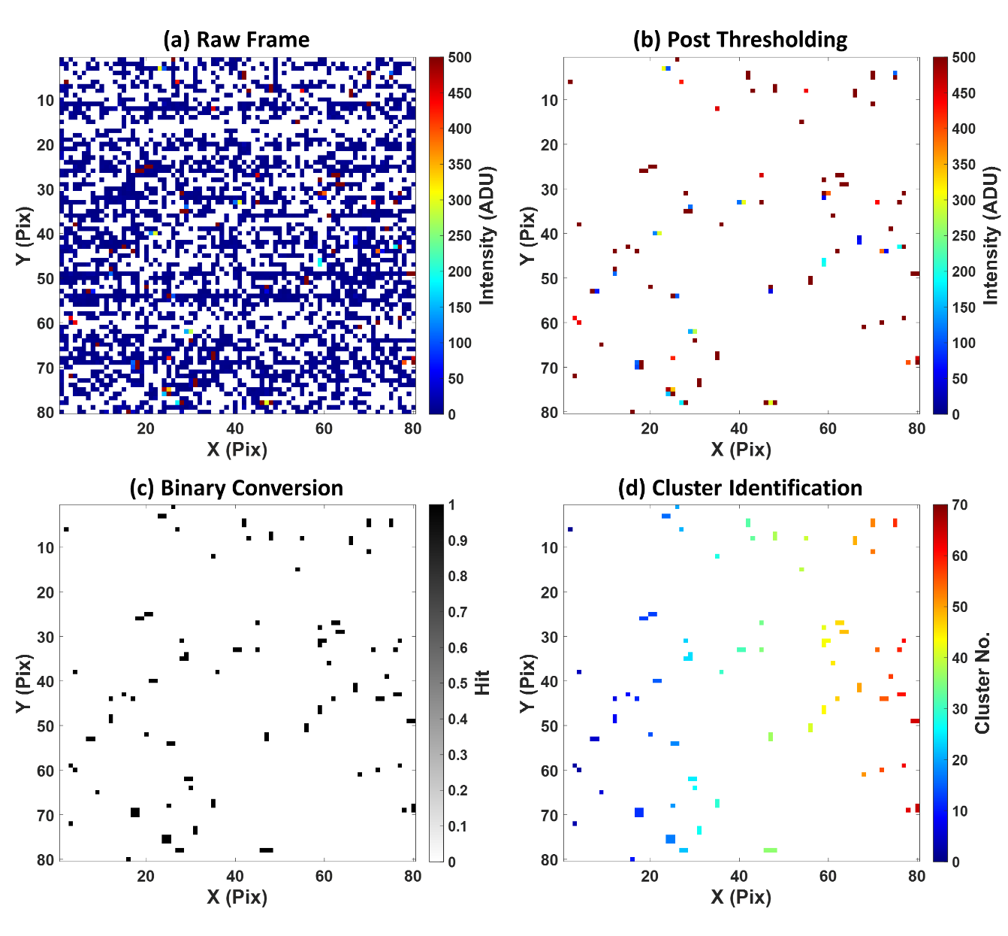
The cluster identification process can be seen in this example frame of data.
Pixels with 0 values appear as white in these plots.

Slide 9
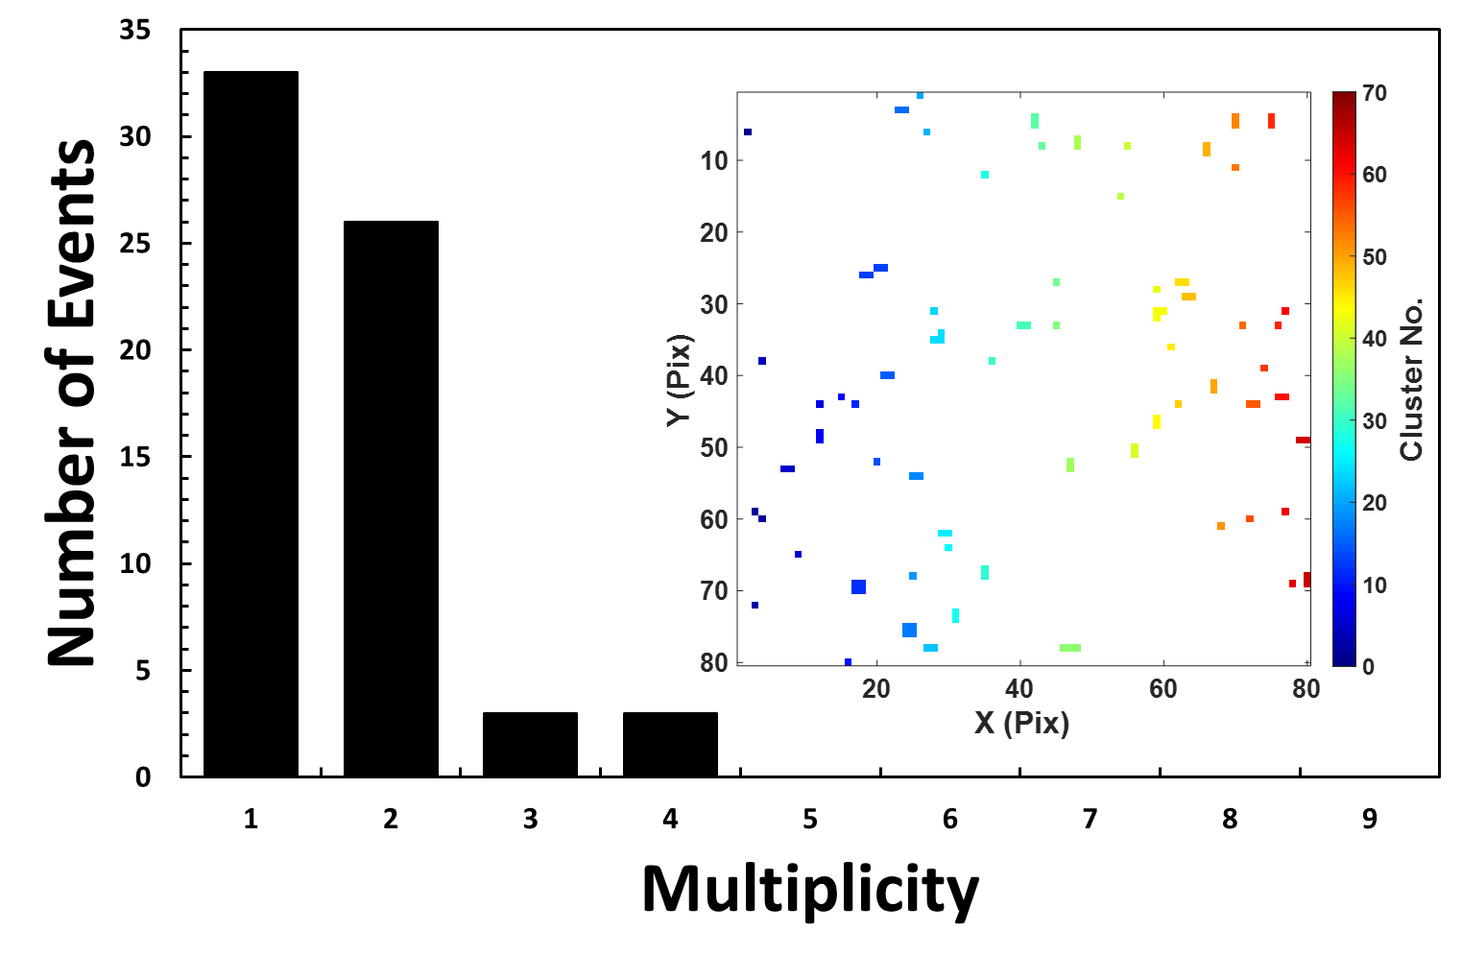
Multiplicity
The multiplicity is defined as the number of pixels involved in a single interaction
The histogram opposite shows the distribution of cluster sizes for a single frame of data
The majority are either m = 1 or m = 2 clusters

Slide 10
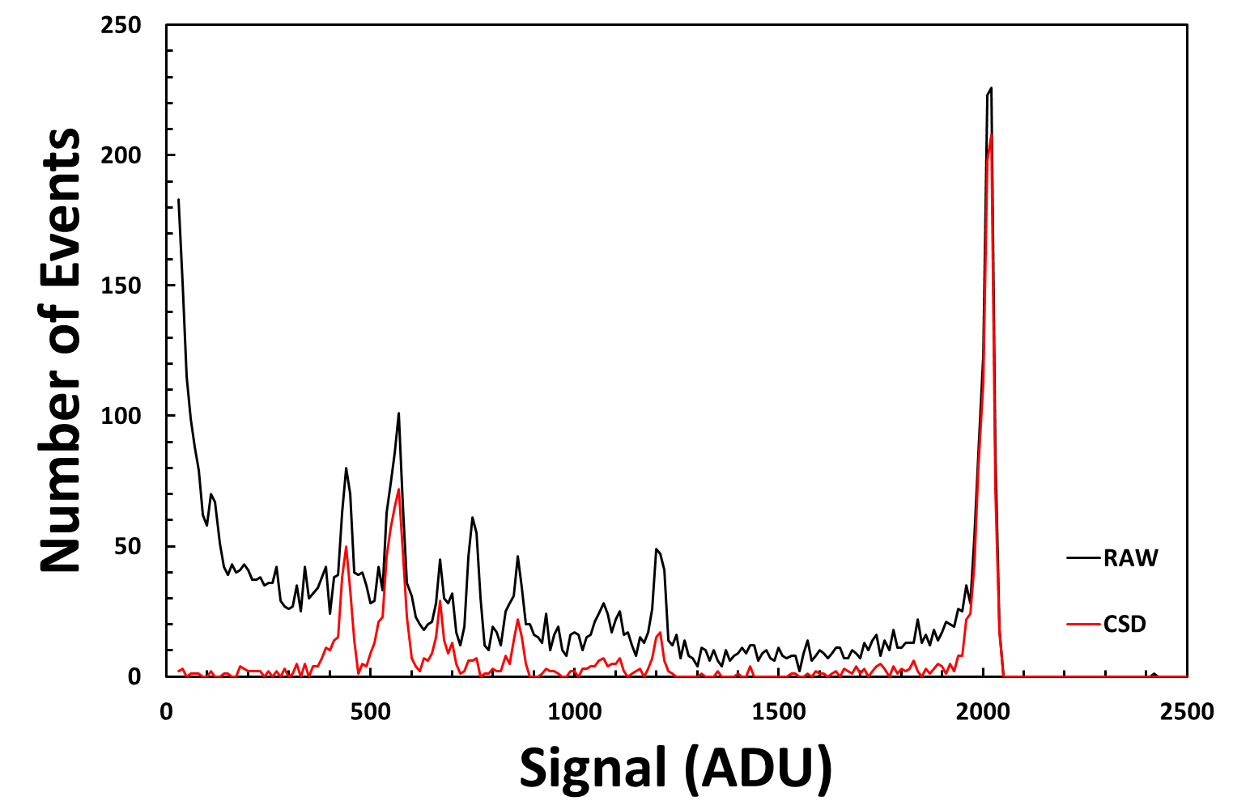
Charge Sharing Discrimination (CSD)
Using the cluster information, spectra can be produced from only m=1 clusters
The spectra opposite compares the spectrum of a single pixel for all events (RAW) and for only m = 1 events (CSD)
The reduction in low energy charge sharing events is clear

Slide 11
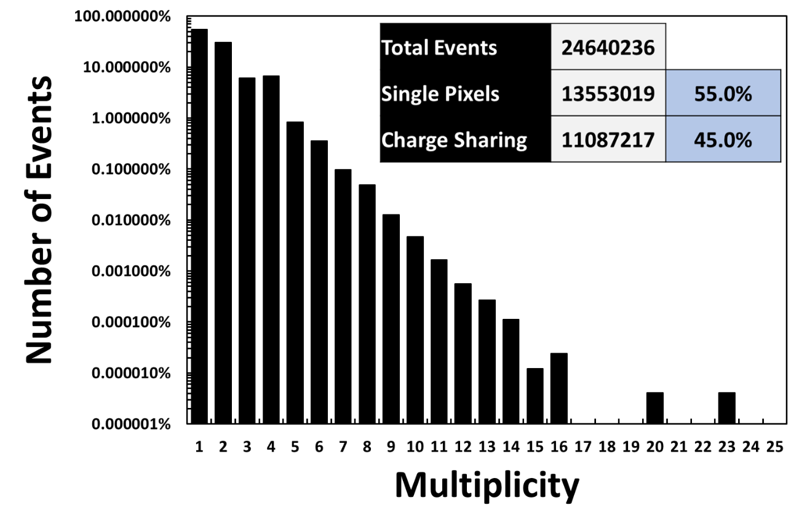
Multiplicity
This figure shows the distribution of cluster sizes across the whole data file
Note that the plot is on a Log scale
While larger clusters are observed these are in very low numbers
In total 45% of events were found to be shared

Slide 12
Charge Sharing
The script produces a multiplicity histogram per pixel
This histogram is then used to calculate the charge sharing percentage per pixel
There is a noticeable gradient across the detector, this is likely to be due to variations in gain across the device.

Slide 13
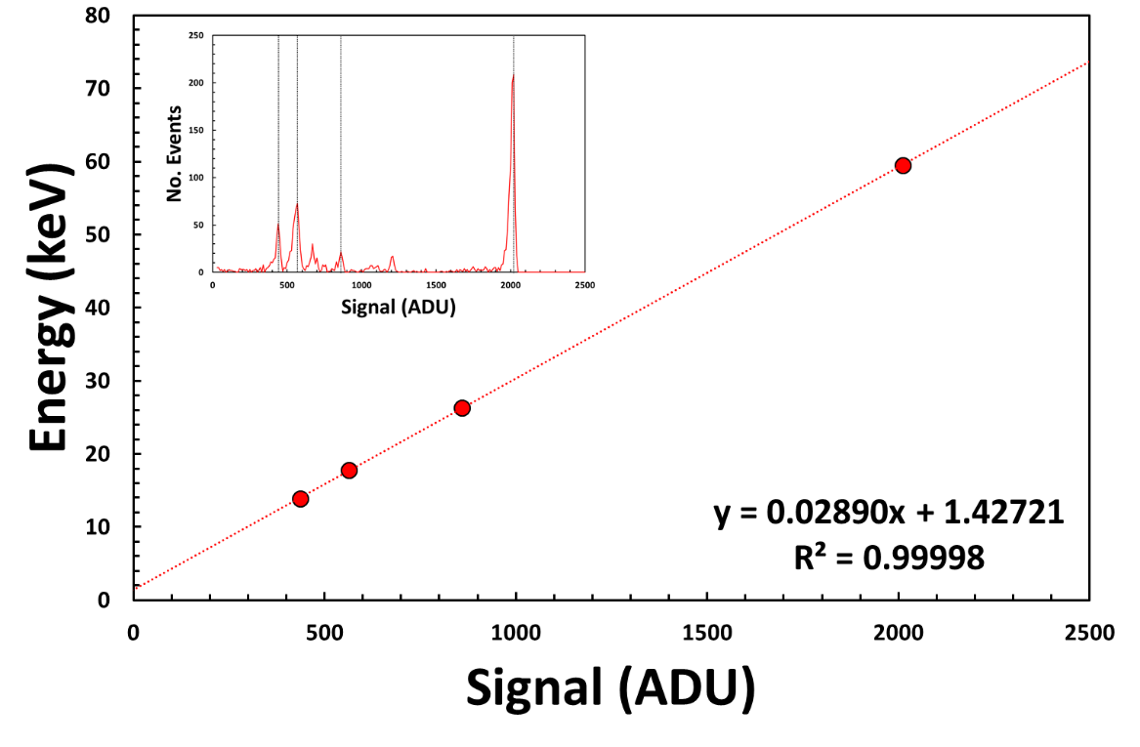
Calibration
Each pixel of the detector is calibrated using the most prominent lines
E = 59.54 13.94 17.75 26.34 keV
A linear calibration is then completed extracting the gradient and intercepts

Slide 14
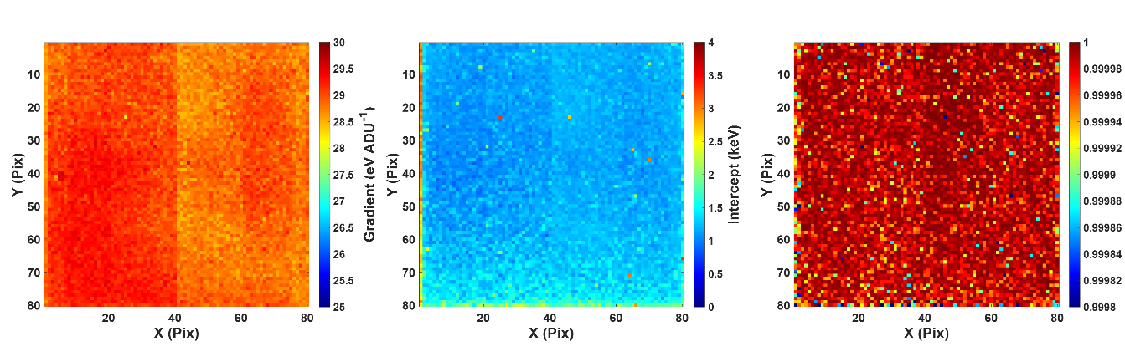
Calibration
Below are maps of the gradient, intercept and r2 value per pixel
The effect of the 4 ADCs is clear in the gradient map
Average values were: m = 28.96 eV ADU⁻¹ and c = 1.23 keV

Slide 15
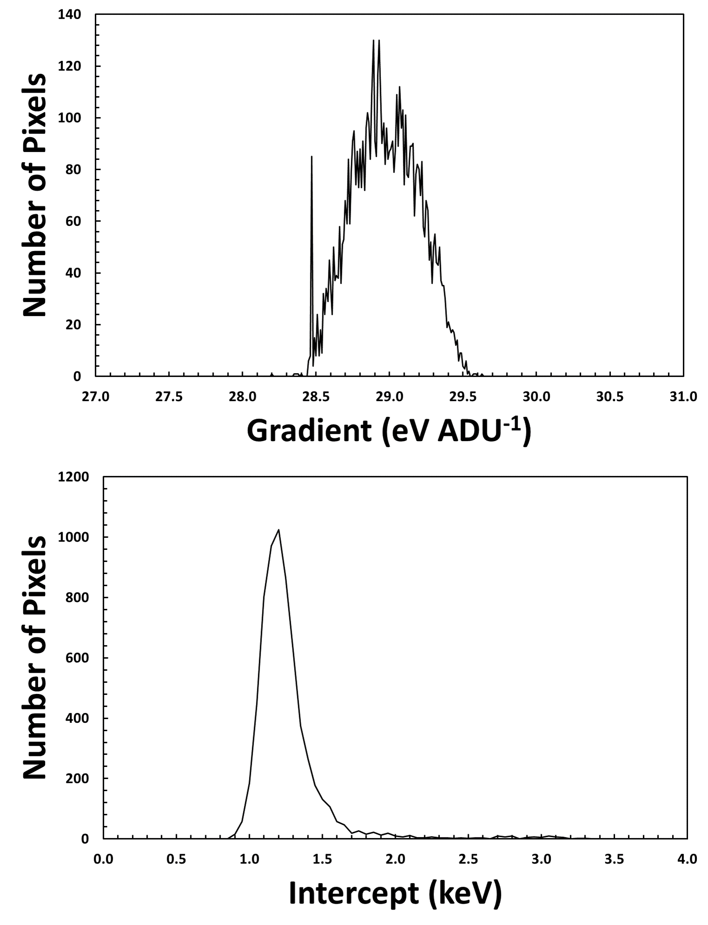
Calibration
The distribution of calibration values can be seen opposite.
This is consistent with what has been seen in previous HEXITEC detectors

Slide 16
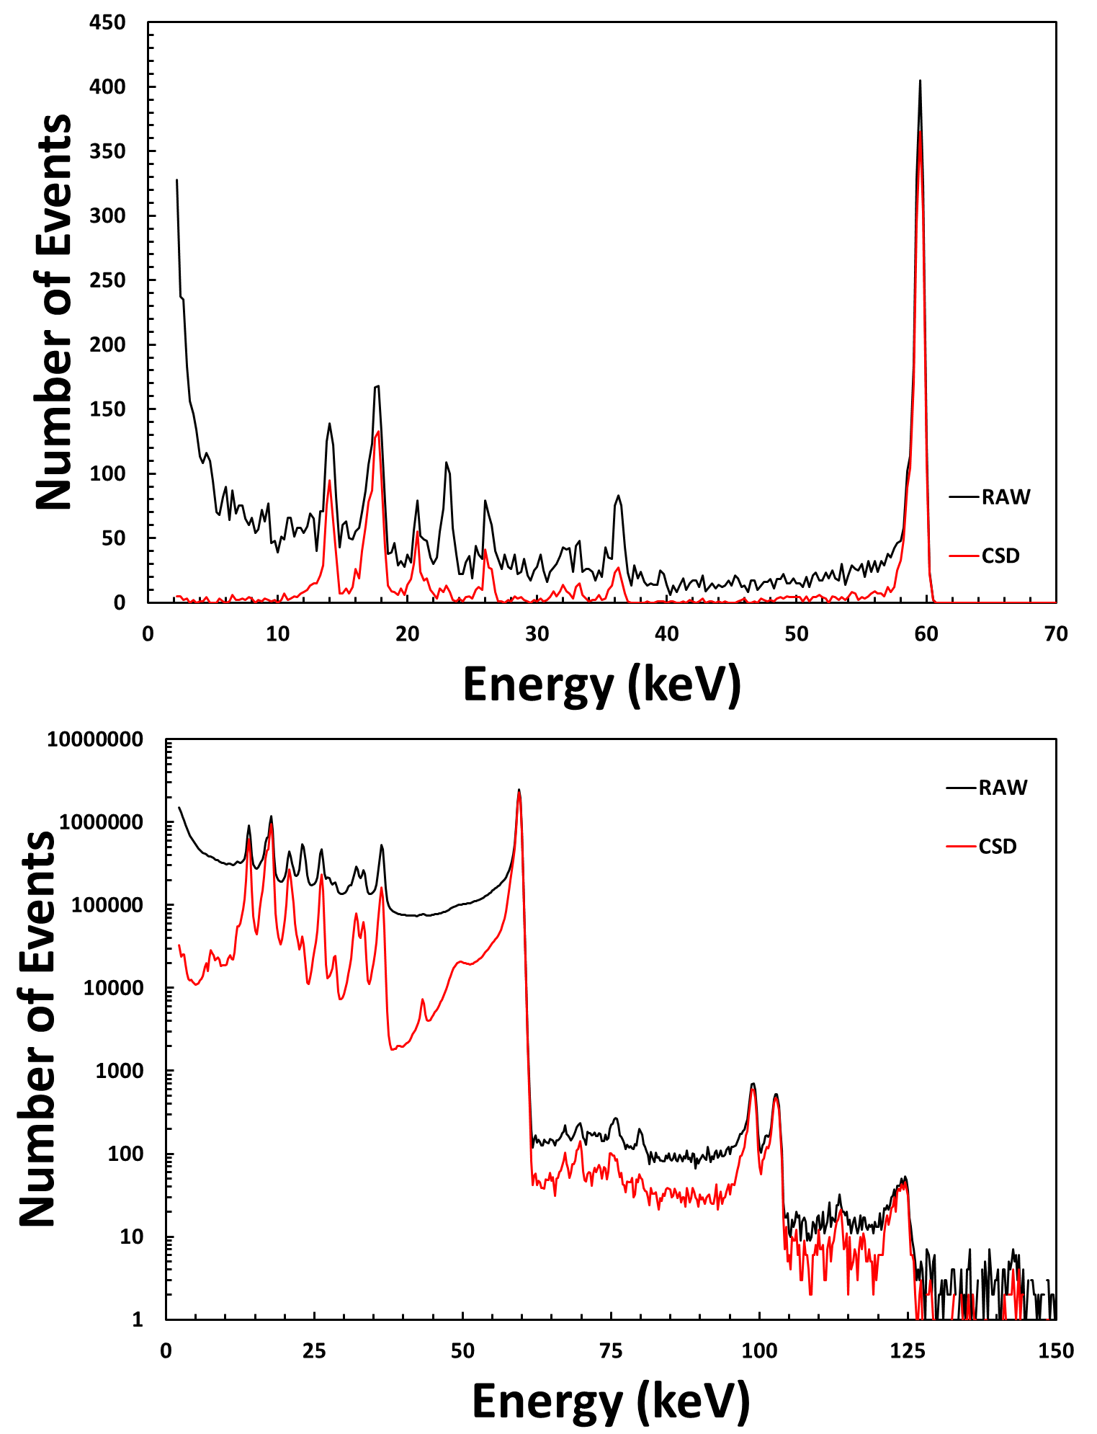
Calibration
If the same data file is replayed applying the calibration and thresholds then the calibrated spectra are generated
Opposite are an example of a single pixel spectrum [40, 40] as well as the global spectrum [3:77, 3:77]
Spectra are shown with and without charge sharing correction

Slide 17
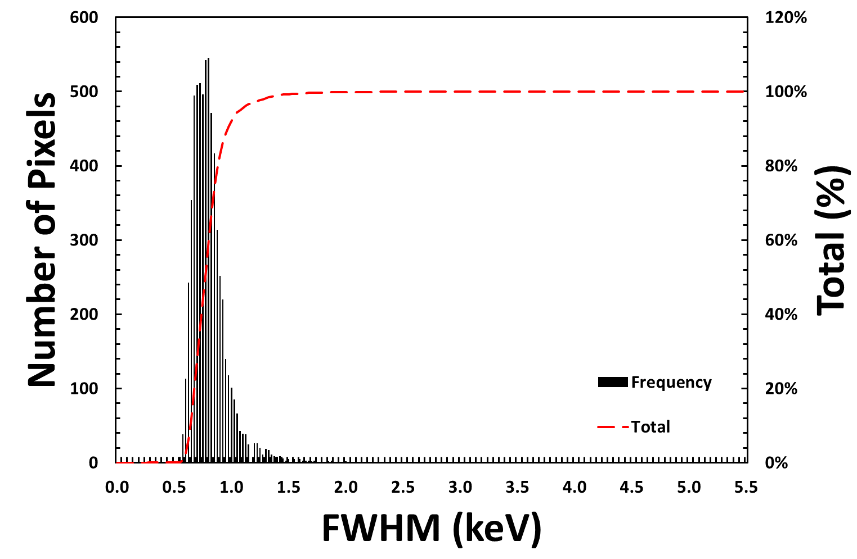
Energy Resolution
The FWHM of the 59.54 keV peak was calculated per pixel
Average FWHM = 0.78 keV

Slide 18
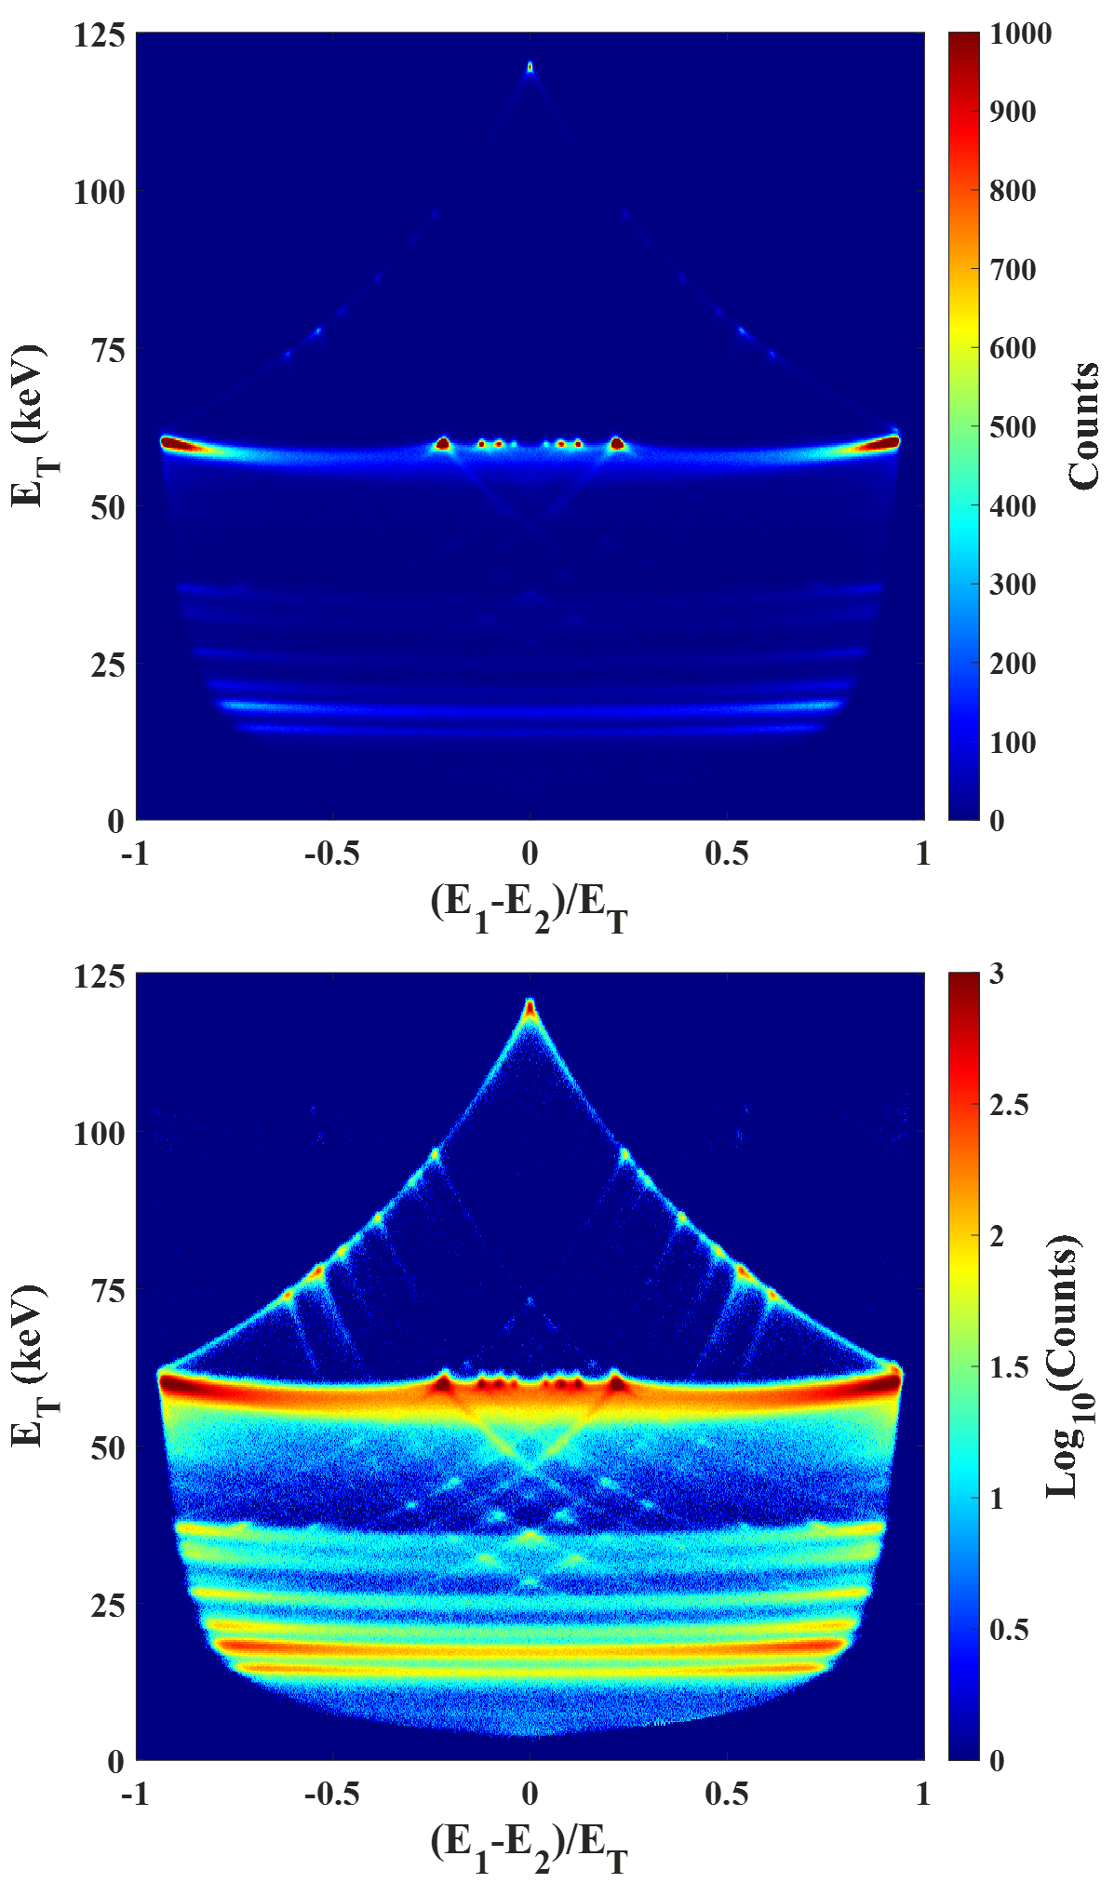
Charge Sharing Addition
The same data set was also processed using charge sharing addition
Rather than ignoring shared events, m = 2 events were summed together to reconstitute the original X-ray energy
The maps opposite show how energy is distributed in these events
Evidence for charge loss in the inter-pixel region is clear

Slide 19
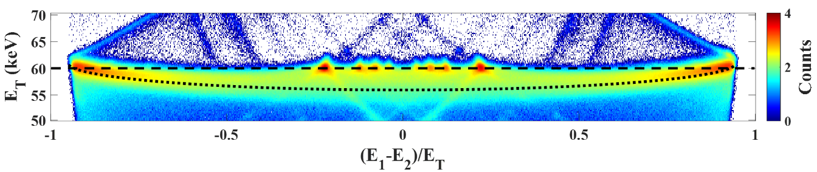
Charge Sharing Addition
Focusing just on the 59.54 keV peak
Charge sharing addition events involving a Cd or Te XRF photon do not show charge loss
Those that interact in the inter-pixel volume can experience up to ~ 5 keV loss

Slide 20
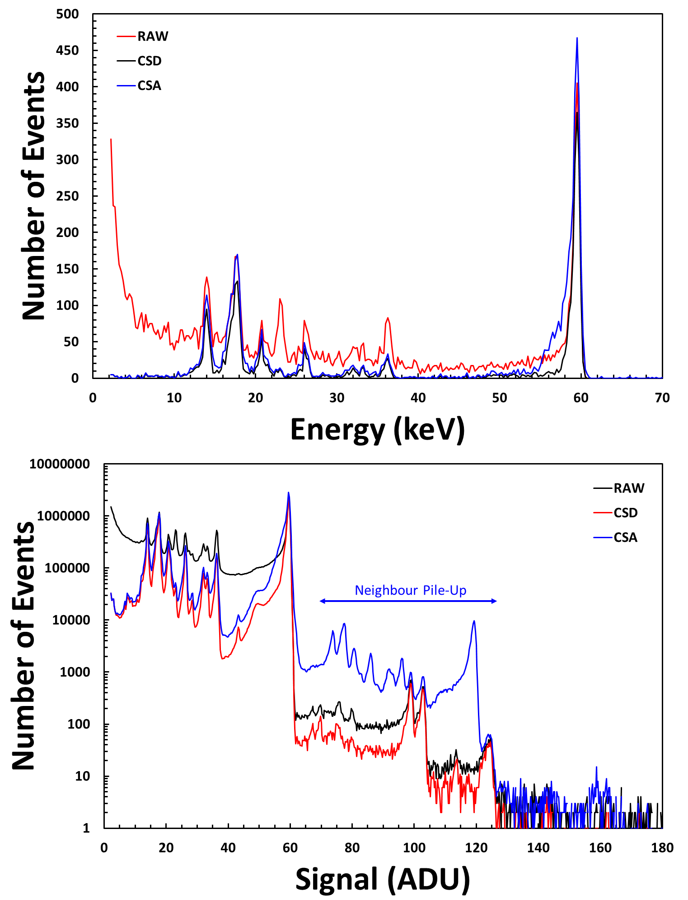
Charge Sharing Addition
The use of CSA does result in more counts in the photo-peak
However, a low energy shoulder is introduced due to charge loss in the gap
Even at low occupancy (~3%) the use of CSA also leads to neighbour pile-up
This pile-up can be seen in the global spectrum

