Slide 1
Global Health Case Studies – HIV and Tuberculosis Clinical Pearls in Diagnosis and Management
Michael Tuggy, MD

Slide 2
Key Concepts
TB is an indolent disease that is a two-phased infection. In the immune-compromised patient, its presentation is quite different than in the immune competent patient.
Cough, X-ray changes may not be prominent in AIDS patients due to lack of inflammatory response.
TB commonly is extrapulmonary among HIV infected patients – look for other loci (CNS, pericaridium, bone)
The mainstay of treatment: RZHE x 2 months, then 4 months of RH – many variations in protocols but this is core to treatment.
IRIS – Immune reconstitution syndrome can be fatal if not managed properly.

Slide 3
Case 1: Shortness of Breath
37 y.o. male presents with shortness of breath, tachypnea with marked work of breathing noted for the past 3 days. He also reports fatigue and weight loss for the past 3 months.
Exam: afebrile, BP 90/72,P=110, RR 52, O2 sat = 41%
MS – arousable, not coherent,
Thin, wasted appearance
Chest – Bilateral rales
CV – RRR, tachy
Neuro – Normal DTR’s, no focal weakness or sensory changes

Slide 4
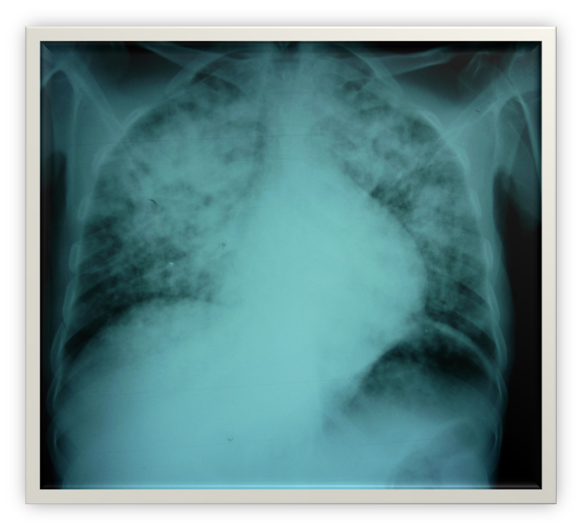
What else do you want to know?
CXR:

Slide 5
Differential Diagnosis
CAP
TB
PCP
What features of the history are most suggestive of TB?
How do the physical exam and vitals signs inform your thinking?

Slide 6
What labs would you order?
Labs:
CBC:
HIV:
CD4:
LP – no cells, normal protein and glucose
HCT =24.9, WBC = 9.2
POS
6

Slide 7
What treatment would you initiate?
Oxygen
IV –D5 NS or D5LR – how much?
Antibiotics:
RHZE – rifampacin-based TB treatment (rifampin, INH, pyrazinamide, ethambutol)
Septra DS – 2 tabs TID
Ceftriaxone - 2gms a day

Slide 8
What else does this patient need?
If you presumptively treating PCP as well, with this degree of hypoxia?
Prednisone (or other available steroid) 40 mg a day.

Slide 9
Key Teaching Points: (TB in the Era of HIV- Jon Fielder, MD)
AIDS patients in Africa often (>50%) have active TB at initial presentation of symptomatic HIV-infection (C3 or C4 stage is the most common phase to diagnose it).
50% of deaths in AIDS patients have TB at autopsy (somewhere) – of the cause of death.
TB is the major cause of wasting in HIV patient in Africa.
70% of patient on HAART will be diagnosed with TB within the first 3 years of treatment
The clinical course of TB with HIV can be indolent or as short as 8 weeks to severe illness.
Any sign of TB outside the lungs means that it is likely to be in the lung as well

Slide 10
Patterns of TB infection
Prior to HIV – 85% of TB was pulmonary
15 % -extrapulmonary alone
In HIV + - 50% pulmonary alone
50% - extrapulmonary often with lung involvement

Slide 11
PCP and TB
Do they co-exist?
In low resource settings, how do you make the diagnosis? When do you treat
Comparison of illness features:
PCP – rapid onset of SOB (days), hypoxia
TB – slower onset (weeks to months), + sweats, anemia, weight loss.
PCP on top of TB is relatively common if very low CD4 count is found

Slide 12
Next Treatment Decisions
What kind of antibiotics for TB?
What other supportive treatment
Prevention/prophylaxis
What else should you look for?

Slide 13
Anti-TB Treatment Regimens
Latent TB - INH for 6 months
Active TB – Preferred Regimen:
Initial Phase: INH, Rifampin, Pyrazinamide, Ethambutol: daily for 56 doses (8 weeks) or 5 days per week
Continuation Phase:
CD4 < 100: INH + Rifampin daily for 126 doses (18 weeks)
CD4 >100: INH + Rifampin twice weekly for 36 doses (18 weeks)
Modified alternative regimens – twice weekly dosing for patients with CD4 >100 after the first two weeks of daily Rx.

Slide 14
Case 2:
27 y.o. admitted for confusion and weight loss. Diagnosed HIV positive 3 months ago. Started HAART 7 days prior to admission. Fevers to 39 degrees noted. + drenching night sweats for 3 months.
Denies any cough, SOB. + 40# weight loss over the last year. No chest pain or abdominal pain. No diarrhea.

Slide 15
Exam:
Thin, male, oriented to self, place but not date/day.
HEENT - + diffuse shotty adenopathy
Chest – Clear
CV- RRR no murmur
Abd – soft, scaphoid
Ext – no edema, lesions or ulcerations

Slide 16
Labs:
CBC – WBC = 5.3, HCT = 31, CD4 – 32
LP – no cells, normal protein and glucose

Slide 17
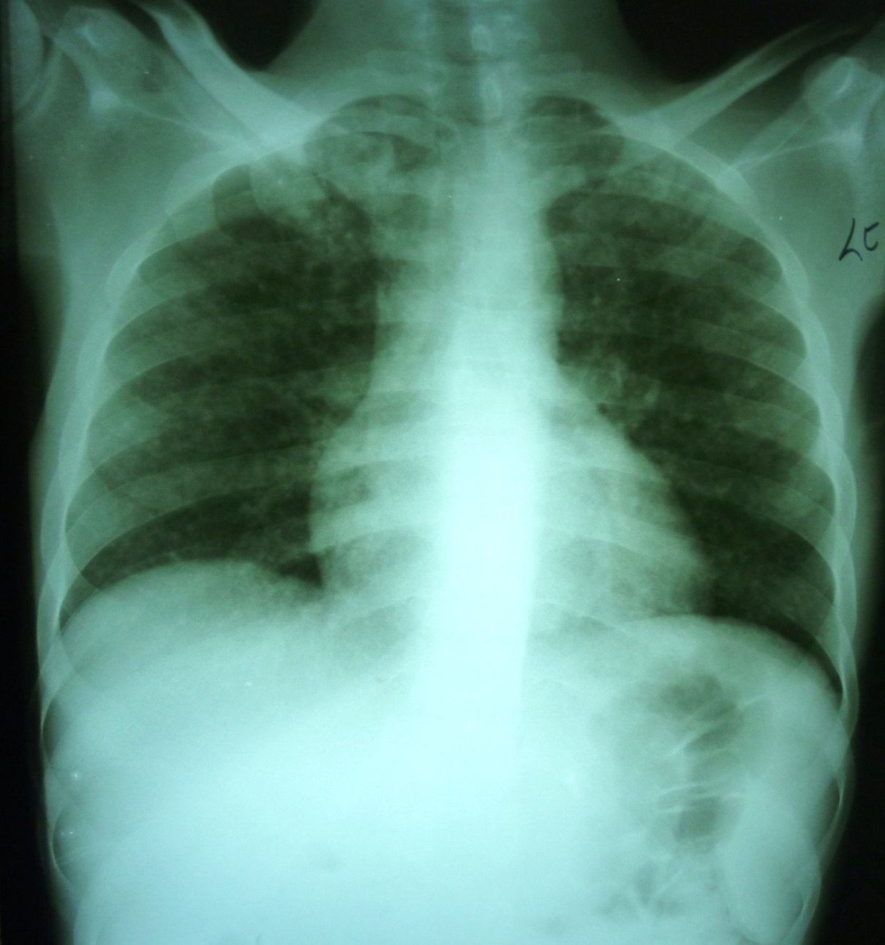
Case 2: Xray

Slide 18
What’s up with the CXR?
Miliary TB pattern
Globular heart (especially when compared to XR from 1 month prior)
Repeated exam while sitting - + pericardial rub noted by the attending…

Slide 19
What else do you need to do for this patient ?
TB pericariditis – add NSAIDS or steroids.
What about IRIS in a patient who is not started on TB treatment shortly after starting HAART?

Slide 20
Treatment considerations
Initiation of RZHE for TB
Had been started on nevirapine, lamovidine, abacavir. - d/c nevirapine and replace with effaverenz.
Place on Bactrim prophylaxis after initial treatment (PCP not ruled out but not likely based on presentations)

Slide 21
Key Learning Points
The most common presenting signs for TB are protracted weight loss and night sweats. Cough may not be prominent in AIDS patients due to lack of inflammatory response.
TB commonly is extrapulmonary among HIV infected patients – look for other loci (CNS, pericaridium, bone)
CXR may be normal with PTB and only change after treatment of HIV has restored some element of immune function to cause the granulomas to form in the lung
Pericarditis is treatable with NSAIDs or Steroids but if missed can be fatal
The mainstay of treatment: RZHE x 2 months, then 4 months of RH – many variations in protocols but this is core to treatment.
MDR TB – not easy to diagnose - other than failure of treatment.
IRIS will develop in AIDS patients once HAART treatment is initiated and should be anticipated. Always treat TB first for at least 2 weeks before initiating HAART.

