Slide 1

Survey of common measure repeatability FNR 647 – Quantitative Methods for Ecologist December 9th, 2021
Spencer T. Gardner
Fisheries and Aquatic Science
Dept. of Forestry and Natural Resources
Purdue University – West Lafayette
Email: gardn125@purdue.edu
Phone: 704.530.4751

Slide 2
Objectives
Define repeatability (R)
Justification/rationale of repeatability as a statistic
Overview and assumptions of conceptual framework
Anova-based repeatability
Linear Mixed-Effect Models
Generalized Linear Mixed-Effect Models
Strength and weakness of common repeatability
Examples in R

Slide 3


What is the common measure of repeatability?
Proportion of total variation in observed often repeated measurements that is attributed to differences among groups (Sokal and Rohlf, 1995).
Often referred to as the intraclass correlation coefficient (ICC).
where,${ σ}_{α}^{2}$ is the between/among group variance, and $σ_{ε}^{2}$ is the within-group variance.
Interpretation:
R = expected correlation among measurements within a particular group
$$R= \frac{σ_{α}^{2}}{σ_{α}^{2} + σ_{ε}^{2}}$$
Notes:
- Statistical concept with evolutionary and behavioral utility…. Not an evolutionary concept (R tells us nothing about the underlying mechanisms).
R = extent to which observations on the same individual are correlated... relative to amount of variation among-individuals.
R is somewhat analogous to Pearson’s correlation coefficient (interclass correlation, proportion of within-group variation)
- Within-group variance contains both residual error and model overdispersion

Slide 4
As an ecologist, how might repeatability help me?
Simplified: Consistent differences among-individuals that are repeatable across a definable spatial and temporal field (Wilson 2018).
Understanding group membership and among-group differences can provide a deeper understanding of genetic diversity and population stability.
Traits that are not repeatable are not hereditable.
Trait variation among-individuals results in fitness variation (i.e., adaptive phenotypic evolution).
Related to the idea of contingents
Trait classification:
1. Morphological – e.g., timing of ontogenetic shifts
2. Physiological – e.g., metabolic rate
3. Behavior – e.g., mate selection and parental quality
Notes:
Contingents : group of individuals that maintain membership by engaging in pattern of migration not shared by other fish

Slide 5
As an ecologist, how might repeatability help me?
Repeatability can also be used to estimate consistency in measurements of static or fixed groups
Error is inevitable! (Systematic or Random)
Limitations of Estimating Measurement Repeatability (Harper 1994)
Cannot measure reproducibility of measurements between observers
Cannot measure accuracy
Notes:
Estimating measurement error is most common use of repeatability.

Slide 6
Interpretation of common measure of repeatability
Two types of interpretation common in literature (Wilson 2018):
Statistical parameter that should be interpreted with skepticism and only when a well-defined understanding for the underlying biological mechanisms.
Implicit/explicit utility to capture drivers of variation among-individuals.
Repeatability does not have a single ‘truth’.
Within any given dataset there is likely a series of equally probable estimates.
As ecologists, our job is to discern between the subtle differences in the estimates to determine which comparison is most applicable to our question.

Slide 7
How can we calculate repeatability?
Gaussian (normal data)
Non-Gaussian
Correlation (+ negative)
ANOVA
Linear Mixed-Effects Model (LMM)
Generalized Linear Mixed-Effect Model (GLMM)
Point Estimation for:
- Binary/Proportion data
- Count data (add. Or multi.)

Slide 8
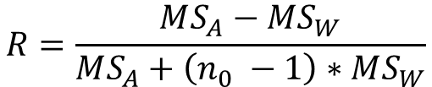

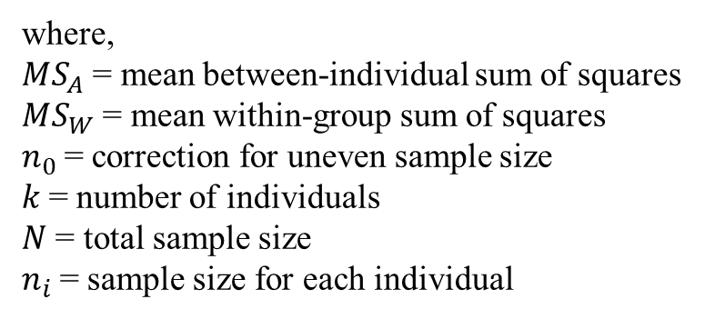
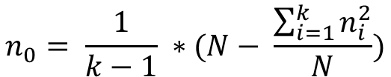
ANOVA-based Repeatability (Lessells and Boag 1987)
Method uses the F-table of an ANOVA
$$aov(dependent \sim group)$$
$$R=\frac{MS_{A}−MS_{W}}{MS_{A}+\left(n_{0} −1\right)∗MS_{W}}$$
summary(model)
Df Sum Sq Mean Sq F value Pr(>F)
ID 34 317218 9330 3.945 6.03e-07
Residuals 70 165542 2365
$$n_{0}= \frac{1}{k−1} ∗(N− \frac{\sum_{i=1}^{k}{n_{i}^{2}}}{N})$$
where,
$MS_{A}$ = mean between-individual sum of squares
$MS_{W}$ = mean within-group sum of squares
$n_{0}$= correction for uneven sample size
$k$= number of individuals
$N$ = total sample size
$n_{i}$= sample size for each individual
Individual or grouping identity treated as factorial predictor

Slide 9



LMM-based Repeatability
Simplest method, very flexible (lme4 or rptR package in R)
Ability to control for unwanted sources of variance (adjusted repeatability).
Fixed effects used to control confounding variation
Additional random effects (aside from grouping variable) used to further partition variance.
Formula:
$$y_{ij}= β_{0}+ α_{i}+ ε_{ij}$$
$$R_{M}= \frac{σ_{α}^{2}}{σ_{α}^{2}+ σ_{ε}^{2}}$$
$$α_{i}=Gaussian (0, σ_{α}^{2})$$
$$ε_{ij}= Gaussian (0, σ_{ε}^{2})$$
Notes:
y_ij = measurement from ith individual
Beta = population level intercept (i.e., grand mean)
alpha = random normal individual effect
epsilon = random normally distributed error term for each individual

Slide 10
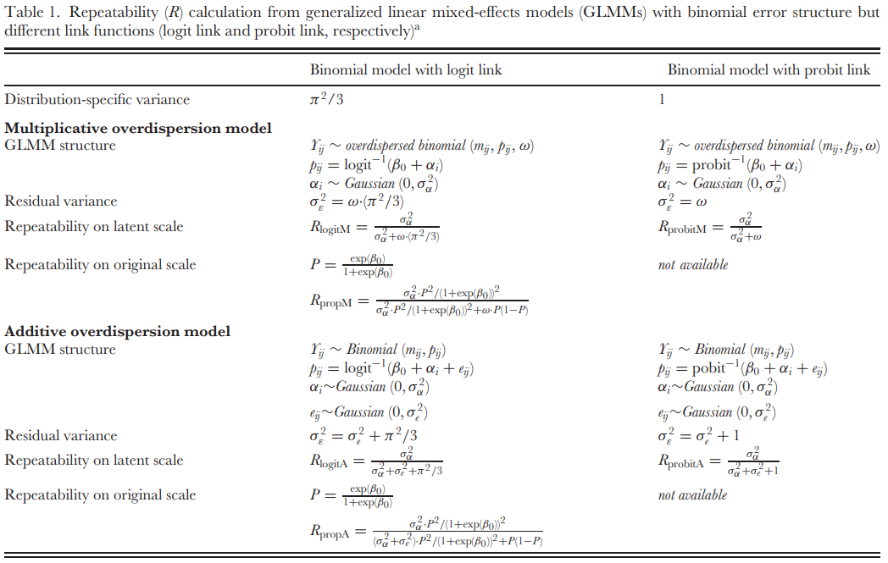
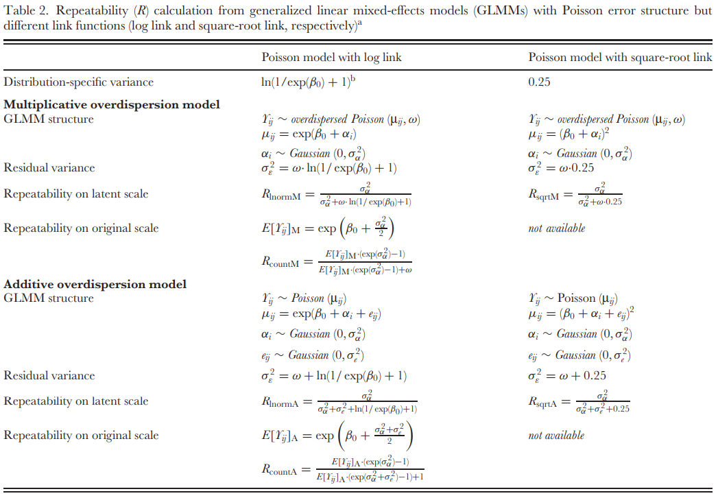
GLMM-based Repeatabilities
* Transformations should be avoided since they are variance-stabilizing.
Binomial, Poisson, Proportional
Unfortunate… GLMM do not provide direct within-group (residual error) variance.
Analogous value estimated by:
Latent-scale distribution-specific variance
Overdispersion parameter expressed relative to (est.1)
multiplicative overdispersion
Latent-scale residual variance
additive overdispersion
For specific non-normal distributions, see Nakagawa and Schielzeth (2010)

Slide 11
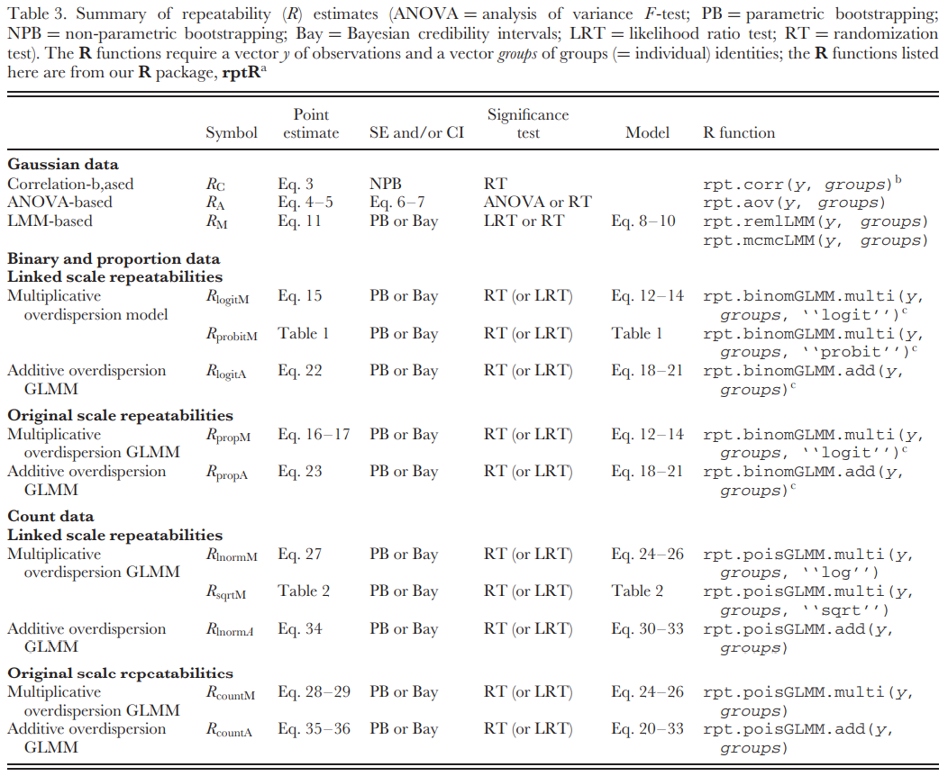
Nakagawa and Schielzeth (2010)

Slide 12
Citations:
Bell, A. M., S. J. Hankison, and K. L. Laskowski. 2009. The repeatability of behaviour: a meta-analysis. Animal Behaviour. 77:771-783.
Birnie-Gauvin, K., A. Koed, and K. Aarestrup. 2021. Repeatability of migratory behavior suggests trade-off between size and survival in a wild iteroparous salmonid. Functional Ecology. 35:2717-2727.
Harper, D. G. C. 1994. Some comments on the repeatability of measurements. Ringing and Migration. 15:84-90.
Lessells, C. M., and P. T. Boag. 1987. Unrepeatable repeatabilities: a common mistake. The Auk. 104:116-121.
Nakagawa, S., and H. Schielzeth. 2010. Repeatability for Gaussian and non-Gaussian data: a practical guide for biologists. Biological Reviews. 85:935-956.
Sokal, R.R., & F. J. Rohlf. 1981. Biometry. San Francisco, W.H. Freeman and Co.
Wilson, A. J. 2018. How should we interpret estimates of individual repeatability? Evolution Letters 2:4-8.
Wolak, M. E., D. J. Fairbairn, and Y. R. Paulsen. 2012. Guidelines for estimating repeatability. Methods in Ecology and Evolution. 3:129-137.
In R:
install.packages(“rptR”)
library(rptR)
citation(“rptR”)
Stoffel, M. A., S. Nakagawa, and H. Schielzeth. (2017). rptR: repeatability estimation and variance decomposition by generalized linear mixed- effects models. Methods Ecol Evol, 8: 1639-1644. doi:10.1111/2041-210X.12797
install.package(“ICC”)
library(ICC)
Wolak, M. E., D. J. Fairbairn, and Y. R. Paulsen. 2012. Guidelines for estimating repeatability. Methods in Ecology and Evolution. 3:129-137.

