Slide 1
Fundamental Project Specification: Inventory Management System (IMS)
Sam Goodland

Slide 2
Introduction
Hello!
BSc Grad. Applied Computing
Approached domain requirements head-on
In retrospect, additional planning would have aided
Notes:
My course didn’t delve deeply into theory you’d see in Computer Science, but rather focused on the coding and day-to-day applications of programming, hence the name.
Not because of any inability to prepare sufficiently. As I did plan for the event where the project did not go according to plan.
The primary issue here stretched from a miscommunication.

Slide 3
Consultant Journey
Technologies I was already familiar with: Java, SQL
Technologies I’d used but not mastered: Git, GitHub
Technologies I’d never used before: Jira, Maven, JUnit
Notes:
I used Java in university, though I don’t like it. SQL is my favourite, I was very glad to get to work with it again.
Had used GitHub in the past but hadn’t truly gotten a grip with it until the project started.
I’d never used Jira, Maven or Junit before, so this proved the most challenging part of the project.

Slide 4
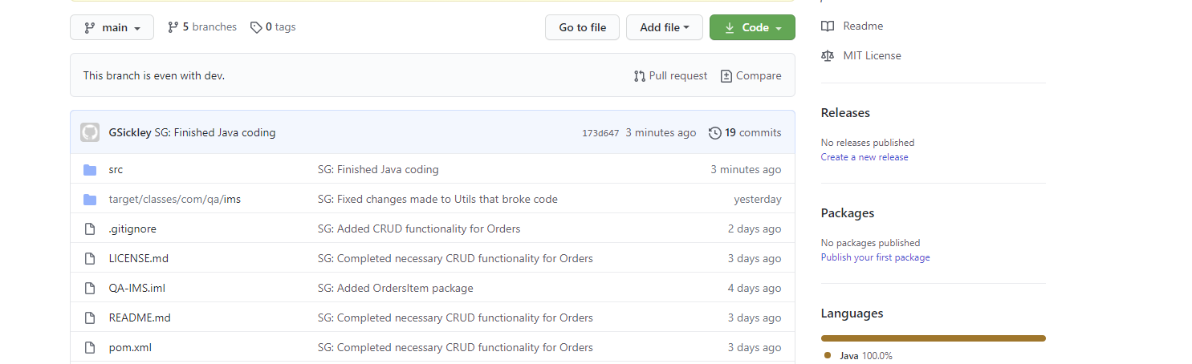
Continuous Integration (CI)
Version control was approached with industry standards in mind
Notes:
As per requirements, I utilised GitHub for simple version control. Pushed and committed often, & file/package structures sensible and meeting industry standards.

Slide 5
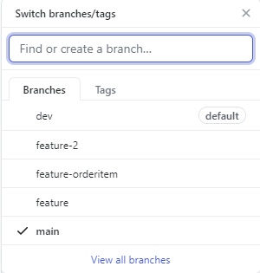
Continuous Integration (CI) – cont.
Feature-dev-main branches utilised; new feature for every new part
Notes:
I also employed the feature-dev-main branches.
Something I had not done prior was give the names of features more clear names. For example, feature-orderitem is much clearer than feature-2.

Slide 6

Testing
Hardest part of the project
Had the least amount of experience with
Scope creep seriously hampered testing
Notes:
Testing was the part of the project that caught me out.
I had little to not experience with testing, and less time than I had planned to do it as a result of a miscommunication.
I had not realised the importance of the IMS starter, and this as a result required additional time to remake the project and transfer my materials into the new file space, refactor appropriately and get acquainted with unforeseen requirements relating to working in the IMS starter, such as adjusting the Utils table and writing both the data & schema for SQL.

Slide 7
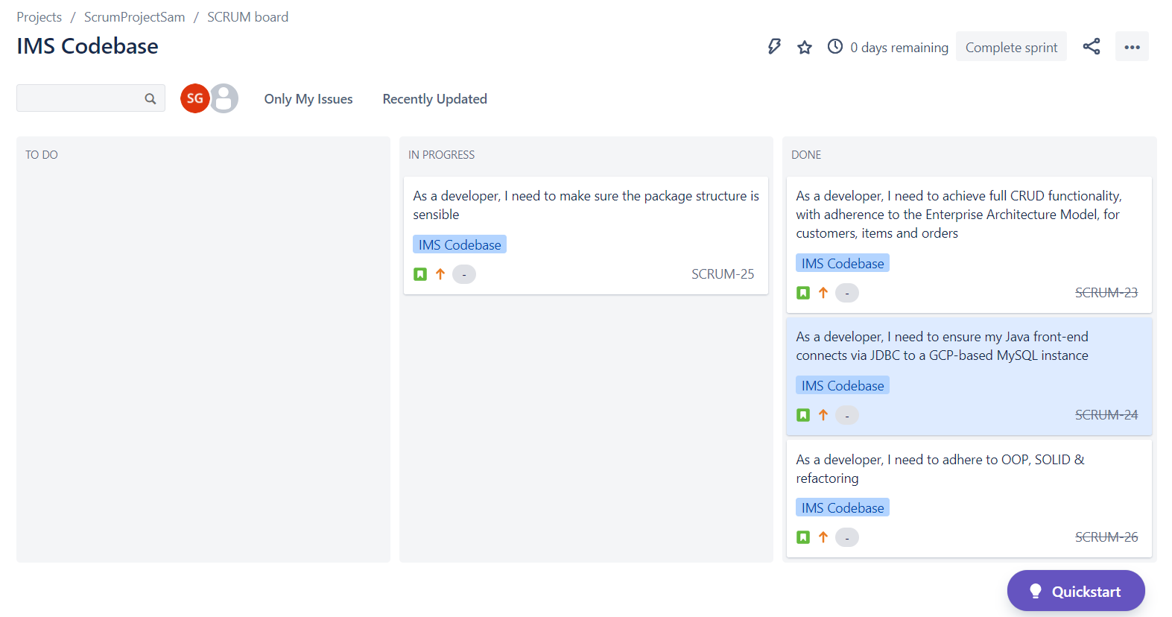
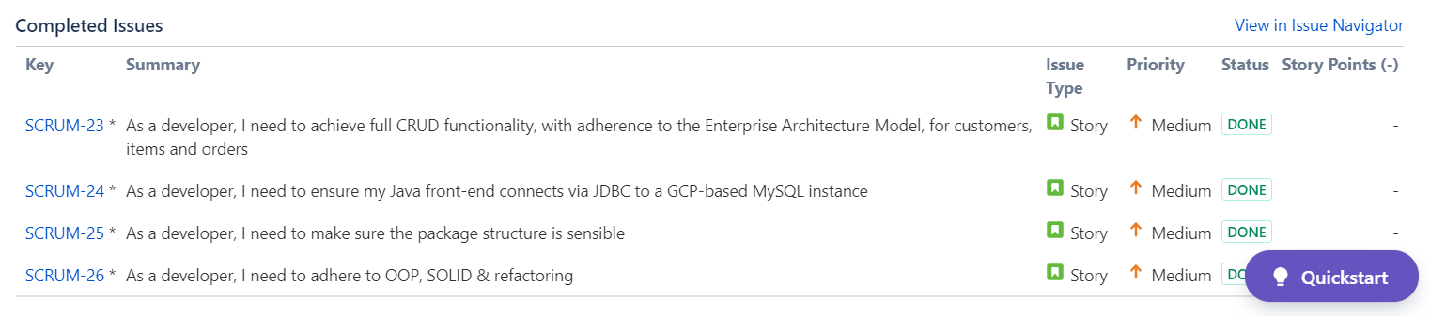
Demonstration – the Codebase

Slide 8
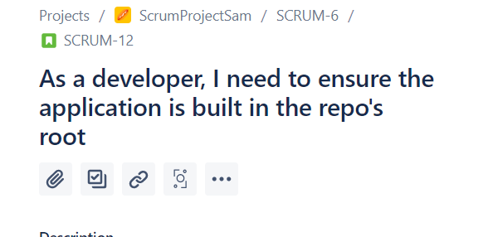
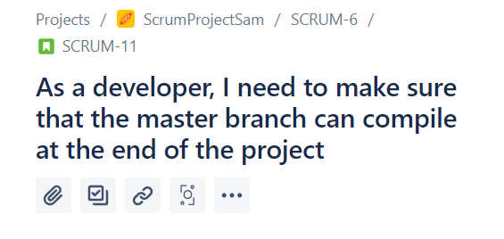
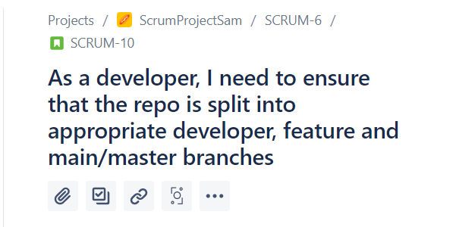
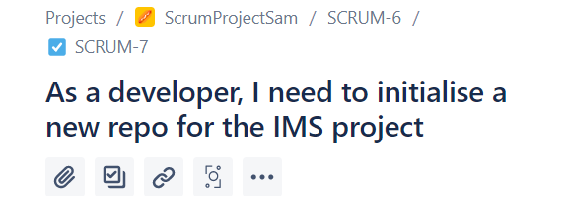
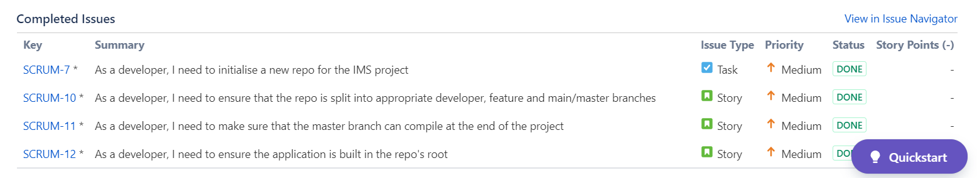
Demonstration – the IMS repo

Slide 9
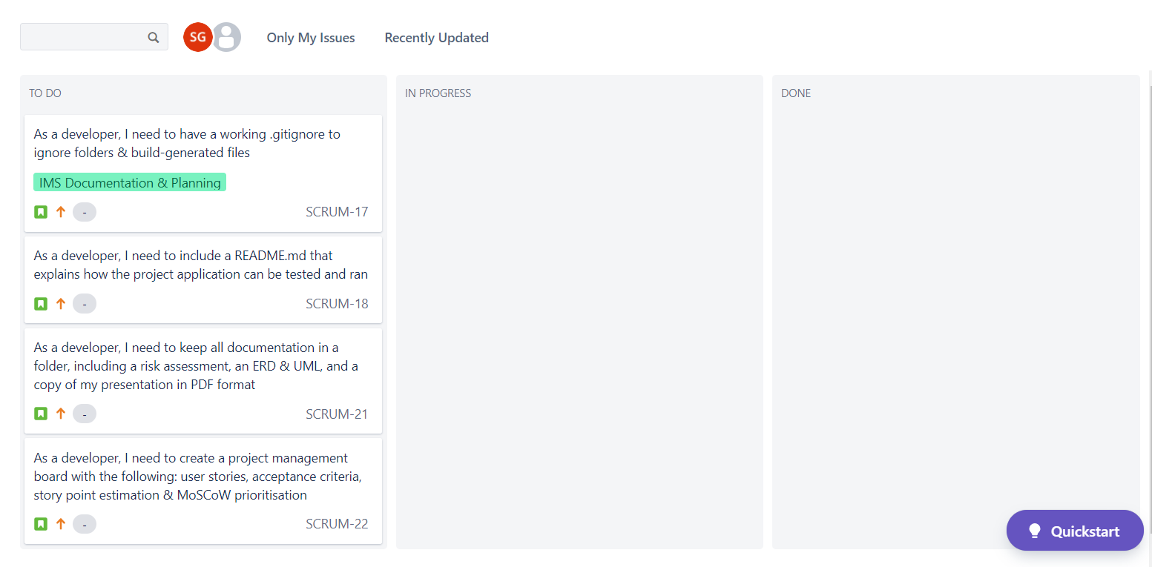
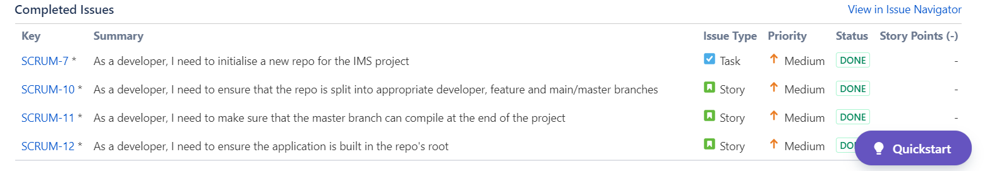
Demonstration – the Documentation

Slide 10
Sprint Review – What was completed
All Codebase aspects, save the calculation of the total cost
All Repository & Documentation aspects
Continuous Integration aspects
Notes:
As it stands, there is complete CRUD functionality on the customers, items and orders in my project.
All diagreams such as ERDs, UMLs and necessary docs such as risk assessment were completed and included with no issue.
The majority of continuous integration aspects. A feature-branch model within the repo, for example. It was however lacking in other areas, we’ll move onto that in…

Slide 11
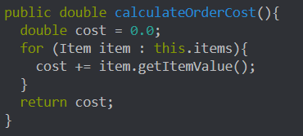
Sprint Review – What was abandoned
The total calculation of a cost
The test coverage 80% threshhold
Notes:
Above is my method for calculating the cost. I was unfortunately unable to figure out how to implement it.
As already stated, due to scope creep and time limitations, I was unable to get the test coverage up to the 80% threshold, only achieving 20%.

Slide 12
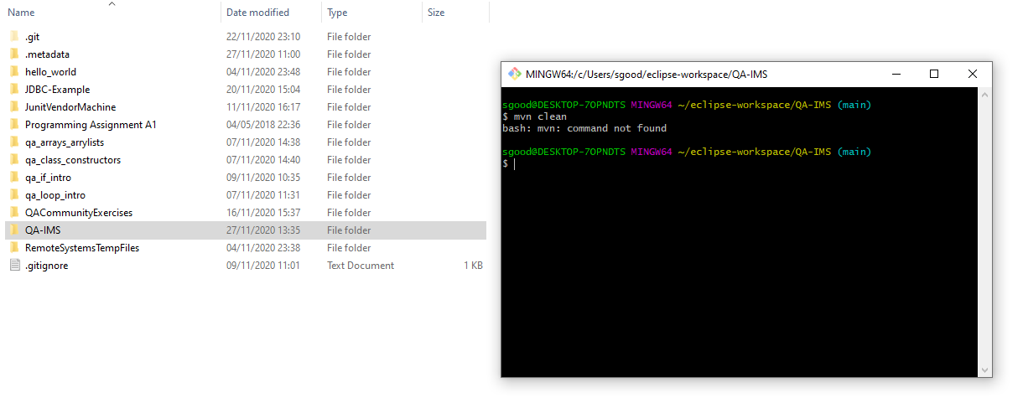
Sprint Review – What was abandoned
The .jar build of the project
Notes:
Another aspect of the project that had to be abandoned was the .jar build, despite the fact that I ran the commands necessary to create it in normal circumstances. Unfortunately, even after speaking to a colleague and a trainer, I was unable to get it functioning.

Slide 13

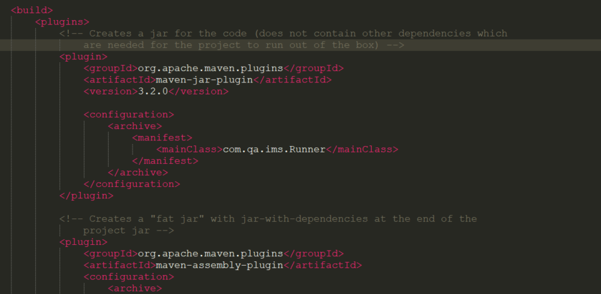
Sprint Review – What was abandoned
Despite containing the correct pom.xml material…

Slide 14
Sprint retrospective – what went well
MySQL
Java
Git
GitHub
Notes:
SQL queries are great, Java went well even though I prefer other less verbose languages such as Python.
Git went well, both in keeping organised branches, committing often and being able to illustrate how the project was gradually completed and the different features added in the respective branches.

Slide 15
Sprint retrospective – what could have been done better
^{Junit}
^{Maven}
^{Jira}
Notes:
As already hinted at, blah blah blah.

Slide 16
Conclusions drawn
1. Time allocation is key
2. Knowledge of Java, GitHub, Git & SQL currently meets or is close to meeting expected standards
3. Additional JUnit practising will need to be conducted in spare time
4. Scope creep was biggest reason for project shortcomings

Slide 17
Conclusion
Thank you for listening!
Are there any questions?

