Slide 1

byte (bool) is_volume boolean to flag a heterogeneous volume
unsigned int64 precision output precision (4 or 8 bit)
unsigned int64 Pi number of incident plane waves
Incident Plane Waves
Heterogeneous Layers
complex * M[0] * M[1] * 4 beta
complex * M[0] * M[1] * 4 gamma
complex * (M[0] * M[1] * 4)^2 gg
complex * M[0] * M[1] ft_RI
unsigned int64 num_boundaries number of boundaries
Boundaries
dtype z boundary position
unsigned int64 Ri number of reflected waves
unsigned int64 Ti number of transmitted waves
Reflected Plane Waves
Fourier coefficients of $\frac{1}{n^{2}(x,y)}$
Transmitted Plane Waves
if heterogeneous
int32 * 2 M[2] number of coefficients along X and Y
dtype * 3 dim[3] sample dimension along all three axes
unsigned int32 num_layers number of heterogeneous layers along Z
Heterogeneous Layers

Slide 2
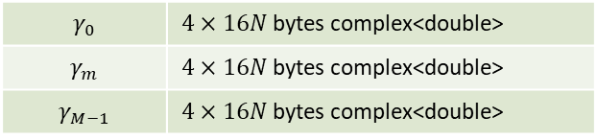
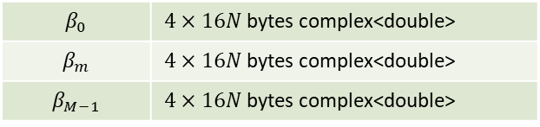
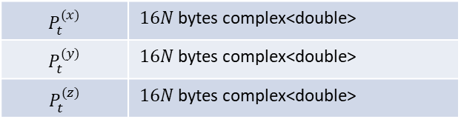
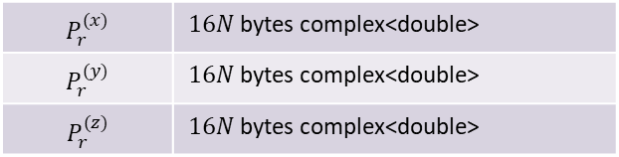

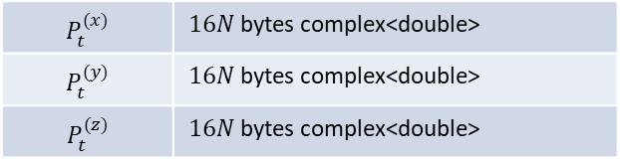

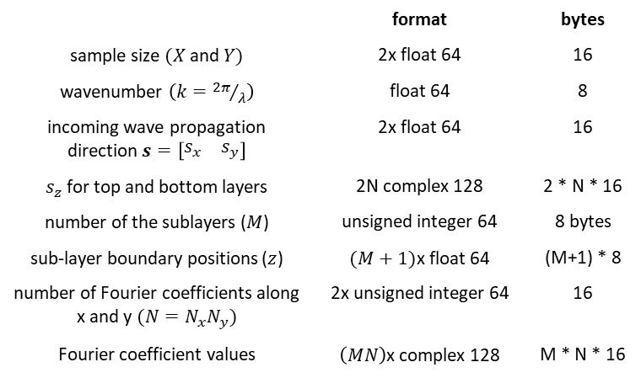
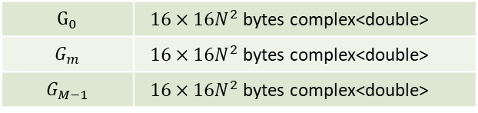
L=3: CW file = $72+336N+\left(144N+256N^{2}\right)M$ bytes
$$P_{t}^{(x)}$$ | $16N$ bytes complex<double>
$$P_{t}^{(y)}$$ | $16N$ bytes complex<double>
$$P_{t}^{(z)}$$ | $16N$ bytes complex<double>
Basic
Configuration
 | format | bytes
sample size $(X$ and $Y)$ | 2x float 64 | 16
wavenumber $\left(k={2π}/λ\right)$ | float 64 | 8
incoming wave propagation direction $s=\left[\begin{matrix}s_{x} & s_{y}\end{matrix}\right]$ | 2x float 64 | 16
$s_{z}$ for top and bottom layers | 2N complex 128 | 2 * N * 16
number of the sublayers ($M$) | unsigned integer 64 | 8 bytes
sub-layer boundary positions ($z$) | $(M+1)$x float 64 | (M+1) * 8
number of Fourier coefficients along x and y $(N=N_{x}N_{y})$ | 2x unsigned integer 64 | 16
Fourier coefficient values | $\left(MN\right)$x complex 128 | M * N * 16
top
layer
$$P_{r}^{(x)}$$ | $16N$ bytes complex<double>
$$P_{r}^{(y)}$$ | $16N$ bytes complex<double>
$$P_{r}^{(z)}$$ | $16N$ bytes complex<double>
$$P_{t}^{(x)}$$ | $16N$ bytes complex<double>
$$P_{t}^{(y)}$$ | $16N$ bytes complex<double>
$$P_{t}^{(z)}$$ | $16N$ bytes complex<double>
LAYERS
bottom
layer
homogeneous layer properties
$$β_{0}$$ | $4×16N$ bytes complex<double>
$$β_{m}$$ | $4×16N$ bytes complex<double>
$$β_{M−1}$$ | $4×16N$ bytes complex<double>
heterogeneous layer properties
$$⋮$$
$$γ_{0}$$ | $4×16N$ bytes complex<double>
$$γ_{m}$$ | $4×16N$ bytes complex<double>
$$γ_{M−1}$$ | $4×16N$ bytes complex<double>
heterogeneous
$$⋮$$
$$G_{0}$$ | $16×16N^{2}$ bytes complex<double>
$$G_{m}$$ | $16×16N^{2}$ bytes complex<double>
$$G_{M−1}$$ | $16×16N^{2}$ bytes complex<double>

Slide 3
L=3: CW file = $72+336N+\left(144N+256N^{2}\right)M$ bytes
$$P_{t}^{(x)}$$ | $16N$ bytes complex<double>
$$P_{t}^{(y)}$$ | $16N$ bytes complex<double>
$$P_{t}^{(z)}$$ | $16N$ bytes complex<double>
Basic
Configuration
 | format | bytes
sample size $(X$ and $Y)$ | 2x float 64 | 16
wavenumber $\left(k={2π}/λ\right)$ | float 64 | 8
incoming wave propagation direction $s=\left[\begin{matrix}s_{x} & s_{y}\end{matrix}\right]$ | 2x float 64 | 16
$s_{z}$ for top and bottom layers | 2N complex 128 | 2 * N * 16
number of the sublayers ($M$) | unsigned integer 64 | 8 bytes
sub-layer boundary positions ($z$) | $(M+1)$x float 64 | (M+1) * 8
number of Fourier coefficients along x and y $(N=N_{x}N_{y})$ | 2x unsigned integer 64 | 16
Fourier coefficient values | $\left(MN\right)$x complex 128 | M * N * 16
top
layer
$$P_{r}^{(x)}$$ | $16N$ bytes complex<double>
$$P_{r}^{(y)}$$ | $16N$ bytes complex<double>
$$P_{r}^{(z)}$$ | $16N$ bytes complex<double>
$$P_{t}^{(x)}$$ | $16N$ bytes complex<double>
$$P_{t}^{(y)}$$ | $16N$ bytes complex<double>
$$P_{t}^{(z)}$$ | $16N$ bytes complex<double>
LAYERS
bottom
layer
homogeneous layer properties
$$β_{0}$$ | $4×16N$ bytes complex<double>
$$β_{m}$$ | $4×16N$ bytes complex<double>
$$β_{M−1}$$ | $4×16N$ bytes complex<double>
heterogeneous layer properties
$$⋮$$
$$γ_{0}$$ | $4×16N$ bytes complex<double>
$$γ_{m}$$ | $4×16N$ bytes complex<double>
$$γ_{M−1}$$ | $4×16N$ bytes complex<double>
heterogeneous
$$⋮$$
$$G_{0}$$ | $16×16N^{2}$ bytes complex<double>
$$G_{m}$$ | $16×16N^{2}$ bytes complex<double>
$$G_{M−1}$$ | $16×16N^{2}$ bytes complex<double>

Slide 4
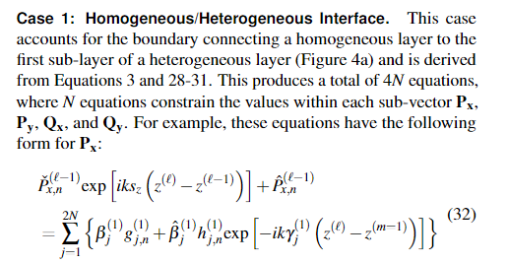
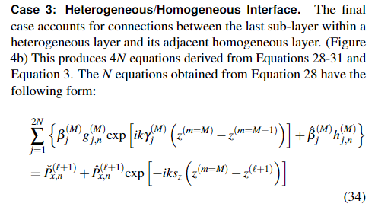



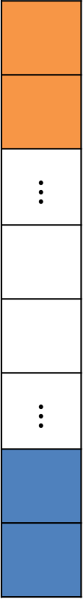


Explanation for “coupled wave paper”
$$⋮$$
$$⋮$$
$$z^{0}$$
$$z^{(m−1)}$$
$$z$$
$$z^{1}$$
$$z^{(m)}$$
pixel position

Slide 5
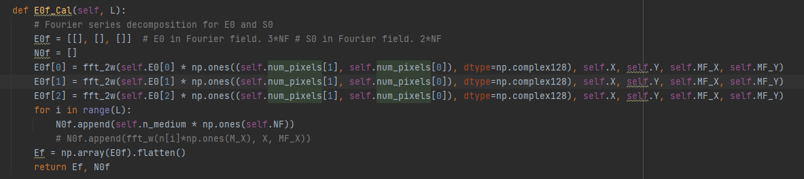
Temp_page –04/24/2022
Pt:
WAS number of layers(3) * 16*N*3 (=complex<double> * N * 3 axis)
Pt for the 0th layer: [0, 0, …, 1, …, 0]
special case: for N 64 = Nx 8 * Ny 8, the position of “1” is: 36 (4*8+4)
Pr is easier. The last dimension is all zeros.

Slide 6

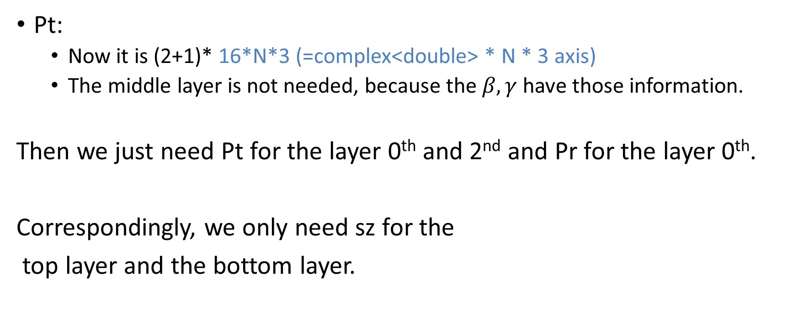


Temp_page –04/24/2022
Pt:
Now it is (2+1)* 16*N*3 (=complex<double> * N * 3 axis)
The middle layer is not needed, because the $β, γ$ have those information.
Then we just need Pt for the layer 0th and 2nd and Pr for the layer 0th.
Correspondingly, we only need sz for the
top layer and the bottom layer.
$$P_{t}$$
$$P_{r}$$
$$P_{t}$$

Slide 7
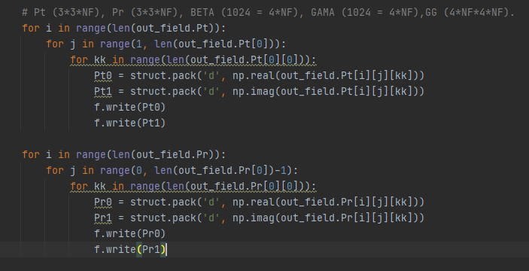
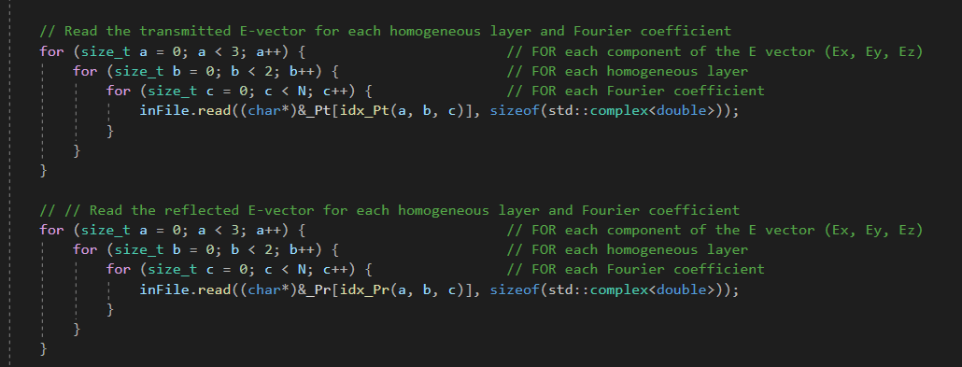
Temp_page –04/24/2022

Slide 9
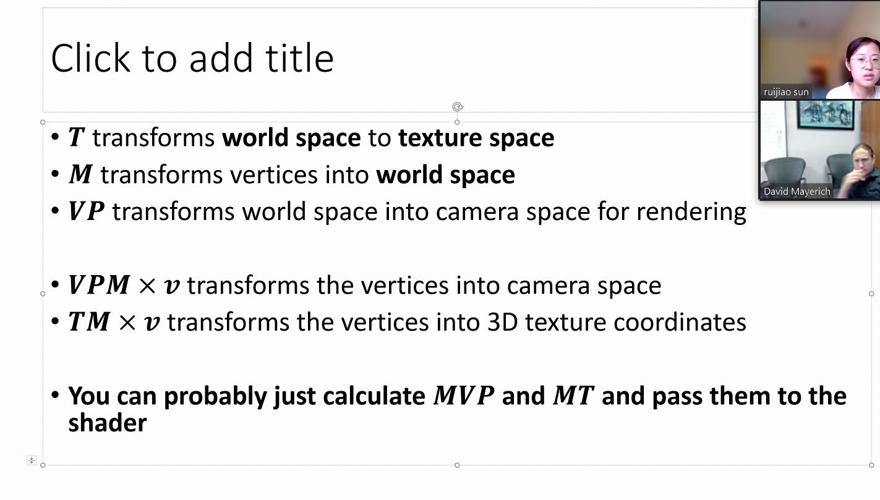

Slide 10
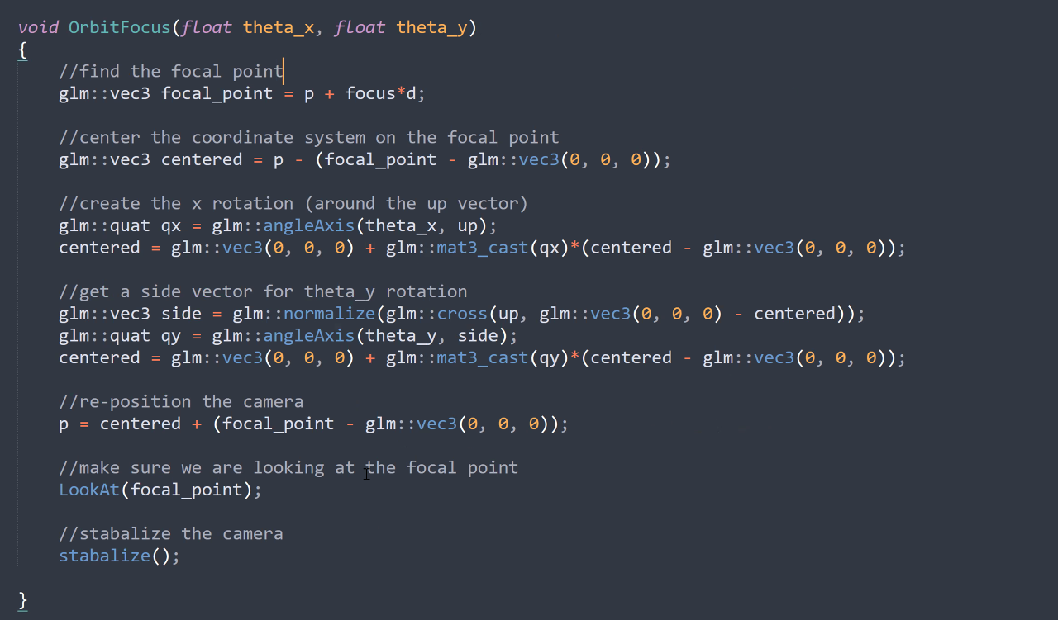

Slide 11
Euler rules
quaternions

