Slide 1

Expressions
${\check{B}}^{(ℓ)}∈ℂ^{3}$ is the field transmitted through layer $ℓ$ from $z^{(ℓ−1)}$ to $z^{(ℓ)}$
${\hat{B}}^{(ℓ)}∈ℂ^{3}$ is the field reflected from $z^{(ℓ)}$ to $z^{(ℓ−1)}$

Slide 2

Boundary Conditions
Incident field:
$${\check{B}}_{x}^{(1)}=E_{x}$$
$${\hat{B}}_{y}^{(1)}=E_{y}$$
$${\hat{B}}_{z}^{(1)}=E_{z}$$
Reflection through the last layer is zero:
$${\hat{B}}_{x}^{(L)}=0$$
$${\hat{B}}_{y}^{(L)}=0$$
$${\hat{B}}_{z}^{(L)}=0$$

Slide 3


Gauss’ Constraints – $2(L−1)$
Gauss’ equation: $∇⋅E\left(r,k,t\right)=0$
Resulting constraints:
$$s_{x}{\check{B}}_{x}^{\left(ℓ\right)}+s_{y}{\check{B}}_{y}^{\left(ℓ\right)}+s_{z}^{(ℓ)}{\check{B}}_{z}^{\left(ℓ\right)}=0$$
$$s_{x}{\hat{B}}_{x}^{(ℓ)}+s_{y}{\hat{B}}_{y}^{(ℓ)}−s_{z}^{(ℓ)}{\hat{B}}_{z}^{\left(ℓ\right)}=0$$

Slide 4
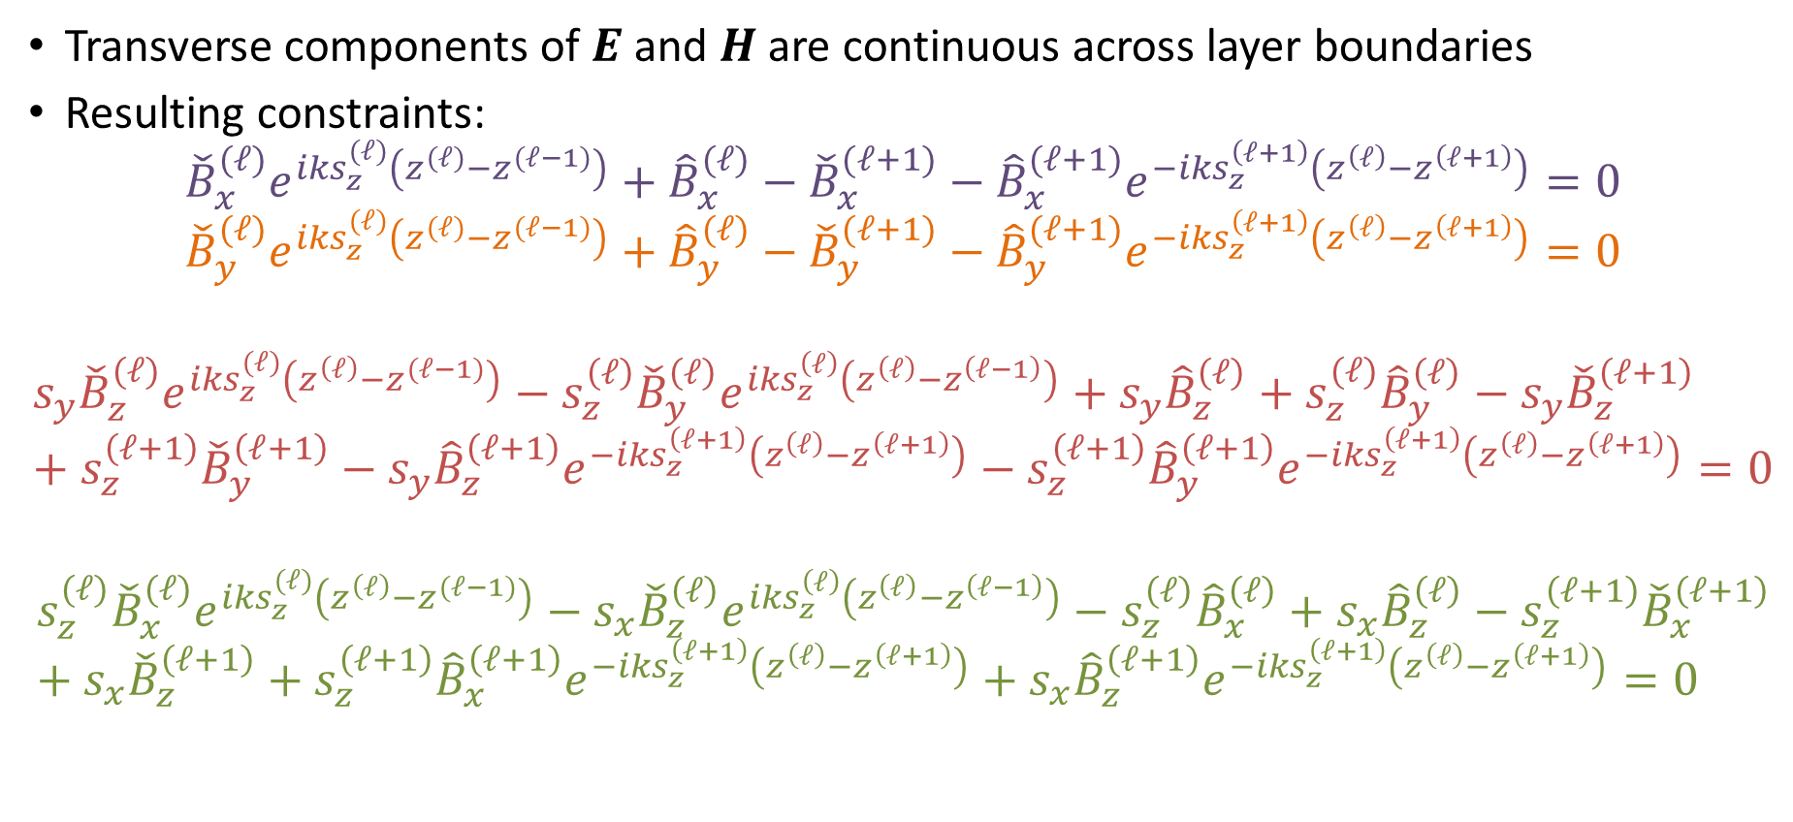

Boundary Conditions – $4(L−1)$
Transverse components of $E$ and $H$ are continuous across layer boundaries
Resulting constraints:
$${\check{B}}_{x}^{(ℓ)}e^{iks_{z}^{(ℓ)}\left(z^{(ℓ)}−z^{(ℓ−1)}\right)}+{\hat{B}}_{x}^{(ℓ)}−{\check{B}}_{x}^{(ℓ+1)}−{\hat{B}}_{x}^{(ℓ+1)}e^{−iks_{z}^{\left(ℓ+1\right)}\left(z^{\left(ℓ\right)}−z^{\left(ℓ+1\right)}\right)}=0$$
$${\check{B}}_{y}^{(ℓ)}e^{iks_{z}^{(ℓ)}\left(z^{(ℓ)}−z^{(ℓ−1)}\right)}+{\hat{B}}_{y}^{(ℓ)}−{\check{B}}_{y}^{(ℓ+1)}−{\hat{B}}_{y}^{(ℓ+1)}e^{−iks_{z}^{\left(ℓ+1\right)}\left(z^{\left(ℓ\right)}−z^{\left(ℓ+1\right)}\right)}=0$$
$$s_{y}{\check{B}}_{z}^{(ℓ)}e^{iks_{z}^{(ℓ)}\left(z^{\left(ℓ\right)}−z^{(ℓ−1)}\right)}−s_{z}^{\left(ℓ\right)}{\check{B}}_{y}^{\left(ℓ\right)}e^{iks_{z}^{\left(ℓ\right)}\left(z^{\left(ℓ\right)}−z^{\left(ℓ−1\right)}\right)}+s_{y}{\hat{B}}_{z}^{\left(ℓ\right)}+s_{z}^{(ℓ)}{\hat{B}}_{y}^{\left(ℓ\right)}−s_{y}{\check{B}}_{z}^{\left(ℓ+1\right)}+s_{z}^{\left(ℓ+1\right)}{\check{B}}_{y}^{\left(ℓ+1\right)}−s_{y}{\hat{B}}_{z}^{\left(ℓ+1\right)}e^{−iks_{z}^{\left(ℓ+1\right)}\left(z^{\left(ℓ\right)}−z^{\left(ℓ+1\right)}\right)}−s_{z}^{\left(ℓ+1\right)}{\hat{B}}_{y}^{\left(ℓ+1\right)}e^{−iks_{z}^{\left(ℓ+1\right)}\left(z^{\left(ℓ\right)}−z^{\left(ℓ+1\right)}\right)}=0$$
$$s_{z}^{(ℓ)}{\check{B}}_{x}^{(ℓ)}e^{iks_{z}^{(ℓ)}\left(z^{\left(ℓ\right)}−z^{(ℓ−1)}\right)}−s_{x}{\check{B}}_{z}^{\left(ℓ\right)}e^{iks_{z}^{\left(ℓ\right)}\left(z^{\left(ℓ\right)}−z^{\left(ℓ−1\right)}\right)}−s_{z}^{\left(ℓ\right)}{\hat{B}}_{x}^{\left(ℓ\right)}+s_{x}{\hat{B}}_{z}^{\left(ℓ\right)}−s_{z}^{\left(ℓ+1\right)}{\check{B}}_{x}^{\left(ℓ+1\right)}+s_{x}{\check{B}}_{z}^{\left(ℓ+1\right)}+s_{z}^{\left(ℓ+1\right)}{\hat{B}}_{x}^{\left(ℓ+1\right)}e^{−iks_{z}^{\left(ℓ+1\right)}\left(z^{\left(ℓ\right)}−z^{\left(ℓ+1\right)}\right)}+s_{x}{\hat{B}}_{z}^{\left(ℓ+1\right)}e^{−iks_{z}^{\left(ℓ+1\right)}\left(z^{\left(ℓ\right)}−z^{\left(ℓ+1\right)}\right)}=0$$

Slide 5
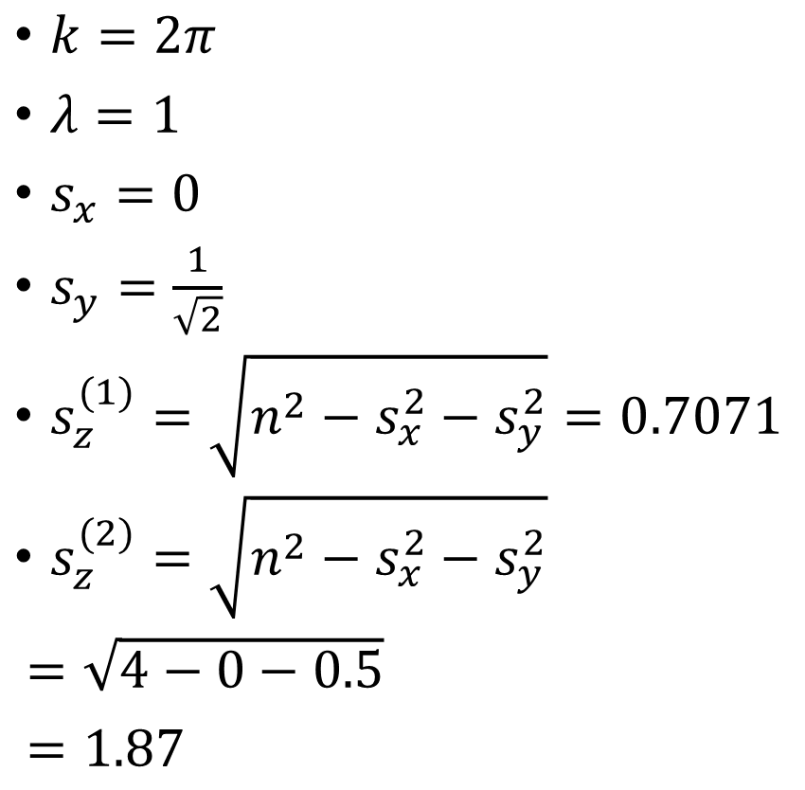

Input Parameters for Two Layers
$z_{1}=0$
$n^{(1)}=1.0$
$n^{(2)}=2.0$
$E_{0}=\left[\begin{matrix}1 \\ 0 \\ 0\end{matrix}\right]$
$k=\left[\begin{matrix}0 \\ \frac{2π}{\sqrt{2}} \\ \frac{2π}{\sqrt{2}}\end{matrix}\right]$
$k=2π$
$λ=1$
$s_{x}=0$
$s_{y}=\frac{1}{\sqrt{2}}$
$s_{z}^{(1)}=\sqrt{n^{2}−s_{x}^{2}−s_{y}^{2}}=0.7071$
$s_{z}^{(2)}=\sqrt{n^{2}−s_{x}^{2}−s_{y}^{2}}$
$=\sqrt{4−0−0.5}$
$=1.87$

Slide 6

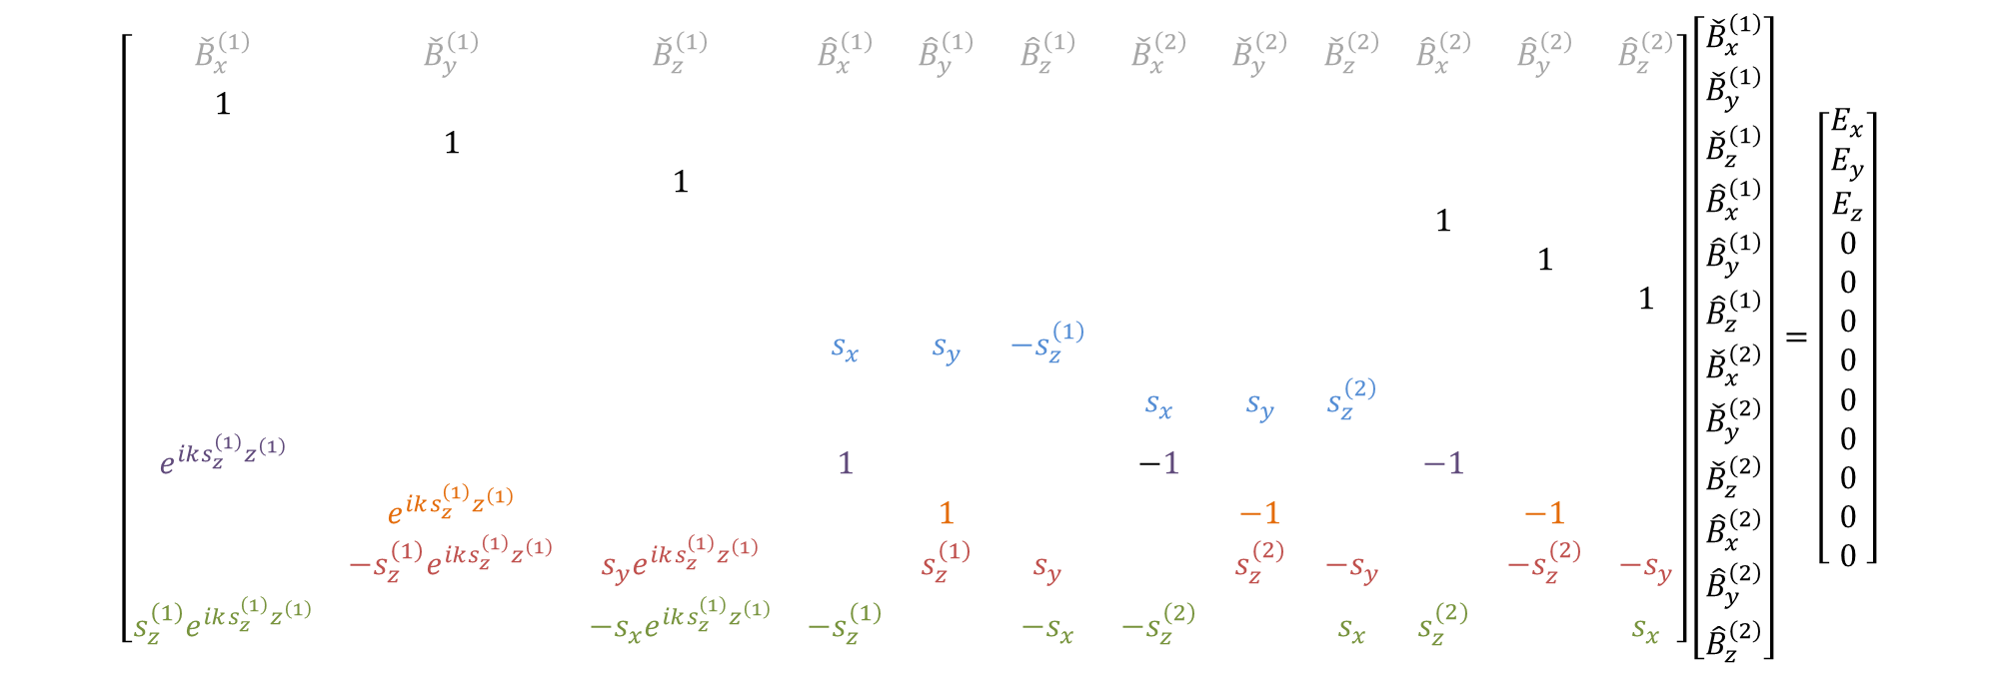
Linear System
$$\left[\begin{matrix}{\check{B}}_{x}^{\left(1\right)} & {\check{B}}_{y}^{\left(1\right)} & {\check{B}}_{z}^{\left(1\right)} & {\hat{B}}_{x}^{\left(1\right)} & {\hat{B}}_{y}^{\left(1\right)} & {\hat{B}}_{z}^{\left(1\right)} & {\check{B}}_{x}^{\left(2\right)} & {\check{B}}_{y}^{\left(2\right)} & {\check{B}}_{z}^{\left(2\right)} & {\hat{B}}_{x}^{\left(2\right)} & {\hat{B}}_{y}^{\left(2\right)} & {\hat{B}}_{z}^{\left(2\right)} \\ 1 & & & & & & & & & & & \\ & 1 & & & & & & & & & & \\ & & 1 & & & & & & & & & \\ & & & & & & & & & 1 & & \\ & & & & & & & & & & 1 & \\ & & & & & & & & & & & 1 \\ & & & s_{x} & s_{y} & −s_{z}^{\left(1\right)} & & & & & & \\ & & & & & & s_{x} & s_{y} & s_{z}^{\left(2\right)} & & & \\ e^{iks_{z}^{\left(1\right)}z^{\left(1\right)}} & & & 1 & & & −1 & & & −1 & & \\ & e^{iks_{z}^{\left(1\right)}z^{\left(1\right)}} & & & 1 & & & −1 & & & −1 & \\ & −s_{z}^{\left(1\right)}e^{iks_{z}^{\left(1\right)}z^{\left(1\right)}} & s_{y}e^{iks_{z}^{\left(1\right)}z^{\left(1\right)}} & & s_{z}^{\left(1\right)} & s_{y} & & s_{z}^{(2)} & −s_{y} & & −s_{z}^{(2)} & −s_{y} \\ s_{z}^{\left(1\right)}e^{iks_{z}^{\left(1\right)}z^{\left(1\right)}} & & −s_{x}e^{iks_{z}^{\left(1\right)}z^{\left(1\right)}} & −s_{z}^{\left(1\right)} & & {−s}_{x} & −s_{z}^{\left(2\right)} & & s_{x} & s_{z}^{(2)} & & s_{x}\end{matrix}\right]\left[\begin{matrix}{\check{B}}_{x}^{\left(1\right)} \\ {\check{B}}_{y}^{\left(1\right)} \\ {\check{B}}_{z}^{\left(1\right)} \\ {\hat{B}}_{x}^{\left(1\right)} \\ {\hat{B}}_{y}^{\left(1\right)} \\ {\hat{B}}_{z}^{\left(1\right)} \\ {\check{B}}_{x}^{\left(2\right)} \\ {\check{B}}_{y}^{\left(2\right)} \\ {\check{B}}_{z}^{\left(2\right)} \\ {\hat{B}}_{x}^{\left(2\right)} \\ {\hat{B}}_{y}^{\left(2\right)} \\ {\hat{B}}_{z}^{\left(2\right)}\end{matrix}\right]=\left[\begin{matrix}E_{x} \\ E_{y} \\ E_{z} \\ 0 \\ 0 \\ 0 \\ 0 \\ 0 \\ 0 \\ 0 \\ 0 \\ 0\end{matrix}\right]$$
$$6L$$

Slide 7
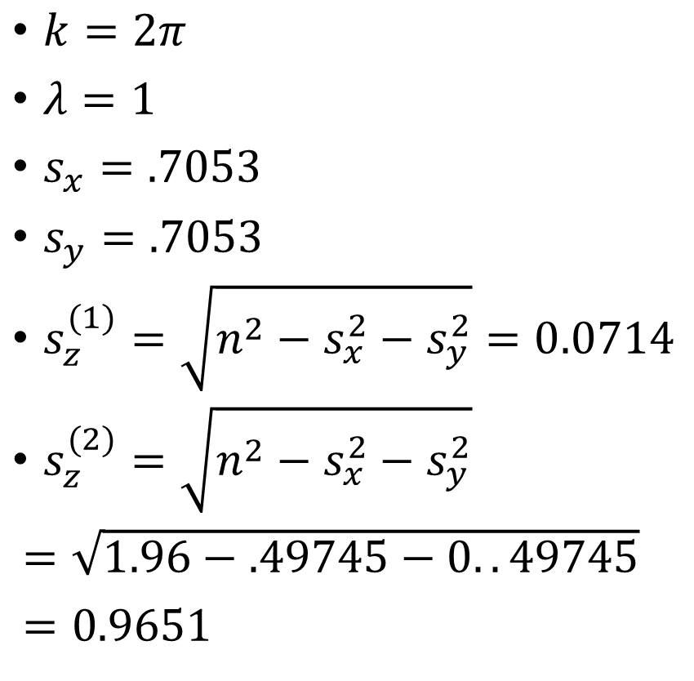

Debug State (1 layer, low incident angle)
$z_{1}=0$
$n^{(1)}=1.0$
$n^{(2)}=1.4$
$E_{0}=\left[\begin{matrix}0 \\ 1 \\ 0\end{matrix}\right]$
$s=\left[\begin{matrix}.7053 \\ .7053 \\ .0705\end{matrix}\right]$
$k=2π$
$λ=1$
$s_{x}=.7053$
$s_{y}=.7053$
$s_{z}^{(1)}=\sqrt{n^{2}−s_{x}^{2}−s_{y}^{2}}=0.0714$
$s_{z}^{(2)}=\sqrt{n^{2}−s_{x}^{2}−s_{y}^{2}}$
$=\sqrt{1.96−.49745−0..49745}$
$=0.9651$

Slide 8
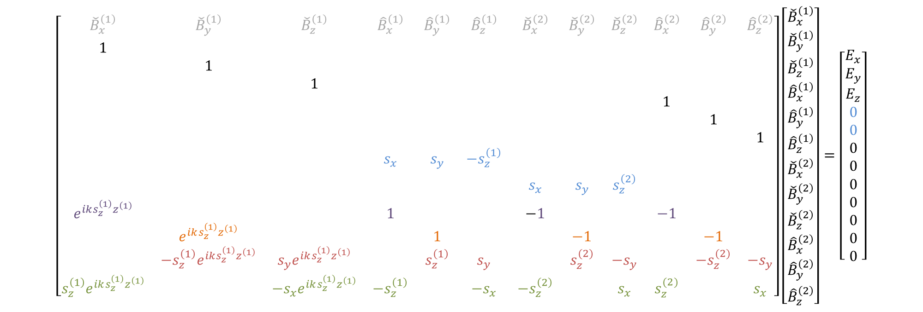
Linear System
$$\left[\begin{matrix}{\check{B}}_{x}^{\left(1\right)} & {\check{B}}_{y}^{\left(1\right)} & {\check{B}}_{z}^{\left(1\right)} & {\hat{B}}_{x}^{\left(1\right)} & {\hat{B}}_{y}^{\left(1\right)} & {\hat{B}}_{z}^{\left(1\right)} & {\check{B}}_{x}^{\left(2\right)} & {\check{B}}_{y}^{\left(2\right)} & {\check{B}}_{z}^{\left(2\right)} & {\hat{B}}_{x}^{\left(2\right)} & {\hat{B}}_{y}^{\left(2\right)} & {\hat{B}}_{z}^{\left(2\right)} \\ 1 & & & & & & & & & & & \\ & 1 & & & & & & & & & & \\ & & 1 & & & & & & & & & \\ & & & & & & & & & 1 & & \\ & & & & & & & & & & 1 & \\ & & & & & & & & & & & 1 \\ & & & s_{x} & s_{y} & −s_{z}^{\left(1\right)} & & & & & & \\ & & & & & & s_{x} & s_{y} & s_{z}^{\left(2\right)} & & & \\ e^{iks_{z}^{\left(1\right)}z^{\left(1\right)}} & & & 1 & & & −1 & & & −1 & & \\ & e^{iks_{z}^{\left(1\right)}z^{\left(1\right)}} & & & 1 & & & −1 & & & −1 & \\ & −s_{z}^{\left(1\right)}e^{iks_{z}^{\left(1\right)}z^{\left(1\right)}} & s_{y}e^{iks_{z}^{\left(1\right)}z^{\left(1\right)}} & & s_{z}^{\left(1\right)} & s_{y} & & s_{z}^{(2)} & −s_{y} & & −s_{z}^{(2)} & −s_{y} \\ s_{z}^{\left(1\right)}e^{iks_{z}^{\left(1\right)}z^{\left(1\right)}} & & −s_{x}e^{iks_{z}^{\left(1\right)}z^{\left(1\right)}} & −s_{z}^{\left(1\right)} & & {−s}_{x} & −s_{z}^{\left(2\right)} & & s_{x} & s_{z}^{(2)} & & s_{x}\end{matrix}\right]\left[\begin{matrix}{\check{B}}_{x}^{\left(1\right)} \\ {\check{B}}_{y}^{\left(1\right)} \\ {\check{B}}_{z}^{\left(1\right)} \\ {\hat{B}}_{x}^{\left(1\right)} \\ {\hat{B}}_{y}^{\left(1\right)} \\ {\hat{B}}_{z}^{\left(1\right)} \\ {\check{B}}_{x}^{\left(2\right)} \\ {\check{B}}_{y}^{\left(2\right)} \\ {\check{B}}_{z}^{\left(2\right)} \\ {\hat{B}}_{x}^{\left(2\right)} \\ {\hat{B}}_{y}^{\left(2\right)} \\ {\hat{B}}_{z}^{\left(2\right)}\end{matrix}\right]=\left[\begin{matrix}E_{x} \\ E_{y} \\ E_{z} \\ 0 \\ 0 \\ 0 \\ 0 \\ 0 \\ 0 \\ 0 \\ 0 \\ 0\end{matrix}\right]$$

Slide 9
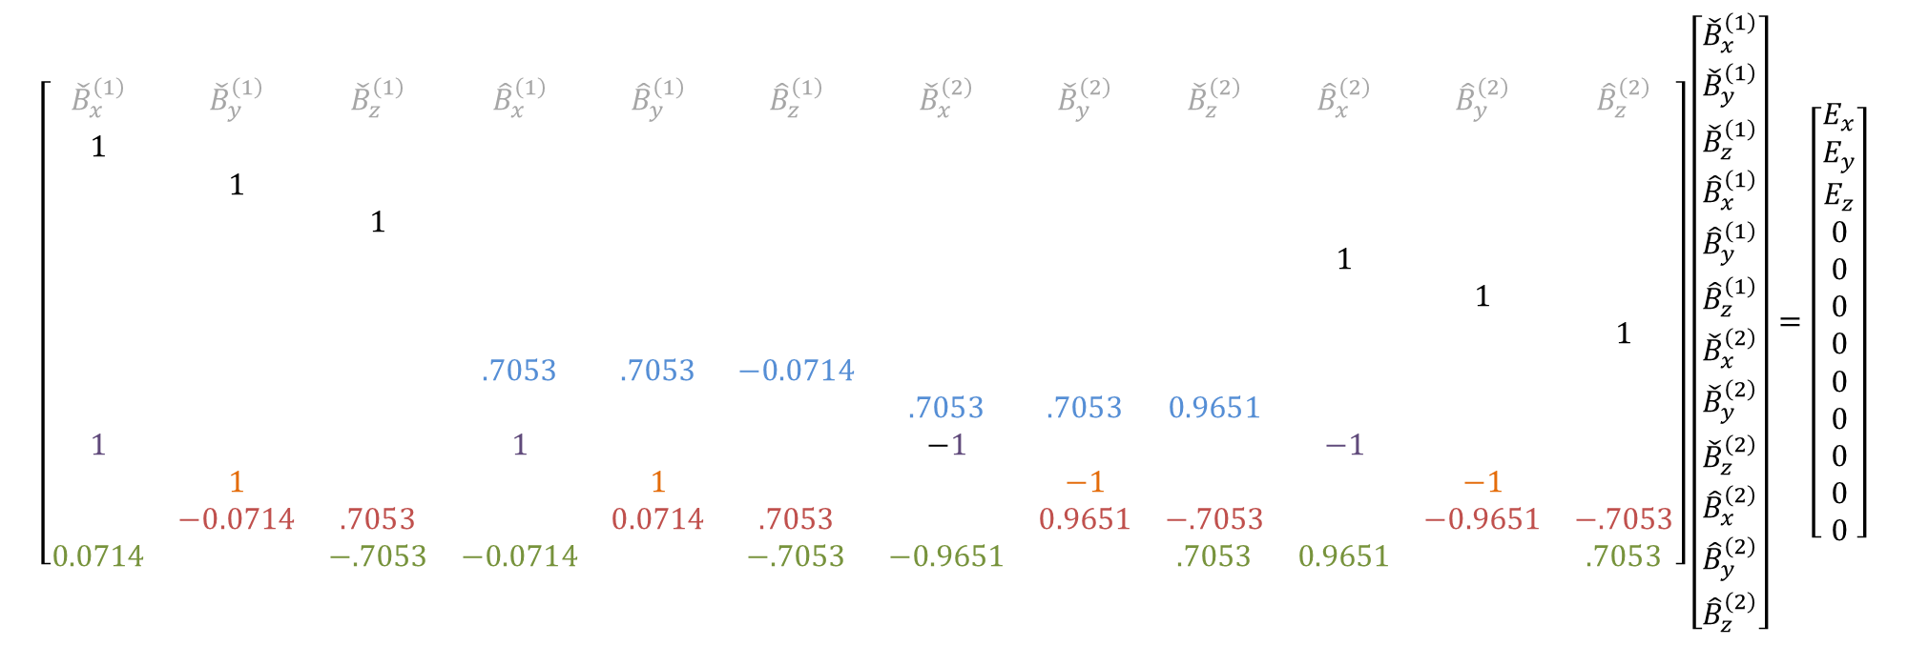
Linear System
$$\left[\begin{matrix}{\check{B}}_{x}^{\left(1\right)} & {\check{B}}_{y}^{\left(1\right)} & {\check{B}}_{z}^{\left(1\right)} & {\hat{B}}_{x}^{\left(1\right)} & {\hat{B}}_{y}^{\left(1\right)} & {\hat{B}}_{z}^{\left(1\right)} & {\check{B}}_{x}^{\left(2\right)} & {\check{B}}_{y}^{\left(2\right)} & {\check{B}}_{z}^{\left(2\right)} & {\hat{B}}_{x}^{\left(2\right)} & {\hat{B}}_{y}^{\left(2\right)} & {\hat{B}}_{z}^{\left(2\right)} \\ 1 & & & & & & & & & & & \\ & 1 & & & & & & & & & & \\ & & 1 & & & & & & & & & \\ & & & & & & & & & 1 & & \\ & & & & & & & & & & 1 & \\ & & & & & & & & & & & 1 \\ & & & .7053 & .7053 & −0.0714 & & & & & & \\ & & & & & & .7053 & .7053 & 0.9651 & & & \\ 1 & & & 1 & & & −1 & & & −1 & & \\ & 1 & & & 1 & & & −1 & & & −1 & \\ & −0.0714 & .7053 & & 0.0714 & .7053 & & 0.9651 & −.7053 & & −0.9651 & −.7053 \\ 0.0714 & & −.7053 & −0.0714 & & −.7053 & −0.9651 & & .7053 & 0.9651 & & .7053\end{matrix}\right]\left[\begin{matrix}{\check{B}}_{x}^{\left(1\right)} \\ {\check{B}}_{y}^{\left(1\right)} \\ {\check{B}}_{z}^{\left(1\right)} \\ {\hat{B}}_{x}^{\left(1\right)} \\ {\hat{B}}_{y}^{\left(1\right)} \\ {\hat{B}}_{z}^{\left(1\right)} \\ {\check{B}}_{x}^{\left(2\right)} \\ {\check{B}}_{y}^{\left(2\right)} \\ {\check{B}}_{z}^{\left(2\right)} \\ {\hat{B}}_{x}^{\left(2\right)} \\ {\hat{B}}_{y}^{\left(2\right)} \\ {\hat{B}}_{z}^{\left(2\right)}\end{matrix}\right]=\left[\begin{matrix}E_{x} \\ E_{y} \\ E_{z} \\ 0 \\ 0 \\ 0 \\ 0 \\ 0 \\ 0 \\ 0 \\ 0 \\ 0\end{matrix}\right]$$

