Slide 1
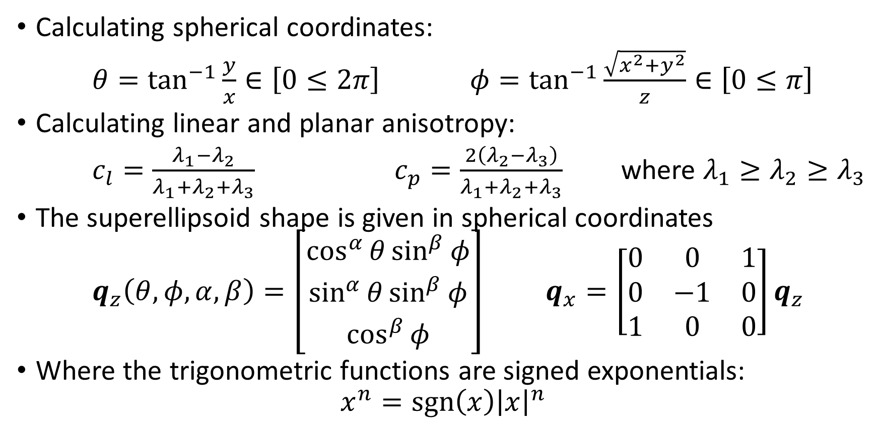
Superellipsoid Equations
Calculating spherical coordinates:
$θ=\tan^{−1}{\frac{y}{x}}∈\left[0≤2π\right]$ $φ=\tan^{−1}{\frac{\sqrt{x^{2}+y^{2}}}{z}}∈\left[0≤π\right]$
Calculating linear and planar anisotropy:
$c_{l}=\frac{λ_{1}−λ_{2}}{λ_{1}+λ_{2}+λ_{3}}$ $c_{p}=\frac{2\left(λ_{2}−λ_{3}\right)}{λ_{1}+λ_{2}+λ_{3}}$ where $λ_{1}≥λ_{2}≥λ_{3}$
The superellipsoid shape is given in spherical coordinates
$q_{z}\left(θ,φ,α,β\right)=\left[\begin{matrix}\cos^{α}{θ}\sin^{β}{φ} \\ \sin^{α}{θ}\sin^{β}{φ} \\ \cos^{β}{φ}\end{matrix}\right]$ $q_{x}=\left[\begin{matrix}0 & 0 & 1 \\ 0 & −1 & 0 \\ 1 & 0 & 0\end{matrix}\right]q_{z}$
Where the trigonometric functions are signed exponentials:
$$x^{n}=\operatorname{sgn}\left(x\right){\left|x\right|}^{n}$$

Slide 2
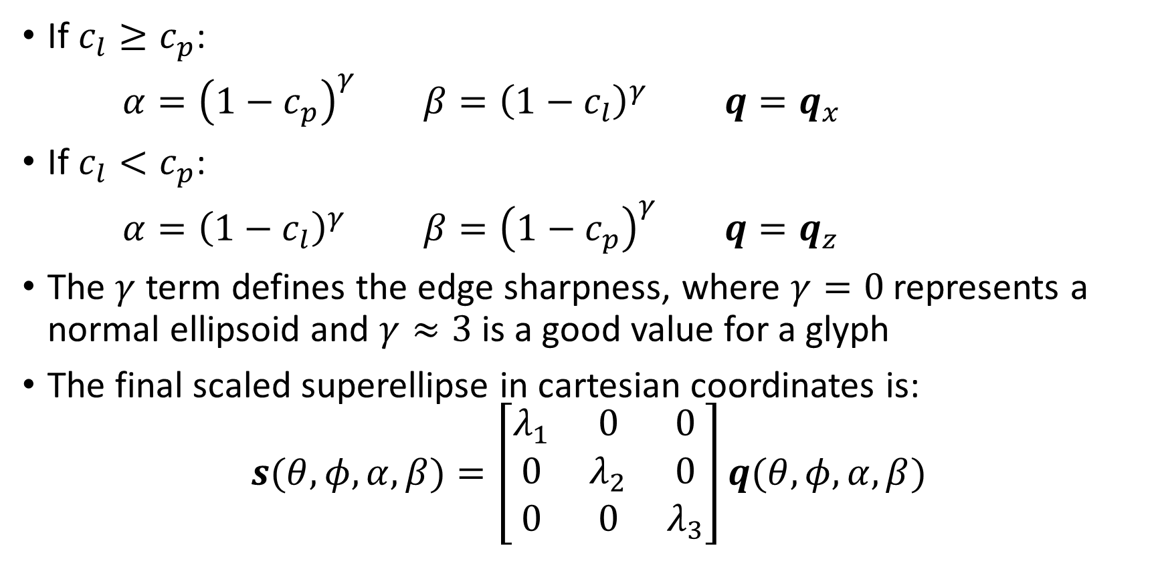
Superellipsoid scaling
If $c_{l}≥c_{p}$:
$α={\left(1−c_{p}\right)}^{γ}$ $β={\left(1−c_{l}\right)}^{γ}$ $q=q_{x}$
If $c_{l}<c_{p}$:
$α={\left(1−c_{l}\right)}^{γ}$ $β={\left(1−c_{p}\right)}^{γ}$ $q=q_{z}$
The $γ$ term defines the edge sharpness, where $γ=0$ represents a normal ellipsoid and $γ≈3$ is a good value for a glyph
The final scaled superellipse in cartesian coordinates is:
$$s(θ,φ,α,β)=\left[\begin{matrix}λ_{1} & 0 & 0 \\ 0 & λ_{2} & 0 \\ 0 & 0 & λ_{3}\end{matrix}\right]q(θ,φ,α,β)$$

Slide 3

Superellipsoid Surface Normals
The surface normal is given by the dual superquadratic:
$$n\left(θ,φ,α,β\right)=\left[\begin{matrix}1/{λ_{1}} & 0 & 0 \\ 0 & 1/{λ_{2}} & 0 \\ 0 & 0 & 1/{λ_{3}}\end{matrix}\right]q\left(θ,φ,2−α, 2−β\right)$$

