Slide 1
NWT (network topology) version 1

Slide 2










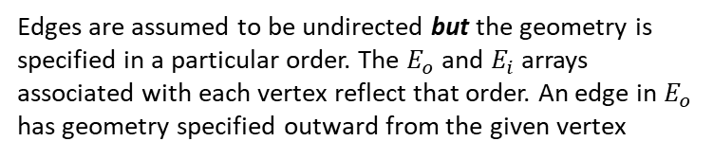











Edges are assumed to be undirected but the geometry is specified in a particular order. The $E_{o}$ and $E_{i}$ arrays associated with each vertex reflect that order. An edge in $E_{o}$ has geometry specified outward from the given vertex
$$v_{0}$$
point: 3D position used as a control point to define the shape of a fiber/edge
$$p_{0}$$
$$e_{3}$$
$$p_{1}$$
$$E_{i}[0]$$
$$e_{5}$$
$$p_{2}$$
$$E_{o}[0]$$
$$v_{4}$$
$$p_{⋅⋅⋅}$$
$$p_{n−1}$$
$$e_{1}$$
$$p_{n}$$
$$v_{1}$$
$$e_{2}$$
$$e_{4}$$
$$v_{2}$$
$$E_{o}[1]$$
edge: 3D curve/fiber connecting two vertices
vertex: 3D position forming the intersection of multiple network fibers
$$e_{6}$$
$$v_{3}$$
$$v_{5}$$

Slide 3








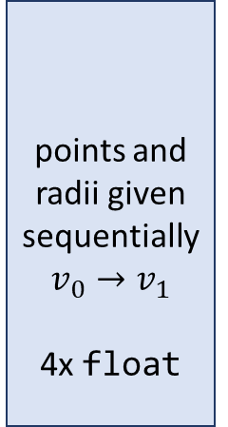






NWT file = N bytes
header
binary
vertex
edge
header
identifier (ID)
14 bytes
“nwtfileformat ”
vertices
$x$ float
$v_{0}$ uint
$$v_{i}$$
$y$ float
$v_{1}$ uint
point
80
bytes
$z$ float
# pts uint
$x$ float
description
58 bytes
$E_{o}$ uint
points and radii given sequentially $v_{0}→v_{1}$
4x float
$y$ float
$E_{i}$ uint
$$p_{i}$$
$z$ float
binary
outgoing
edge
indices
4 bytes
each
$r$ float
edges
$$e_{i}$$
N - 80
bytes
incoming
edge
indices
4 bytes
each
#vertices 4 byte uint
#edges 4 byte uint

Slide 4
File format for storing network, surfaces, volume, and topology *.vasc

Slide 5
















NETSVT file = N bytes
header
binary
node
edge
$x$ float
header
identifier (ID)
14 bytes
“nsvt2”
nodes
# pt id
$n_{0}$ uint
$y$ float
$$n_{i}$$
$n_{1}$ uint
$z$ float
80
bytes
# pts uint
$r$ float
description
58 bytes
pt id
$x$ float
$y$ float
binary
$z$ float
$r$ float
edges
edge bytes uint
$$⋮$$
$$e_{i}$$
N - 80
bytes
surface bytes uint
volume bytes uint
surface data
(binary)
$x$ float
#pts 4 byte uint
$y$ float
#nodes 4 byte uint
volume data
(binary)
$z$ float
#edges 4 byte uint
$r$ float

