Slide 1


Welcome

Slide 2
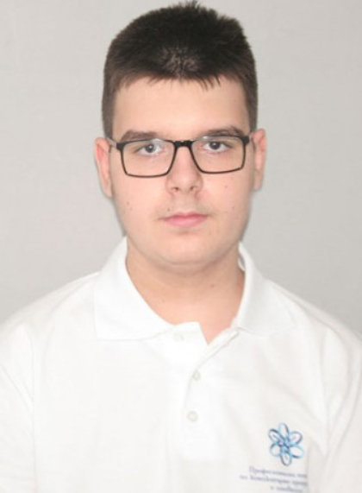
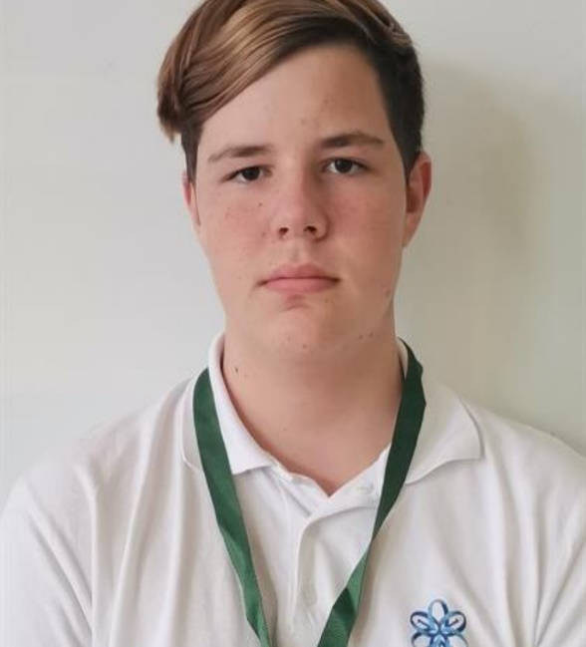

O U R T E A M
Frontend Developer- Todor Ivanov
Backend Developer and Scrum Trainer – Stelian Ivanov
QA Engineer- Dobril Peev
|Error404

Slide 3

O U R I D E A
|Error404

Slide 4
1. I D E A D I S C U S S I O N
2. D E S I G N C R E A T I O N
S T A G E S
3. G A M E C R E A T I O N
4. P R E S E N T I N G
|Error404

Slide 5








U S E D P R O G R A M S

Slide 6
L e t ‘ S J U M P TO
T O T H E P R O J E C T !
|Error404

