Slide 1

ELL888-Project Coarsening Graphs via Hashing for Graph Neural Networks
Sajal Tyagi
2019MT60761

Slide 2
Why Coarsening?
An ideal Coarsened Graph contains all the important properties (e.g. similar eigenvalue spectrum) of the original graph but has a significantly smaller size.
Training on the smaller coarsened graph gives computational benefit as mini-batch learning approaches for GCN leads to ineffective message-passing.
Due to the smaller size of the graph the training time too is reduced

Slide 3
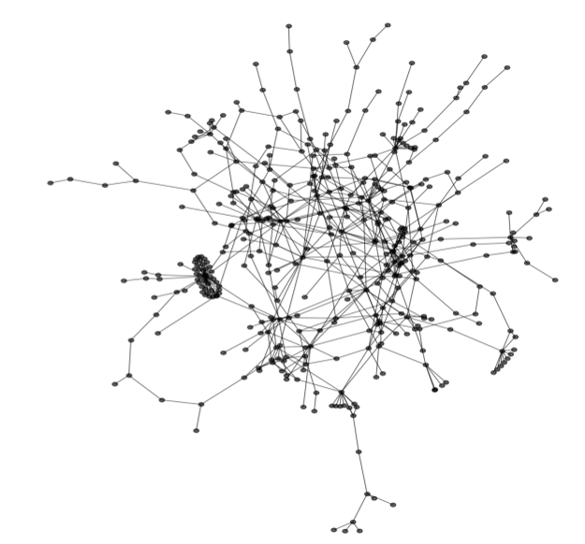
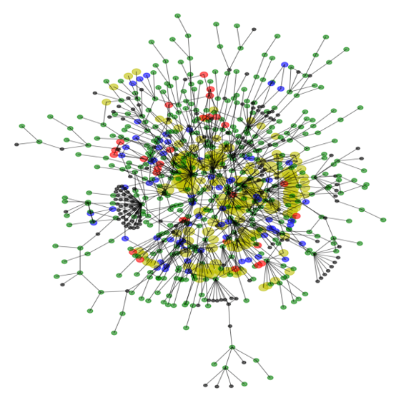
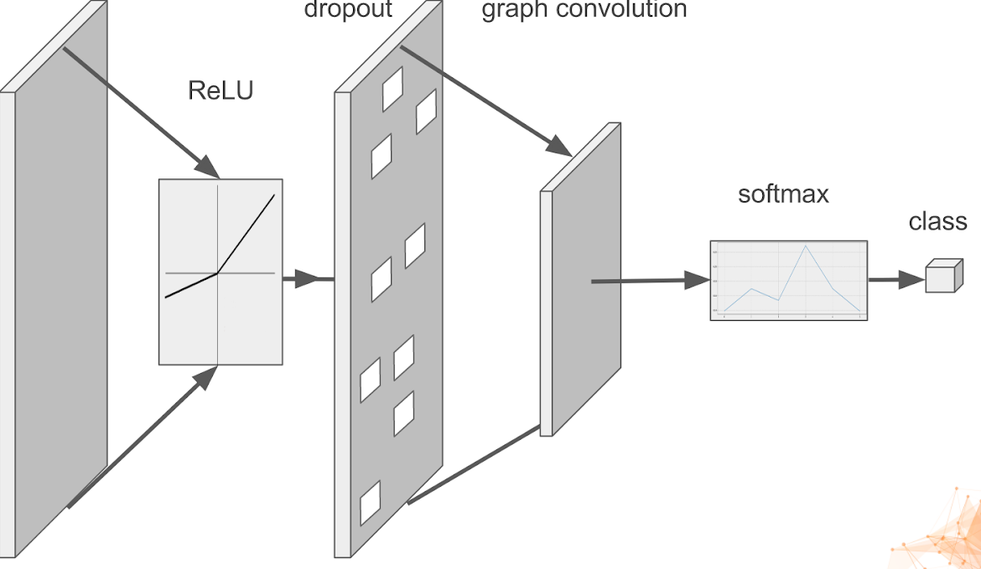
Big Picture of our Approach
Training neural network on the coarsened graph
Graph Coarsening via Hashing
Making prediction on the original graph using weights learned on the coarsened graph during training

Slide 4
Method
Clustering of nodes of original graph using Unsupervised Projection Hashing.
Construction of coarsened graph:
Clusters formed using hashing are super-nodes for the coarsened graph
If there is an edge between any two nodes in different clusters, an edge is considered between their corresponding super-nodes and the strength of edge depends on the number of such inter-cluster edges.
Refining the above obtained Coarsened Matrix using a GSP based approach.
Training GNN model on the coarsened graph for node classification task.

Slide 5
Hashing
Hash Function -
h(x, bin_width) = floor($\frac{a.x+bias}{bin_width}$), s.t. $x∈R^{d}$ and floor(.) is the integer floor function.
Here-
a = $(a_{1},a_{2}...,a_{d})/∥(a_{1},a_{2}...,a_{d})∥_{2}^{2}$ , here $a_{i}\overset{iid}{∼}U(0,1)$
bias = b, here b $∼U(-bin_width,bin_width)$

Slide 6
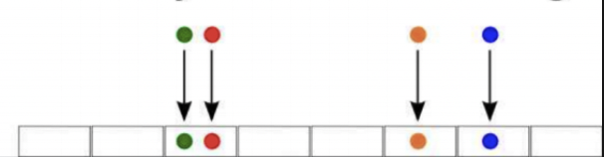
Hashing
We want nodes with similar features to fall into same hash buckets i.e. have the same value of floor($\frac{a.x+bias}{bin_width}$). To see if that’s happening we use the help of JL-lemma.
Hash Buckets

Slide 7
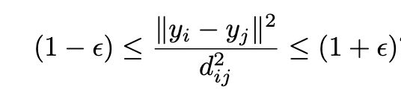
JL-Lemma
If S : $R^{d}→R^{k}$ is a linear transformation with d > 2k and ε > 0, sufficiently small, then for w a randomly chosen vector in $S^{d-1}$ (unit hyper-sphere of radius 1), Pr[|$∥Sw∥^{2}$ −1| > ε] ≥ exp(−O(kε2 + 1)).
In our case, this S is s(x) = a.x, which satisfies all the above properties by virtue of it’s formulation. Hence, this s gives rise to an uniformly almost isometric hashing. i.e.
Here- $y_{i}=s(x_{i})$ and $d_{ij}=∥x_{i}-x_{j}∥^{2}$.

Slide 8
Bin-Width
Our hash function is h(x, bin_width) = floor($\frac{a.x+bias}{bin_width}$) and a quick look at it is enough to intuitively understand that the spread of the hashes is in some way related to the bin_width values .i.e. consider bin_width -> inf, we can clearly see every node will be hashed to the same bucket i.e. 0 and hence, no similarity information gained. Similarly if bin_width -> 0, nodes with different features must be sent to different hashes i.e. ideally number of hash buckets = number of nodes and hence, again no information regarding similarity gained.

Slide 9
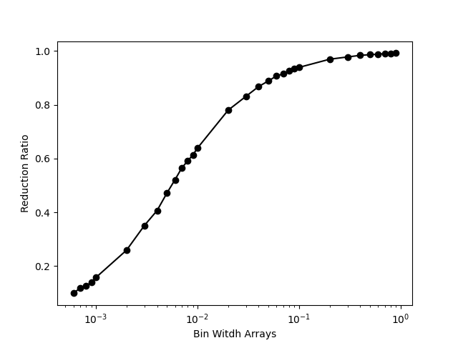
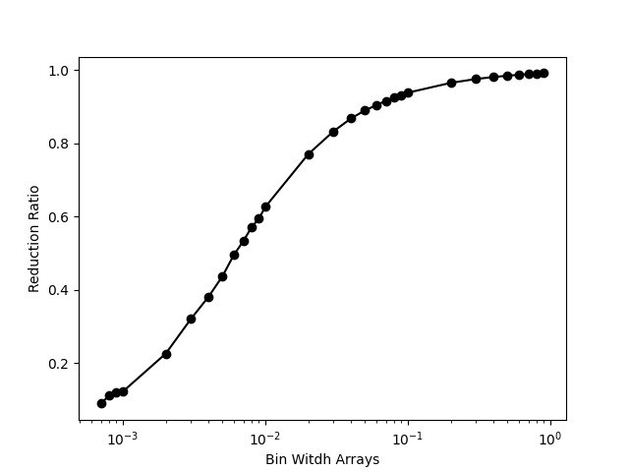
Bin-Width
We extort this property of bin_width being able to somewhat control the number of hash buckets for coarsening graphs to nearly desired levels of reduction.
We plot the graphs of Reduction Ratio vs Bin_Width
The change of Reduction
Ratio with bin-width is fairly
Smooth and hence, it’s
Possible to obtain wide
Range to reduction values
For Cora
For Citeseer

Slide 10


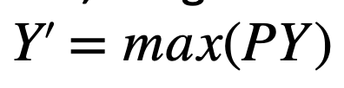
Coarsened Graph Generation
After Hashing we have a binary Partition Matrix, $P∈\{0,1\}^{N×N_{c}}$, here N is the number of nodes in Original Graph and Nc is the number of nodes in Coarsened Graph.
Using simple and intuitive Matrix Multiplications of P with the Adjacency, Feature and Label Matrices, we get these respective matrices for the Coarsened Graph.

Slide 11
GSP based Coarsened Matrix Refining
Constraints ensuring non-negativity of edge weights and symmetry of Laplacian were added*
Log Degree Convex Regulariser was used in current testing*

Slide 12
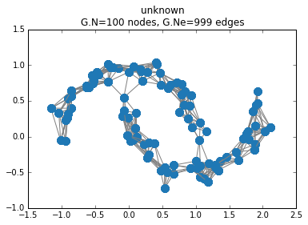
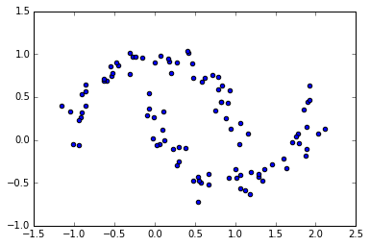
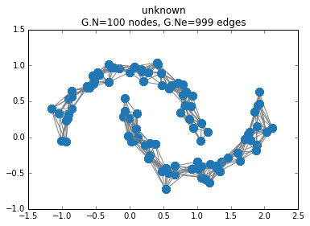
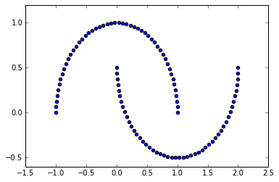
Testing Implementation on 2-Moon DataSet
Graph learnt using standard GSP approaches without validation
Graph learnt using Validated GSP approach acquiring Validating matrix from de-noised version of original Dataset
We can see the graph obtained below maintains 2 connected
components which ensures the validating effect is working

Slide 13
Results of Scalability
All Results have been obtained
By testing on a set of 5 random seeds
and are hence, reproducible
Datasets\Coarsening ratio | 30% | 50% | 70%
Cora (without refining) | 0.79278 | 0.7582717873 | 0.6930576071
Cora (with refining) | 0.757 | 0.723 | 0.652
CiteSeer(without refining) | 0.606 | 0.536 | 0.484
CiteSeer(with refining) | 0.631 | 0.596 | 0.523
Pubmed(without refining) | 0.735 | 0.6976 | 0.672
PubMed(with refining) | OOM | OOM | 0.681
For each case Grid Search Based
Hyper-parameter Tuning was done
On Lr, Decay, Alpha and Beta
Coarsened Graph
Original Graph
OOM => out of memory error. All tests were done on device of similar spec and an OOM error
Implies the GSP refining subroutine takes a lot of space

Slide 14
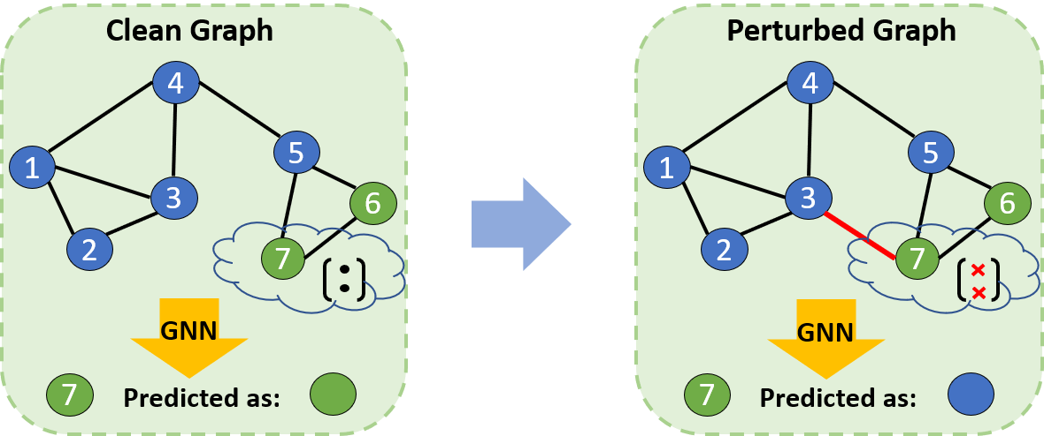
Robustness Testing
Due to being a feature Based hashing method, the structural properties of the Graph are not used while deciding the Cluster Membership and hence, that part is invariant of any poisoning done on the Adjacency matrix of the graph and the smoothness refining optimisation problem too should be helpful in removing the effect of spurious edge.

Slide 15
Robustness Testing
We use the DeepRobust toolbox to simulate Un-targeted Metattacks on the graph with different perturbation rates and the comparision with baseline GCN on Cora without Smoothness refining can be seen as-
Perturbations Vs Model | GCN | CoarsenedGCN
0.05 | 0.7655 | 0.787
0.1 | 0.7039 | 0.741
0.15 | 0.651 | 0.680
0.2 | 0.5956 | 0.61
0.25 | 0.4753 | 0.546
Testing was done On a set of 5
random seeds and hence, results
Are reproducible

Slide 16
Conclusion and Next Steps
Progress till now:
Scalability tests done on several datasets and the accuracy on coarsened versions of larger datasets (Pubmed, DBLP) is comparable to standard GCN.
Strong Code-base for future testing using different Hashing Approaches.
Using GSP based edge construction for Coarsened Graph.
Next Steps:
Time comparison with the SOTA coarsening methods.
Faster Implementation of Smoothing Optimisation Problem
Robustness Testing using the Smooth Problem and Proper hyper-parameter tuning

