Slide 1
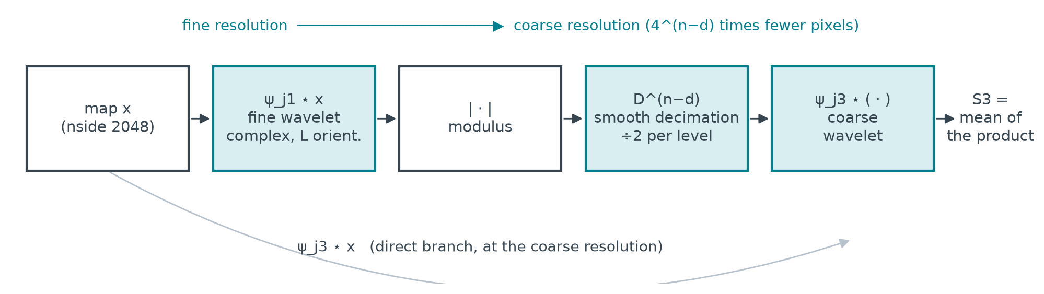
S3 couples a fine wavelet with a coarse one
S3(j1, j3) = mean over the coarse pixels of ψ_j3 ⋆ D^(n−d) |ψ_j1 ⋆ x| × conj(ψ_j3 ⋆ x) with d the resolution of j1 and n the resolution of j3
S1 and S2 live at a single scale: they are naturally computed level by level.
S3 ties two scales together: the gradient of one coarse pixel reads 4^(n−d) fine pixels through the chain, i.e. the whole sky for j1 = 0, j3 = J−1.
At nside 2048 (50 M pixels), a single complex field ψ ⋆ x with L = 4 orientations is 3.2 GB, and the full-sky convolution geometry 250 GB.
The whole sky cannot be held in memory: it has to be split.

Slide 2
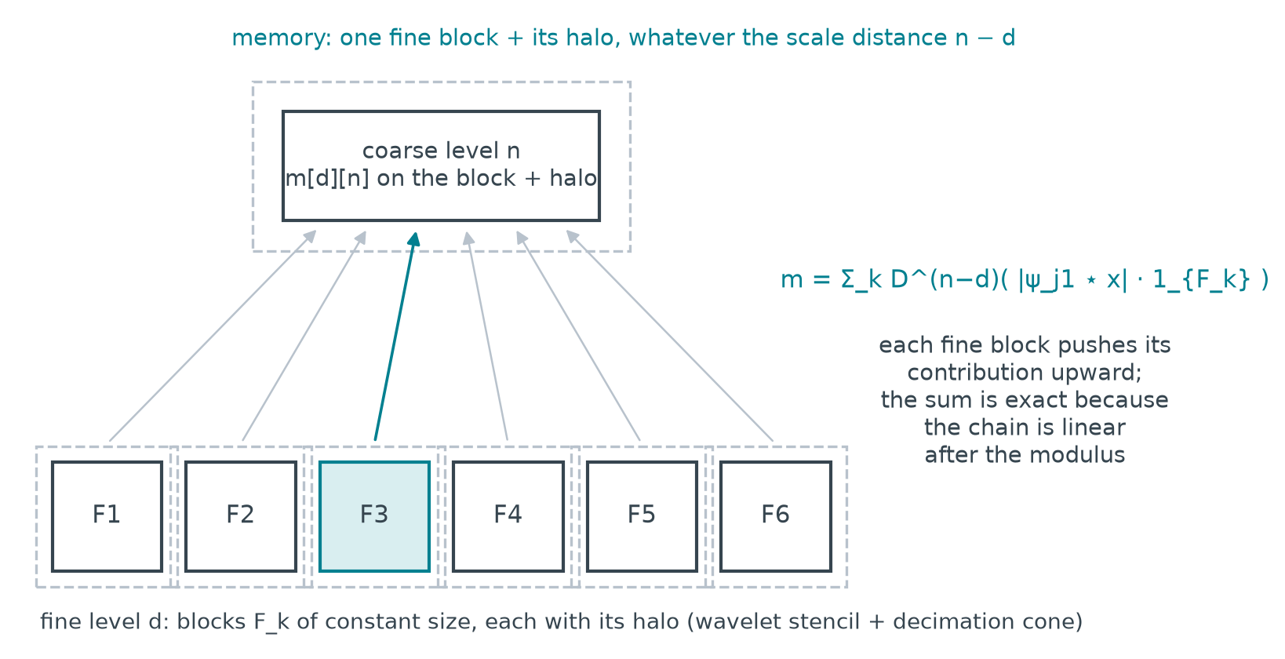
Splitting the chain into blocks: linearity does the work
After the modulus, everything is linear
Decimation and the coarse wavelet are linear operators: the contribution of each fine block F_k is computed on its own and summed at the coarse level.
One block at a time, with its halo
The halo (a few pixels: wavelet stencil, decimation cone) makes every block exact in its interior; border rows are never used.
Same block size at every level
Coarse levels smaller than one block are processed whole: the former full-sky computation, where it costs nothing.
Geometry recomputed on the GPU block by block: nothing to store, neither geometry nor full-sky field.

Slide 3
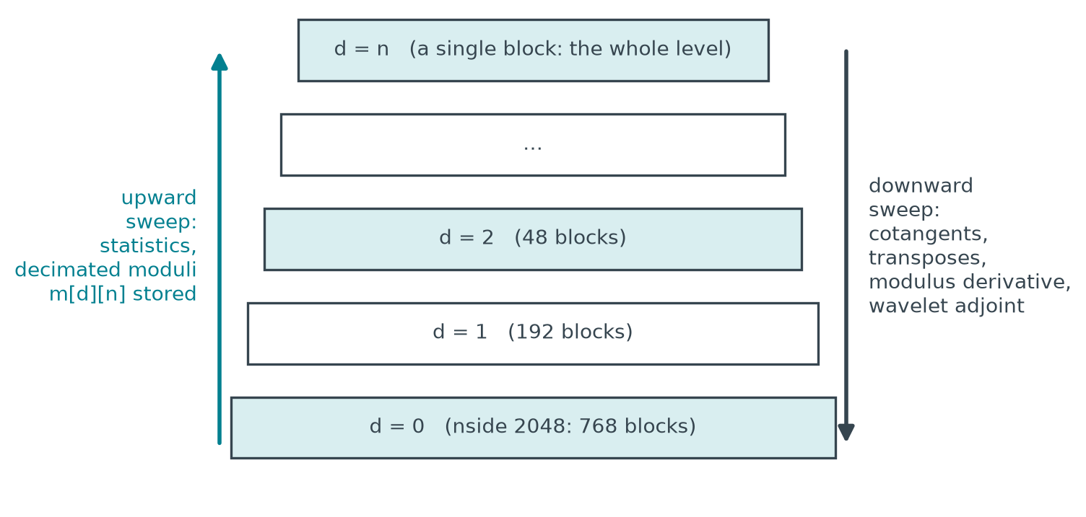
An exact gradient assembled by two sweeps
Global loss, global variable
Σ |S(x) − S(target)|² over all families; the whole map is the variable; LBFGS with line search, as in the classical synthesis.
Upward: the statistics
Level by level, block by block: partial sums of the coefficients, and decimated moduli m[d][n] pushed to the coarser levels (real maps, four times smaller per level).
Downward: the gradient
Cotangents of the coefficients, then in reverse order: transposes of the chain, modulus derivative, wavelet adjoint, accumulated on the map.
Identical to the full-sky computation to 1e-10; same LBFGS trajectory as the classical synthesis.

Slide 4
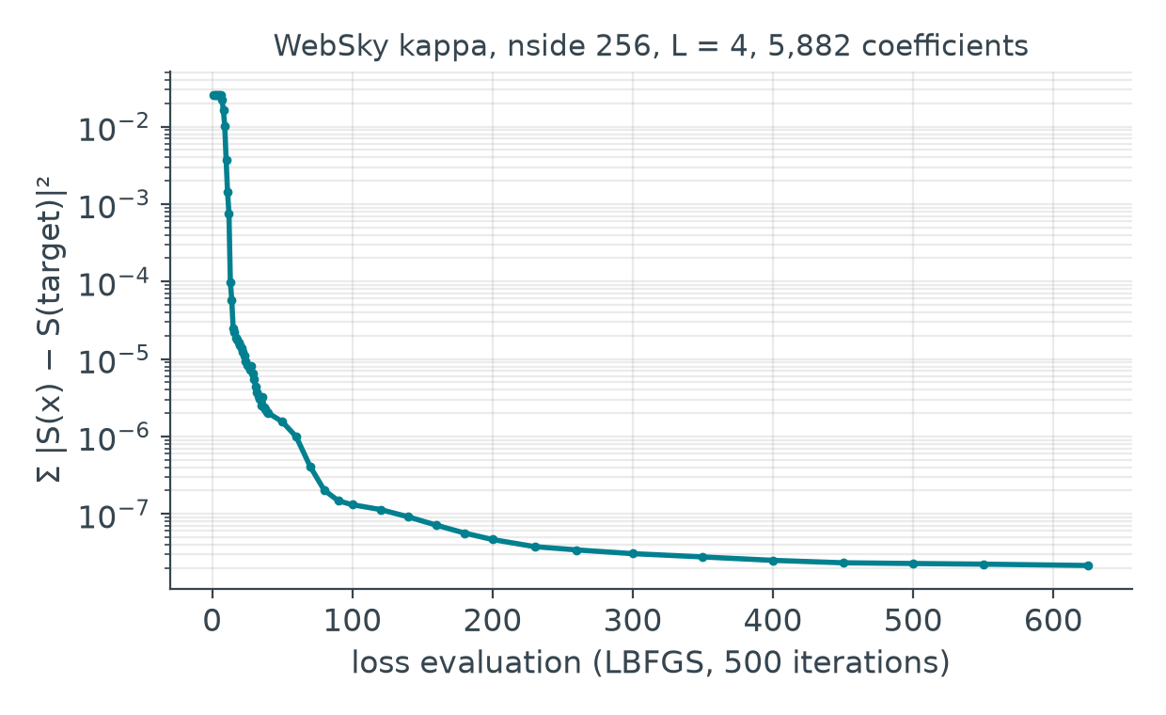
WebSky: from nside 256 to nside 2048 on a 24 GB GPU
nside | pixels | coefs | per evaluation | GPU peak | classical full sky
256 | 0.8 M | 5,882 | 5.9 s | 3.2 GB | possible
1024 | 12.6 M | 11,354 | 108 s | 8.2 GB | 16 GB of geometry alone
2048 | 50 M | ≈ 14,000 | ≈ 7 min | ≈ 10 GB | 250 GB: impossible
L = 4 orientations, J = 7 to 9 scales, all families S1 to S4; target: WebSky CMB lensing convergence (Stein et al. 2020).
What the curve shows: the loss drops by six orders of magnitude; the block-wise gradient is not an approximation, it is the same gradient computed with memory bounded by the block size.
Going up in resolution: the nside 256 synthesis, replicated on the child pixels plus white noise calibrated on the target, directly initialises the nside 2048 synthesis, which only has to create the small scales.

