Slide 1
Pneumonia detection with Keras Deep Learning techniques
By: Sergio teso lorenzo

Slide 2

Use case
Detecting Pneumonia in a person using an X-ray image of his lungs.

Slide 3
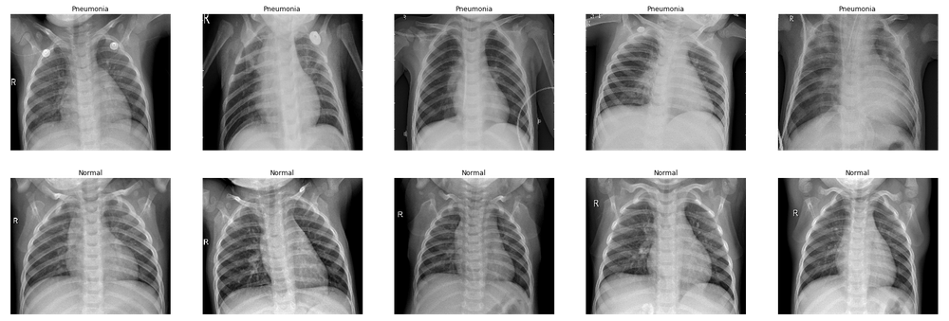
Dataset

Slide 4
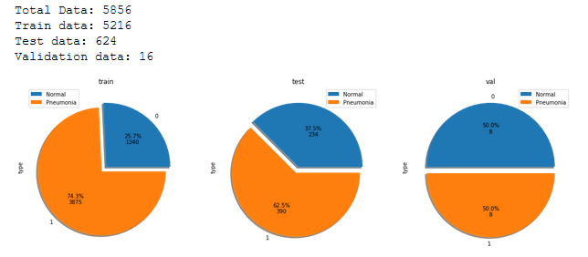
Dataset

Slide 5
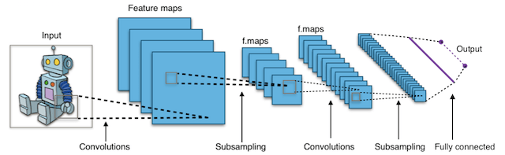
Solution: Keras CNN

Slide 6
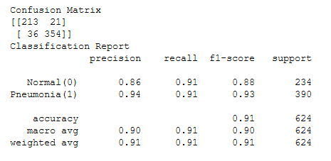
Results
Testing accuracy of:
96.875%

Slide 7
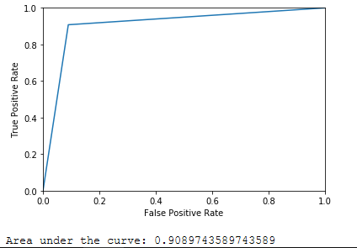
Results

