Slide 1


Prometheus & Grafana
Monitoring & Observability Stack

Slide 2


Worker node 1
Worker node 2
Worker node 3

Slide 3
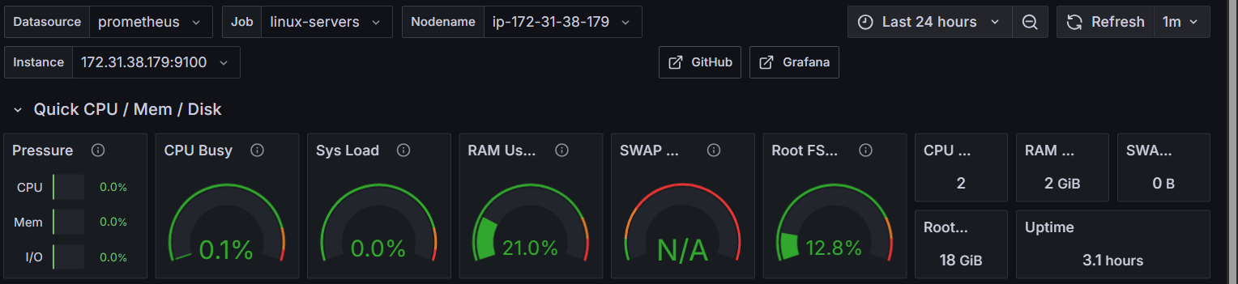
Monitoring & Observability
• Monitoring: Collecting and analyzing metrics
• Observability: Understanding system behavior
• Why it matters: Early issue detection
• Key components: Metrics, Logs, Traces
• Perfect for: Complex distributed systems

Slide 4
What is Prometheus?
• Open-source monitoring and alerting system
• Time-series database for metrics collection
• Pull-based architecture
• Lightweight, reliable, and available
• Perfect for containerized environments
• Active community and ecosystem

Slide 5
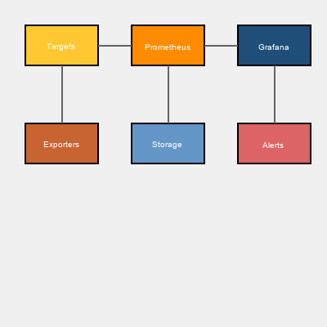
Prometheus Architecture
• Prometheus Server: Collects metrics
• Service Discovery: Finds targets
• Exporters: Expose metrics from systems
• Alertmanager: Handles alerts
• Pushgateway: Batch job metrics
• Client Libraries: Direct instrumentation

Slide 6
Prometheus Key Features
• PromQL query language for data analysis
• Multi-dimensional time-series data
• Pull-based metric collection (HTTP)
• Built-in data retention and compression
• Service discovery integration
• Recording and alerting rules
• Highly scalable and efficient storage

Slide 7
What is Grafana?
• Open-source visualization platform
• Real-time dashboarding and monitoring
• Supports multiple data sources
• Beautiful, interactive visualizations
• Powerful alerting system
• Enterprise-ready with RBAC

Slide 8
Grafana Key Features
• 20+ visualization types available
• Variables and templating support
• Advanced alert management
• User management and permissions
• Dashboard versioning and annotations
• Plugin ecosystem
• REST API for automation

Slide 9
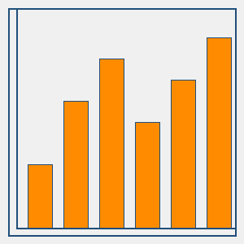
Prometheus Data Model
• Time-series: metric_name{label1=value1}
• Labels: Dimensional data (env, service)
• Sample: Data point with timestamp
• Metric Types:
- Counter: Always increasing
- Gauge: Can go up/down
- Histogram: Value distribution
- Summary: Histogram with quantiles

Slide 10
PromQL - Query Language
• Instant vector: Current values
• Range vector: Values over time
• Scalar: Single numeric value
• Example queries:
- rate(requests_total[5m])
- sum(container_memory_usage_bytes)
- histogram_quantile(0.95, latency)

Slide 11
Integration Architecture
• Prometheus collects metrics from targets
• Grafana connects to Prometheus
• Query Prometheus through dashboards
• Alerts from Prometheus trigger
• Alertmanager routes notifications
• Workflow: Collect → Store → Visualize

Slide 12
Real-World Use Cases
• Kubernetes monitoring: Pods, nodes, clusters
• Microservices monitoring
• Infrastructure monitoring
• Application Performance Monitoring (APM)
• Cost optimization tracking
• SLA/SLO monitoring
• Security monitoring

Slide 13
Prometheus vs Grafana
Prometheus:
✓ Time-series database
✓ PromQL query language
✓ Pull-based collection
✓ Built-in alerting
Grafana:
✓ Visualization platform
✓ Multiple data sources
✓ Beautiful UI/UX
✓ Advanced alerting

Slide 14
Deployment & Best Practices
• High availability: Multiple instances
• Retention policy: Balance storage
• Service discovery: Automate discovery
• Security: Authentication & encryption
• Performance: Recording rules
• Scaling: Remote storage for long-term
• Monitoring: Monitor Prometheus itself

Slide 15
Common Challenges & Solutions
• Cardinality explosion: Limit combinations
• Storage management: Set retention
• Query performance: Use recording rules
• Alert fatigue: Fine-tune thresholds
• Missing metrics: Proper instrumentation
• Data consistency: Reliable collection
• Skill gap: Team training

Slide 16
Prometheus Ecosystem
• Exporters: Node, MySQL, PostgreSQL, Redis
• Service Discovery: K8s, Consul, AWS
• Remote Storage: Cortex, Thanos
• Dashboard Templates: Community
• Recording Rules: Pre-computed metrics
• Client Libraries: All major languages
• Community: Active and supportive

Slide 17
Getting Started
1. Install Prometheus server
2. Configure targets and scrape configs
3. Install Node Exporter
4. Start Prometheus (localhost:9090)
5. Install and configure Grafana
6. Add Prometheus as data source
7. Create dashboards
8. Set up alerting rules

Slide 18
+
✓ Prometheus: Robust metrics collection
✓ Grafana: Beautiful visualization
✓ Together: Complete monitoring solution
✓ Open-source: Cost-effective
✓ Industry standard: Widely adopted
✓ Future-ready: Cloud-native systems

