Slide 1


MSc BUSINESS ANALYTICS · TEXT ANALYTICS GROUP PROJECT
News Topic Modelling
Finding the themes hidden in 18,185 newsgroup posts with TF-IDF, LDA and NMF
GROUP 14
Fianu Adze Kofi Dovlo 22418771
Nana Ama Banafo 22420379
Stephen Ofori-Boateng 22417816
Kwame Ababio 22424321
Obiri-Yeboah Boateng Kwame 22418785
Live app: ba7kc55rxwry8gvzb8uuam.streamlit.app
Notes:
OPENING (30 seconds). Introduce the group and the project in one sentence: we took about 18,000 old internet forum posts, hid their real categories, and asked two algorithms, LDA and NMF, to discover the topics on their own. Then we checked which one did better. Answer: NMF. Mention the live app link at the bottom right; we will demo it near the end.

Slide 2
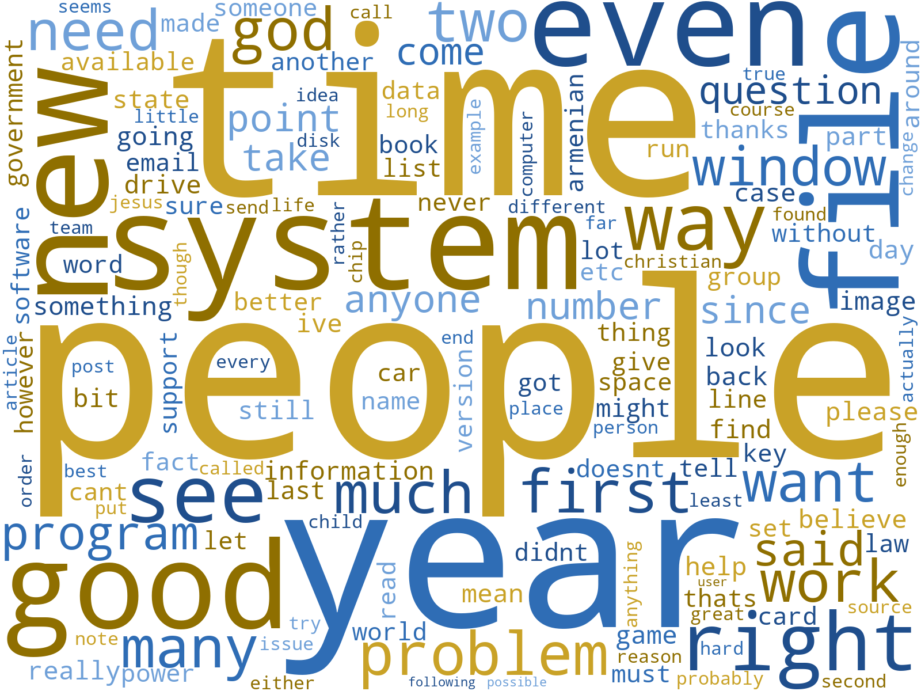
01 · BACKGROUND AND OBJECTIVE
Two algorithms sorted 18,185 forum posts into topics, with no labels given
The problem
1
Newsrooms, forums and support teams produce far more text than anyone can read or sort by hand.
The data
2
20 Newsgroups: 18,331 Usenet posts from 20 categories, 18,185 left after cleaning.
The twist
3
Real categories stay hidden while the models learn, then act as an answer key.
18,185
20
2
15
The words in the posts. Everyday words dominate, which is why a vague catch-all topic appears later.
posts
hidden categories
models
topics each
Group 14 · News Topic Modelling · MSc Business Analytics
2
Notes:
Topic modelling is like asking a computer to sort a huge pile of unsorted letters into themes by noticing which words appear together. It is unsupervised: nobody tells the computer the topic names. We used the 20 Newsgroups dataset: 18,331 Usenet posts from 20 categories. We hid the real categories while training and used them only afterwards as an answer key. After cleaning, 18,185 posts remain. The word cloud shows everyday words dominate the posts, which explains the vague 'catch-all' topic we meet later.

Slide 3
02 · APPROACH: DATA AND CLEANING
Cleaning mattered: three hidden data bugs were fixed before modelling
1
2
3
4
5
6
Regex clean
Tokenise
Stopwords
Lemmatise
Length filter
De-duplicate
lowercase; remove emails, links, HTML, symbols, digits
split each post into words
NLTK list plus 18 custom filler words
pens becomes pen
keep words of 3 to 20 letters
drop exact copies
BUG 1
BUG 2
BUG 3
AFTER CLEANING
Underscore artefacts
A corrupted token
146 duplicate posts
18,331
Signature lines like ____ survived punctuation removal. Fix: a dedicated regex for underscore runs.
One garbled string repeated thousands of times. Fix: keep only words of 3 to 20 letters.
One poster's repeated text formed a fake topic. Fix: remove exact copies after cleaning.
to 18,185 posts
47 posts with none of the model's words are left unassigned.
Group 14 · News Topic Modelling · MSc Business Analytics
3
Notes:
Walk through the chain: regex cleaning, tokenising, stopword removal, lemmatising, length filter, and de-duplication. Spend most time on the three bugs, because finding them is the best story in the project: 1) old email signature lines made of underscores survived punctuation removal; 2) one garbled repeating token appeared thousands of times; 3) 146 cross-posted duplicates formed their own fake topic. Result: 18,331 posts became 18,185. Also mention 47 posts contain none of the 5,000 model words, so they are marked unassigned instead of being forced into topic 0. Note: the lemmatiser handles plurals (pens to pen) but leaves words like running unchanged.

Slide 4
02 · APPROACH: REPRESENTATION AND MODELS
One input, two models: TF-IDF feeds both LDA and NMF
TF-IDF
MODEL 1 · PROBABILISTIC
MODEL 2 · MATRIX SPLIT
Scores a word by how special it is to a post, instead of how often it appears.
LDA
NMF
Each post is a mixture of topics, like a smoothie recipe.
Each post is built from topic blocks that can only be added.
Ignore words in over 90% of posts
Ignore words in fewer than 5 posts
Keep the best 5,000 words
15 topics, 20 passes
Seed 42, one worker
Latent Dirichlet Allocation
15 topics, up to 500 passes
Seed 42, smart start (nndsvd)
Non-negative Matrix Factorization
Like a party: "nice weather" tells you nothing, "beekeeping" tells you a lot.
No train/test split: topic modelling is unsupervised, so both models learn from the whole corpus. Same 15 topics for a fair comparison.
Group 14 · News Topic Modelling · MSc Business Analytics
4
Notes:
TF-IDF turns each post into numbers by scoring how special a word is to a post. Common words everywhere score low, distinctive words score high. We ignore words in more than 90% of posts, words in fewer than 5 posts, and keep the best 5,000. LDA is a probabilistic model: every post is a mixture of topics, like a smoothie recipe. NMF breaks the big table into topic building blocks that can only be added. Both use 15 topics so the comparison is fair. No train/test split because topic modelling is unsupervised. Technical note for questions: LDA is normally fed raw word counts; we fed it TF-IDF because the brief specifies TF-IDF and it keeps both models on identical input. We fixed n_jobs=1 so results do not change with the number of CPU cores.

Slide 5
02 · APPROACH: HOW WE JUDGED THE MODELS
Three yardsticks decide which model finds better topics
1
Coherence
2
Diversity
3
Purity
Do a topic's top words appear together in the same posts?
Do the topics use different words from each other?
Does a topic match one real category?
Score every pair of the top 10 words, then average.
Unique words divided by all top words across the topics.
Share of a topic's posts from its biggest real category. Labels check results, never train.
Closer to 0 is better
Closer to 1.0 is better
Higher is better
Cross-check: the app also reports the textbook UMass coherence (Mimno et al., 2011). NMF wins under both formulas.
Group 14 · News Topic Modelling · MSc Business Analytics
5
Notes:
No single metric tells the whole story in unsupervised learning, so we used three. Coherence: do a topic's top ten words really show up together in the same posts? Closer to zero is better. Diversity: do the topics use different words, or repeat each other? Closer to 1 is better. Purity: using the real labels, but only afterwards, what share of a topic's posts come from one real category? That is our stand-in for interpretability. We wrote our own coherence code instead of using gensim, which has had compatibility problems with new Python versions. Our version divides by the lower-ranked word of each pair; the textbook UMass divides by the higher-ranked word. The app reports both and NMF wins under both.

Slide 6
03 · RESULTS
NMF wins on coherence and purity; diversity is a tie
Closer to 0 is better
Higher is better
Higher is better
NMF wins
Tie
NMF wins
LDA (gold) · NMF (blue) · 15 topics each, 18,185 posts
Group 14 · News Topic Modelling · MSc Business Analytics
6
Notes:
Read the three charts left to right. Coherence: NMF -1.59 versus LDA -2.21; closer to zero is better, so NMF's top words co-occur more reliably. Diversity: both models score 0.933, a tie. Purity: NMF 0.329 versus LDA 0.277; NMF's topics match real categories more closely. These are the numbers the corrected app shows on its Model Evaluation page. LDA is randomised, so its exact numbers vary by setting; the next slide shows the ranking does not.

Slide 7
03 · RESULTS: THE TOPICS
NMF's topics read like real subjects, but both models keep one vague catch-all
0.70
Cars and bikes
rec.autos
THE CATCH-ALL TOPIC
car, engine, mile, bike, dealer, ford
4,956 LDA posts 3,341 NMF
0.68
Cryptography
sci.crypt
key, chip, clipper, encryption, phone, bit
Words like people, time, year, good: ordinary chat with no strong subject.
0.66
Armenian-Turkish conflict
talk.politics.mideast
armenian, turkish, muslim, genocide, turkey, armenia
AN ARTEFACT TO WATCH
0.56
Religion
soc.religion.christian
NMF Topic 13: purity 0.658
god, jesus, christian, bible, believe, christ
Words: bank, chastity, skepticism, intellect, surrender. One poster's repeated quote made a topic that is not about medicine.
0.55
Sport
rec.sport.hockey
game, team, player, hockey, year, baseball
Group 14 · News Topic Modelling · MSc Business Analytics
7
Notes:
Left: NMF's five clearest topics, each with the words that define it and its purity. Cars, cryptography, the Armenian-Turkish conflict, religion and sport are all recognisable at a glance. Right, top: both models also produce one big catch-all topic made of everyday words (people, time, year, good): LDA's has 4,956 posts, NMF's has 3,341 posts (its Topic 0). The 'dominant category' of such a topic is nominal only; it just means which real group contributed the most posts. Right, bottom: NMF Topic 13 has a high purity (0.658, sci.med) but its words (bank, chastity, skepticism) come from one poster's repeated signature quote, not from medicine. That is the same kind of artefact as the duplicates and is listed as future work.

Slide 8
03 · RESULTS: ROBUSTNESS CHECK
NMF stayed ahead in all seven LDA re-runs
7 of 7 LDA runs had lower coherence and lower purity than NMF.
s = random seed, 4w = four parallel workers. LDA's exact numbers move between runs; the ranking does not.
Group 14 · News Topic Modelling · MSc Business Analytics
8
Notes:
LDA is a randomised model, so we asked: is NMF's win a fluke? We trained LDA seven times: five different random seeds, plus the seed 42 run with one worker and with four workers. NMF is not random with our settings, so it gives the same answer every time. In all seven LDA runs NMF had better coherence and better purity. LDA's diversity matched or beat NMF's in six of seven runs, between 0.927 and 0.960 versus NMF's 0.933. So the conclusion is robust even though LDA's exact numbers move around. This is why we fixed the seed and the number of workers in the final app.

Slide 9
04 · INTERPRETATION
Recommendation: use NMF, keep LDA for soft topic mixtures
RECOMMENDED
NMF
TRY IT LIVE
More coherent and more pure: sharp, human-recognisable topics. Best for routing documents by topic.
Paste any text and both models name its topic
https://group14-news-topic-modelling.streamlit.app/
ALTERNATIVE
LDA
Home
Corpora Viewer
Gives a probability mix per post (60% politics, 30% economics) and spreads over a wide vocabulary.
Text Preprocessing
Exploratory Analytics
Topic Explorer
Model Evaluation
WHAT THE CORPUS TELLS US
Topics with their own vocabulary (crypto, cars, sport) are found easily. Overlapping newsgroups blur together, so purity has a ceiling.
Try It Yourself
Group 14 · News Topic Modelling · MSc Business Analytics
9
Notes:
Our recommendation is NMF for anything like routing documents by topic: its topics are more coherent, closer to real categories, and recognisable at a glance. Keep LDA for cases where you need a probability mix, for example 'this post is 60% politics and 30% economics', or the widest vocabulary spread. The corpus matters too: topics with their own vocabulary (cryptography, cars, the Armenian-Turkish conflict, religion, sport) were found by both models, while overlapping newsgroups such as politics and guns blur together. So the purity ceiling is partly a data issue, not only a modelling issue. LIVE DEMO: open the app, go to Try It Yourself, paste a sentence about hockey or space, click Predict Topic, and show both models answering with their top words.

Slide 10
05 · LIMITATIONS AND FUTURE WORK
What to keep in mind, what comes next, and thank you
LIMITATIONS
NEXT STEPS
1
Coherence is a UMass variant. Fair for LDA versus NMF here; the app also shows the textbook version.
1
Split the catch-all topic: more topics or another stopword pass.
2
LDA was fitted on TF-IDF as the brief requires. Raw counts usually suit LDA better.
2
Remove repeated signature quotes, like the one behind NMF Topic 13.
3
15 topics for both models, not tuned. Overlapping real categories cap purity.
3
Re-check coherence with gensim and test LDA on raw word counts.
Thank you. Questions?
Key references: Blei, Ng and Jordan (2003) · Lee and Seung (2001) · Mimno et al. (2011) · Pedregosa et al. (2011) · Lang (1995)
Group 14 · News Topic Modelling · MSc Business Analytics
10
Notes:
Be upfront about limitations; it earns credibility. 1) Our coherence is a UMass variant: fine for comparing LDA with NMF here, not for comparing with other studies, so the app shows the standard version too. 2) LDA was fitted on TF-IDF because the brief requires it; in a side test with raw word counts LDA reached higher purity (0.34 to 0.38) than NMF, so this choice handicaps LDA. 3) We fixed 15 topics for both models and did not tune them; some real categories overlap, so purity has a ceiling. Next steps: split the catch-all topic with more topics or another stopword pass; remove repeated signature quotes (NMF Topic 13); re-check coherence with gensim and try LDA on raw counts. Close by thanking the audience and inviting questions. References: Blei, Ng and Jordan (2003); Lee and Seung (2001); Mimno et al. (2011); Pedregosa et al. (2011); Lang (1995).

