Slide 1
Coordinates changes in GEM, GEF, rds files

Slide 2
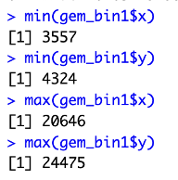
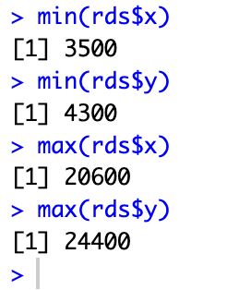
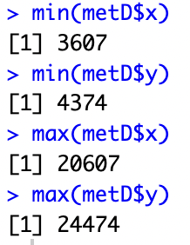
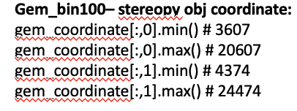
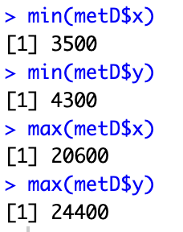
GEM and GEF file coordinates
GEM bin 100--GEM2RDS
GEM bin 1
GEM bin 100 - stereopy
GEM bin 100 - seurat
GEF bin100 Seurat
Gef bin1
gef_coordinates[:,0].min() # 3557
gef_coordinates[:,0].max() # 20646
gef_coordinates[:,1].min() # 4324
gef_coordinates[:,1].max() # 24475
gef_bin100– stereopy:
gef_coordinate[:,0].min() # 3500
gef_coordinate[:,0].max() # 20600
gef_coordinate[:,1].min() # 4300
gef_coordinate[:,1].max() # 24400

Slide 3
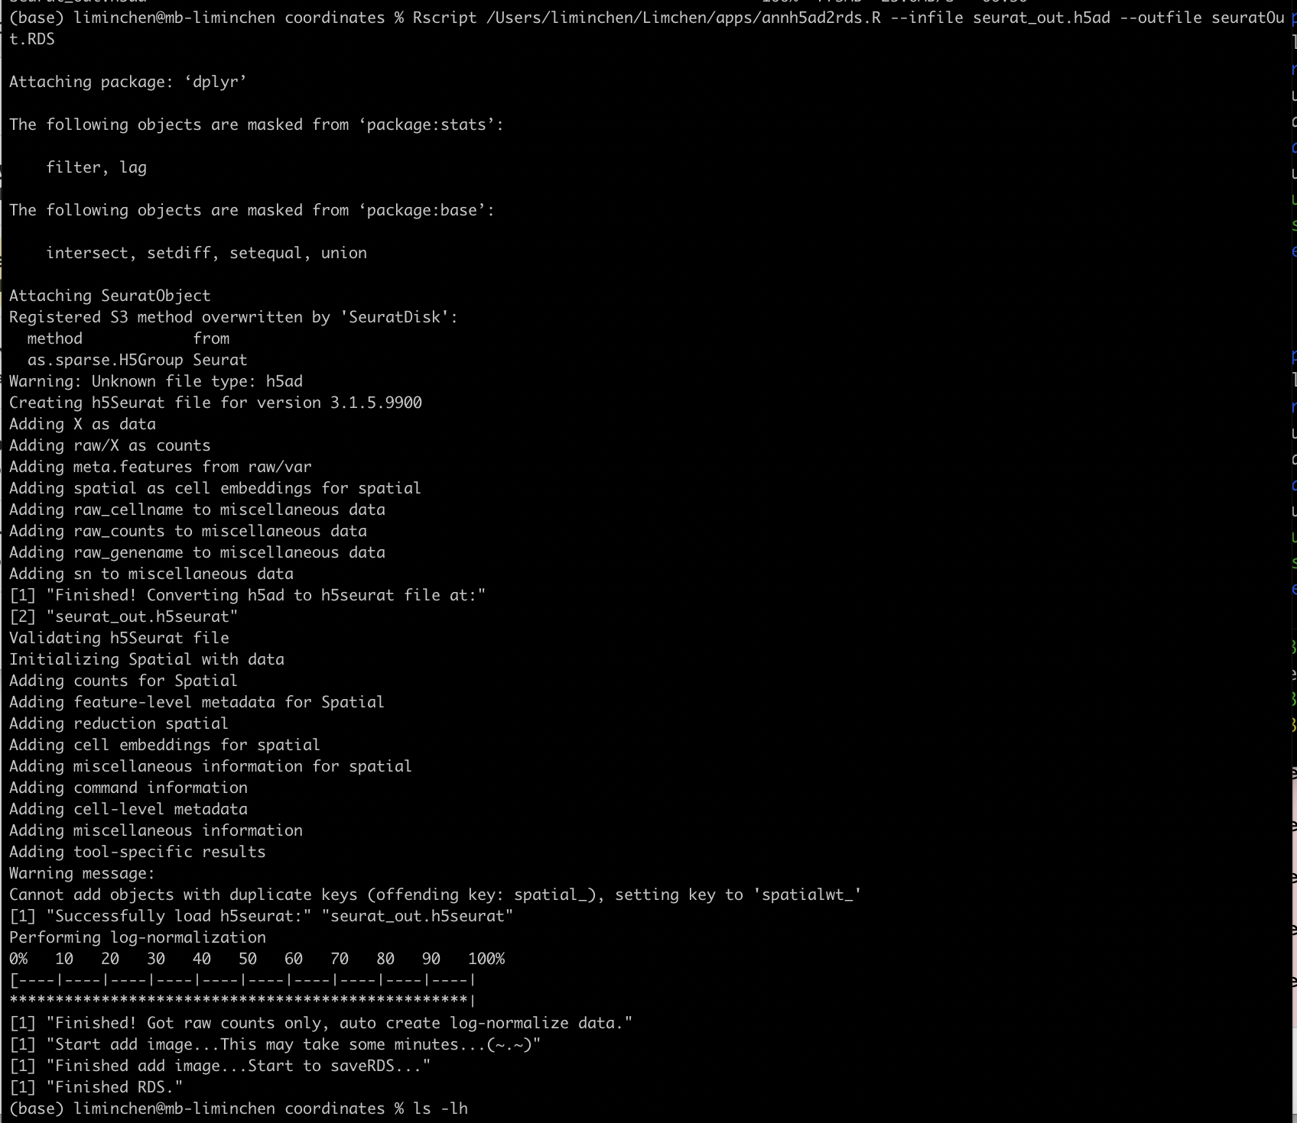
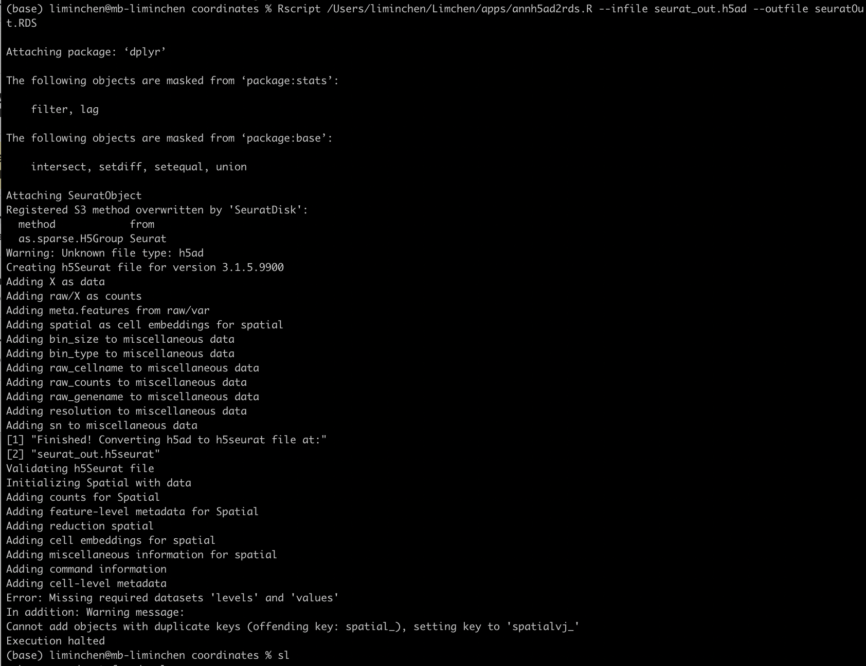
Convert to Seurat
stereopy 0.12.1
stereopy 0.13.0b1

Slide 4
GEM and GEF file coordinates
Summary and Conclusion:
To make sure the coordinate consistent in different files and analysis process, we agreed to use GEF file to convert to either Seurat or Scanpy compatible format. NOT Gem file.
Stereopy 0.12.1 is the correct version for GEF conversion.

