Slide 1
Saw6.0 VS. Saw7.0 outputs
Sub commands of SAW7 pipeline

Slide 2
Visualize saw7.0 cellbin.gef in StereoMap 3.0
ChipID.cellbin.gef from SAW7.0 can't be visualized directly in StereoMap 3.0. But you can run the following codes to make it visible.
docker run -it --rm -v /stomics_data/liminData/test:/home/temp stomics/saw:07.0.0 bash
# Inside docker, run the following command
export HDF5_USE_FILE_LOCKING=FALSE
export NUMBA_CACHE_DIR=$PWD/tmp
export MPLCONFIGDIR=$PWD/tmp
cellCluster -i SS200000135TL_D1.cellbin.gef -o SS200000135TL_D1.cell.cluster.h5ad
cellChunk -i SS200000135TL_D1.cellbin.gef -o .

Slide 3
Generate adjusted cellbin.gef and adjusted.cell.cluster.h5ad for stereoMap 3.0--continued
# step 1: go to saw7 docker image:
docker run -it --rm -v /:/home/temp stomics/saw:07.0.0 bash
# step 2: modify the following 4 parameters for your example and run following codes sequencially
SN=SS200000135TL_D1
nucleusMask=/home/temp/stomics_data/demo/SS200000135TL_D1_v5_brain/SAW7_run1/result/03.register/ssDNA_SS200000135TL_D1_mask.tif
rawgef=/home/temp/stomics_data/demo/SS200000135TL_D1_v5_brain/SAW7_run1/result/02.count/${SN}.raw.gef
outdir=/home/temp/stomics_data/liminData/test/out # generated adjusted cellbin.gef
cellCorrect \
-i ${rawgef} \
-m ${nucleusMask} \
-d 10 \
-o ${outdir}
# add clusters to the adjusted cellbin.gef for Stereomap3.0 visualization
export HDF5_USE_FILE_LOCKING=FALSE
export NUMBA_CACHE_DIR=$PWD/tmp
export MPLCONFIGDIR=$PWD/tmp
cellCluster -i ${outdir}/${SN}.adjusted.cellbin.gef -o ${outdir}/${SN}.adjusted.cell.cluster.h5ad
cellChunk -i ${outdir}/${SN}.adjusted.cellbin.gef -o ${outdir}
# you should get SS200000135TL_D1.adjusted.cell.cluster.h5ad; SS200000135TL_D1.adjusted.gem; SS200000135TL_D1.adjusted.cellbin.gef; ssDNA_SS200000135TL_D1_mask_edm_dis_10.tif 4 files.

Slide 4
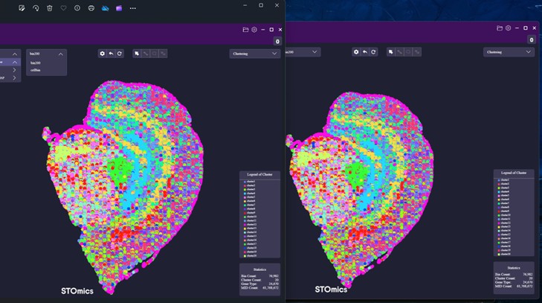
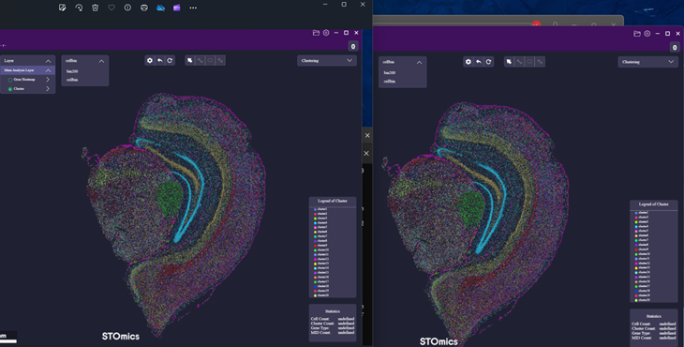
Generate adjusted cellbin.gef and adjusted.cell.cluster.h5ad for stereoMap 3.0--continued
Replace <chipID.raw.gef> with <chipID.gef> to run commands in slide 3. It gave the same results. Below is the demo data, left is from original saw7.0 pipeline, right is from chipID.gef following slide 3 instruction.

Slide 5
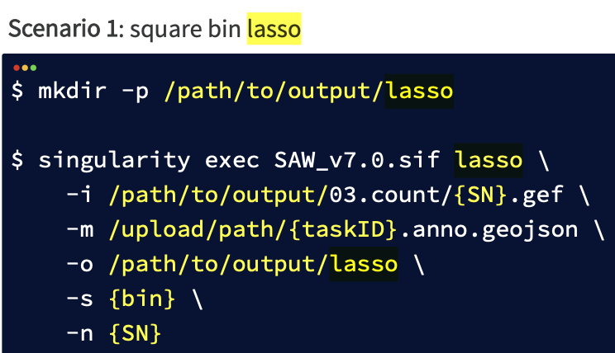
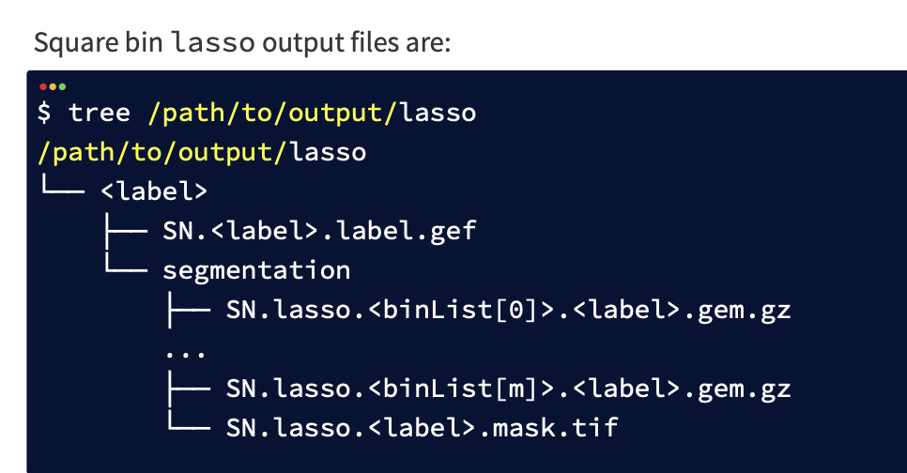
Subset region of interest --1
Step 1: subset the region of interest in the stereoMap.
This step will generate a Geojson file.
Step 2, generate corresponding gene expression data.

Slide 6
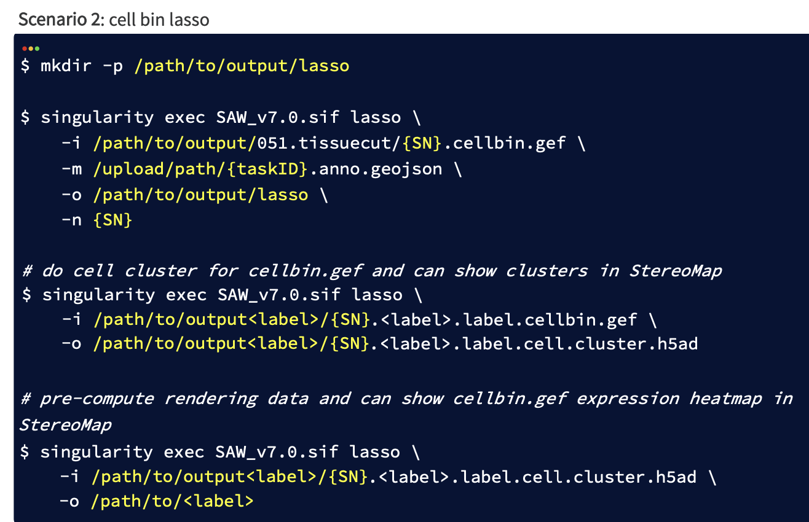
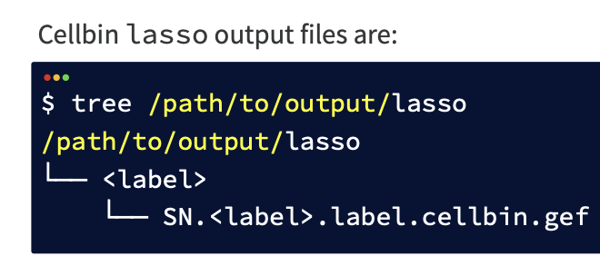
Subset region of interest --2
Step 2: cellbin lasso

