Slide 1
Imagestudio: Manual stitching, tissue and cell segmentation
11.3.23

Slide 2
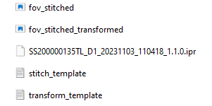
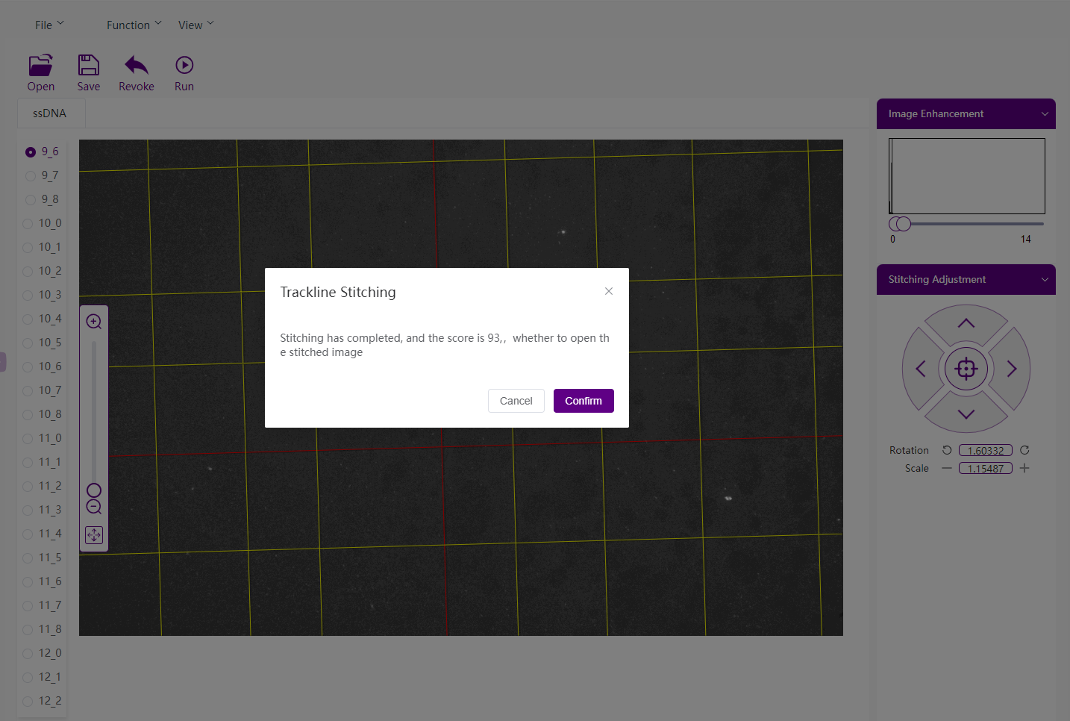
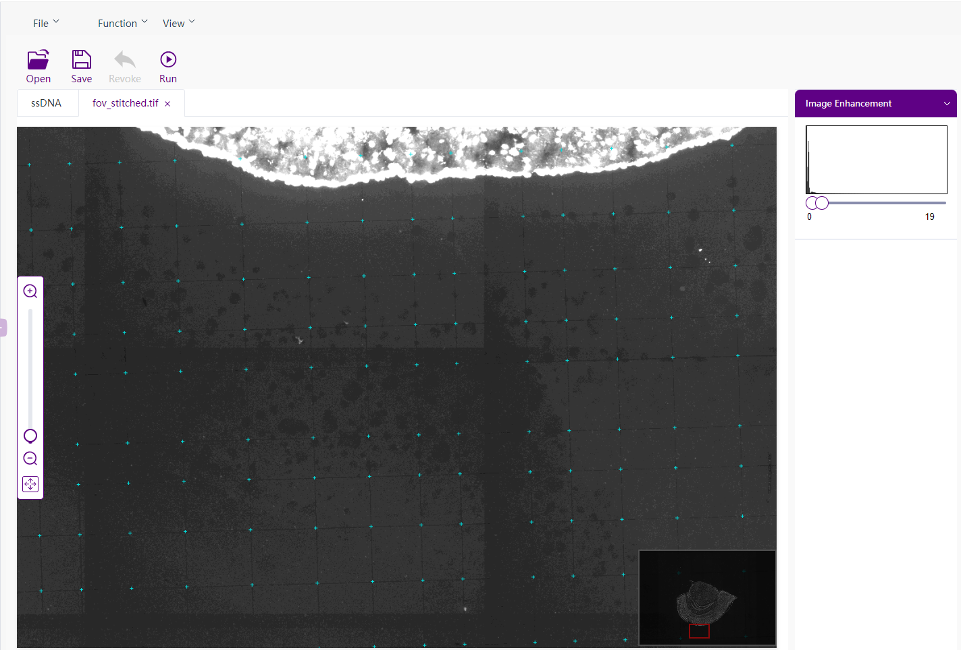
Image stitching(tracklines)
Output files
Confirmation of track lines stitching: make sure green dots are at the crosspoints

Slide 3
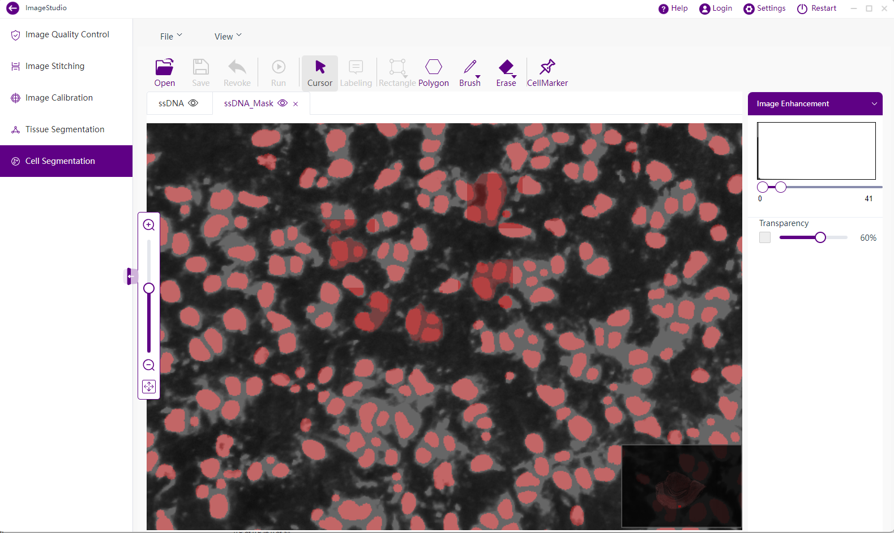
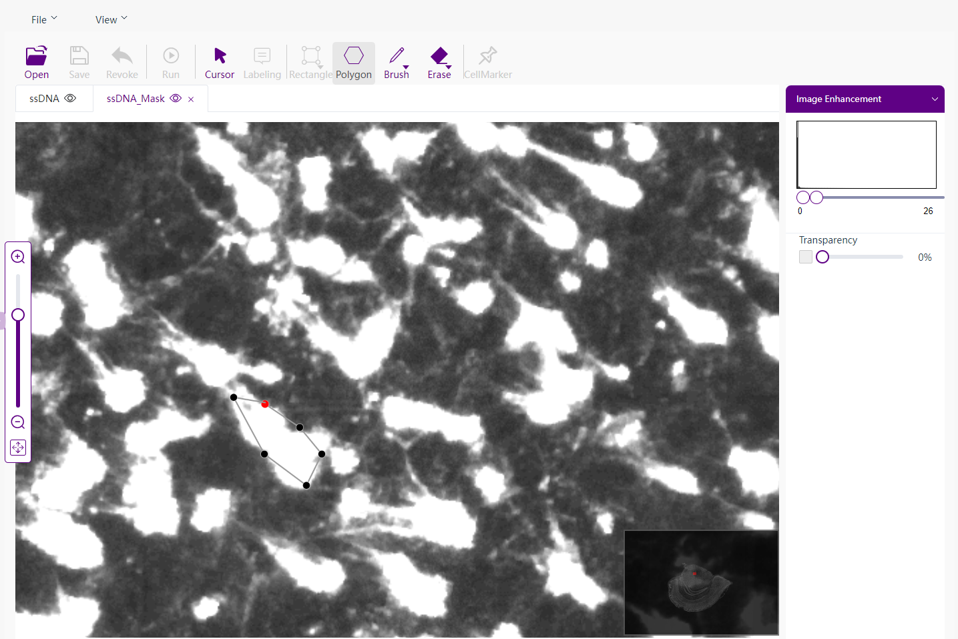
Cell segmentation
CellMarker: This function mainly operates on the Mask image for rapidly identifying cells in sparse tissue area through clicking on the cell. Save to update the cell Mask image and write it into the IPR file
Polygon

Slide 4
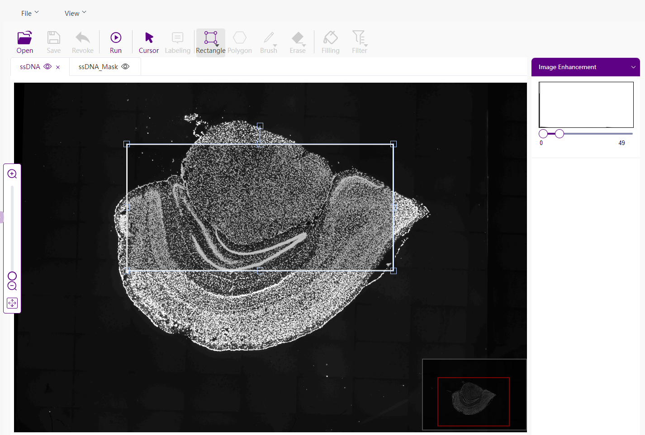
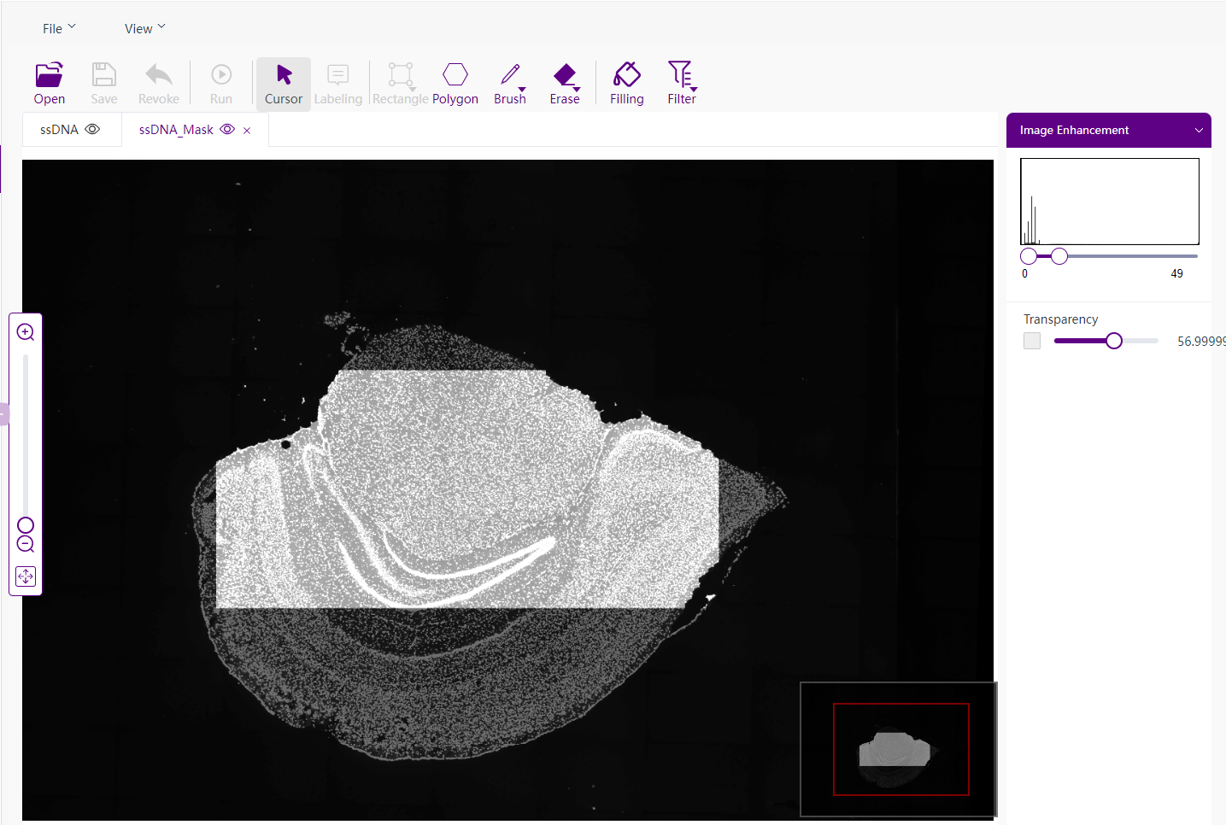
Tissue segmentation
'Save' after editing to write the new tissue Mask file into the IPR file

