Slide 1
1 sec
10 sec
Housekeeping
<Task>
TTC
<Task>
Temperature
Sensor
Storage
<Protected object>
Serial
Host
terminal

Slide 2
1 sec
Housekeeping
<Task>
TTC
<Task>
Temperature
Sensor
Storage
<Protected object>
Serial
Host
terminal

Slide 3
1 sec
Housekeeping
<Task>
TTC
<Task>
Temperature
Sensor
Storage
<Protected object>
Display

Slide 4
1 sec
Housekeeping
<Task>
Temperature
Sensor
Display

Slide 5
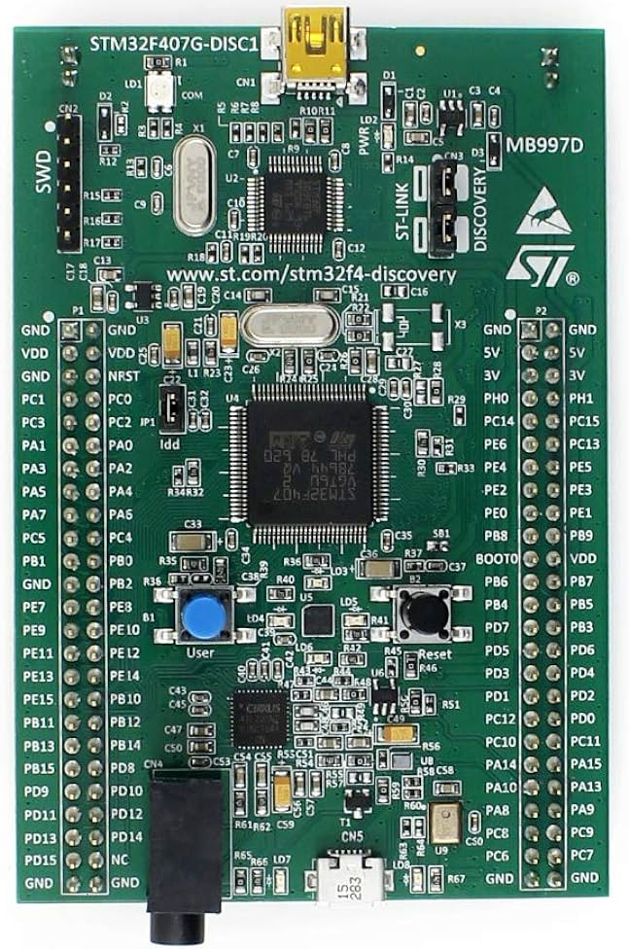
Pins PB6 & PB7

