Slide 1
1 sec
10 sec
Housekeeping
<Task>
TTC
<Task>
Temperature
Sensor
Storage
<Protected object>
Serial
Host
terminal

Slide 2
1 sec
10 sec
2 sec
Housekeeping
<Task>
TTC
<Task>
ACS
<Task>
Temperature
Sensor
Storage
<Protected object>
Display
Serial
Host
terminal

Slide 3
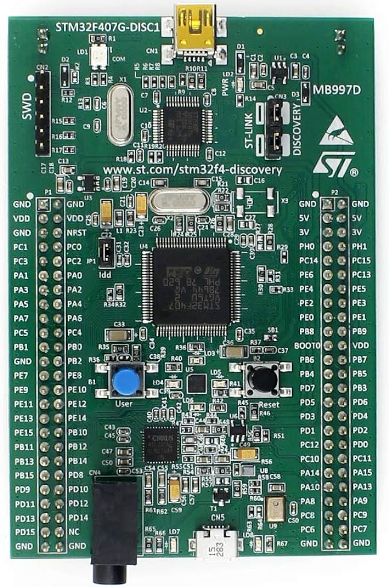
Pins PB6 & PB7

