Slide 1




CYBERSECURITY LAB · STATIC CODE ANALYSIS
SAST & SCA on two repositories
with opposite risk profiles
One toolchain, one deliberately-vulnerable app, one clean library to measure what the tools catch, miss, and over-report.
VULNERABLE REPO
CLEAN REPO
TOOLS
OWASP Juice Shop (fork)
Node.js e-commerce, insecure by design (OWASP Top 10).
→ github.com/<me>/juice-shop
chalk v4.1.2
Small, mature terminal-styling library. MIT. No advisories.
→ github.com/<name>/chalk
SAST · SonarCloud
scans the source for insecure code patterns.
SCA · Trivy
scans dependencies for known CVEs.

Slide 2

REPOSITORY 1 · KNOWN ISSUES
OWASP Juice Shop — the ground-truth target
WHAT IT IS
WHY THIS REPO
A deliberately insecure Node.js / Angular e-commerce app maintained by OWASP.
Every OWASP Top 10 category is present on purpose injection, broken auth, XSS, and more each mapped to a documented challenge.
The bugs are known in advance. That turns the exercise from “find bugs” into “measure the tools” I can check which real flaws each tool catches (true positives) and what noise it adds.
A benchmark for accuracy. High density of documented injection/auth flaws makes it a strong stress test for both SAST recall and SCA false positives.
Node.js · ~130k LOC · public repo

Slide 3

REPOSITORY 2 · NO KNOWN ISSUES
chalk — the clean control
WHAT IT IS
WHY THIS REPO
A small, widely-used terminal string-styling library (hundreds of millions of weekly downloads). MIT-licensed, actively maintained, no security advisories.
Shallow dependency tree, 5 packages total:
ansi-styles, supports-color → color-convert, color-name, has-flag
A control, not a second bug hunt. On code this clean, anything a tool reports says more about the tool than the code it exposes the opposite failure mode: over-reporting.
Small enough to trust the result. A five-package tree can be reasoned about by hand, so I can tell a genuine “clean” from a tool that simply isn’t looking.

Slide 4
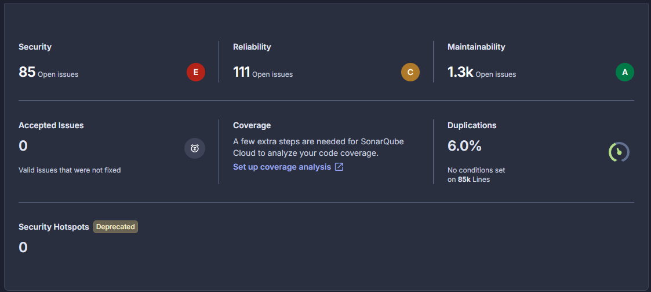

JUICE SHOP · SAST (SONARCLOUD)
The scan output — and why the count isn’t the finding
Security issues = definite rule violations. Security rating [E], 85 open issues.
Reliability = 111 flagged issues that may or may not be real each needs human review So the raw number isn’t the result. The work is triage: which flags are exploitable, and which are noise?
[SCREENSHOT 1 — SonarCloud summary:
Security rating, open issues, hotspots]

Slide 5


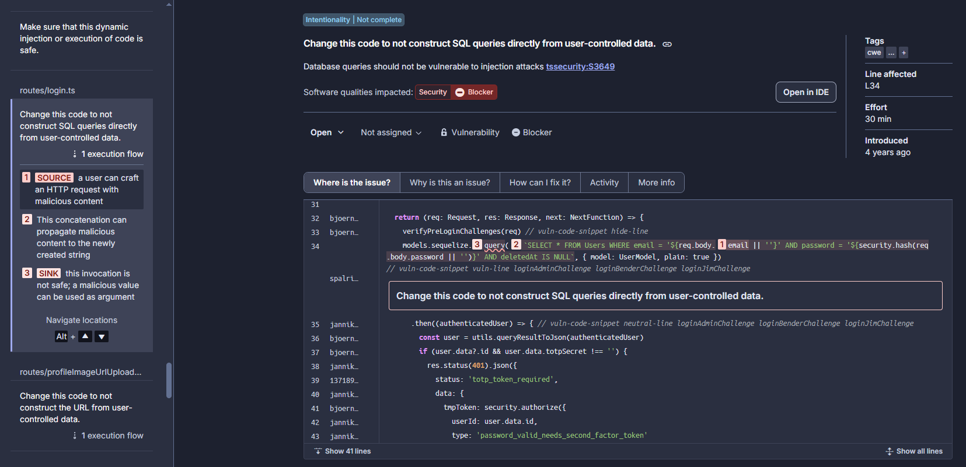
JUICE SHOP · SAST
Two true positives — same root cause
Login bypass · auth via string-built SQL
Probe: the login route, email/password reach a DB query.
Flagged sink: email concatenated into SELECT … WHERE email = '<input>' (no binding).
Why it’s real: untrusted input becomes SQL, so ' OR 1=1-- logs in as the first user (admin).
FIX
parameterised query:
WHERE email = ? AND password = ?

Slide 6
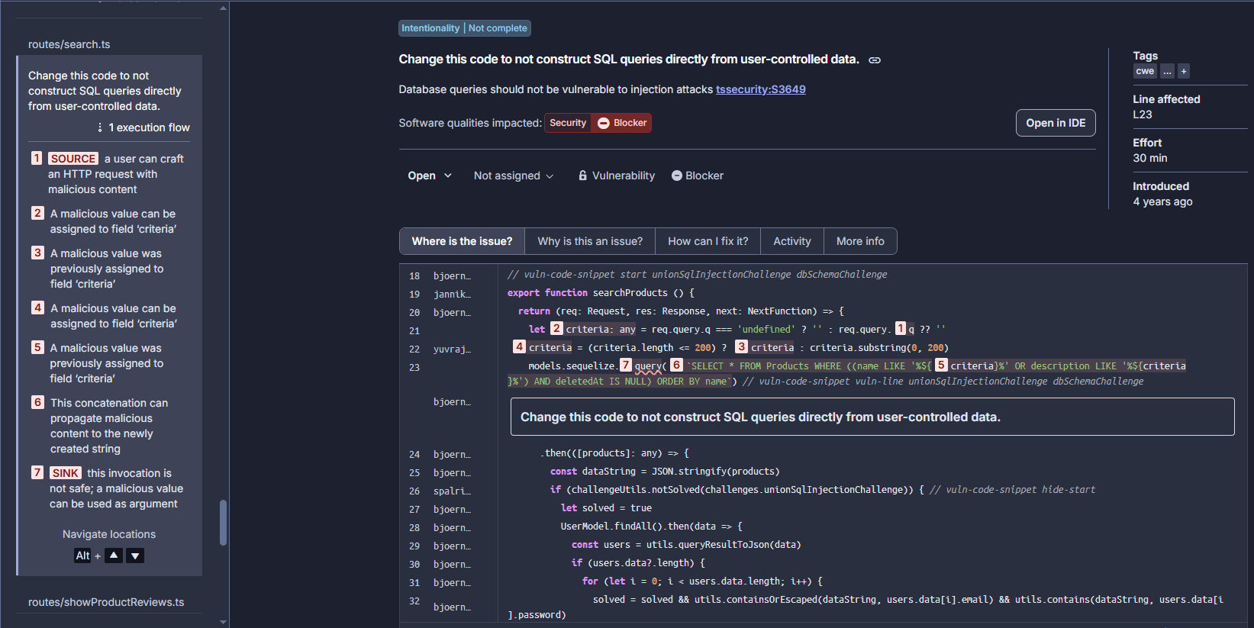
JUICE SHOP · SAST
Two true positives — same root cause
Product search · data extraction via LIKE
Probe: the search endpoint, the q parameter feeds a LIKE clause.
Flagged sink: criteria concatenated into LIKE '%<input>%' in the products query.
Why it’s real: same pattern → a UNION payload reads arbitrary tables. One root cause, two sinks.
FIX
parameterised query:
name LIKE ? OR description LIKE ?

Slide 7
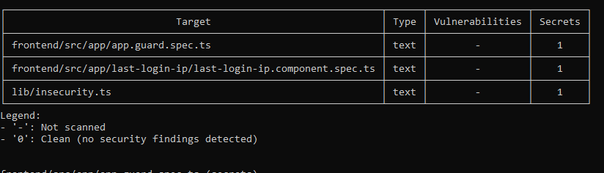


JUICE SHOP · SCA (Trivy)
Real supply-chain risk vs. scanner noise
No vulnerabilities found
Probably because the dependencies are included as the source code
[SCREENSHOT 4 — Dependency-Check
vulnerable-dependencies table]
Found some hardcoded secrets
Trivy found some hardcoded secrets left intentionally as the webapp is vulnerable by design

Slide 8
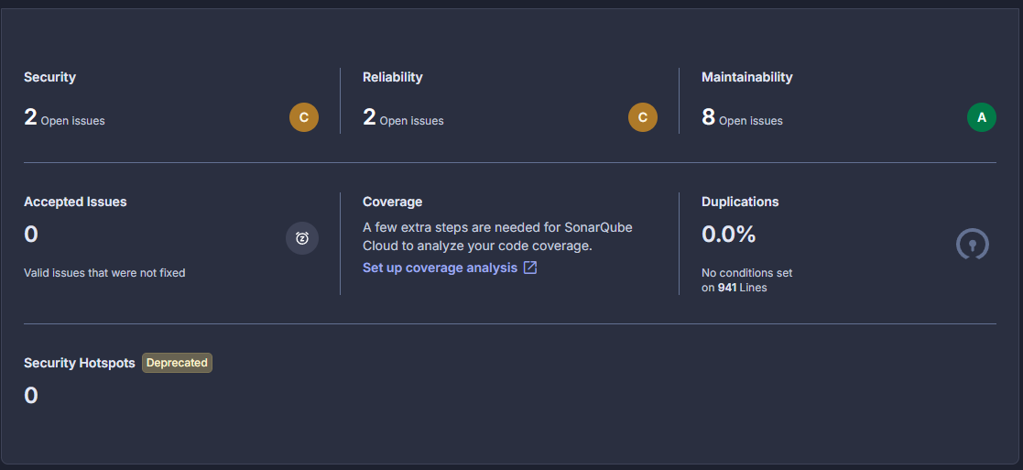
CHALK · SAST (SONARCLOUD)
Zero issues — but what does zero prove?
0 security issues
Security rating A. Clean, as expected.
Zero ≠ provably secure
[SCREENSHOT 5 — SonarCloud summary for chalk:
rating A, 0 issues, 0 hotspots]
“0 issues” means no rule in SonarCloud’s free-tier ruleset matched not that the code is safe.
SAST can’t see logic errors, authorization design, or bug classes outside its rules those are potential false negatives. The clean result raises confidence; it doesn’t certify.

Slide 9
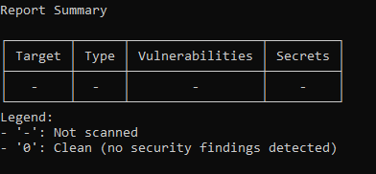

CHALK · SCA (Trivy)
A correctly-scoped scan, for contrast
Five packages, scoped to the manifest
Result: expected 0 vulnerable dependencies across the 5-package tree
Why this matters as a control: the scan is pointed at chalk’s own package-lock, not a parent directory.
Conclusion: Clean code + a small current dependency tree = a clean SCA report
[SCREENSHOT 6 — Dependency-Check
report for chalk]

