Slide 1
A Way Out: Pandemic preparedness in context of health disparities to limit disproportionate morbidity and mortality
Udana Torian
Vincent La
Dinh Nguyen
Ashley Bamfo
Shreya Shah
Bryan Wilder (mentor)

Slide 2
Team Roles
Project Lead: Udana Torian
Sysadmin: Shreya Shah
Writers: Vincent La and Dinh Nguyen
Subject Matter Experts: Ashley Bamfo and Vincent La

Slide 3
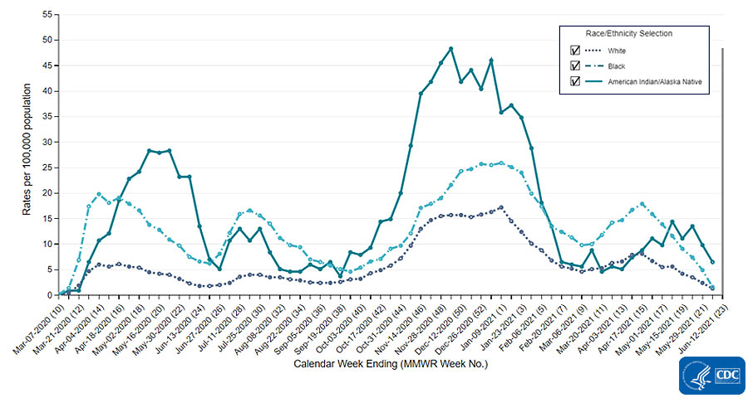
Figure 1: Covid rates affected by ethnicity, Black and American Indian/Alaska Native populations are affected significantly more than White populations.

Slide 4
Work Flow
Stage 1: Feature Identification
Stage 2: Data Processing
Stage 3: Modeling
Demographics
Comorbidities
Social Determinants
Normalization
Analysis
Testing

Slide 5
Stage 1
Identifying a health disparity score per state
Features:
Population data with demographics
Comorbidity data per state (i.e. hypertension, diabetes, obesity)
Social determinants (i.e. employment, access to healthcare, access to grocery stores, social economic status)
Identifying datasets for each feature

Slide 6
Stage 2
Data normalization
Same time frame (~March 2020- ~April 2021)
Analysis
Culling datasets so that only useful data is present
Provide evidence for reliability of each feature with peer-reviewed articles
Reduce bias by cross-validating datasets (such as morbidity and mortality rates compared to Covid deaths)

Slide 7
Stage 3
Predictive model
Analyze what the population is and what resources need to be deployed in consideration to population vulnerabilities
Model testing

Slide 8
What we would like to accomplish:
Identify and assign crucial features necessary to create health disparity scores
Accurately establish health disparity scores for each state
Create a reliable model that can aid in reducing morbidity/mortality rates by providing resources to areas with greater vulnerabilities from pandemic impact

Slide 9
Thank you for listening!

