Slide 1
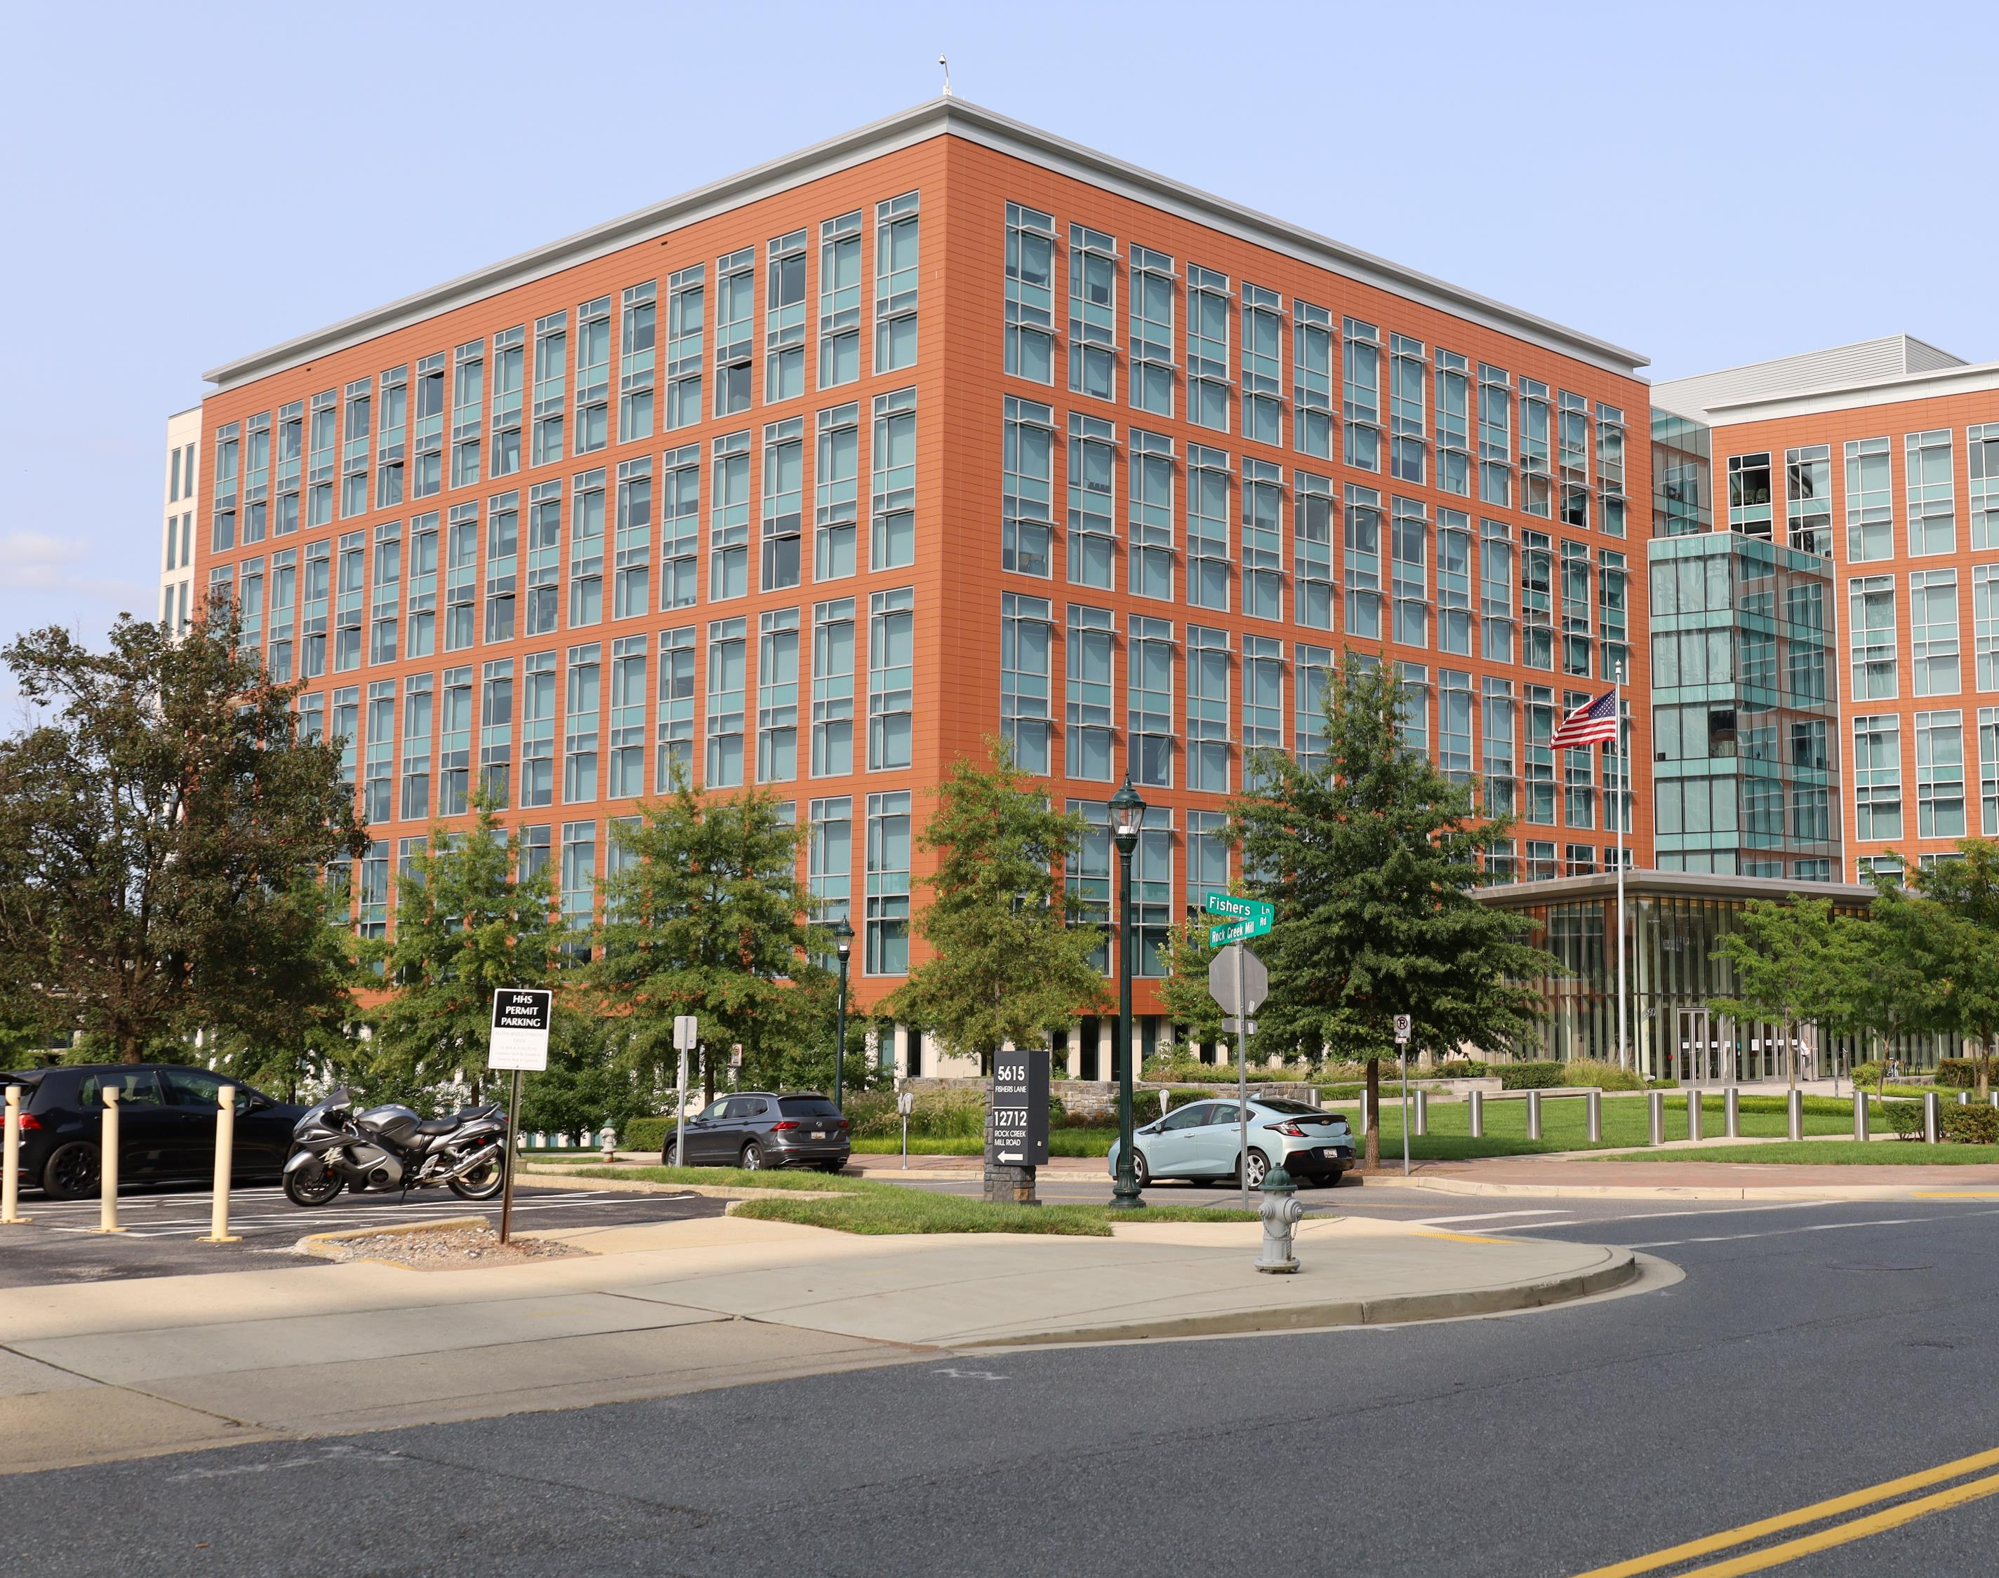
Environmental infectious disease risk in agricultural workers
Office of Data Science and Emerging Technology Fellows, NIAID, NIH: Sydney Foote, Lisa Mayer, Meg Hartwick, Mark Rustad, Sara Jones

Slide 2
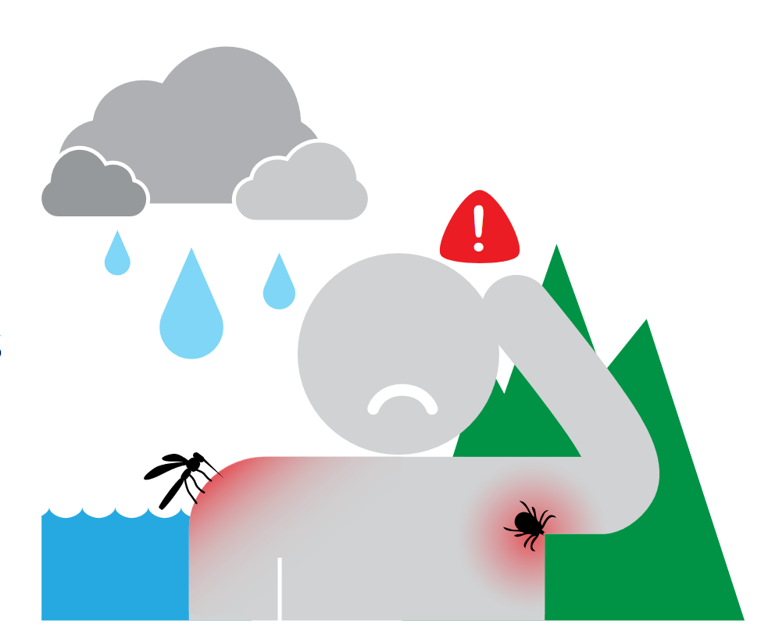
Environmental infectious diseases have significant mortality and morbidity and are expected to increase with climate change.
Tick-borne: Lyme
Mosquito-borne
Dengue
Malaria
Waterborne bacteria
Campylobacteriosis ("Camp"))
Waterborne parasites
Cyclosporiasis (“Cyclo”)
Cryptosporidiosis ("Crypto")
Notes:
https://www.cdc.gov/climateandhealth/pubs/VECTOR-BORNE-DISEASE-Final_508.pdf
- Warmer average temps > longer warm seasons AND earlier spring seasons AND shorter & milder winters AND hotter summers
Development and survival of ticks and their animal hosts are strongly influenced by climatic factors
Expansion of geographic habitat
Milder winters = fewer disease-carrying ticks dying in winter

Slide 3









Agricultural workers are at higher risk of exposure to environmental infectious diseases and face challenges in mitigating disease.
Risk factors/challenges
No extensive studies in US
Demonstrating risk important to get worker protections
Notes:
Risk factors/challenges
Environmental Exposure
Access to Healthcare
Housing
Income

Slide 4
National Agricultural Workers Survey (NAWS)
CDC National Notifiable Diseases Surveillance System (NNDSS)
National Oceanic and Atmospheric Administration (NOAA)
Public data
Disease risk factor score
Disease counts and climate data
Intermediate data and analysis
R Shiny app for visualization
Final product
Notes:
Used R in a virtual machine
Analysis transforming to regions from state/individual
Summary statistics
Making things binary from categorical/continuous

Slide 5
Identify as migrant worker
Household income below poverty level
Crowded housing
No health insurance
Not authorized to work in USA
Have used public aid
Reported a health condition
Difficulty accessing healthcare
Individual Risk Score =
0, 1, …., 8
Low risk High risk
Notes:
Individual risk used to calculate average risk for the region, which we fed into the shiny app

Slide 6


Major challenges were data availability and structure.
CDC API only 2016-2019
NAWS only until 2016
Different levels (state vs. person vs. region)
Cleaning was challenging (vague codebooks, confusing delimiters, etc.)
Making moving maps is complicated

Slide 7

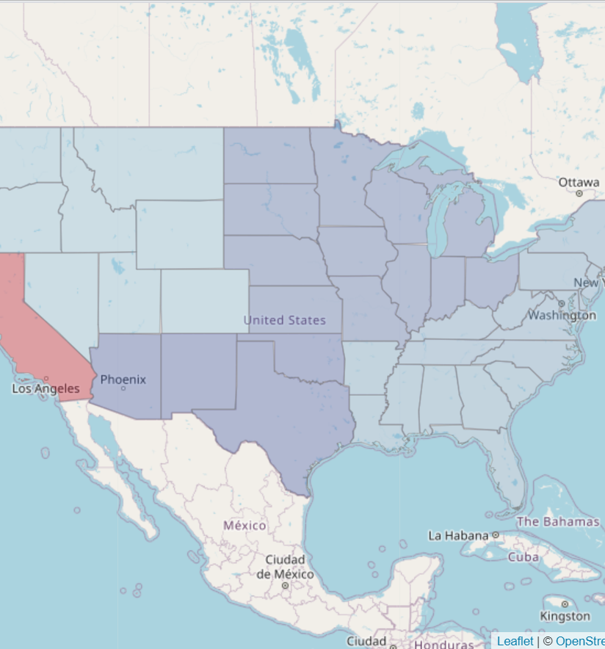
Future goals and directions
Additional years of data
Ability to stratify by variables such as race and ethnicity in shiny app
More granular data
Projections based on past trends

Slide 8
Shiny App Demo!
Github readme: link

