Slide 1
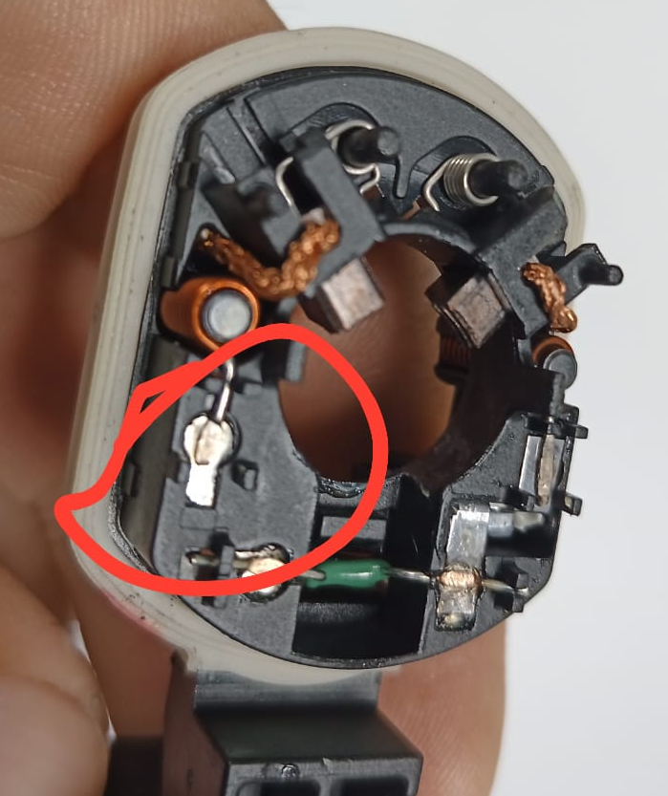
Poor welding |  |  |  |  | Importance | Grade
1. (Problem Definition) |  |  | 1-2 Issue (photo) |  | 4. (C. Action)
Date of Issue | 22/ Feb/24 |  |  |  | ◆ Improvement measures -Colocate continuity test with multimeter after final inspection temporary until actions are validated. - GP-12 temporary until actions has been implemented. - Increase frecuancy of pull and peel test every 30 minutes temporary while actions has been implemented. - Modify the fixture to allow fit the part until bottom (Op 060b and implement in others welding machines) - To place a sensor (switch) to assure the correct position in the fixture. (Op 060b and implement in others welding machines). - Place an acrylic in parameters área to block posible modification of no personnel authorized (Double lock). - Implement a control of electrodes cleanless to remove the plastic Burr in the top and bottom electrode. (Op 060b). ANALYSIS STILL IN PROGRESS
Location | DY MÉXICO
Product name | BRUSH HOLDER ASSY BL7M 60P058800
Lot No | 17/2/2024
Issue Description | Poor welding between Inductor and terminal
Occurrence quantity | 1
Recurrence history | 1
2. Containment measures |  |  | 3. R.C. Analysis |  | 5. Validation of measures [Validation of measures to be taken]
Start containment 22/2/24 inspected 100% with multimeter DY WH: 2080 pcs 416 pcs from AVO lot prod date 08 feb 416 pcs from AVO lot prod date 09 feb 624 pcs from AVO lot prod date 09 feb Zero defects found, AVO current inventory= 3744 (FG)+2496 (GP12) Inspected with multimeter with zero defects |  |  | ◆ Root cause analysis (Draft) In process of analysis . ◆ Root cause analysis Possible root causes: Draft 1.-Fixture did not allow the correct position of the part, causing incorrect contact between the electrode and the terminal ◆ Spill cause analysis Part after reinjection in the tester was rejected, also with multimeter and visual inspection criteria ◆ Spill cause analysis
 |  |  |  |  | 6. Drill Deep Wide
 |  |  |  |  | 7. Lessons Learned
Inductor
Poor welding
Terminal

