Slide 1
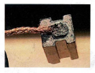
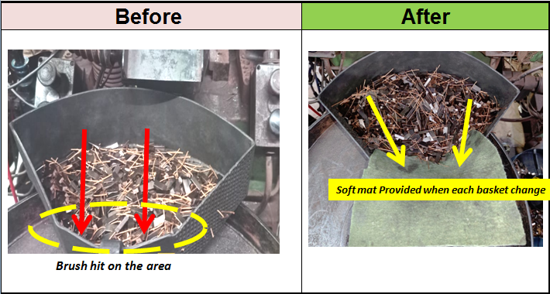
▣ OOOOOOOO |  | Supplier Date | Avo carbon india 01.02.2024
Problem
CUSTOMER | M/s Lucas Tvs TV kovil
ORGIN | Avo carbon india pvt ltd
MODEL | P107
PART NO/NAME | 26718346
QUANTITY | 1
ISSUE HISTORY | 1
Improvement measures
Before | After
-
▶ Phenomenon
-Carbon head broken
Containment Action (ICA)
No | Location | Q'ty | OK | NG | Remarks
1 | Avo carbon | 40000 | 40000 | 0
2
Root Cause
CAUSE ( Why Occur ) :
-
When the brush is ejected in the pilling machine after the brush is compacted, it hits the iron OK basket with some force. Because of this, the nipple-shaped narrow angle head on Part#8346 breaks into the iron basket
&Operators handling of collection baskets is not improved
When the brush is ejected in the pilling machine after the brush is compacted, it hits the iron OK basket with some force.
Because of this, the nipple-shaped narrow angle head on Part#8346 breaks into the iron basket
-
soft mat provided brush collection basket whenever brush fall down the basket no head broken
CAUSE ( Why Not Detect)
-100% visual inspection sop not Clearly mention this defect its happened to escape
Notes:
1
1
1
1
1

Slide 2
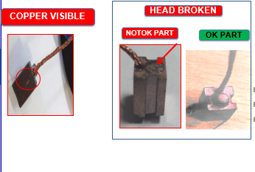
2) DETECTION
Before | After
Head broken added in sop
Visual inspection sop not clearly mention the defect
Visual inspection sop clearly updated

