Slide 1
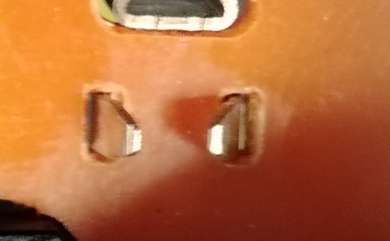
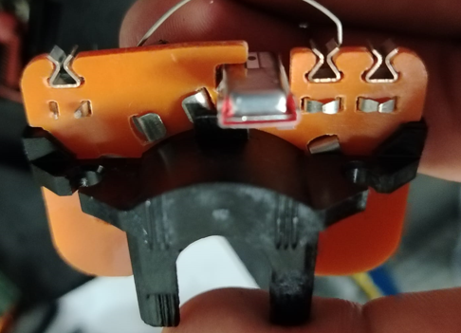
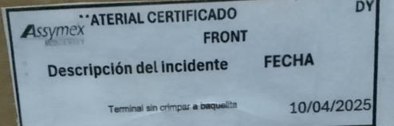
In Brush holder with missing crimp. |  |  |  |  | Importance | Grade
1. (Problem Definition) |  |  | 1-2 Issue (photo) |  | 4. (C. Action)
Date of Issue | April 10, 2025 |  |  |  | ◆ Improvement measures
Location | DY AUTO MÉXICO
Product name | BRUSH HOLDER ASSY
Lot No | ###
Issue Description | DY FRONT WIPER 33-0134(60P054005) In Brush holder with missing crimp in operation ###. Information on the production label in lot ### dated ###
Occurrence quantity | 1
Recurrence history | 0
2. Containment measures |  |  | 3. R.C. Analysis |  | 5. Validation of measures [Validation of measures to be taken]
Containment 10-04-2025 Dy plant : Assymex plant:3168 pcs / 0 defects found. |  |  | ◆ Root cause analysis ◆ Spill cause analysis
 |  |  |  |  | 6. Drill Deep Wide
 |  |  |  |  | 7. Lessons Learned
Certification label

